Slide 1
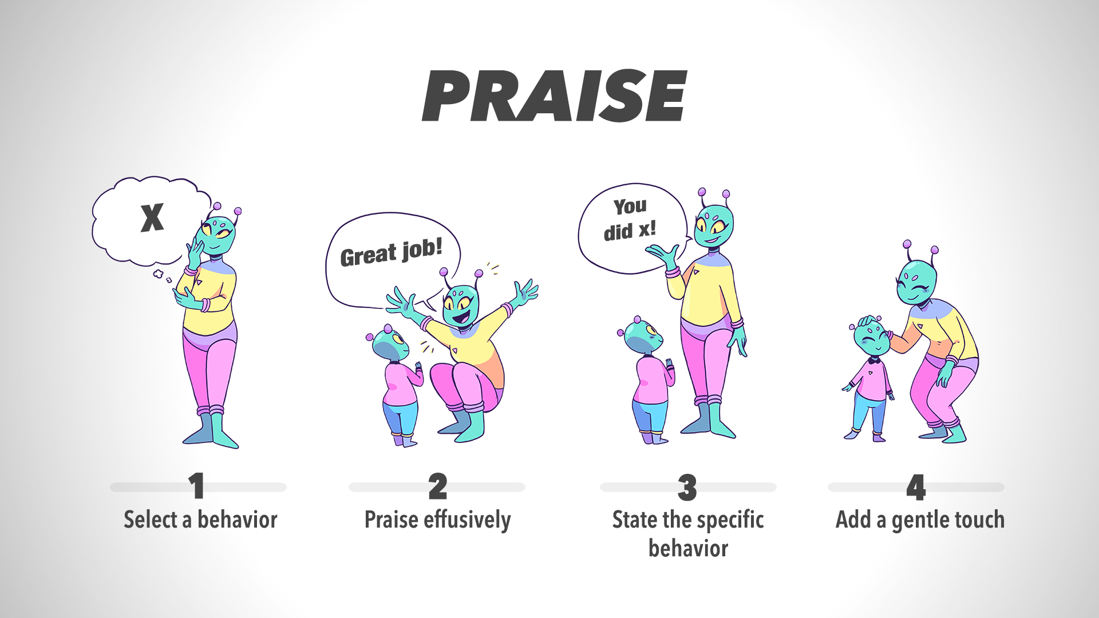

Slide 2
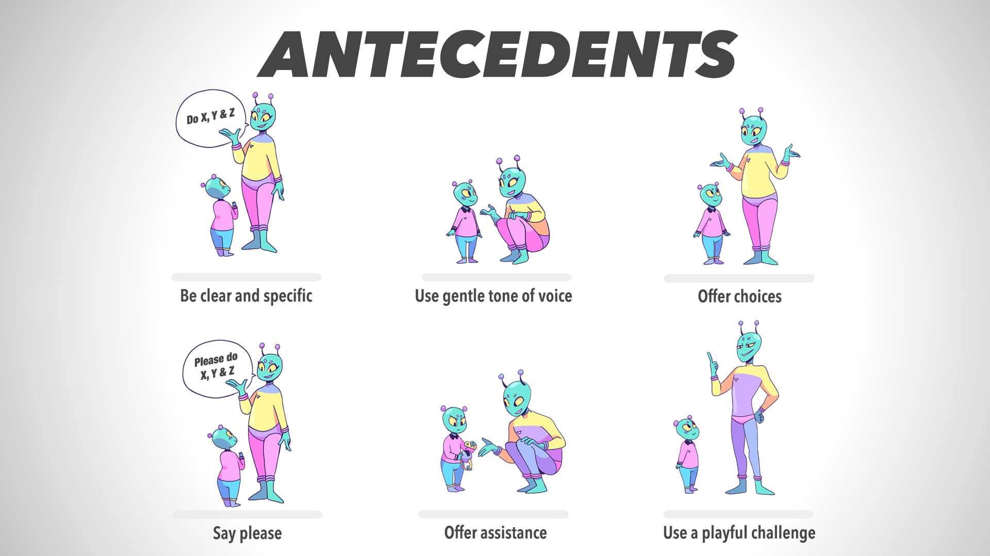

Slide 3
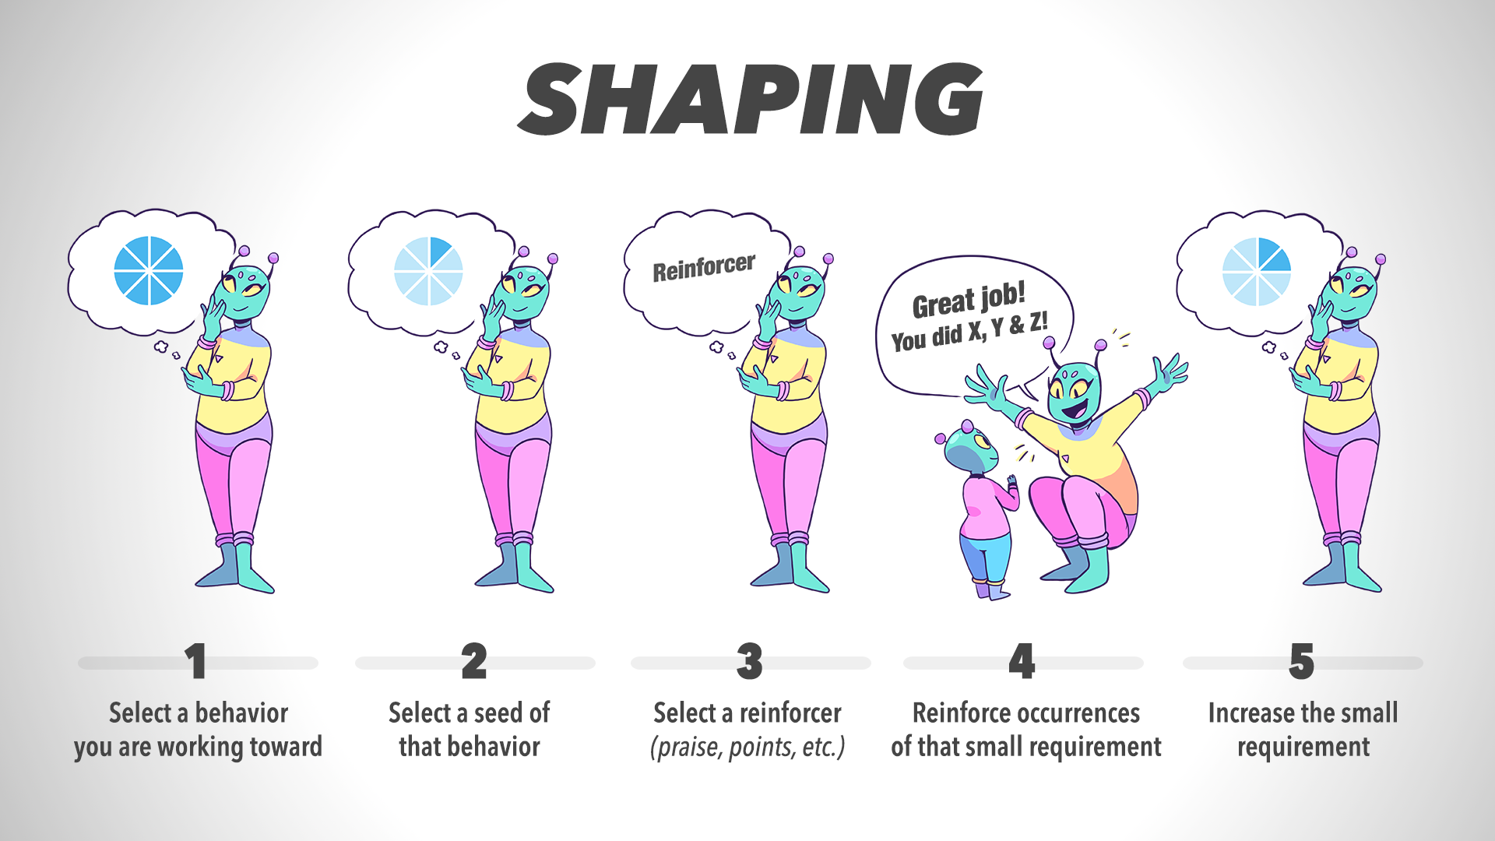

Slide 4
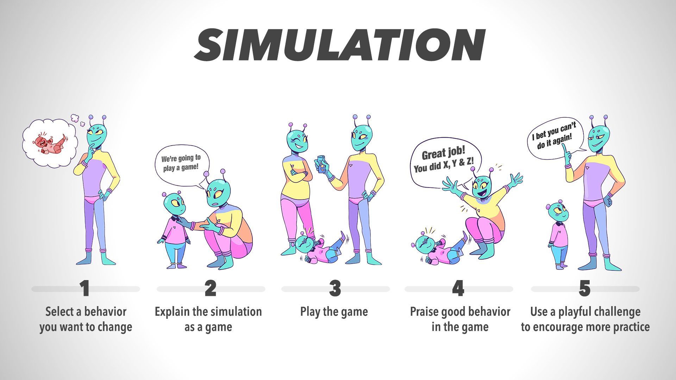

Slide 5
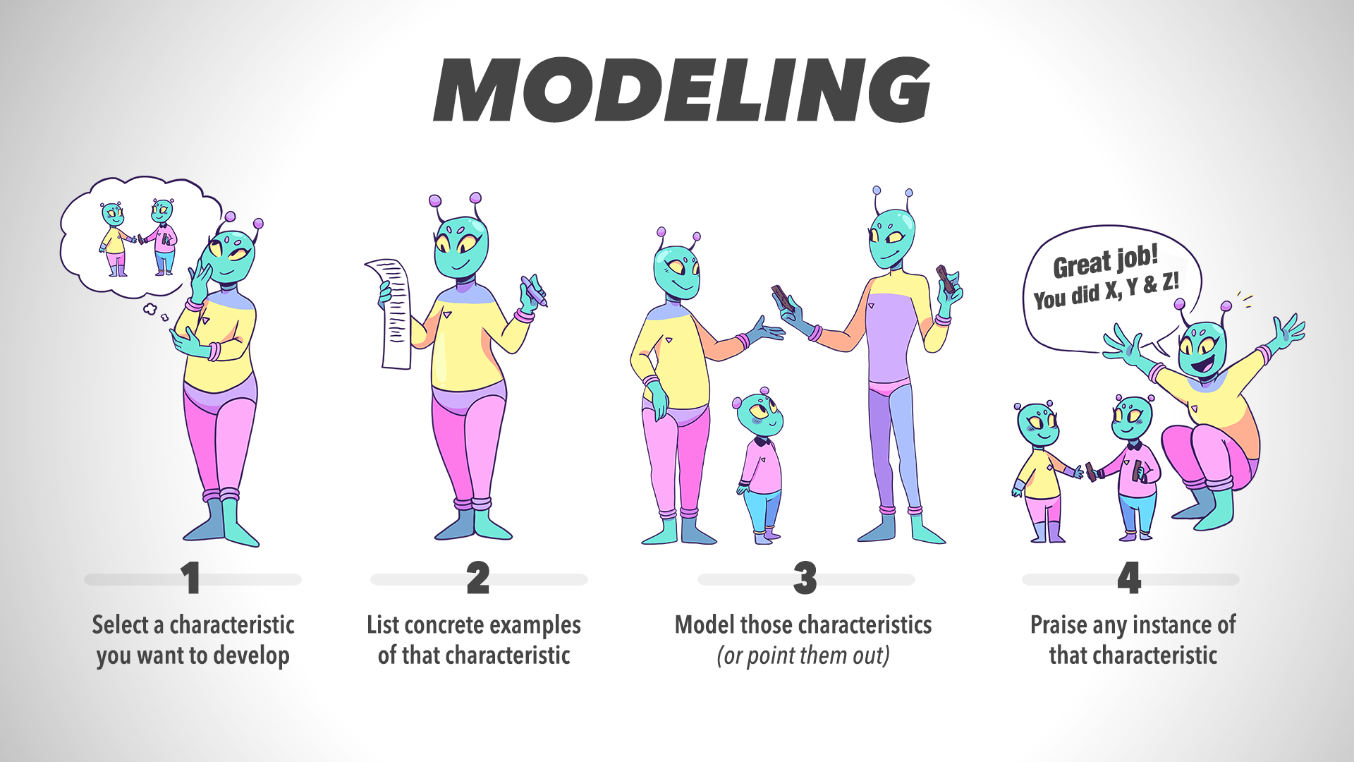

Slide 6
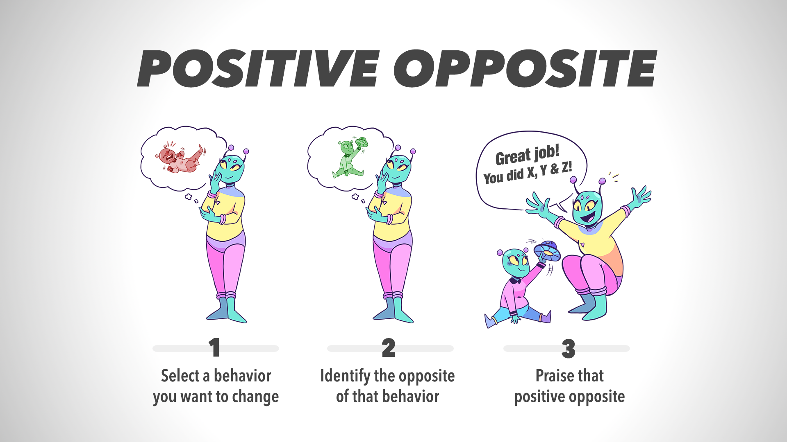

Slide 7
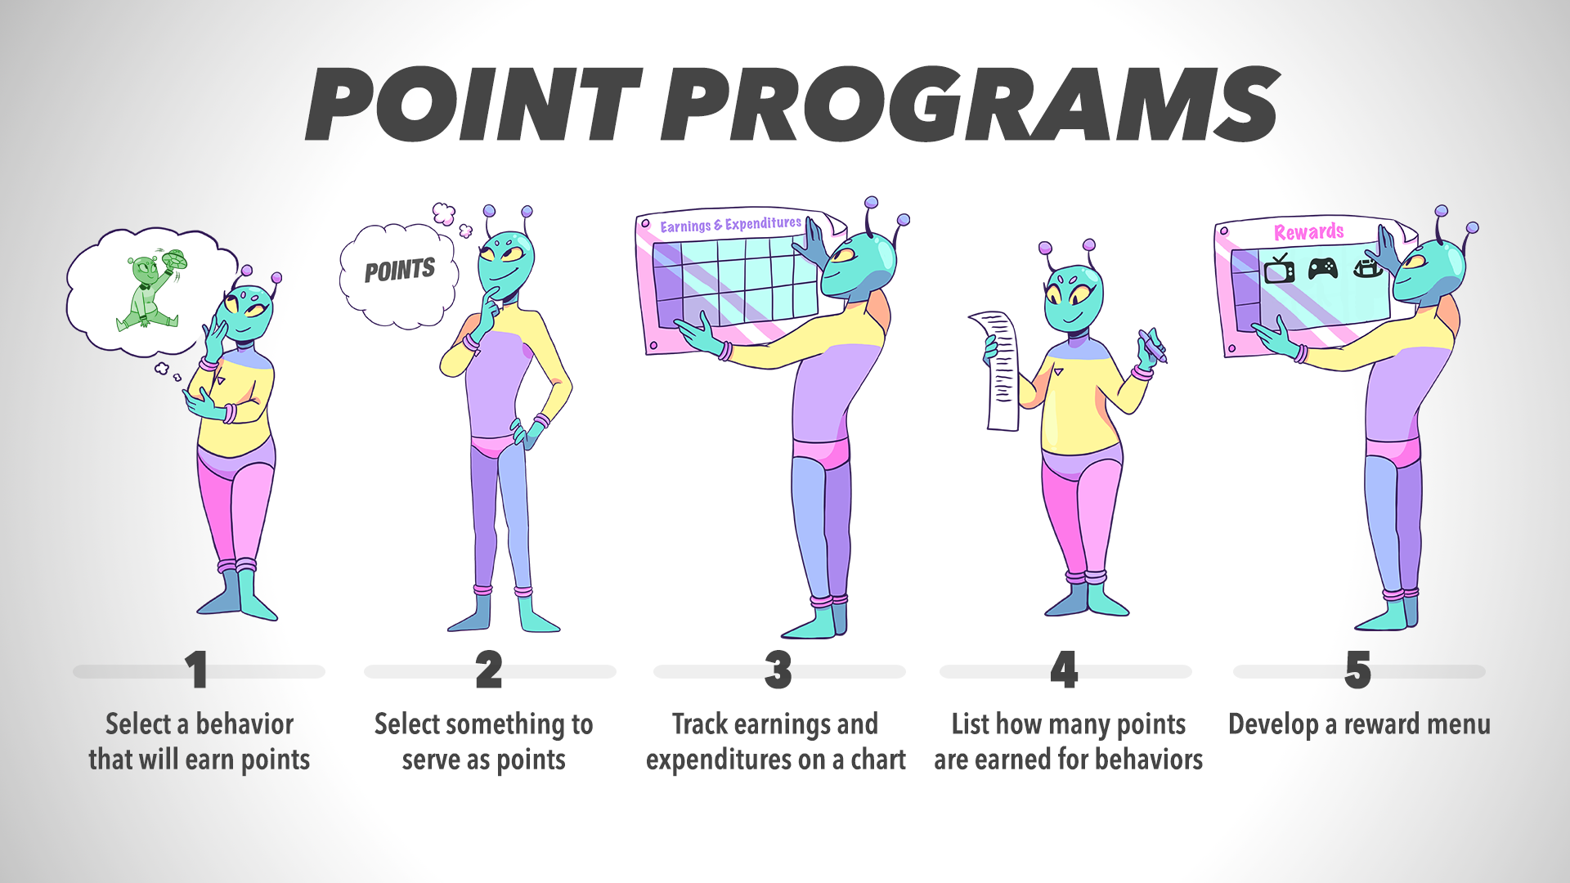

Slide 8
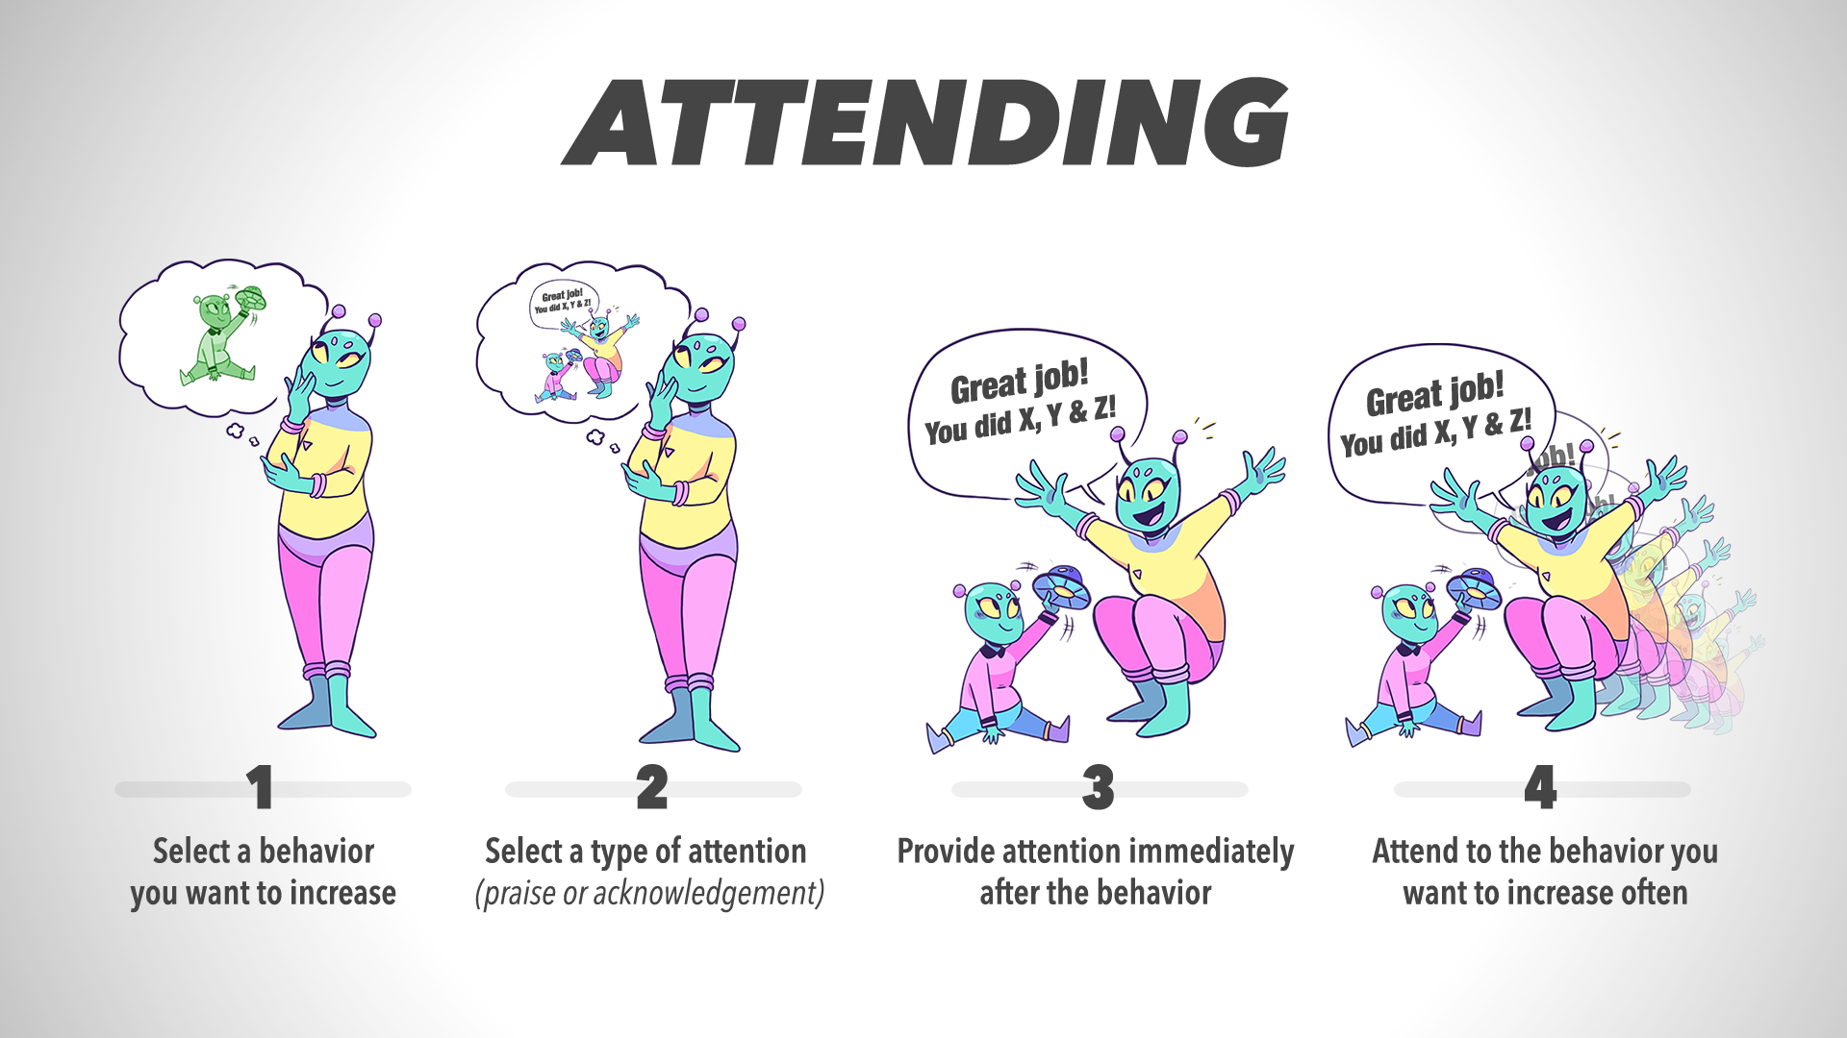

Slide 9
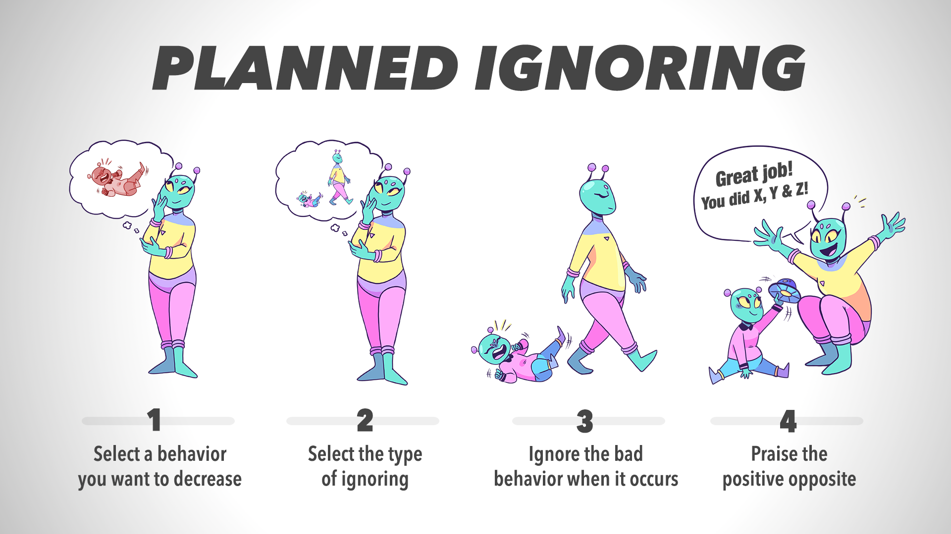

Slide 10
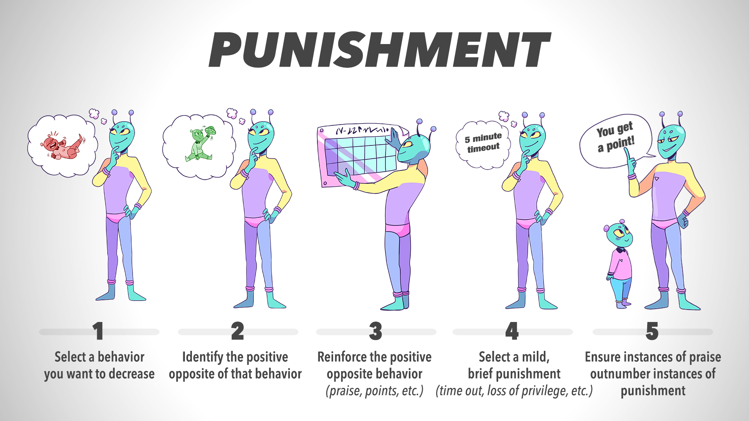

Slide 11
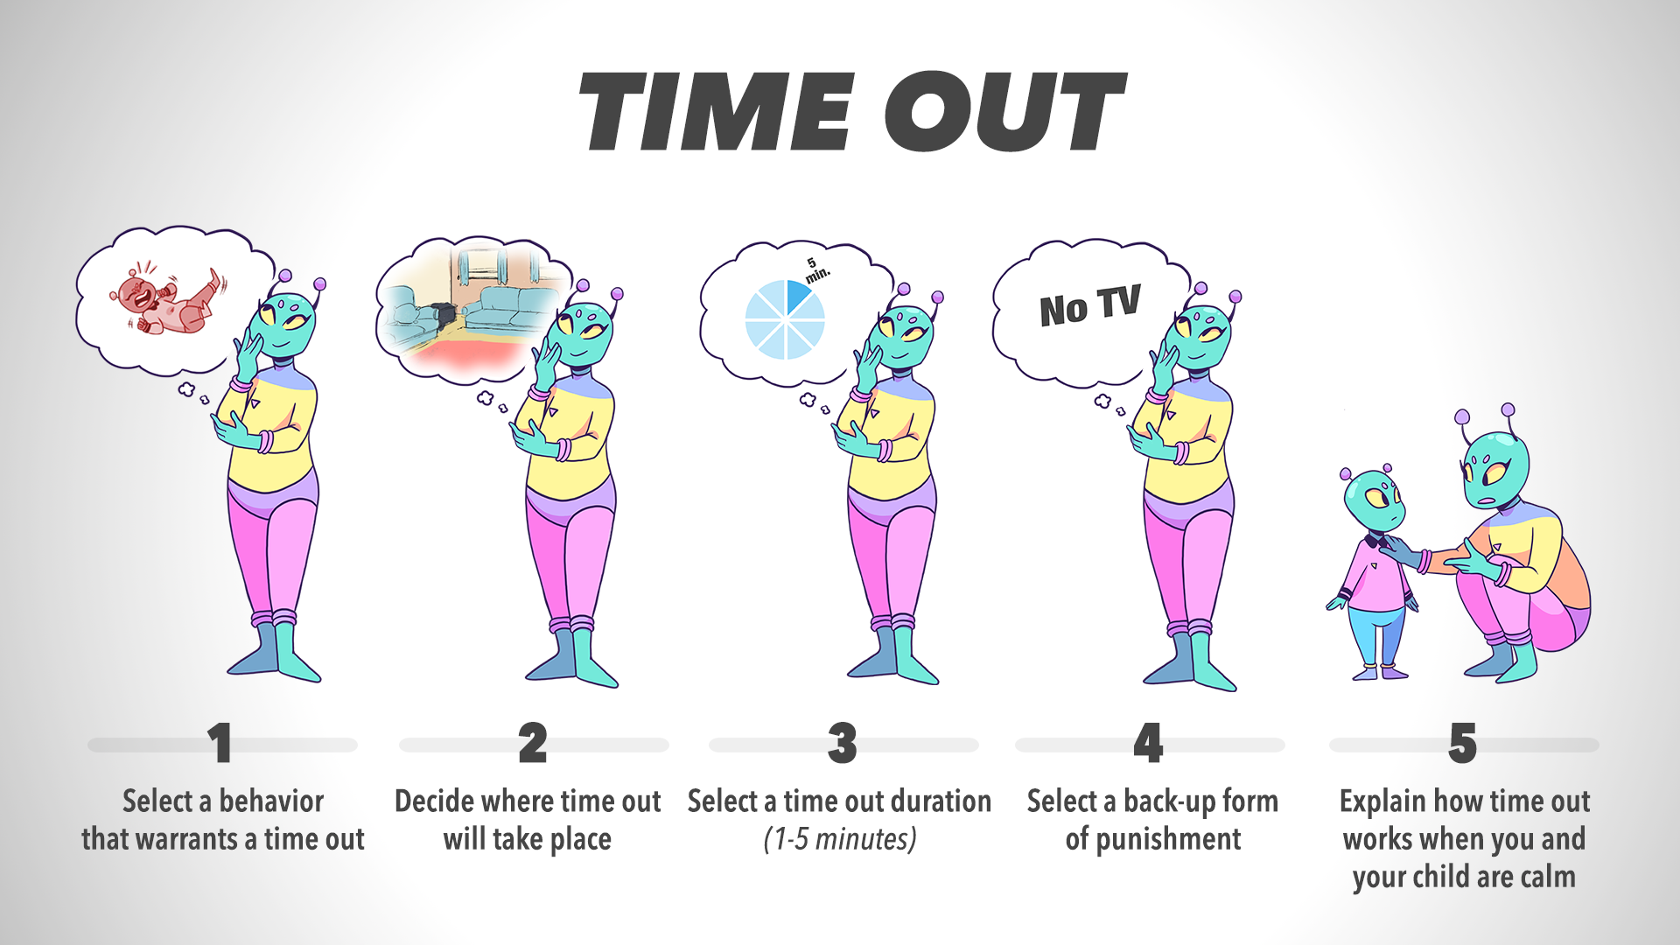

Slide 12
TROUBLESHOOTING TIPS
1
Provide prompts right before desired behavior
2
Note that distant prompts are often less effective
3
Demand smaller amounts of behavior at the beginning
4
Break down the behavior and praise partial completion
5
Remember that knowing does not equal doing
6
Keep in mind that doing the behavior once does not mean consistency

Slide 13
TROUBLESHOOTING TIPS
7
Praise the positive behavior every time you see it
8
Praise the desired behavior immediately, effusively, concretely, and affectionately
9
Make sure your child wants to spend earned points
10
Base rewards on your child’s interest
11
Consistently praise and reward positive behavior
12
Create a daily routine for your reward program

Slide 14
JUMPSTARTING
1
Prompt your child to complete the first step of a task
2
Mention that your child can stop after completing the first step
3
Restate that your child has a choice to stop after the first step or keep going
4
Praise taking the first step whether or not your child continues the sequence

Slide 15
CONSEQUENCE SHARING
Provide a rewarding consequence to an individual for behavior
and also give the same reward to others
Use when you want to develop behavior for only one child in a small group

Slide 16
GROUP PROGRAM
Provide a rewarding consequence to a group
only when all (or almost all) individuals have completed the behavior
Use when you want to develop the same behavior for more than one child

Slide 17
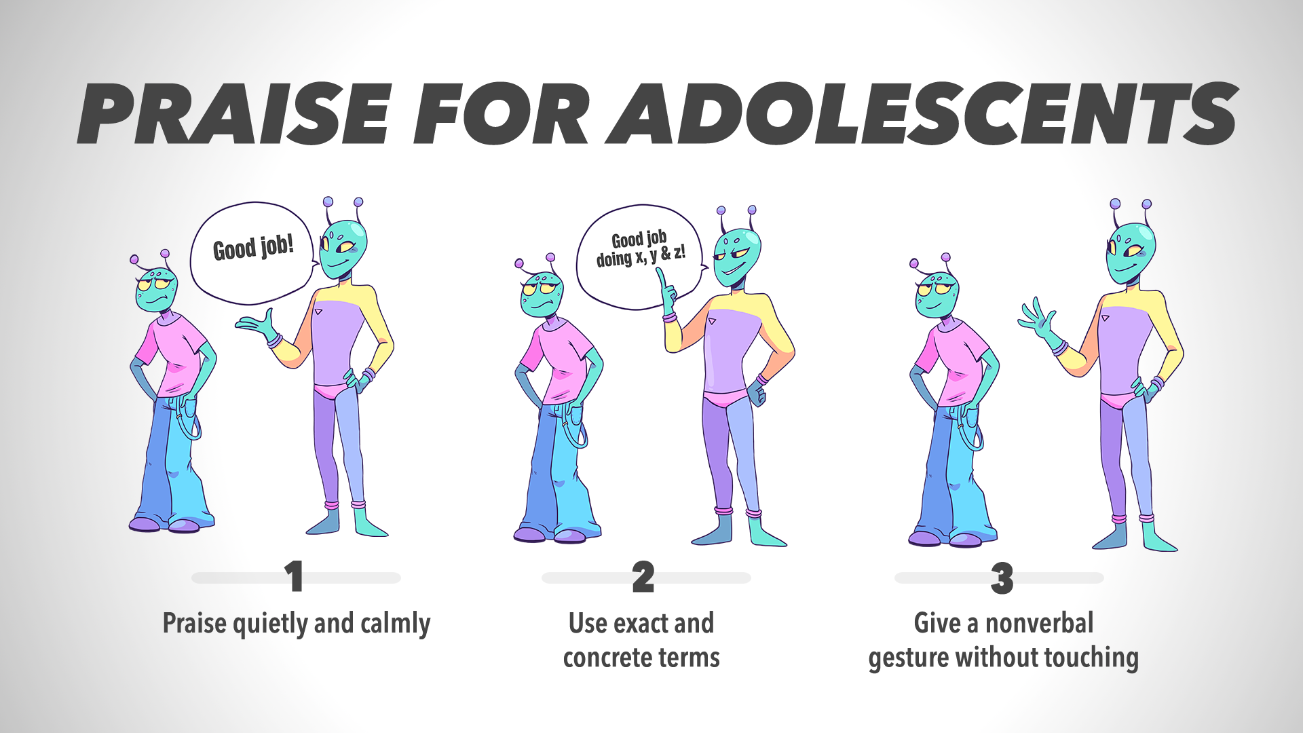

Slide 18
COMPROMISE
Be more flexible as your child enters adolescence and consider bending
on behaviors that are likely to be temporary and are not dangerous
Use the extra space to jot down ideas:
1
2
3
4

Slide 19
NEGOTIATION
1
Listen to your child without interrupting
2
Be respectful of your child and withhold judgments
3
Focus on the present and refrain from mentioning any past mistakes
4
Stay on subject at hand
5
Provide a few alternatives without being authoritative or judgmental

Slide 20
PROBLEM SOLVING
1
Identify and state the problem
2
Prompt and encourage potential solutions
3
Identify a few ways to handle the problem
4
Go through each strategy and identify its consequences
5
Select the solution based on the best consequences
6
Role play the situation and the selected solution

Slide 21
BUILD A NURTURING FAMILY ENVIRONMENT
1
Promote communication by modeling how share openly and listen intently
2
Build family connections by seeing relatives on a regular basis
3
Establish a few regular family routines inside and outside the home
4
Promote social behavior by putting your child in more social situations and use praise
5
Be flexible with your child and compromise or negotiate when possible
6
Monitor your child and know what he or she is doing online and offline
7
Minimize stressors in the home by avoiding conflict as much as possible
8
Practice self-care by taking time for yourself to enjoy friends or special activities

Slide 22
HOME-BASED REINFORCEMENT PROGRAM
1
Specify the behavior you want to change in your child
2
Create a system that the teacher can use to measure your child’s behavior
Medium: index card, phone call, email, text, etc.
Scoring: 0 = no improvement, 1 = slight improvement, 2 = total improvement
3
Devise a point program to reward points and give praise based on child’s score
See ‘Point Programs’ lesson for steps

Slide 23
BUILD COMPETENCIES
1
Ask your child what topics are of interest
2
Develop a point program for talking about area of interest
See ‘Point Programs’ lesson for steps
3
Praise your child for sharing what he or she has learned
4
Keep the program pressure-free and casual

Slide 24
SEEKING PROFESSIONAL HELP: SIGNS
1
IMPAIRMENT - Is your child’s aggressive behavior, high levels of activity, anxiety, or depression just getting in the way of routine activities?
2
DANGEROUS BEHAVIOR - Is your child’s behavior of any danger to himself or to others?
3
UNUSUAL BEHAVIOR - Does your child engage in repetitive behaviors, see things
that are not there, or hear voices?
4
CHANGE IN BEHAVIOR – Has your child’s behavior changed drastically and suddenly?
5
DISTRESS - Is your child showing signs of stress that coincide with an event or stressor?
6
UNMANAGEABLE – Is your child difficult or impossible to control?

Slide 25
QUESTIONS TO ASK A TREATMENT PROVIDER
1
What is the treatment you provide for my child’s problems?
2
How long have you been providing this treatment?
3
Has this particular treatment been studied,
and does it have scientific evidence in its favor?
4
What are treatment options other than the one you provide?

