Slide 1
Find The Episode!
Just me - Sreeja Cheekireddy

Slide 2

Watch this video!
Notes:
https://www.youtube.com/shorts/nK51l6GSkG4

Slide 3
Big Problem
YouTube content also includes TV shows or web series.
But details about the source of the video is often not provided.
As a content viewer, this leads to a lot of curiosity, especially if the video is interesting.
It is often natural to have a feeling to watch the entire episode.
The viewer would like to find information about the origin of the video.

Slide 4
Methodology
To find the season and episode information, a comments list can be a helpful source (if not provided in the description or title).
Different methods can be tried for this use case.
So, to solve this problem, different greedy and divide and concur methods will be used.
These methods will be compared and contrasted.
The metrics will include Accuracy, precision, and recall.

Slide 5
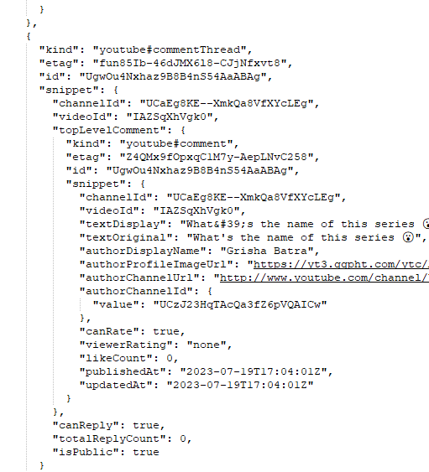
Dataset
A set of 10 shots that contain scenes from some medical series are selected for the dataset.
The comments are gathered using YouTube Data API called “CommentThreads: list.”
The video ID must be provided for the request. 100 comments can be retrieved at a time.
Figure 1: JSON sample from the API request

Slide 6
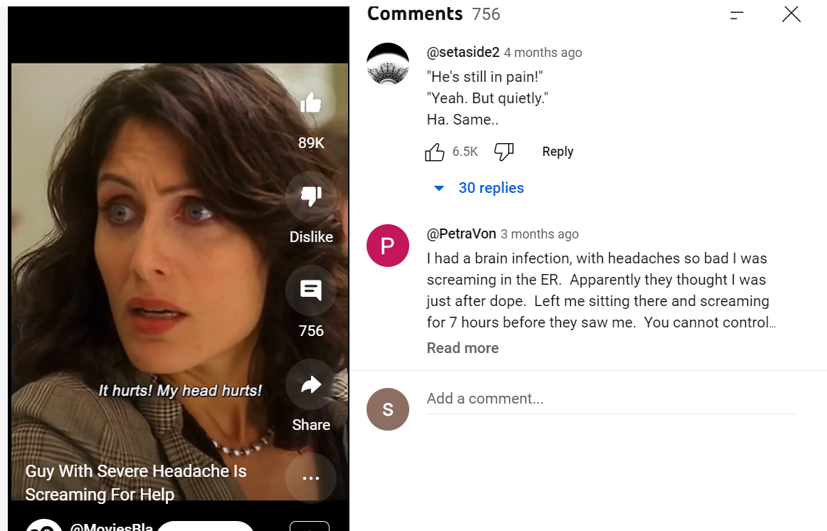
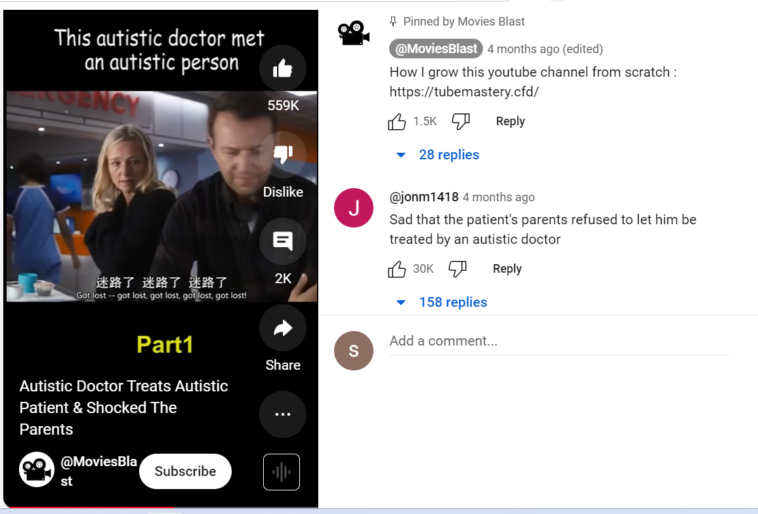
Can you guess the Series?

Slide 7
Can you guess the Series?
Figure 2 :Screenshots of YouTube videos from ‘House’ and ‘Good Doctor’

Slide 8
Dataset Cont.
Video Id | Link | Series | Season | Episode
IAZSqXhVgk0 | https://www.youtube.com/shorts/IAZSqXhVgk0 | Good Doctor | 1 | 7
oHXl4mKTHbA | https://www.youtube.com/shorts/oHXl4mKTHbA | Good Doctor | 1 | 2
nK51l6GSkG4 | https://www.youtube.com/shorts/nK51l6GSkG4 | Grey's Anatomy | 18 | 13
fYJDDLB45c8 | https://www.youtube.com/shorts/fYJDDLB45c8 | House | 3 | 12
RYYJnYLMbzQ | https://www.youtube.com/shorts/RYYJnYLMbzQ | Good Doctor | 3 | 3
phOHc0u-5DA | https://www.youtube.com/shorts/phOHc0u-5DA | Grey's Anatomy | 12 | 16
2j7apjKaemo | https://www.youtube.com/shorts/2j7apjKaemo | House | 1 | 4
DODBr-8Cw_U | https://www.youtube.com/shorts/DODBr-8Cw_U | Good Doctor | 3 | 5
t9ntcd-hfL8 | https://www.youtube.com/shorts/t9ntcd-hfL8 | Good Doctor | 1 | 6
bBNyWRe5KVA | https://www.youtube.com/shorts/bBNyWRe5KVA | House | 5 | 10
Video Id | Length of the video in minutes | Approximate number of comments as of 9/11/2023 | Episode information in Title or description?
IAZSqXhVgk0 | 1 | 2000 | No
oHXl4mKTHbA | 1 | 2600 | No
nK51l6GSkG4 | 1 | 8900 | No
fYJDDLB45c8 | 1 | 759 | No
RYYJnYLMbzQ | 1 | 6600 | No
phOHc0u-5DA | 1 | 1000 | No
2j7apjKaemo | 1 | 9800 | No
DODBr-8Cw_U | 1 | 383 | No
t9ntcd-hfL8 | 1 | 21 | No
bBNyWRe5KVA | 1 | 722 | No

Slide 9
Dataset Cont.
“1.json”: This contains the first 100 comments from the default API request using that VideoID
“episode.json”: The searchTerms parameter is used in the API request. It is made equal to “episode.” Hence the name for the JSON. As usual, only the first 100 comments with “episode “ in them are retrieved.
“Relevance.Json”: The order parameter is set to “relevance” here.
The following is the dataset structure:
>>Dataset
>> =>VideoID name
>> => => 1.json
>> => => episode.json
>> => => relevance.json
Notes:
backup

Slide 10
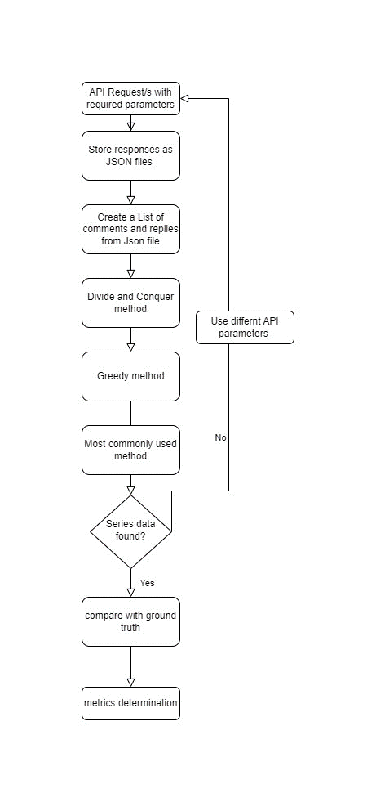
Algorithms
Greedy strategy
Divide and Conquer
Most Commonly used
Knuth-Morries_Pratt Algorithm
Figure 3: Flow chart of the process

Slide 11
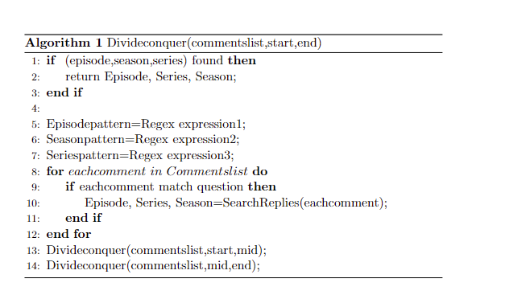
Divide and conquer
Comments can be divided and processed to find what is needed.
Some keywords like “episode,” “season,” show”, etc. can be used for the search.
Regex is used here.
Time complexity is O(n * log(n) * p)
Figure 4: Pseudocode of Divide and conquer method

Slide 12
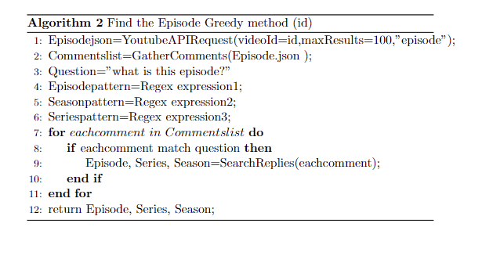
Greedy strategy
It is observed that episode/season information is often given in the comments after a question regarding the same.
For example, if “What is this episode?” is the comment.
The replies to this comment may have the correct information.
Using the greedy method, we can first search for those replies. If we get an answer here, we don’t search the remaining comments.
Time complexity O(n * r * p)
Figure 5: Pseudocode of Greedy method
Notes:
R-replies
P-length of pattern

Slide 13
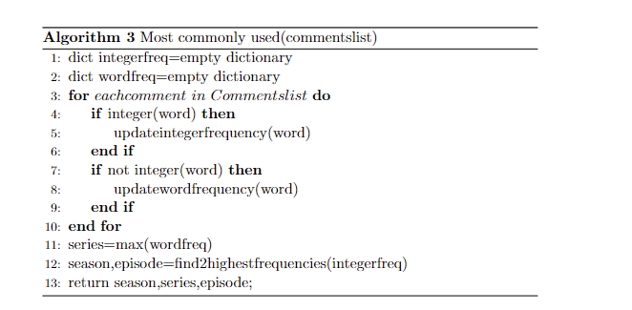

Most Commonly used
Find the most commonly used word(after ignoring certain words like “is”, “that” etc.) and treat it as the ‘series’ name.
Also find the two most commonly used integers, which can be season and episode numbers.
Hash map is used here to count frequencies.
Figure 6: Pseudocode of most commonly used method

Slide 14
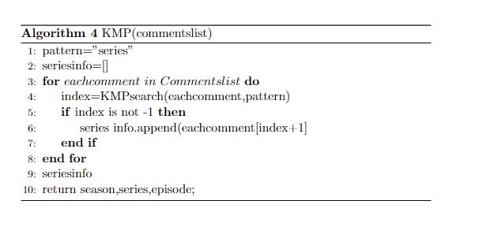
Knuth-Morries_Pratt Algorithm
Search happens using a pattern “series.”
Used to find only series name
A list of comments is returned, manually we need to identify the series name based on those.
This method has better worst-case time complexity than brute force
The time complexity is O(n * (n + p)).
Figure 7: Pseudocode of KMP method

Slide 15
Experiment Design
20k
23
Does the number of comments matter?
2k
10k

Slide 16
Experiment Design cont.
Video Id | Approximate number of comments as of 9/11/2023 | Episode identified | Season Identified | Found in episode.json?
IAZSqXhVgk0 | 2000 | 7 | 1 | Yes
oHXl4mKTHbA | 2600 | 2 | 1 | Yes
nK51l6GSkG4 | 8900 | 13 | 18 | Yes
fYJDDLB45c8 | 759 | 12 | 3 | Yes
RYYJnYLMbzQ | 6600 | - | - | Yes
phOHc0u-5DA | 1000 | 16 | 12 | Yes
2j7apjKaemo | 9800 | 4 | 1 | Yes
DODBr-8Cw_U | 383 | 5 | 3 | Yes
t9ntcd-hfL8 | 21 | 6 | - | Yes
bBNyWRe5KVA | 722 | 10 | 5 | Yes
Greedy method

Slide 17
Experiment Design cont.
Is any one method enough to get all the information?

Slide 18
Experiment Design cont.
Identified by Greedy and Divide and conquer
Identified only by Divide and conquer
Series identified only by the “most commonly used” method

Slide 19
Experiment Design cont.
Video Id | Episode identified |  |  |  | Season identified |  |  |  | Series identified Yes or No
Algo-> | 1 | 2 | 3 | 4 | 1 | 2 | 3 | 4 |  | 1 | 2 | 3 | 4
IAZSqXhVgk0 | 7 | 7 | 7 | - | 1 | 1 | 3 | - |  | no | yes | no | yes
oHXl4mKTHbA | 2 | 2 | 2 | - | 1 | 1 | 1 | - |  | no | no | yes | no
nK51l6GSkG4 | 13 | 13 | 13 | - | 18 | 18 | 18 | - |  | no | no | yes | yes
fYJDDLB45c8 | 12 | 12 | 12 | - | 3 | 3 | 3 | - |  | no | no | no | no
RYYJnYLMbzQ | - | 3 | 3 | - | - | 3 | 1 | - |  | no | no | yes | no
phOHc0u-5DA | 16 | 16 | 16 | - | 12 | 12 | 12 | - |  | no | no | no | no
2j7apjKaemo | 4 | 4 | 4 | - | 1 | 1 | 1 | - |  | no | no | no | no
DODBr-8Cw_U | 5 | 5 | 2 | - | 3 | 3 | 27 | - |  | no | no | no | no
t9ntcd-hfL8 | 6 | 6 | - | - | - | - | - | - |  | no | no | no | no
bBNyWRe5KVA | 10 | 5 | 10 | - | 5 | 5 | 5 | - |  | no | no | no | yes

Slide 20
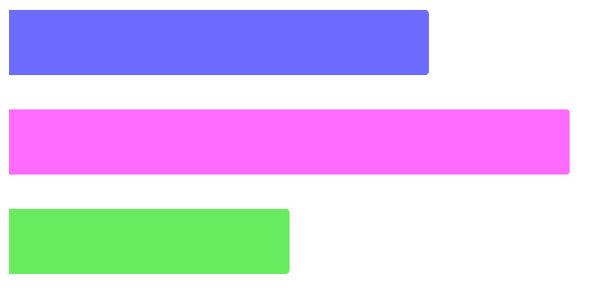
Analysis and discussion
Greedy
90%
Divide and conquer
90%
Most commonly used
80%
Episode Accuracy

Slide 21
Analysis and discussion
01
80 %
Greedy
02
90 %
Divide and conquer
03
60%
Most commonly used
Season Accuracy

Slide 22
Analysis and discussion
10 %
30 %
30%
Divide and conquer
Most commonly used
KMP
Series Accuracy

Slide 23
Analysis and discussion
 | Advantages | Disadvantages
Divide and conquer | Can be done in parallel | Stack overflow might occur.
Greedy | Simple strategy | Not always right
Most commonly used | Successful if we ignore certain words | There is no distinction between season number and episode number.
KMP | Used for series identification | Manual intervention is required after searching for the series

Slide 24
Conclusion and future work
Divide and conquer is best for episode and season identification.
“Most commonly used” is better for series identification
Future work:
Can be used for various other videos from other platforms.
Thumbnail and subtitles can be used to search further
Wikipedia and IMDb can be other sources

Slide 25
Thank you
Do you have any questions?

