Slide 1
Bank Account Management
- By Jiamin Yuan & Jonathan Dimitriu

Slide 2

Project Description
Bank Account Management is a graphical user interface (GUI) programme that simulates online banking. It offers services for new user registration as well as account management for current users.
The user has the option of choosing which action to take. An administrator account in the banking system has access to view consumer account. The goal of this programme is to help banks better control their customers' use.

Slide 3
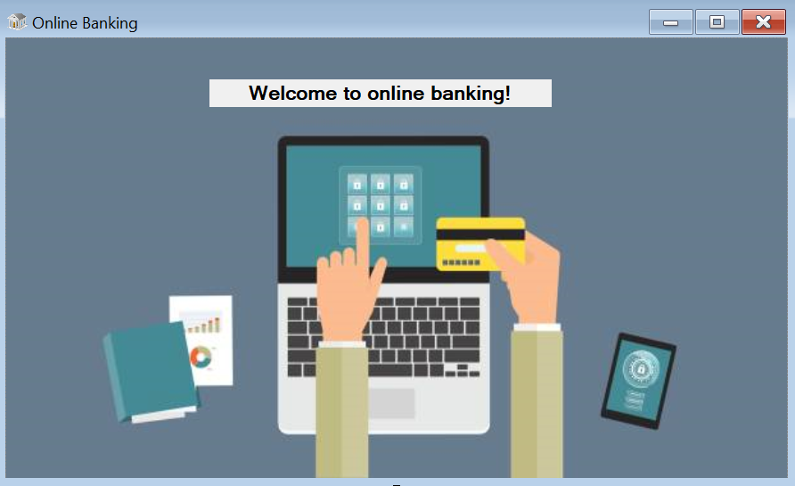
Functionalities
Welcome Page
In the upper left corner of the welcome screen, there is a small bank icon. We have special icons for all the forms in our project (bank/piggy). After one second, it will automatically switch to the next interface.

Slide 4

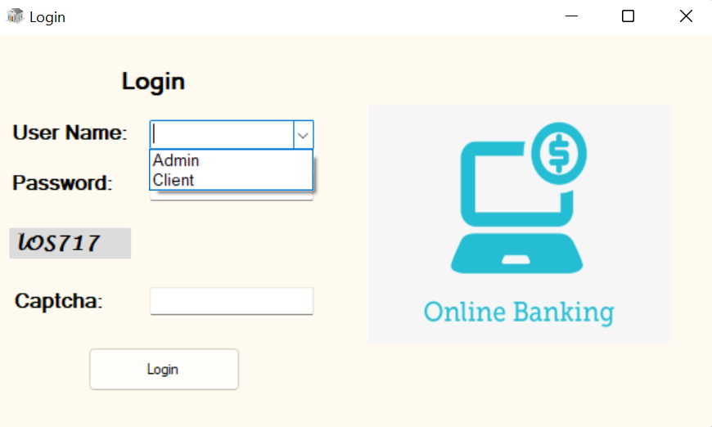
Functionalities
2. Random Captcha. Every time the form is reloaded, it will change.

Slide 5
Functionalities
3. Account Options. User can either log in as an admin or a client. Different identities correspond to different user interfaces.

Slide 6
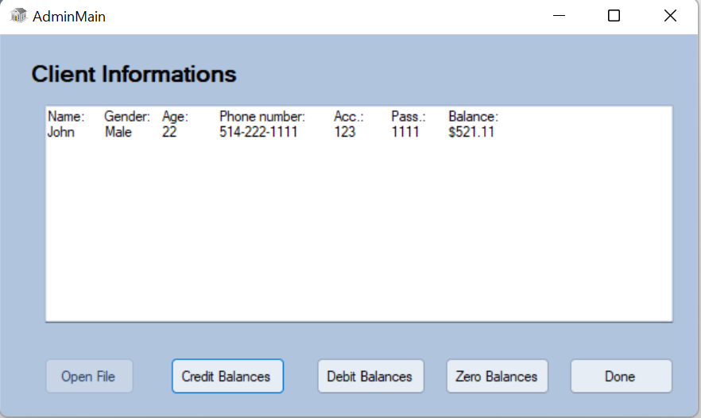
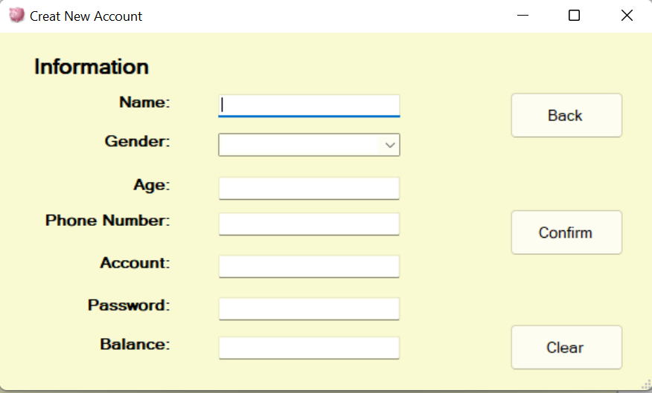
Functionalities
4. Read, write, update a text file

Slide 7
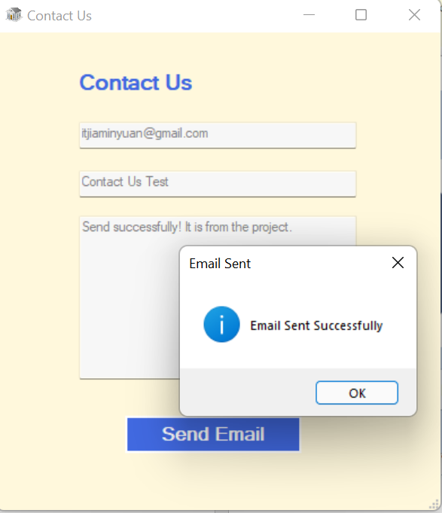
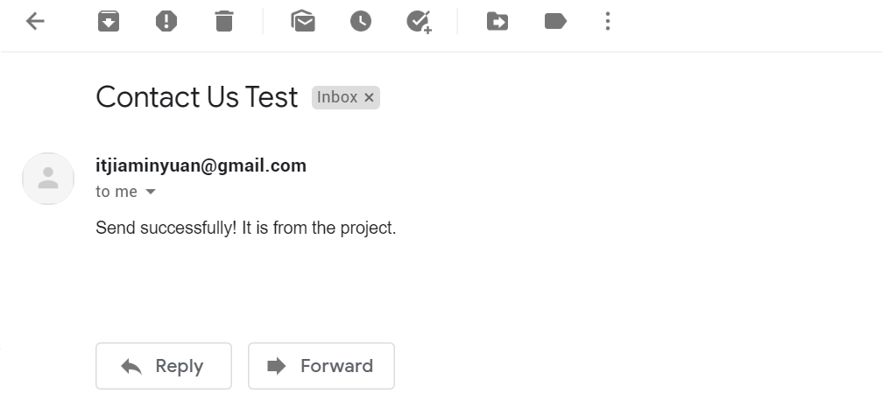
Functionalities
5. Contact Us. To Send a Gmail through the form. More detail information included in the following step-by-step tutorial.

Slide 8
Thank you!

