Slide 1
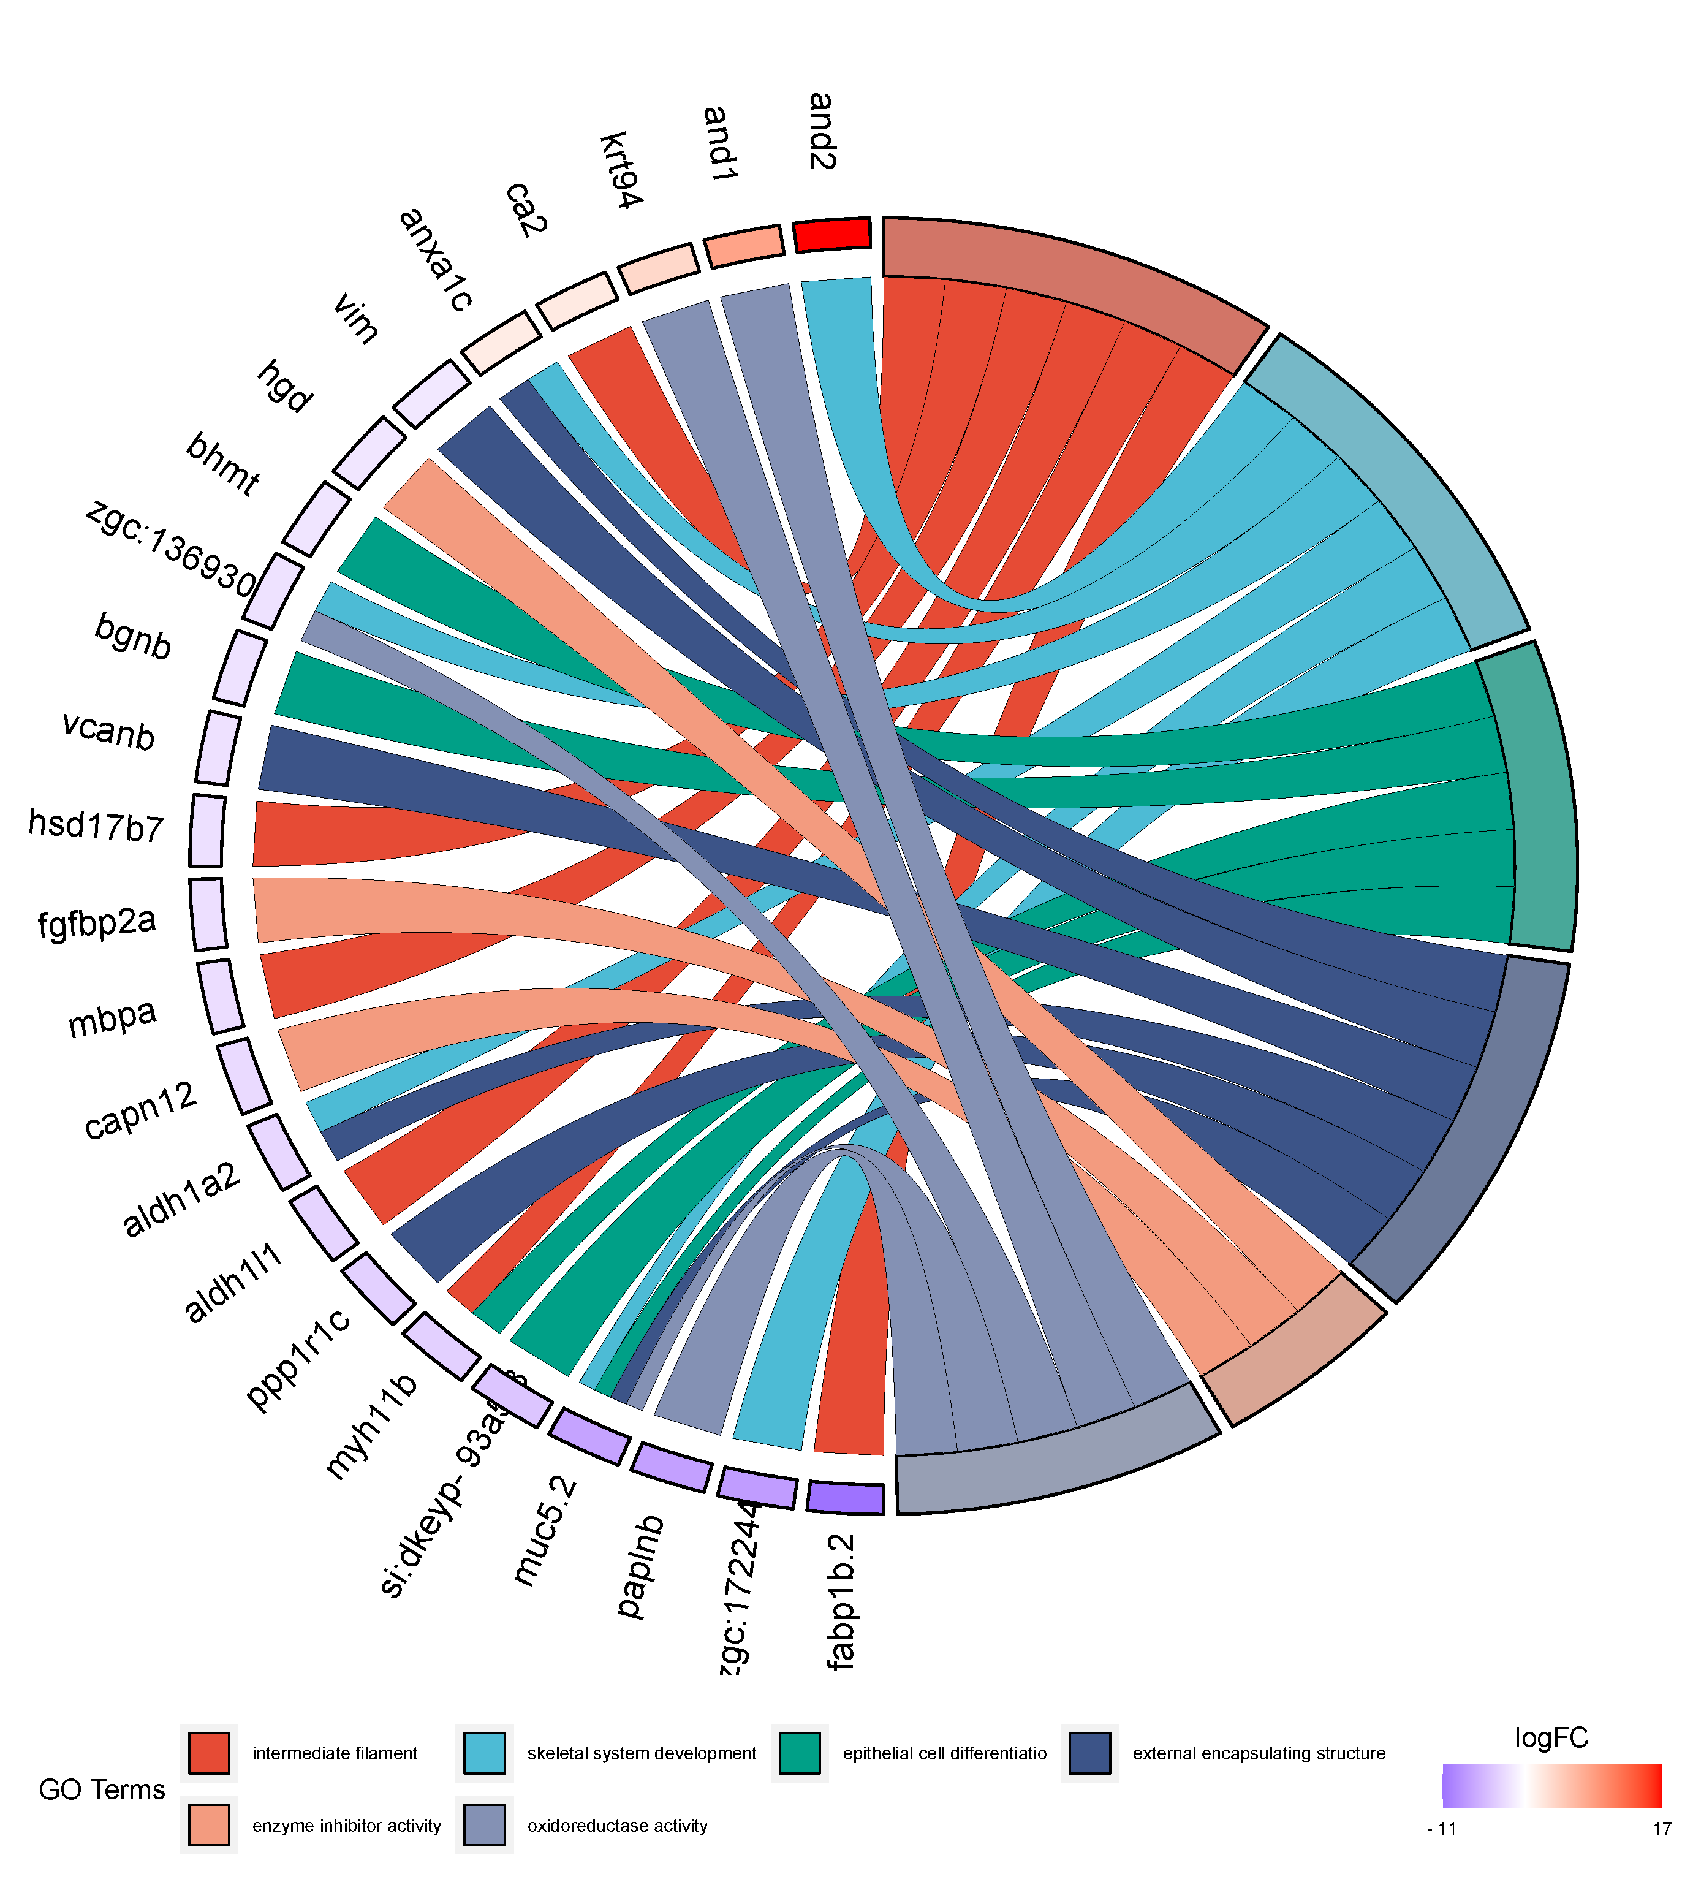




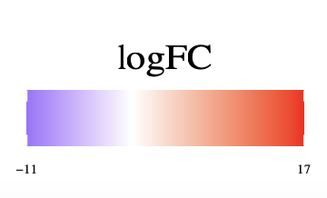
intermediate Filament
skeletal system development
epithelial cell differentiation
GO Terms
external encapsulating structure
enzyme inhibitor activity
oxidoreductase activity

