Slide 1
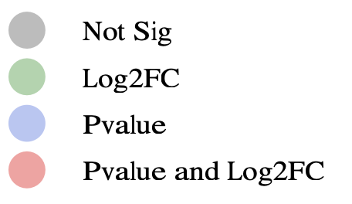
Total Variables: 151

