Slide 1
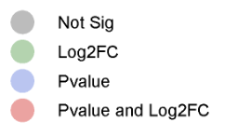
Volcano Plot of Proteomics
Total Variables: 18274

