Slide 1
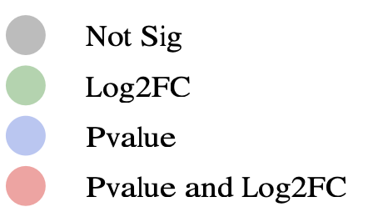
Volcano Plot of Transcriptomics
Total Variables: 20464

