Slide 1








3D Modelling of Chitinase and Docking of Allosamidin
Simiao Wang ID: 2143183
Supervisor: Faez Iqbal Khan

Slide 2
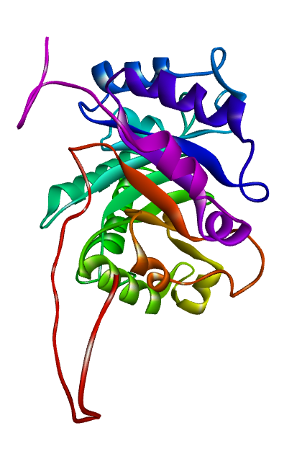
Introduction: Chitinase
Why I choose this Chitinase ?
Thermal stable
Structure is unknown
Importance of Chitinase
We generated the 3D structure of Chitinase

Slide 3
Introduction: Chitinase
Why I choose this Chitinase ?
Thermal stable
Structure is unknown
Importance of Chitinase
We generated the 3D structure of Chitinase

Slide 4
Introduction: Tools
Homology Modelling Steps:
Sequence from NCBI
BLAST
Choose templates
Easy modeller
Ab initio Modelling Steps:

Slide 5
Introduction: Tools
Docking Steps:
Use AutoDock: pdb to pdbqt
Discovery ctrl+H define -> right click property -> look at xyz
In contig file, change the xyz
Run dock code

Slide 6
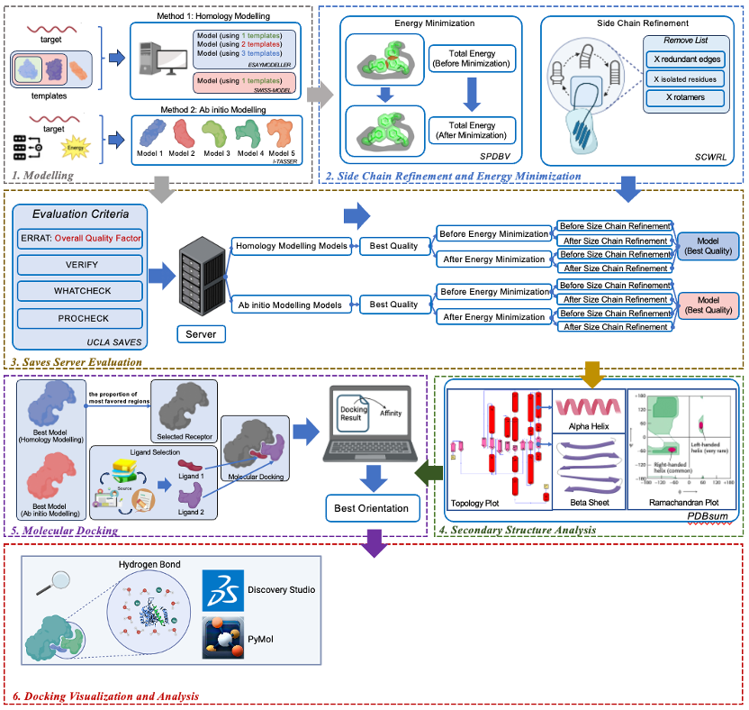
Introduction
The Overall Workflow

Slide 7
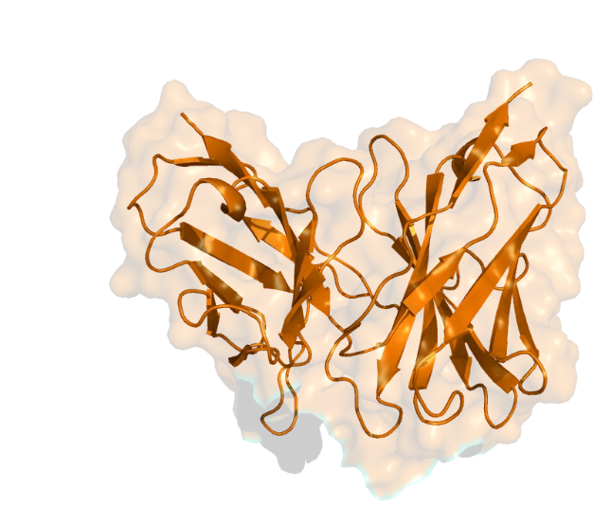
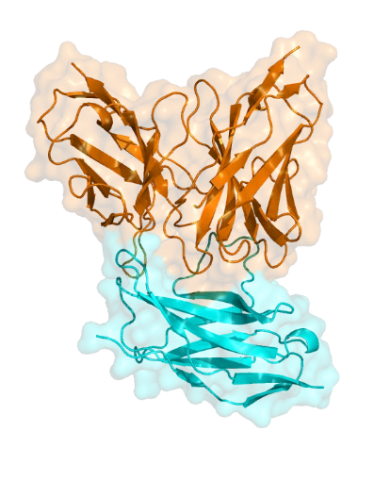
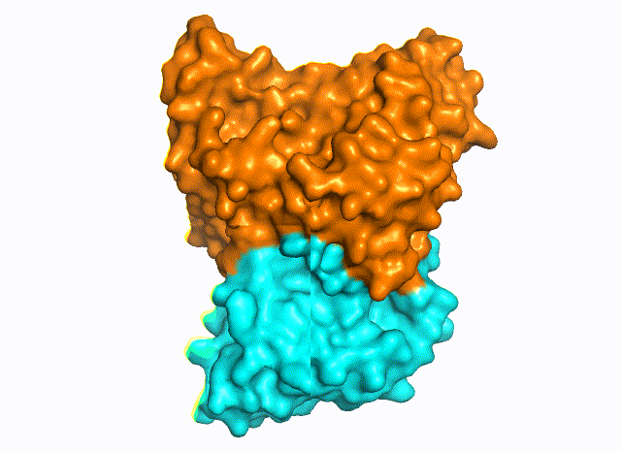
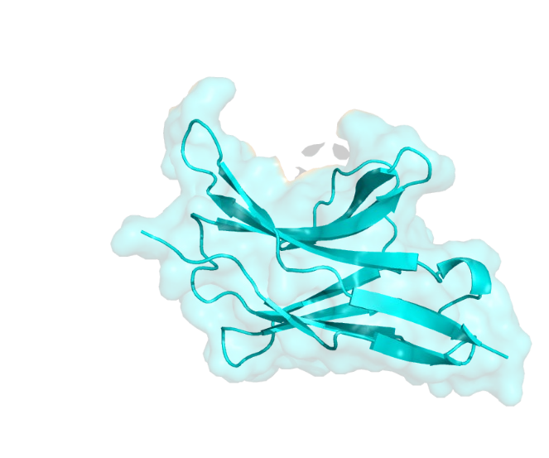
Hypothesis
What is the molecular interactions mechanism of Pembrolizumab and PD-1?
Structure analysis
RMSD
PD-1/Pembrolizumab
Complex
RMSF
SASA
PPI
Pembrolizumab
Radius of Gyration
Modevector
MD Simulation
Gibbs Free Energy Landscape
PD-1

Slide 8
Results
Best Structure Finding
Dock Allosamidin

Slide 9
Conclusion
Chitinase is an important industrial enzyme XXX. 3D structure information of Chitinase is not known. We performed homology modelling of Chitinase using XXX template.
The structure showed high quality (XXX values). Further, we docked allosamidin inhibitor of Chitinase. We found that it interacts with important catalytic residues.

Slide 10

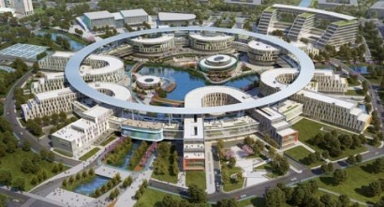

Acknowledgement
Dr. Faez Iqbal Khan
Assistant Professor
Xi’an Jiaotong-Liverpool University
The high-performance computing facility at Xi'an Jiaotong-Liverpool University
Centre for High Performance Computing South Africa

Slide 11
Acknowledgement
Thank you !

