Slide 1
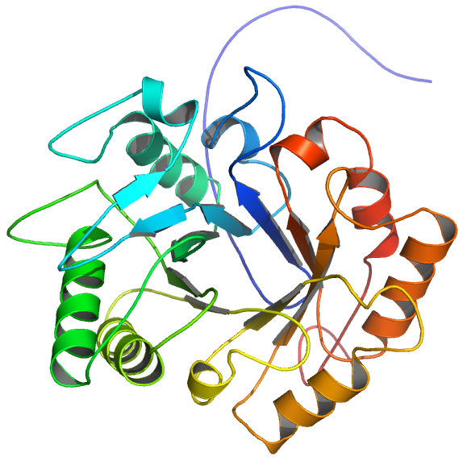
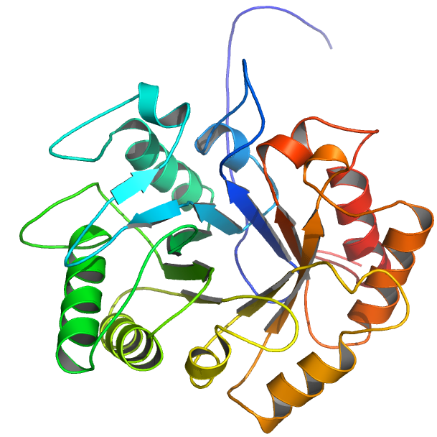
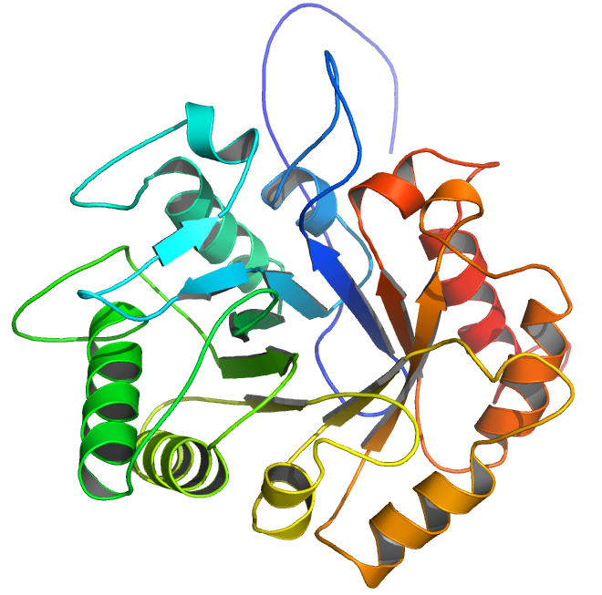
With One Template
(7ZYA)
With Two Template
(7ZYA, 2UY2)
With Three Template
(7ZYA, 2UY2 and 4TX6)

