Slide 1
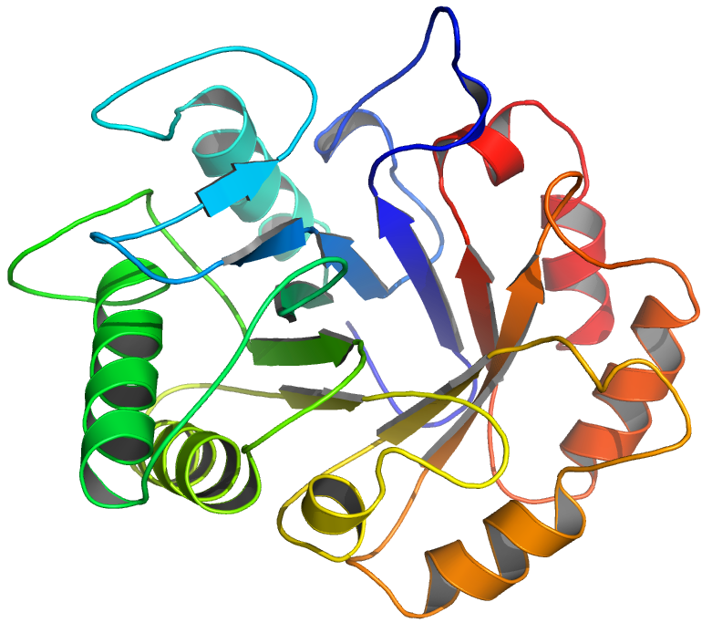
With One Template
(7ZYA)

