Slide 1
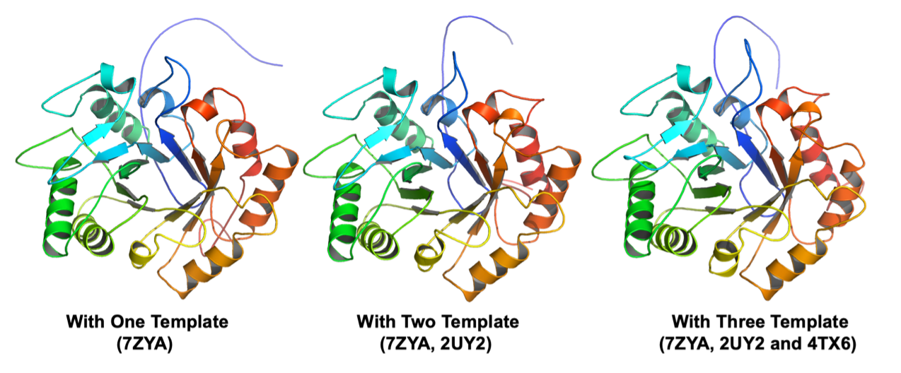
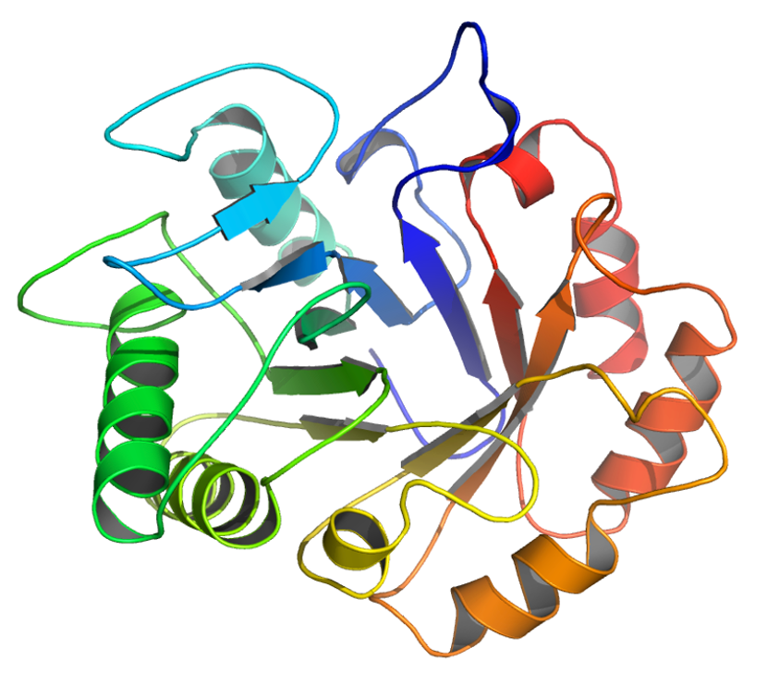
A
B
With One Template
(7ZYA)
With Two Template
(7ZYA, 2UY2)
C
D
With Three Template
(7ZYA, 2UY2 and 4TX6)
With One Template
(7ZYA)

Slide 2
A
B
With One Template
(7ZYA)
With Two Templates
(7ZYA, 2UY2)
C
D
With Three Templates
(7ZYA, 2UY2 and 4TX6)
With One Template
(7ZYA)

