Slide 1

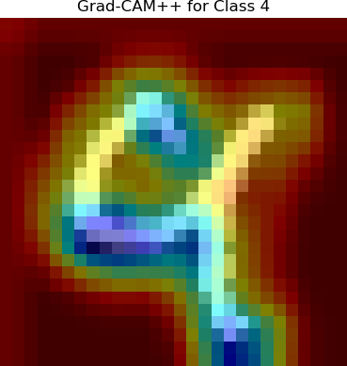

A. Benchmark Dataset
B. Individual Model Construction
C. CAM-based Visual Interpretability
MNIST images
(train = 60000, test = 10000)
RE-SWE
Normalization
Data Preparation
Grad-CAM
Kernel Size
Grad-CAM++
Hyperparameter tuning
Stride
Layer-CAM
Padding
Score-CAM
Optimizer
…
Best model for each algorithm
B.1 ResNet (ResNet-34)
B.2 Vision Transformer (ViT)
Conv2d
Batch norm
ReLU
MaxPool
Conv Block
Identity Block*2
Conv Block
Input with 1 channel,
N samples / batch
Identity Block*2
Conv Block
Identity Block*5
Conv Block
Identity Block*3
Sigmoid
Linear Projection of Flattened Patches
AvgPool2D
Flatten
0
Malignant
Yes / No
1
Patch + Positional Embedding
0
1
2
3
4
5
6
7
8
9
*
Conv Block
Input
Conv2d
Batch norm
ReLU
Conv2d
Batch norm
ReLU
Conv2d
Batch norm
Transformer Encoder
Sigmoid
Individual model architecture
MLP Head
0
Malignant
Yes / No
Conv2d
Batch norm
ReLU
Output
1
Remove Redundant Columns
Identify Block
Conv2d
Batch norm
Conv2d
Batch norm
Transformer Encoder
Input
ReLU
ReLU
Conv2d
Batch norm
Embedded
Patches
Norm
Same-dim
ReLU
Output
B.3 ShuffleNet
Q
K
V
Channel
spilt
Conv2d (1*1)
Batch norm
ReLU
DWConv (3*3)
Batch norm
Conv2d (1*1)
Batch norm
Multi-
head
Input with 1 channel,
N samples / batch
Softmax
Malignant
Yes / No
Sigmoid
Norm
MLP
Output
0
Channel Shuffle
Concatenation
ReLU
1
D. Ensemble Learning
ResNet
ViT
ShuffleNet
x
Concat
Training
CNN block
Attention
Reshape
……
Ensemble Learning
CNN block
……
……
T⁻¹
Q
K
V
Flatten
Testing
Model selection & Prediction aggregation

Slide 2
a. Original
a. Grad-CAM
b. Grad-CAM++
c. Layer-CAM
d. Score-CAM

Slide 3
A
B

