Slide 1
How to run the tutorials on Google Colab

Slide 2
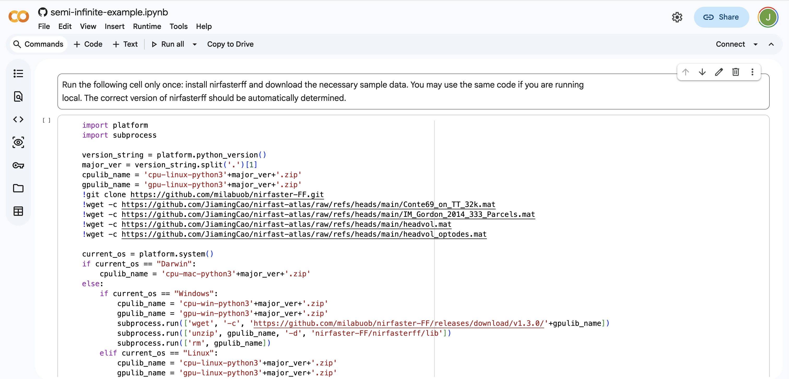
Prerequisites
First of all, you must have a Google account
Three tutorials are provided, which should have been sent to you via email. Click on the links, and everything should be ready to go
You don’t have to manually download any other files at this point, if you choose to use Google Colab
You may choose to save a copy to your personal Google Drive

Slide 3
Alternatively, you can download the tutorials first. After that, you have two options
  Run locally using Jupyter Notebook, Jupyter Lab, or VS Code
  Manually upload to your own Colab session, and run from there

Slide 4
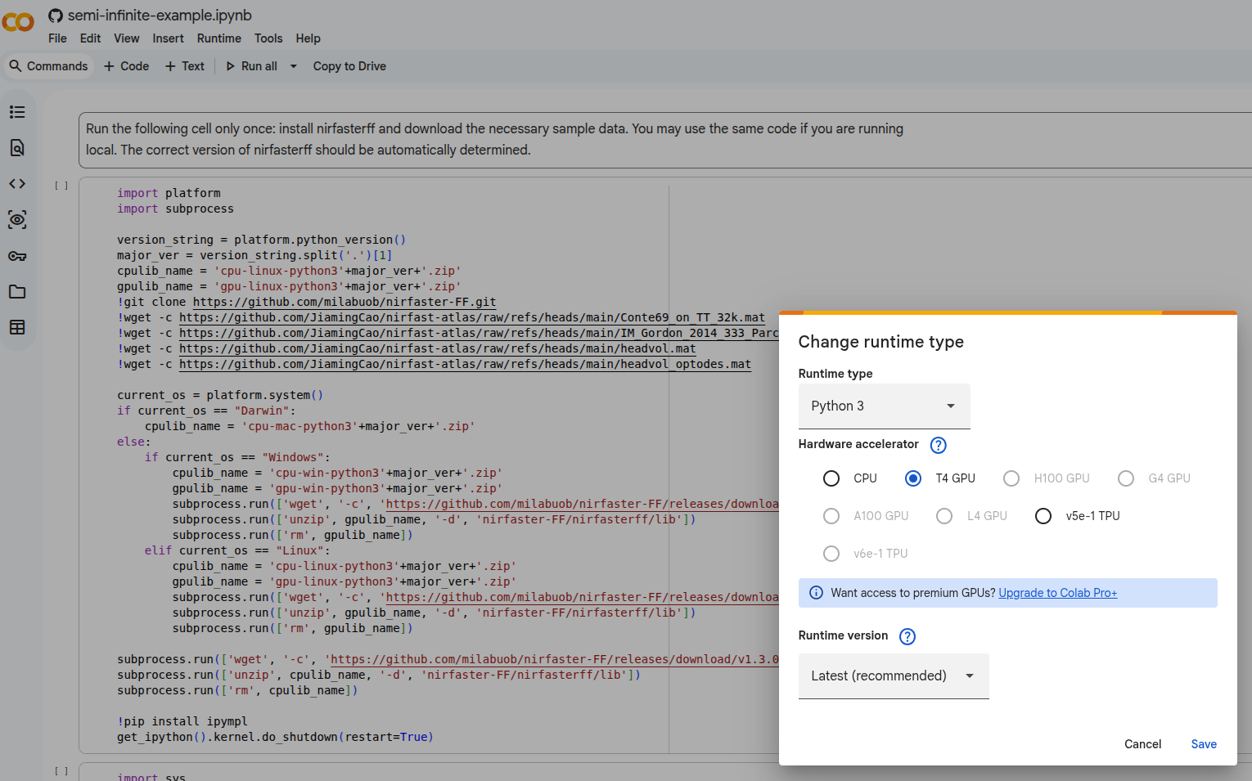
Start a session
We need to use the GPU for the head_model_example. To do so,

Slide 5
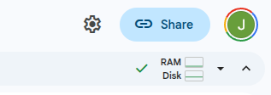
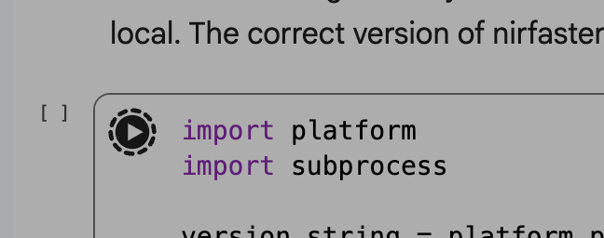
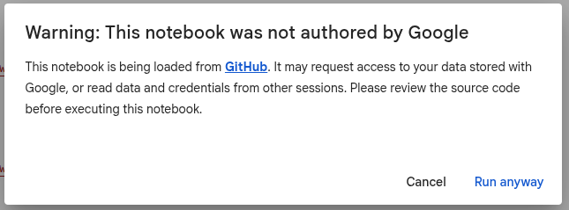
Now, click the “Connect” button in the top right corner
Wait a few moments for it to connect to the session. The button will then look like this
Click the play button to run the cell
Ignore the warning, and you should be good to go!

Slide 6
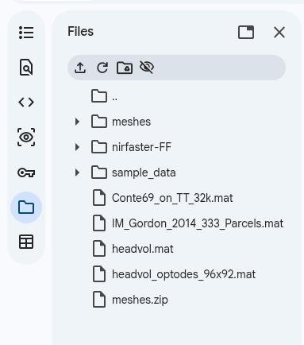
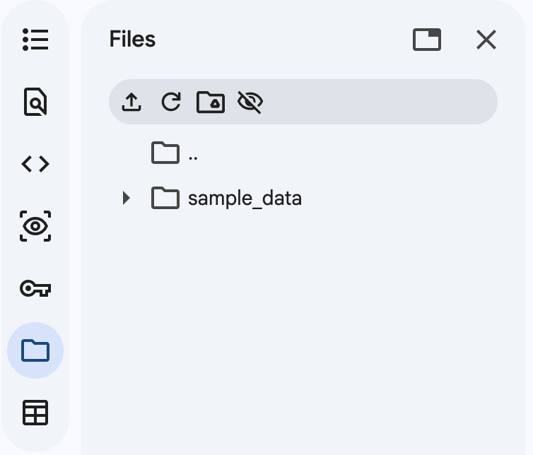
Once you’ve finished the create_head_model tutorial, you need to download the resulting mesh, which will be used again in the head_model_example tutorial.
Download this one
Once you’ve finished the create_head_model tutorial, you need to download the resulting mesh, which will be used again in the head_model_example tutorial.
Upload from here

