Slide 1



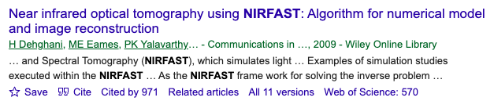
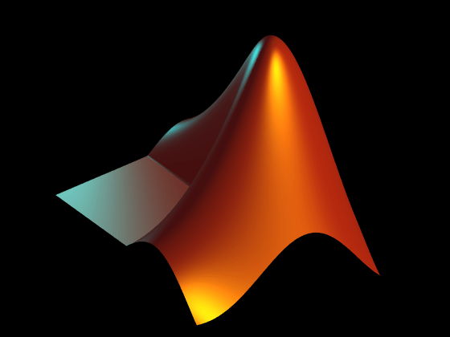
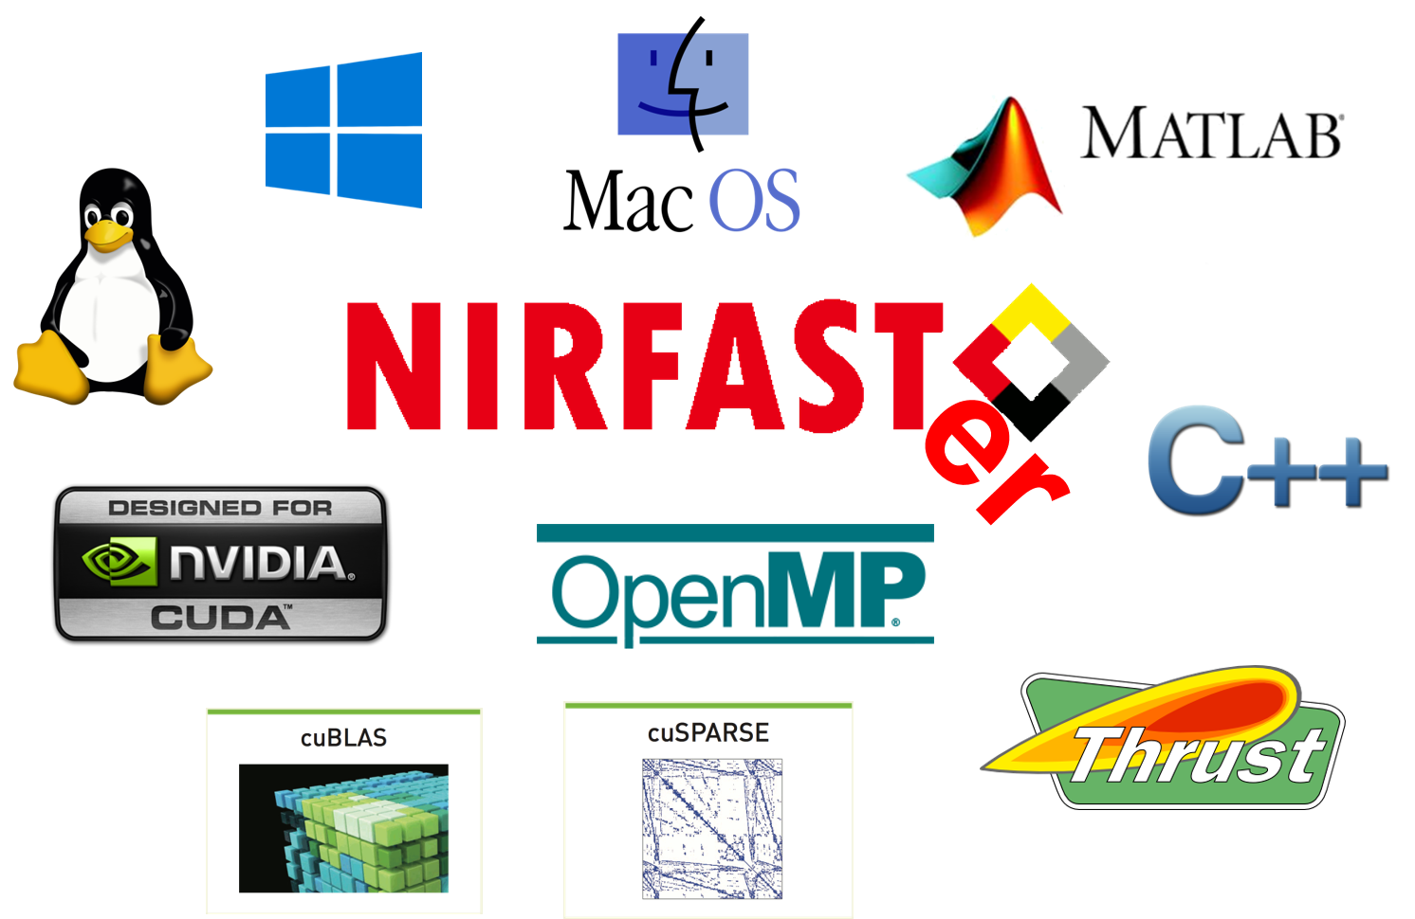
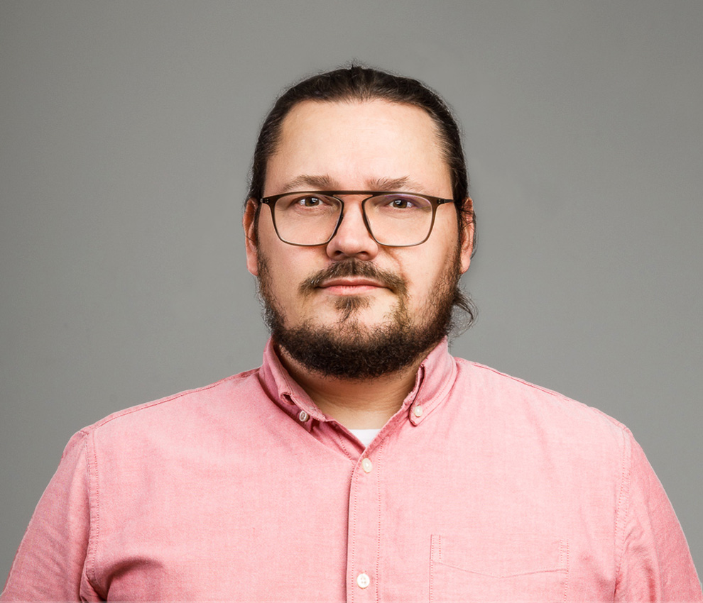
The NIRFAST family
NIRFASTer Fast and Furious
2001-2018
Even faster
Improved applicability
Improved stability
Prof. Hamid Dehghani
GPU acceleration
Algorithms adapted from NIRFASTer
Updated for better performance
More efficient algorithm
2018-2025
+
More parallelization
Dr. Stanisław Wojtkiewicz

Slide 2

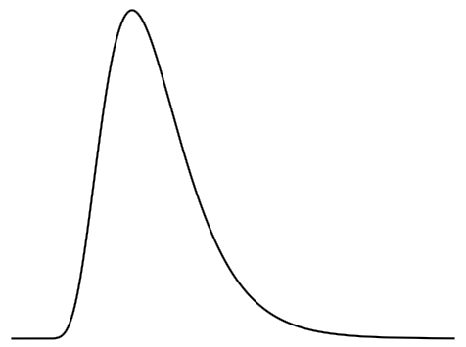
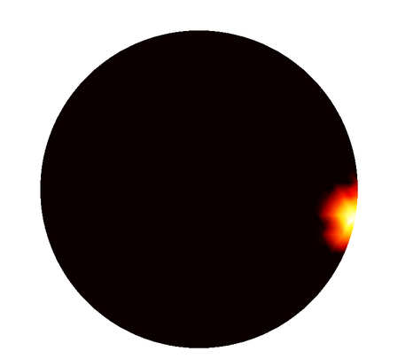

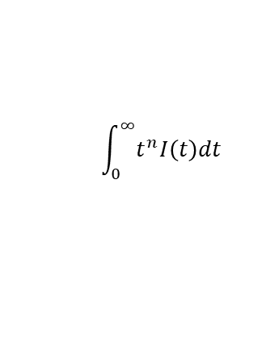
New, versatile Python package: NIRFASTerFF
Segmented volume
File
CGAL mesher
https://github.com/milabuob/nirfaster-FF
FEM
mesh
Acceleration
Moments
standard
fluorescence
DCS
CPU: OpenMP
Direct calculation
<$I_{out}\left(t\right),I_{out}\left(t+τ\right)$>
GPU: CUDA
$$\int_{0}^{∞}{t^{n}I\left(t\right)dt}$$
C++ implementation
flow
X
TPSF
Cross-platform
Fluence
Linux
Intensity
macOS
I(t)
Windows
time
Sensitivity matrix
TPSF: temporal point spreading function
In DOT

Slide 3

Old solver and its limitations
Symmetric
Sparse
Too large to solve directly
$$MΦ=Q$$
Iterative solvers
src n
…
Computational load of one source is low for modern GPUs
Communication overhead
More efficient PCG algorithm suffices when system is real
NIRFASTer
src 2
src 1
BiCGStab + FSAI
BiCGStab: biconjugate gradient stabilized
PCG: preconditioned conjugate gradient
FSAI: factorized sparse approximate inverse

Slide 4
Why faster? The new solvers
GPU
More efficient algorithm
Increased parallelization
FD problems
Complex numbers
Others
Real numbers
GPU
if fail
CPU
…
…
src 17
src 18
src 32
src 17
src 18
src 32
src n
src n
…
…
if fail
…
…
src 2
src 2
src 1
src 2
src 16
src 1
src 2
src 16
…
…
src 1
src 1
BiCGStab + FSAI
PCG + FSAI
BiCGStab + FSAI
PCG + FSAI

Slide 5
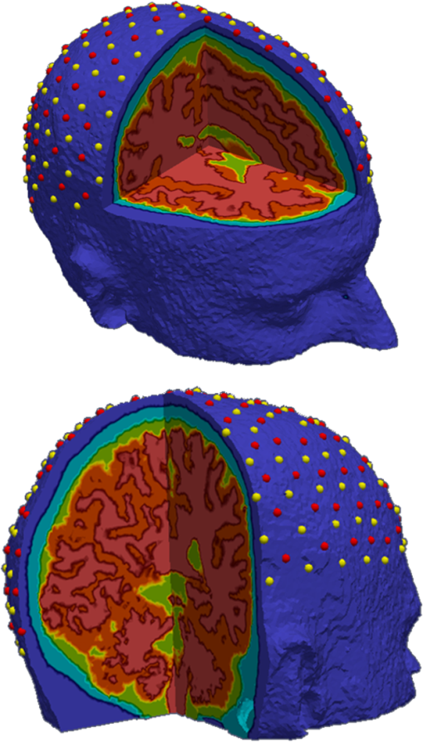
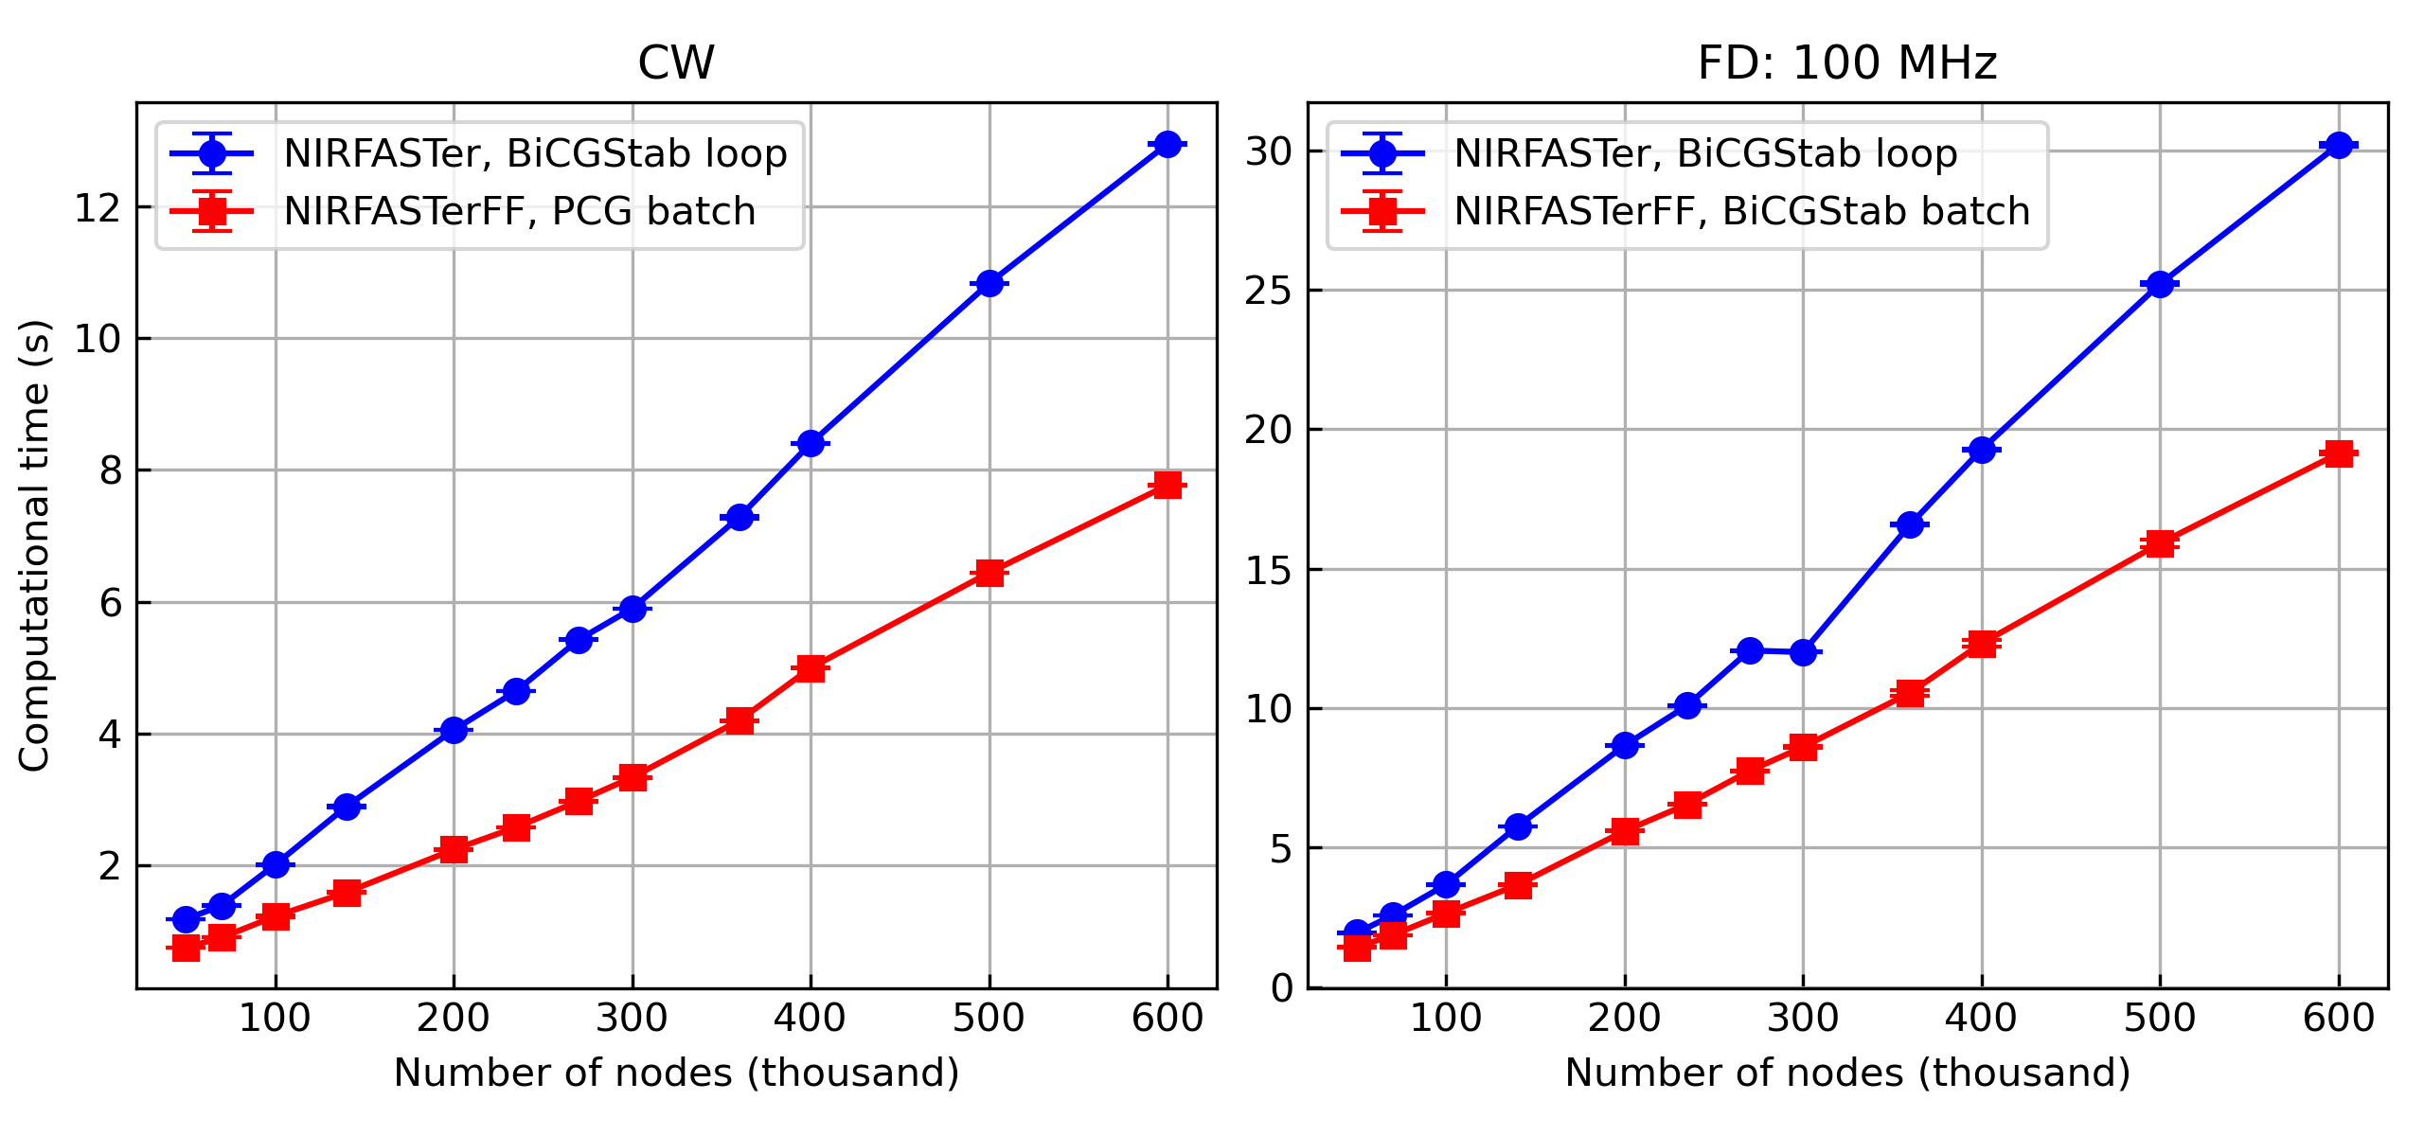
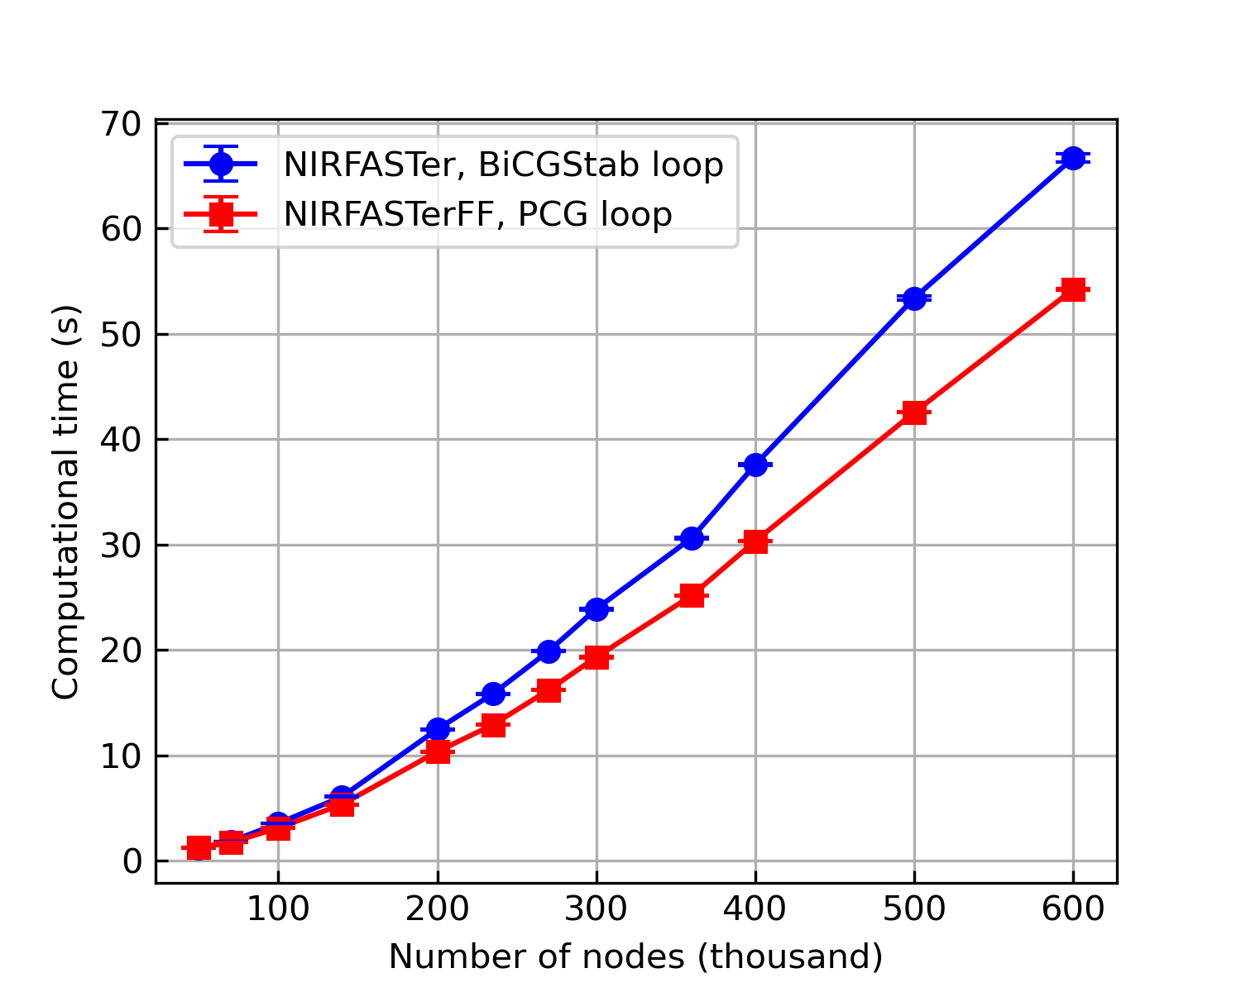
Benchmarking against the old NIRFASTer
Same head model -> 13 meshes with 50k – 600k nodes
158 sources
GPU: NVIDIA Tesla V100; CPU: Intel Core i7-13700K
GPU
CPU
35-45%
25-37%
Up to 20%
better
Faster algorithm + more parallelization
More parallelization
Faster algorithm
Doulgerakis et al., JBO, 2017
Cao et al., JBO, 2025

Slide 6
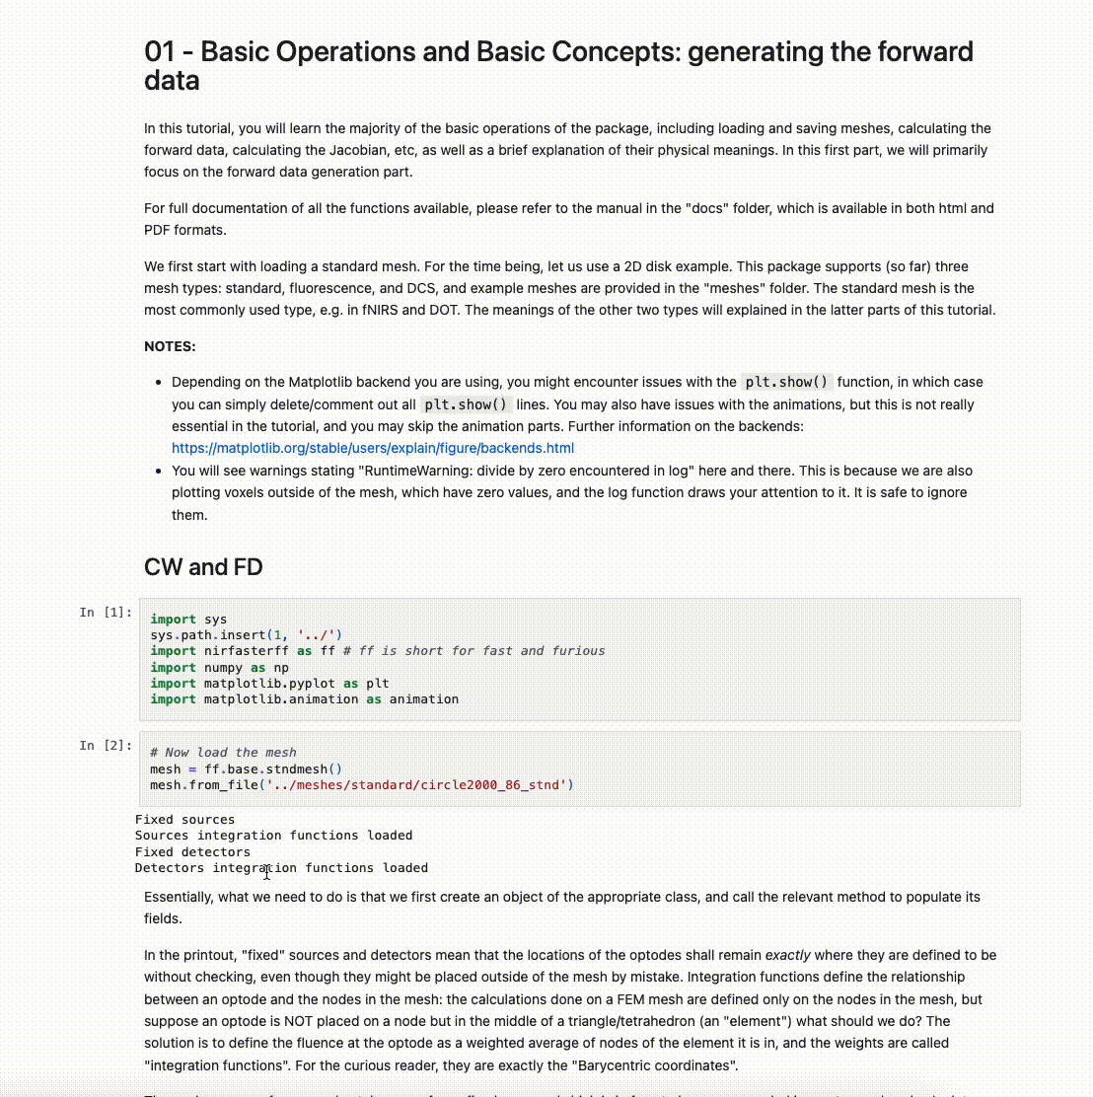
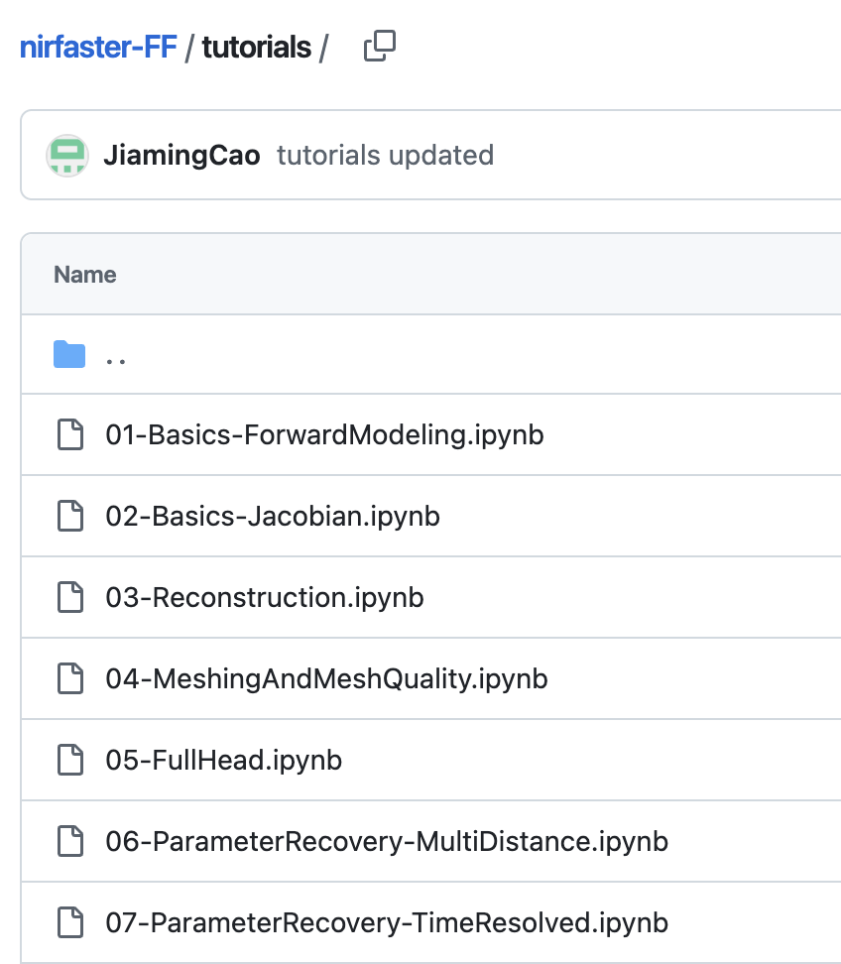
Extensive tutorials and API documentation

Slide 7
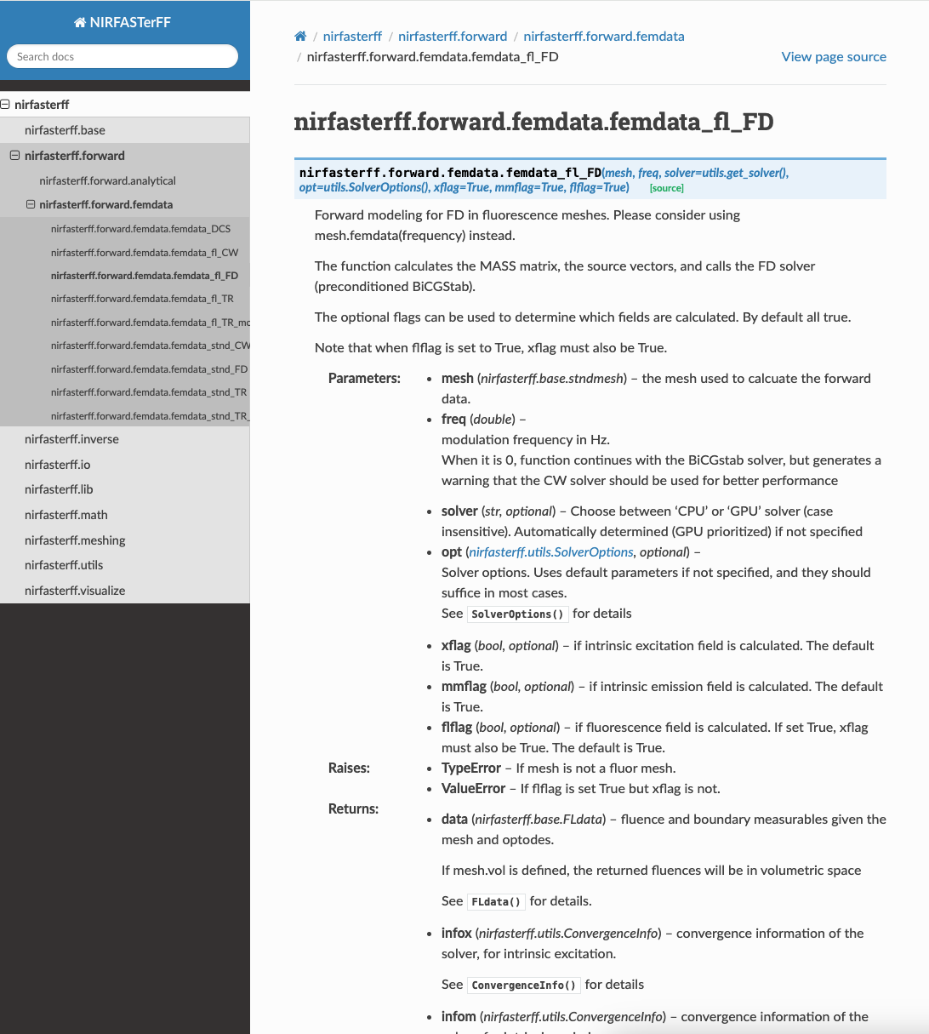
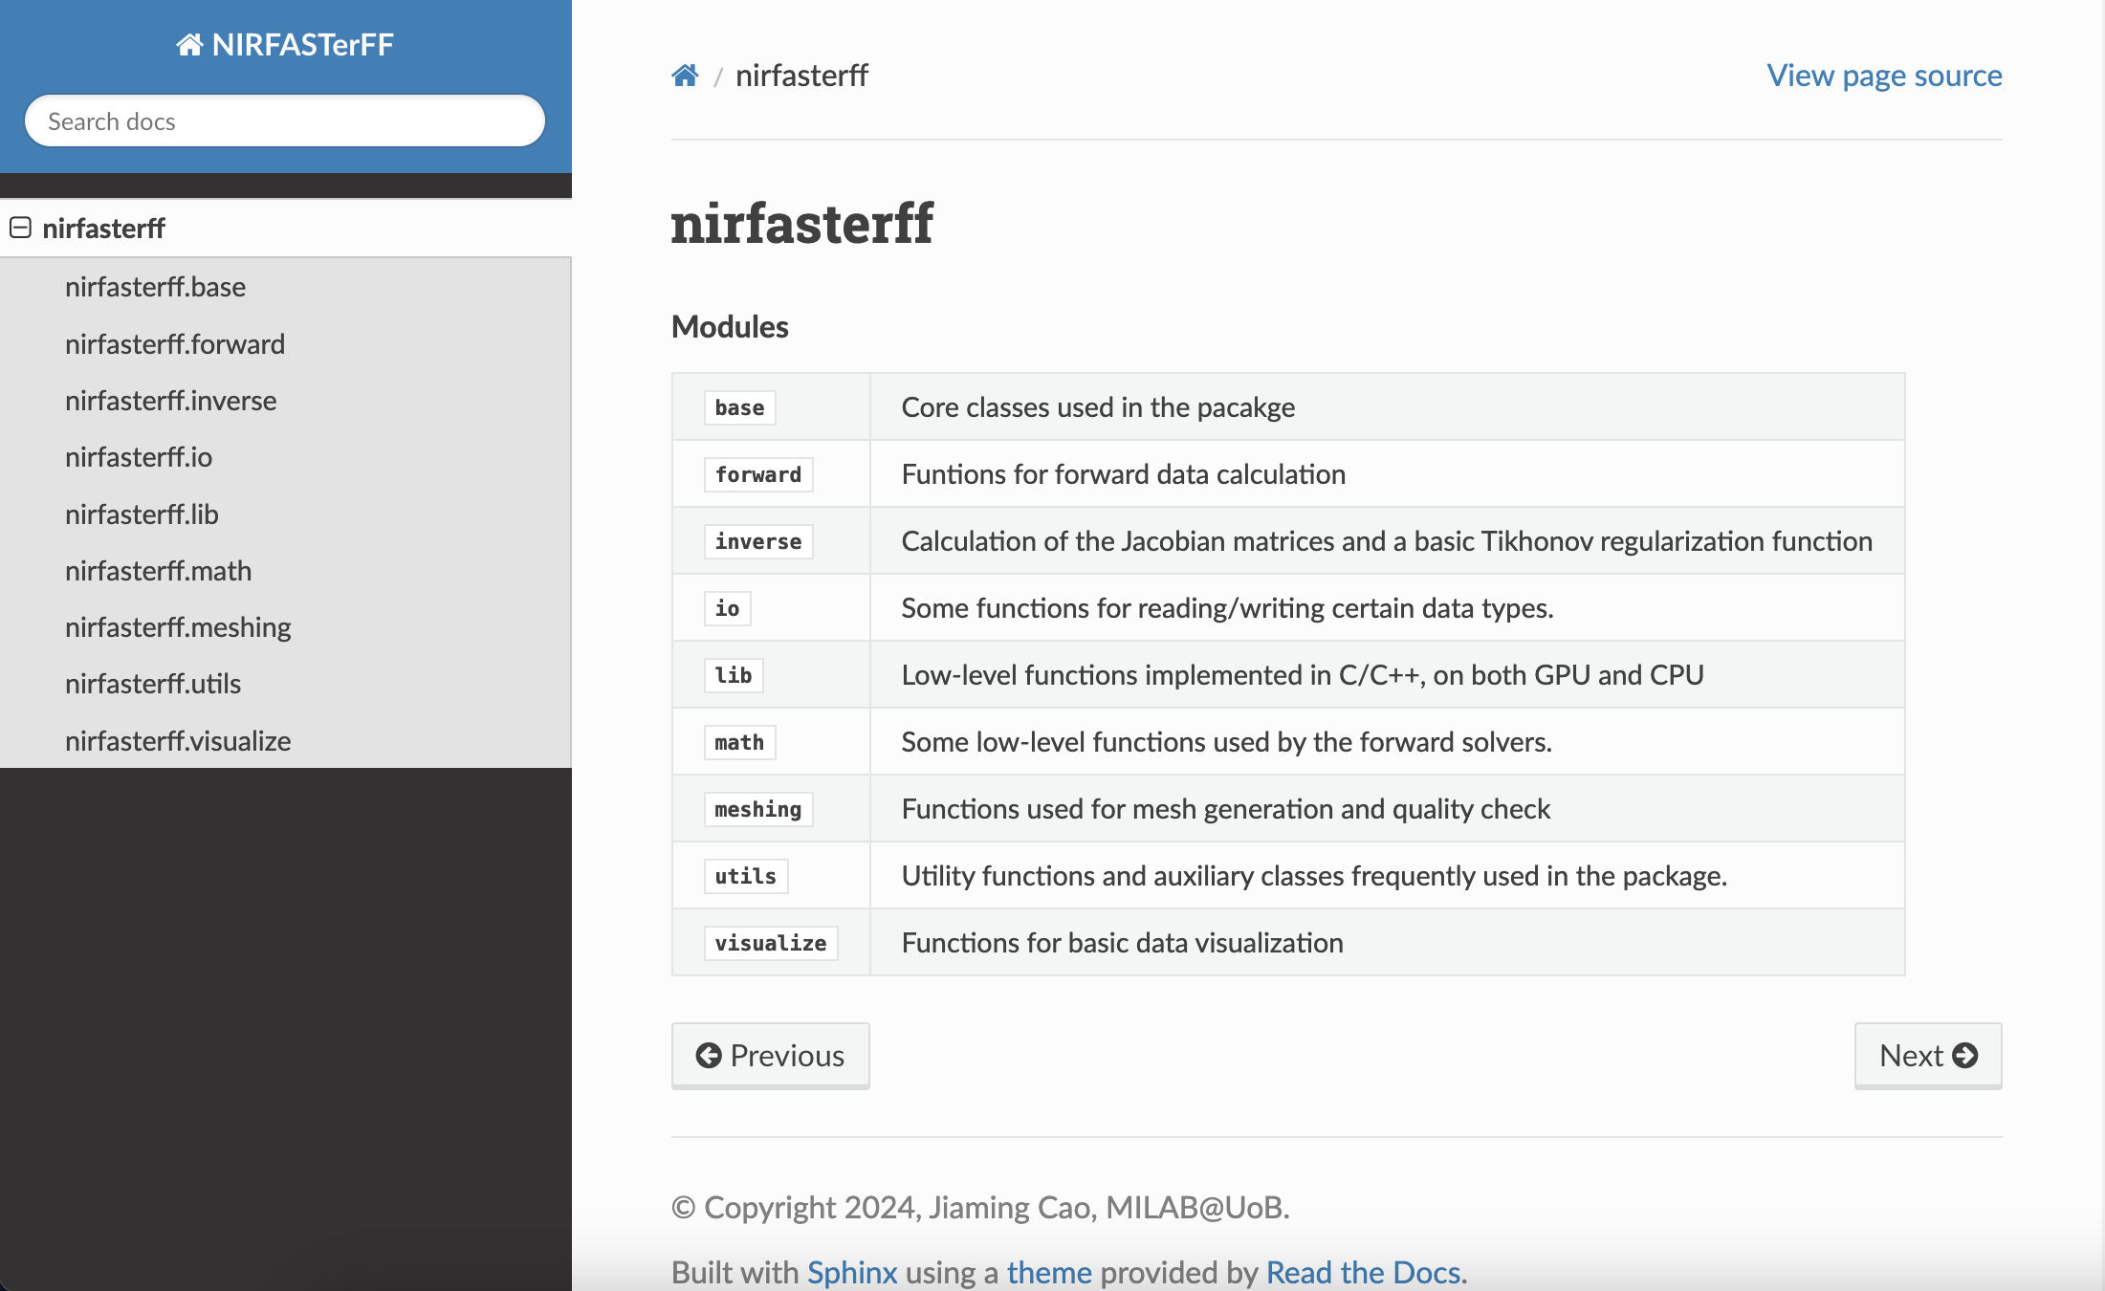
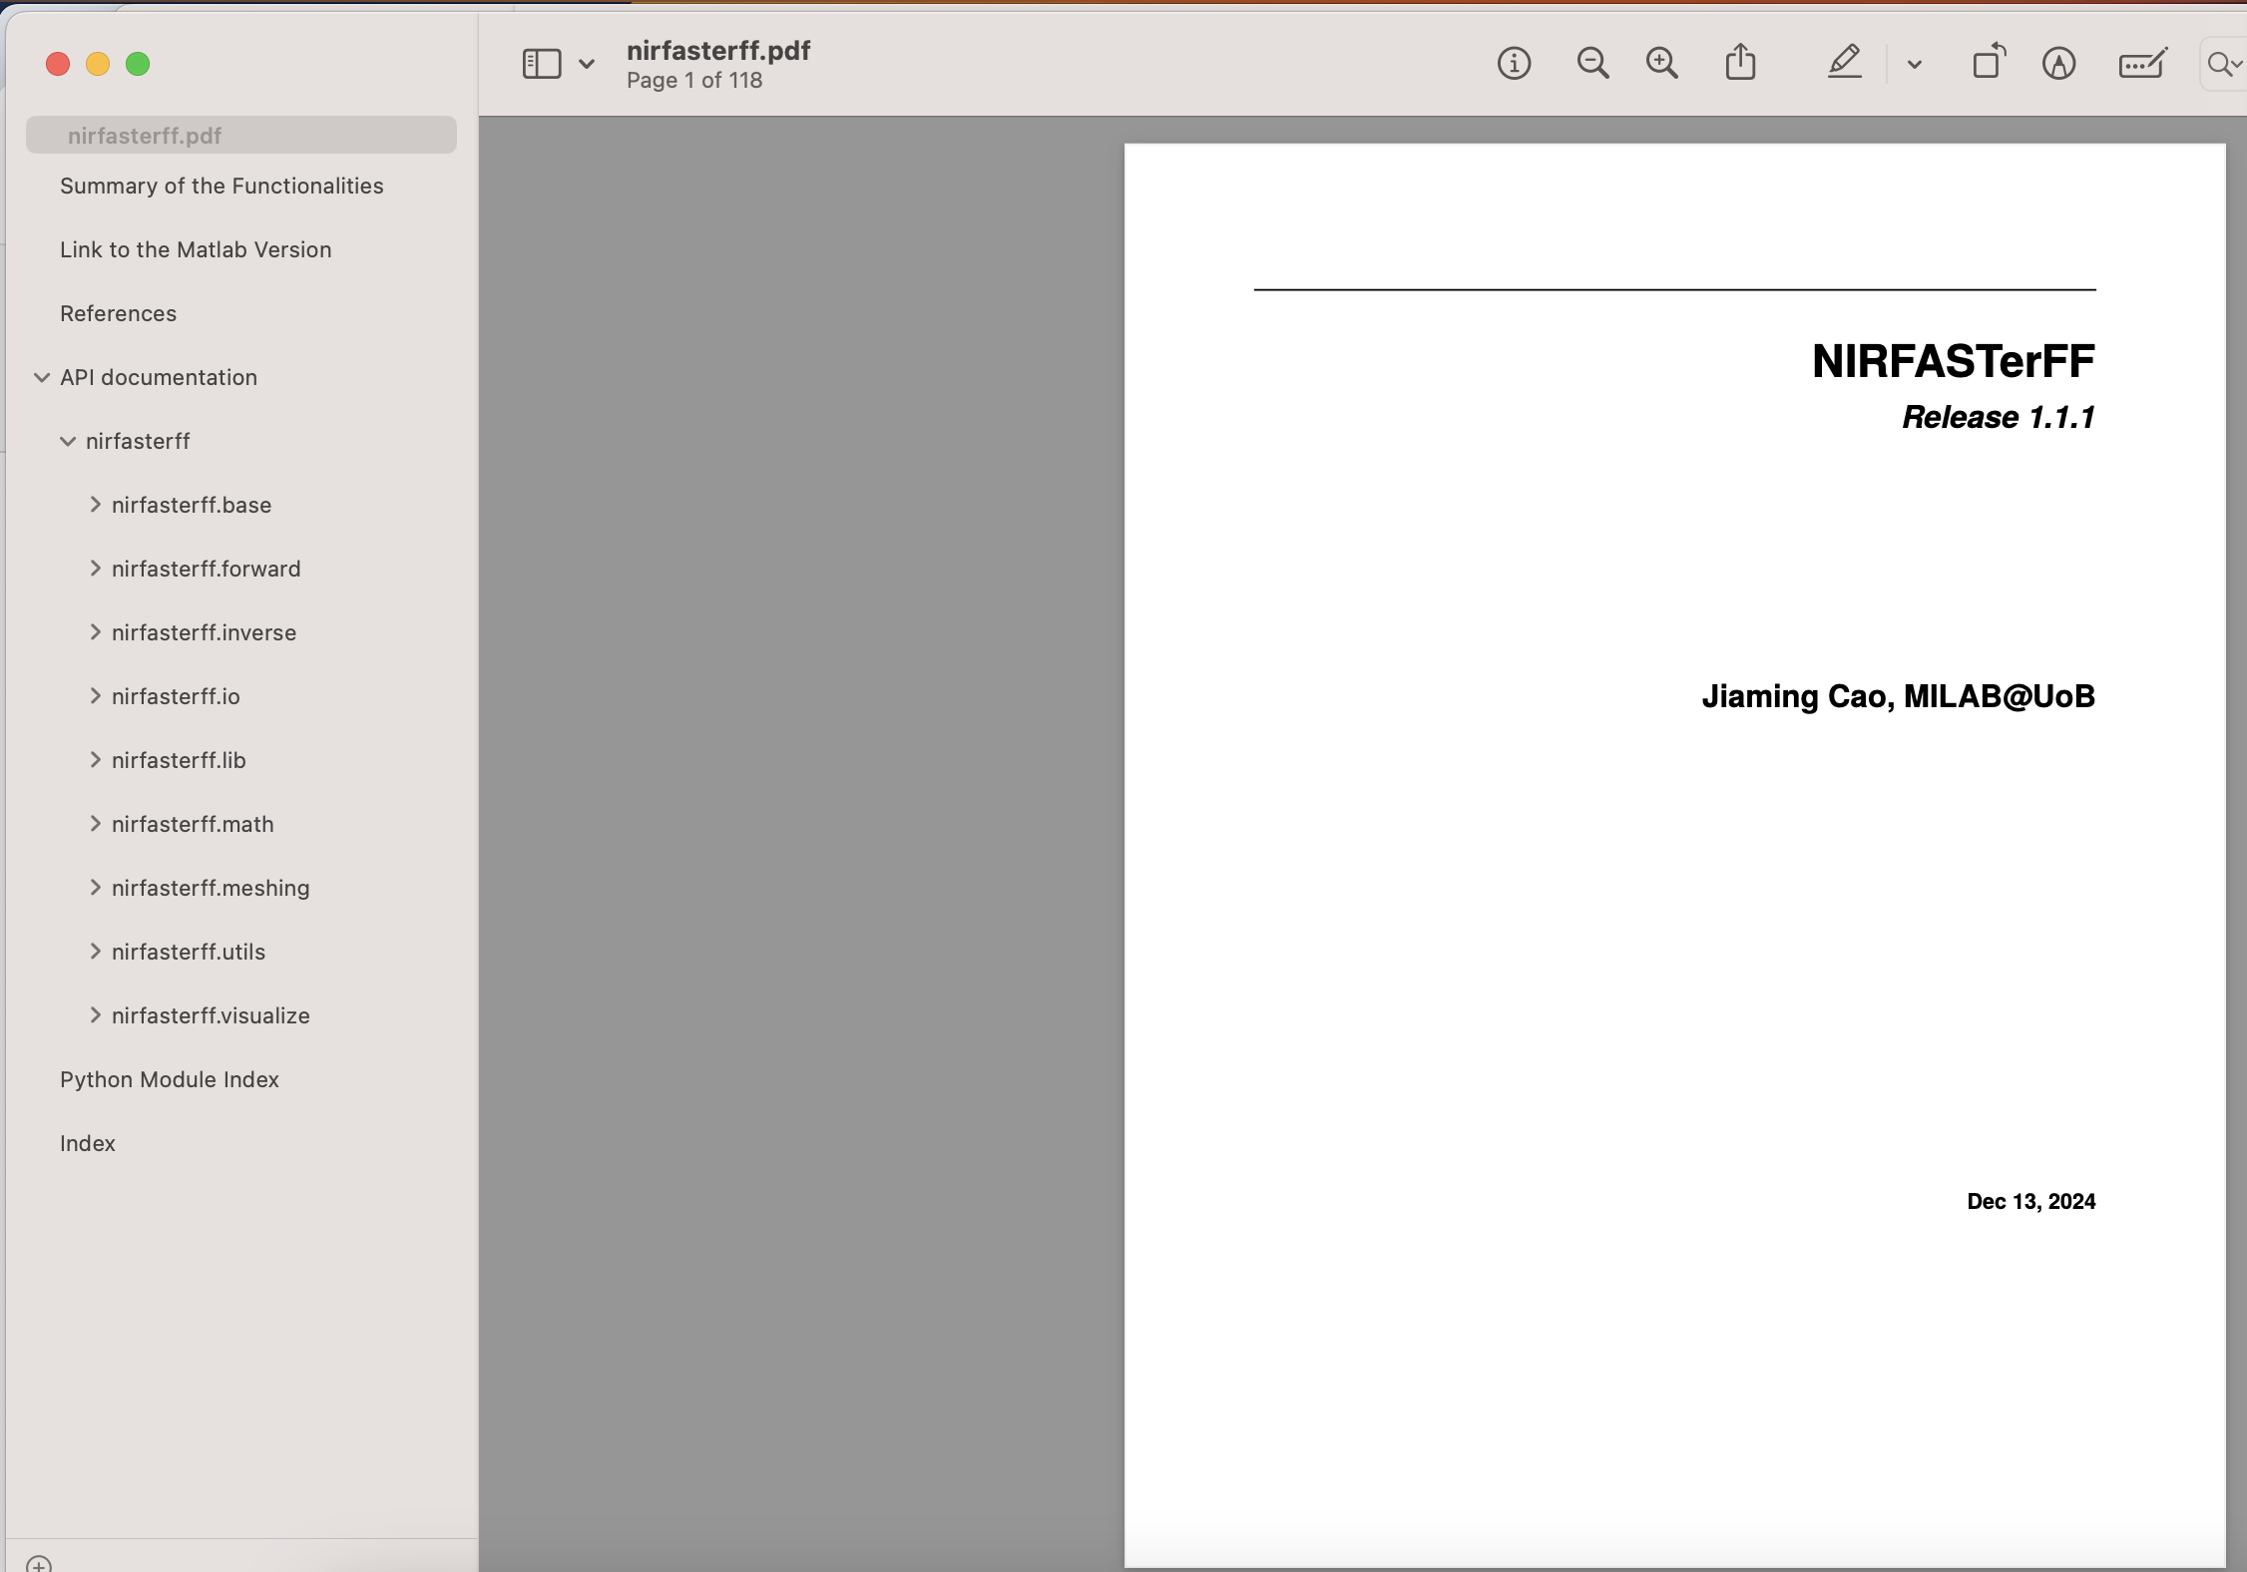
Extensive tutorials and API documentation
HTML
pdf

Slide 8
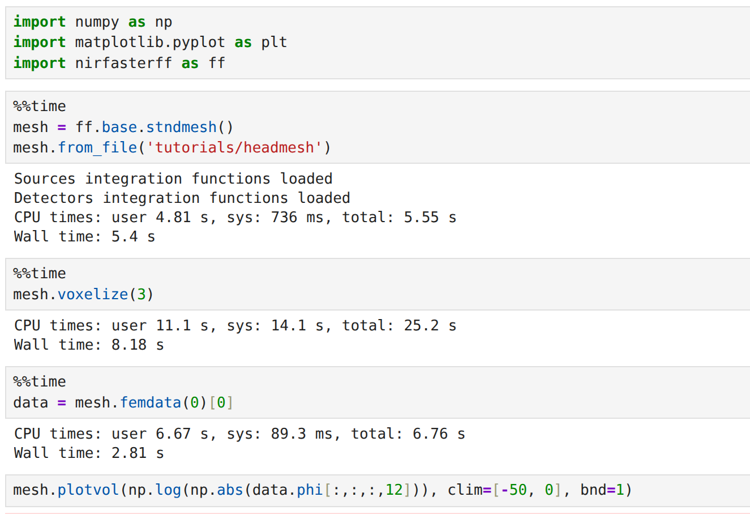
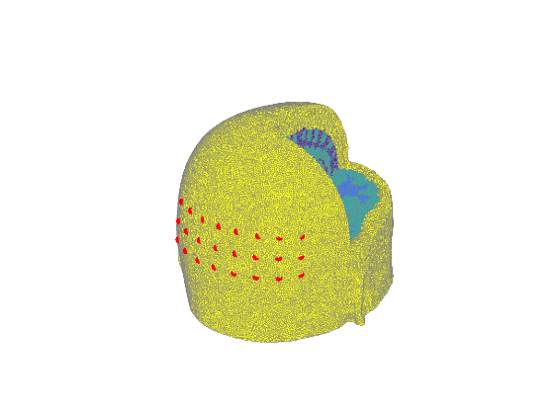
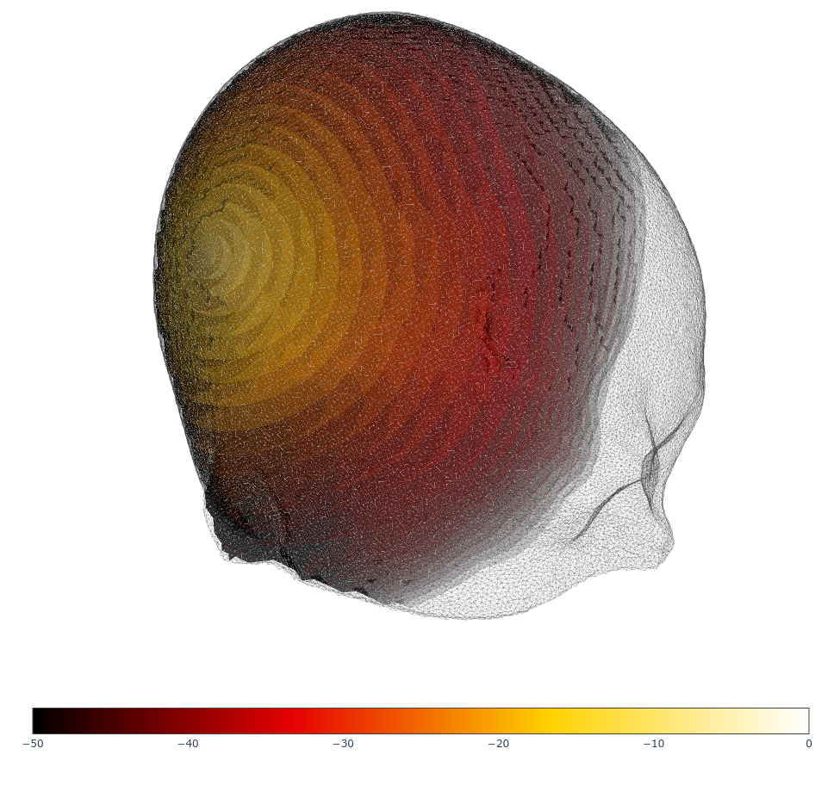
A “live” coding demo
Head mesh with ~688k nodes
24 sources
Desktop PC
  Intel Core i7-14700
  NVIDIA RTX 5060Ti GPU
Load mesh
CW fluence
Plot data
8

Slide 9
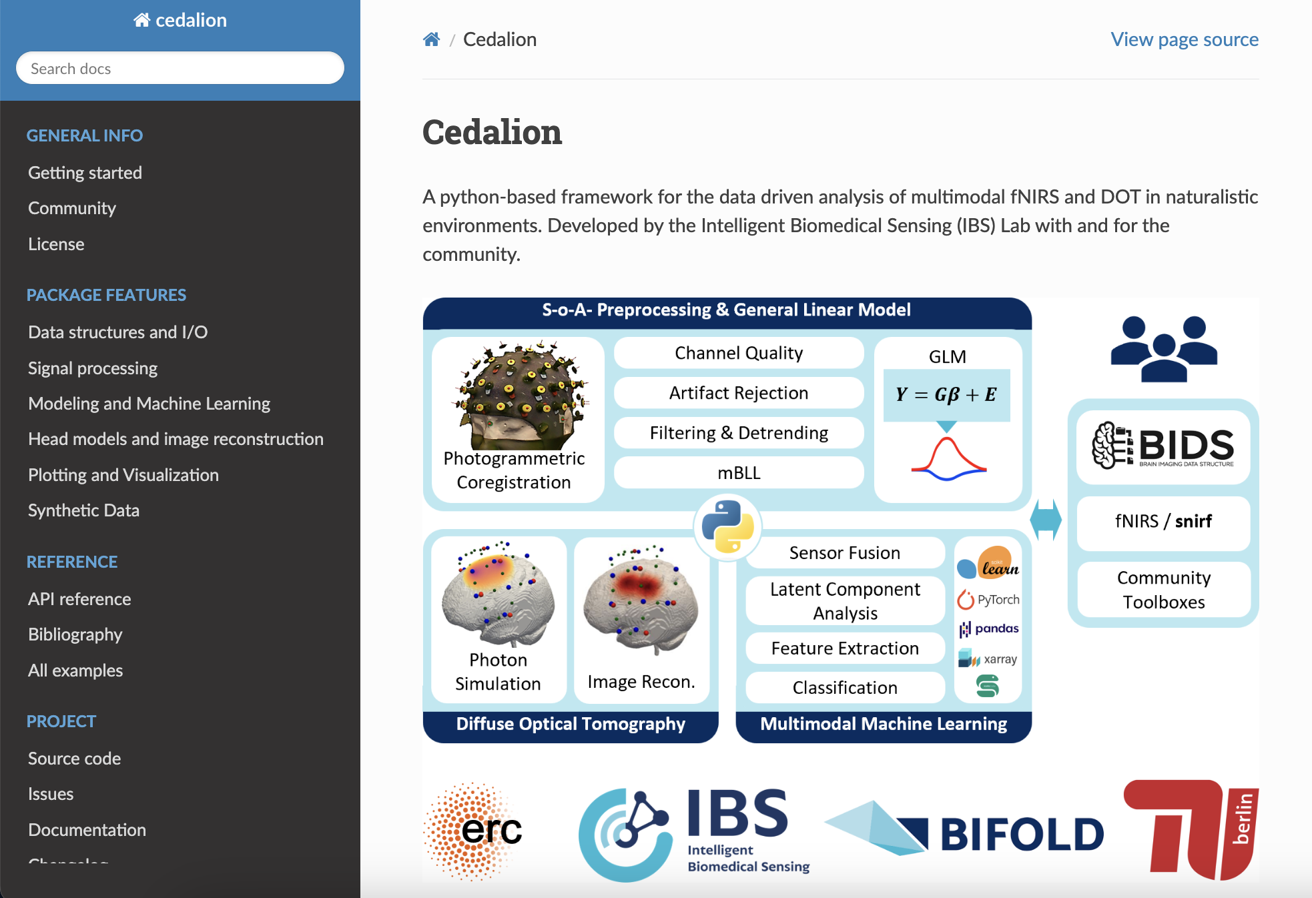
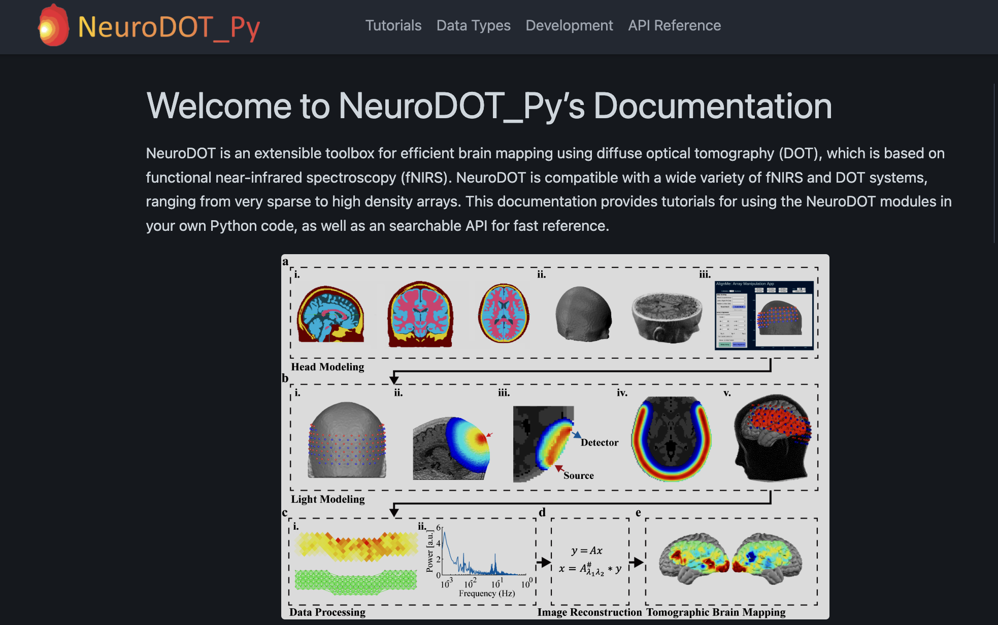
Computational engine for other DOT toolkits
Cedalion, TU Berlin
NeuroDOT_Py, WUSTL

