Slide 1
TensorFlow Scalability Test
Hui Xie
September 26th, 2017

Slide 2
Deep Learning Model
A full connect Deep Learning network to train and predict brain MRI 3D volume image for pixel-wise segmentation;
Layer structure: 54-240-200-160-120-80-40-26
Input layer: 54 nodes with normalized MRI Brain gray pixel value;
Output layer: 26 categories of brain matters, using softmax_cross_entropy;
Number of train examples: 6,309,580 pixels;
Number of test examples: 1,577,396 pixels;
Development Language and Framework: Python With TensorFlow.
Resulted predicting accuracy: 92.8%

Slide 3
Test Environment in Argon HPC
Linux-64 Red Hat 4.8.2-15
Intel Python 3.6.2;
Intel compiled Tensorflow 1.2.1
URL: https://conda.anaconda.org/intel/linux-64/tensorflow-1.2.1-np113py36_1.tar.bz2
This Conda Tensorflow library wasn’t compiled to use below instructions:
SSE4.1 and SSE4.2: Streaming SIMD Extensions 4 is a SIMD CPU instruction set used in the Intel Core microarchitecture and AMD K10 (K8L);
AVX and AVX2: Advanced Vector Extensions are extensions to the x86 instruction set architecture for microprocessors from Intel and AMD
FMA: FMA instruction set is an extension to the 128 and 256-bit Streaming SIMD Extensions instructions in the x86 microprocessor instruction set to perform fused multiply–add (FMA) operations.
Intel mkl 2018.0.0: Intel Math Kernel Library (Intel MKL) is a library of optimized math routines;
Intel mkl-dnn 0.7: Intel MKL-DNN is intended for accelerating deep learning frameworks on IA. It includes highly vectorized and threaded building blocks for implementing convolutional neural networks with C and C++ interfaces;
Intel Numpy 1.13.1;
Intel Xeon E5-2680 v4: 56 CPU(s), 3GHz, 263GB memory;
Run command:
~/intel/intelpython3/bin/python3 ~/Projects/3DSegTensorFlow/MultiCoreTest.py ~/temp/T1T2LabelCubicNormalize.csv 20 240,200,160,120,80,40,26 0.002

Slide 4
Test Environment in Local Server Putamen with Intel Compiled Tensorflow
maxOS Sierra 10.12.6
Intel Python 3.6.2;
Intel compiled Tensorflow 1.1.1
URL: https://repo.continuum.io/pkgs/free/osx-64/tensorflow-1.1.0-np112py36_0.tar.bz2
This Conda Tensorflow library wasn’t compiled to use below instructions:
SSE4.1 and SSE4.2: Streaming SIMD Extensions 4 is a SIMD CPU instruction set used in the Intel Core microarchitecture and AMD K10 (K8L);
AVX and AVX2: Advanced Vector Extensions are extensions to the x86 instruction set architecture for microprocessors from Intel and AMD
Intel mkl 2017.0.3: Intel Math Kernel Library (Intel MKL) is a library of optimized math routines;
Intel Numpy 1.12.1:
Intel 8-core Xeon E5: 16 CPU(s), 3GHz, 32GB memory;
Run command:
~/miniconda3/bin/python3.6 ~/Projects/3DSegTensorFlow/MultiCoreTest.py ~/temp/T1T2LabelCubicNormalize.csv 20 240,200,160,120,80,40,26 0.002

Slide 5
Test Environment in Local Server Putamen with Manually Compiled Tensorflow
maxOS Sierra 10.12.6
Standard Python 3.6.2;
Manually compiled Tensorflow master branch in Github
URL: https://github.com/tensorflow/tensorflow (August 3th,2017 version)
Bazel compile:
bazel build --config=opt //tensorflow/tools/pip_package:build_pip_package
This manually compiled Tensorflow library uses SSE, AVX, FMA instruction set, without using Intel MKL.
Intel Numpy 1.8.0.rc1;
Intel 8-core Xeon E5: 16 CPU(s), 3GHz, 32GB memory;
Run command:
python3 ~/Projects/3DSegTensorFlow/MultiCoreTest.py ~/temp/T1T2LabelCubicNormalize.csv 20 240,200,160,120,80,40,26 0.002

Slide 6
Experimental Result in Sep 21, 2017
 | Time(s) | Time(s) | Time(s)
nCores | HPC Intel Tensorflow | Putamen Intel Tensorflow | Putamen Compiled Tensorflow
12 | 204128
16 | 202053 | 3697 | 3159
20 | 203489
24 | 203155
28 | 202540
32 | 205009
36 | 89727
40 | 85081
44 | 83370
48 | 83831
52 | 83596
56 | 84395
Notes: in HPC, when qsub for 1,4, 8 cores, the programs are automatically terminated as number of cores are not enough for run the program;
Analysis:
The possible reasons why it is so slow in HPC are not very clear; maybe we need further experiments.
Intel Tensorflow was not compiled with latest CPU instruction sets;
Referring the comparison experiment in Putamen, the local compiled Tensorflow without MKL is quicker a little than Intel Tensorflow without using latest CPU instructions sets;
The program does not limit the number of cores. In the running program, the program indeed uses the number of cores we required, through top command checking.

Slide 7
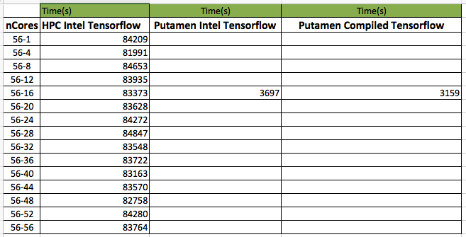
Experimental Result in Sep 30, 2017
Command:
~/intel/intelpython3/bin/python3 ~/Projects/3DSegTensorFlow/MultiCoreTest.py ~/temp/T1T2LabelCubicNormalize.csv 20 240,200,160,120,80,40,26 0.002
Notes:
1 all require 56 cores, which means lonely occupy a physical node;
2 56-x in the above table, x is just a index for output file, and no code configuration for x;

Slide 8
Thank you

