Slide 1
TensorFlow Scalability Research
Hui Xie
Oct 05th, 2017

Slide 2
Deep Learning Model
A full connect Deep Learning network to train and predict brain MRI 3D volume image for pixel-wise segmentation;
Layer structure: 54-240-200-160-120-80-40-26
Input layer: 54 nodes with normalized MRI Brain gray pixel value, in which 3*3*3 T1 cubic image and 3*3*3 T2 cubic image in same physical coordinates;
Ground Truth: 26 categories label file with same physical coordinates with T1 image;
Output layer: 26 categories of brain matters, using softmax_cross_entropy;
Number of train examples: 6,309,580 pixels;
Number of test examples: 1,577,396 pixels;
Development Language and Framework: Python With TensorFlow.
Resulted predicting accuracy: 92.8%

Slide 3
Test Environment in Argon HPC -1
Linux-64 Red Hat 4.8.2-15
Intel Python 3.6.2;
Intel compiled Tensorflow 1.2.1
URL: https://conda.anaconda.org/intel/linux-64/tensorflow-1.2.1-np113py36_1.tar.bz2
This Conda Tensorflow library wasn’t compiled to use below instructions:
SSE4.1 and SSE4.2: Streaming SIMD Extensions 4 is a SIMD CPU instruction set used in the Intel Core microarchitecture and AMD K10 (K8L);
AVX and AVX2: Advanced Vector Extensions are extensions to the x86 instruction set architecture for microprocessors from Intel and AMD
FMA: FMA instruction set is an extension to the 128 and 256-bit Streaming SIMD Extensions instructions in the x86 microprocessor instruction set to perform fused multiply–add (FMA) operations.
Intel mkl 2018.0.0: Intel Math Kernel Library (Intel MKL) is a library of optimized math routines;
Intel mkl-dnn 0.7: Intel MKL-DNN is intended for accelerating deep learning frameworks on IA. It includes highly vectorized and threaded building blocks for implementing convolutional neural networks with C and C++ interfaces;
Intel Numpy 1.13.1;
Intel Xeon E5-2680 v4: 56 CPU(s), 3GHz, 263GB memory;
Run command line:
~/intel/intelpython3/bin/python3 ~/Projects/3DSegTensorFlow/MultiCoreTest.py ~/temp/T1T2LabelCubicNormalize.csv 20 240,200,160,120,80,40,26 0.002

Slide 4
Test Environment in Argon HPC -2
Linux-64 Red Hat 4.8.2-15
Intel Python 3.6.2;
Manually compiled Tensorflow master branch in Github
URL: https://github.com/tensorflow/tensorflow (Oct 3th,2017 version)
Bazel compile:
bazel build --config=mkl --copt="-DEIGEN_USE_VML" -c opt //tensorflow/tools/pip_package:build_pip_package
This manually compiled Tensorflow library doesn’t uses SSE, AVX, FMA instruction set, with using Intel MKL.
Intel mkl 2018.0.0: Intel Math Kernel Library (Intel MKL) is a library of optimized math routines;
Intel mkl-dnn 0.7: Intel MKL-DNN is intended for accelerating deep learning frameworks on IA. It includes highly vectorized and threaded building blocks for implementing convolutional neural networks with C and C++ interfaces;
Intel Numpy 1.13.1;
Intel Xeon E5-2680 v4: 56 CPU(s), 3GHz, 263GB memory;
Run command line:
~/intel/intelpython3/bin/python3 ~/Projects/3DSegTensorFlow/MultiCoreTest.py ~/temp/T1T2LabelCubicNormalize.csv 20 240,200,160,120,80,40,26 0.002

Slide 5
Test Environment in Local Server Putamen with Intel Compiled Tensorflow
maxOS Sierra 10.12.6
Intel Python 3.6.2;
Intel compiled Tensorflow 1.1.1
URL: https://repo.continuum.io/pkgs/free/osx-64/tensorflow-1.1.0-np112py36_0.tar.bz2
This Conda Tensorflow library wasn’t compiled to use below instructions:
SSE4.1 and SSE4.2: Streaming SIMD Extensions 4 is a SIMD CPU instruction set used in the Intel Core microarchitecture and AMD K10 (K8L);
AVX and AVX2: Advanced Vector Extensions are extensions to the x86 instruction set architecture for microprocessors from Intel and AMD
Intel mkl 2017.0.3: Intel Math Kernel Library (Intel MKL) is a library of optimized math routines;
Intel Numpy 1.12.1:
Intel 8-core Xeon E5: 16 CPU(s), 3GHz, 32GB memory;
Run command:
~/miniconda3/bin/python3.6 ~/Projects/3DSegTensorFlow/MultiCoreTest.py ~/temp/T1T2LabelCubicNormalize.csv 20 240,200,160,120,80,40,26 0.002

Slide 6
Test Environment in Local Server Putamen with Manually Compiled Tensorflow
maxOS Sierra 10.12.6
Standard Python 3.6.2;
Manually compiled Tensorflow master branch in Github
URL: https://github.com/tensorflow/tensorflow (August 3th,2017 version)
Bazel compile:
bazel build --config=opt //tensorflow/tools/pip_package:build_pip_package
This manually compiled Tensorflow library uses SSE, AVX, FMA instruction set, without using Intel MKL.
Intel Numpy 1.8.0.rc1;
Intel 8-core Xeon E5: 16 CPU(s), 3GHz, 32GB memory;
Run command:
python3 ~/Projects/3DSegTensorFlow/MultiCoreTest.py ~/temp/T1T2LabelCubicNormalize.csv 20 240,200,160,120,80,40,26 0.002

Slide 7
Experimental Result in Sep 21, 2017
 | Time(s) | Time(s) | Time(s)
nCores | HPC Intel Tensorflow | Putamen Intel Tensorflow | Putamen Compiled Tensorflow
12 | 204128
16 | 202053 | 3697 | 3159
20 | 203489
24 | 203155
28 | 202540
32 | 205009
36 | 89727
40 | 85081
44 | 83370
48 | 83831
52 | 83596
56 | 84395
Notes: in HPC, when qsub for 1,4, 8 cores, the programs are automatically terminated as number of cores are not enough for run the program;
Analysis:
The possible reasons why it is so slow in HPC are not very clear; maybe we need further experiments.
Intel Tensorflow was not compiled with latest CPU instruction sets;
Referring the comparison experiment in Putamen, the local compiled Tensorflow without MKL is quicker a little than Intel Tensorflow without using latest CPU instructions sets;
The program does not limit the number of cores. In the running program, the program indeed uses the number of cores we required, through top command checking.

Slide 8
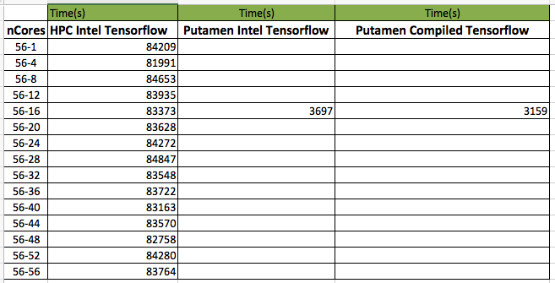
Experimental Result in Sep 30, 2017
Command:
~/intel/intelpython3/bin/python3 ~/Projects/3DSegTensorFlow/MultiCoreTest.py ~/temp/T1T2LabelCubicNormalize.csv 20 240,200,160,120,80,40,26 0.002
Notes:
1 all require 56 cores, which means lonely occupy a physical node;
2 56-x in the above table, x is just a index for output file, and no code configuration for x;

Slide 9
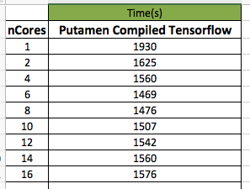
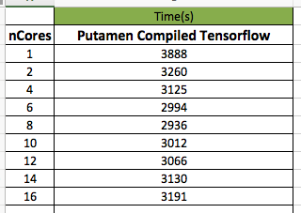
Test in Putamen with local compiled Tensorflow
python3 ~/Projects/3DSegTensorFlow/MultiCoreTest.py ~/temp/T1T2LabelCubicNormalize.csv 10 240,200,160,120,80,40,26 0.002
Test date: Oct 3th,2017
python3 ~/Projects/3DSegTensorFlow/MultiCoreTest.py ~/temp/T1T2LabelCubicNormalize.csv 20 240,200,160,120,80,40,26 0.002
Test date: Oct 5th, 2017

Slide 10
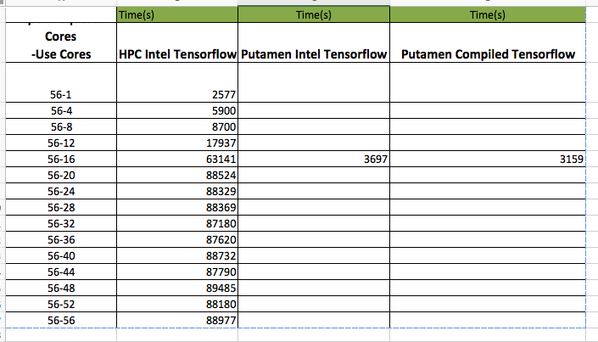
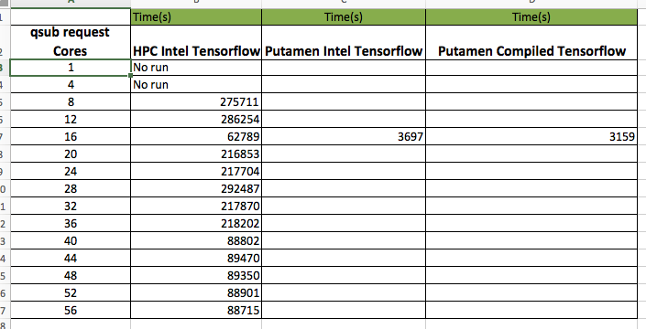
Test in HPC with Manually compiled Tensorflow
This test all required 56 cores resource, but the program code configed how many threads to use;
Single thread has the maximum speed;
Test date: Oct 04th, 2017
This test required specific cores resource, according to program code config;
Test date: Oct 05th, 2017

Slide 11
Tensorflow Optimization on CPU
The important basis: "CPUs, which includes Intel® Xeon Phi™, achieve optimal performance when TensorFlow is built from source with all of the instructions supported by the target CPU.”
configuration options (intra_op_parallelism_threads, inter_op_parallelism_threads), if they are unset or set to 0, will default to the number of logical CPU cores; A common alternative optimization is to set the number of threads in both pools equal to the number of physical cores rather than logical cores.
Tuning MKL for the best performance, set KMP_BLOCKTIME and NCHW etc. parameters. but MKL was added as of TensorFlow 1.2 and currently only works on Linux.
Tensorflow optimization is specific-application-related: " For models like ResNet and InceptionV3, placing variables on the CPU is the optimal setting, but for models with a lot of variables like AlexNet and VGG, using GPUs withNCCL is better."

Slide 12
Thank you

