Slide 1
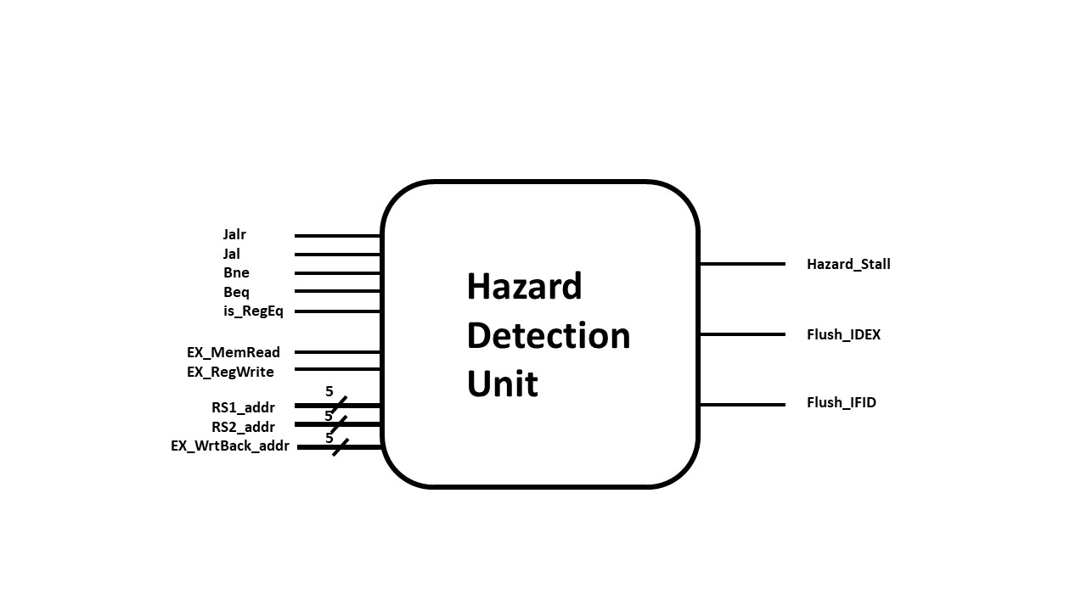
Hazard Detection Unit
Load-use hazard
Jalr hazard
Branch hazard
Flush IF/ID

Slide 2
Branch Prediction Unit
Most branch patterns are interleaving patterns in hasHazard.
Poor accuracy of 1-bit or 2-bit.
 | Always-not-taken | Always-taken | 1-bit predictor | 2-bit predictor
The accuracy rate (using hasHazard pattern) | 41.4% | 60% | 10% | 41%

Slide 3
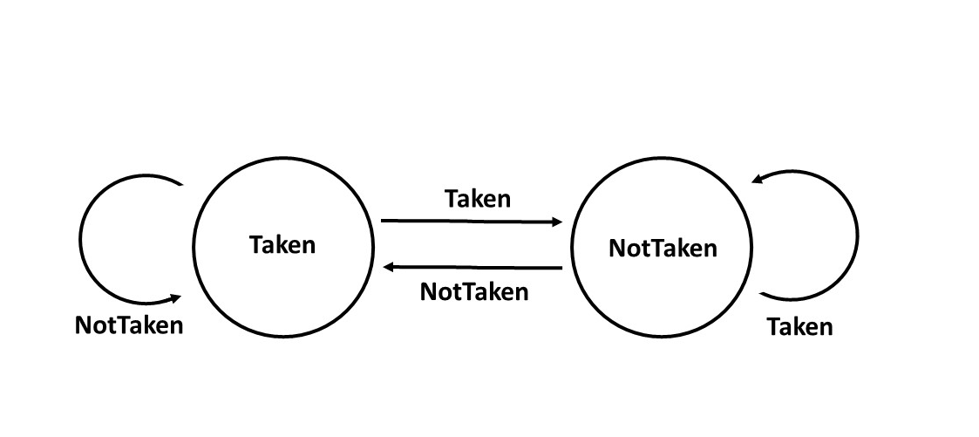
Another idea of BPU

Slide 4
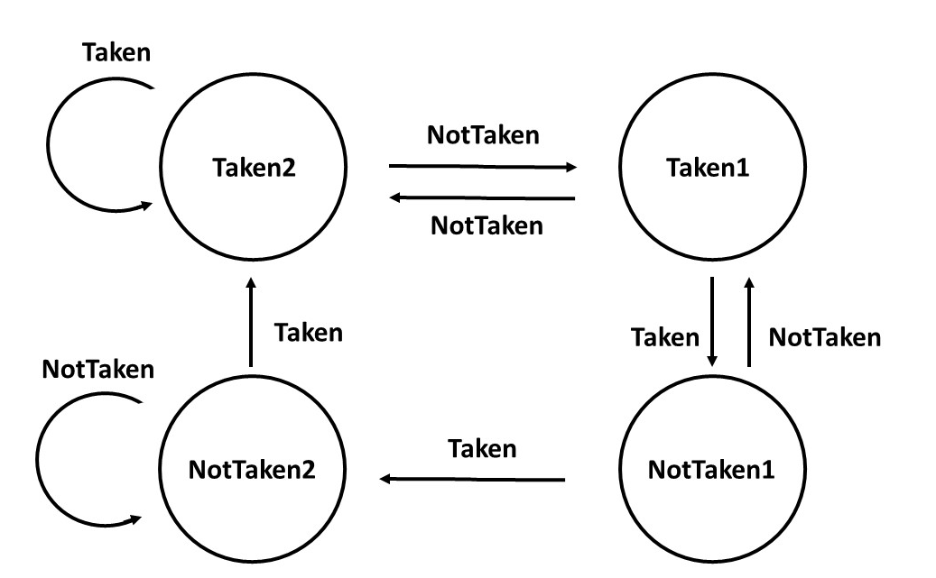
Another idea of BPU
For always-taken patterns
after interleaving patterns
For interleaving patterns

Slide 5
Analysis-hasHazard
 | Without BPU | Always-not-taken | Always-taken | 1-bit predictor | 2-bit predictor | Reverse 1-bit predictor | 2-bit predictor v2.0
The total execution time(ns) | 20595 | 20595 | 20485 | 21505 | 20645 | 19565 | 19475
 | Always-not-taken | Always-taken | 1-bit predictor | 2-bit predictor | Reverse 1-bit predictor | 2-bit predictor v2.0
The accuracy rate (using hasHazard pattern) | 41.4% | 60% | 10% | 41% | 83% | 87%

Slide 6
Analysis-BrPred
When the number of a (never) ↑, the number of c (always) ↓
2-bit v2.0 has bad performance because there are more never-branch patterns.
When the number of b (interleave) ↑
1-bit predictor and 2-bit predictor will perform poorly.
Reverse 1-bit and 2-bit v2.0 can maintain comparatively good performance.

Slide 7
Analysis-BrPred
 | The execution time(ns)
 | Always-not-taken | Always-taken | 1-bit predictor | 2-bit predictor | Reverse 1-bit predictor | 2-bit predictor v2.0
a = 5 b = 20 c = 35 | 3735 | 3445 | 3605 | 3635 | 3765 | 3445
a = 10 b = 20 c = 30 | 3785 | 3595 | 3705 | 3735 | 3865 | 3605
a = 25 b = 20 c = 15 | 3935 | 4045 | 4005 | 4035 | 4165 | 4045
a = 13 b = 8 c = 39 | 3455 | 3205 | 3165 | 3195 | 3565 | 3205
a = 5 b = 40 c = 15 | 4335 | 4245 | 4605 | 4635 | 4365 | 4245
a = 2 b = 52 c = 6 | 4665 | 4635 | 5145 | 4645 | 4665 | 4645

