Slide 1

哔哩哔哩_咻管家

Slide 2



MIEC_EE308 Software Engineering _ Course Project _ Develop applets based on open source software
Bilibili_xiu assistant
哔哩哔哩_咻管家
XIU, get the latest updates anytime，anywhere
咻一下，随时随地得到最新推送

Slide 3
Alpha Sprint
Langcent互联网股份有限公司
23/11/2021

Slide 4
Project Membership Division
Alpha Sprint
Team Leader: Lang Jian 831902224 PM & Front-end
Tech Leader: Xie Wei 831902110 Back-end
Developer: He Yuxiang 831902223 Back-end
Developer: Wu Diancong 831902124 Back-end & Report_writing
Tester: Wang Zekai 831902101 Tester & Front-end

Slide 5
Expected Plan
Finish login and register function!
Notes:
展示我们的功能

Slide 6
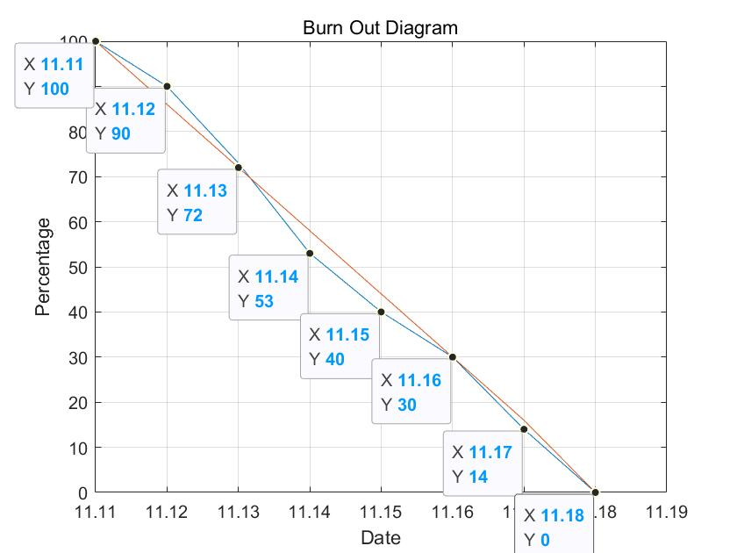
Burn Out Diagram
Notes:
展示我们的功能

Slide 7
Problems And Solution
Countless problems but now solved!
Notes:
展示我们的功能

Slide 8
Techniques
Front-end:
Uni-app framework(vue+wx-api+H5+Css3)
Back-end:
Flask framework Ali Cloud Server
Mysql
Notes:
展示我们的功能

Slide 9
Testing
Front-end:
Wechat Developer Tools, Google Browser
Back-end:
Postman, Edge Browser
Notes:
展示我们的功能

Slide 10
Process Experience
How to work as a team.
Notes:
展示我们的功能

Slide 11
Q&A
Notes:
展示我们的功能

Slide 12
MIEC_EE308 Software Engineering _ Course Project _ Develop applets based on open source software
Bilibili_xiu assistant
哔哩哔哩_咻管家
XIU, get the latest updates anytime，anywhere
咻一下，随时随地得到最新推送

