Slide 1

哔哩哔哩_咻管家

Slide 2



MIEC_EE308 Software Engineering _ Course Project _ Develop applets based on open source software
Bilibili_xiu assistant
哔哩哔哩_咻管家
XIU, get the latest updates anytime，anywhere
咻一下，随时随地得到最新推送

Slide 3
Our Team Members

Slide 4
Langcent
——Under the leadership of Mr. Lang, strive to become an NB team like Tencent
Team Leader: Lang Jian 831902224 PM & Front-end
Tech Leader: Xie Wei 831902110 Back-end
Developer: He Yuxiang 831902223 Back-end
Developer: Wu Diancong 831902124 Back-end & Report_writing
Tester: Wang Zekai 831902101 Tester & Front-end

Slide 5
Why are we making this little program?

Slide 6
Do you have a blogger you really like?
Do you have any live events that you really care about,
that you can't miss?
Do you have a passion to watching the newest vedios every day?
Do you use Bilibili a lot?
Notes:
你是否会经常使用哔哩哔哩？你有没有非常喜欢的博主，每一个作品都不会放过的那种。你有没有非常关注的赛事直播，绝对不能错过的那种。你有没有极其热爱的番剧，每天都会追更的那种。

Slide 7
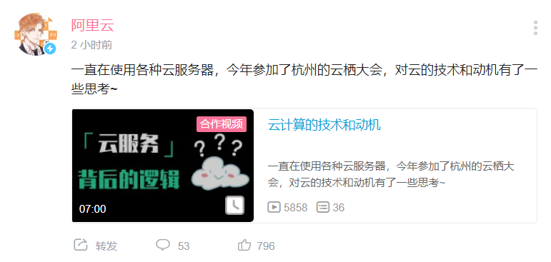

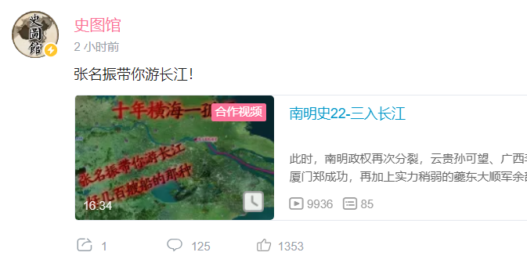
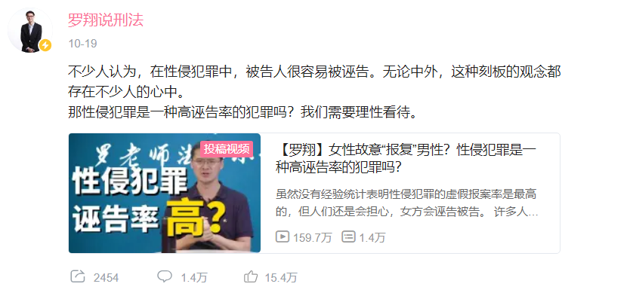
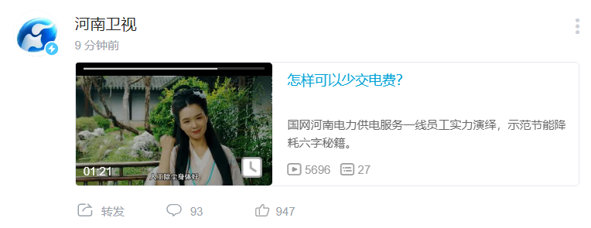
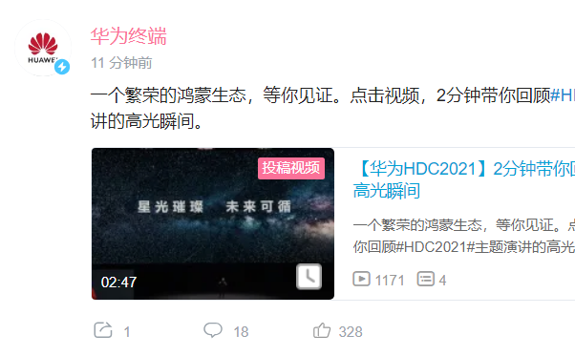
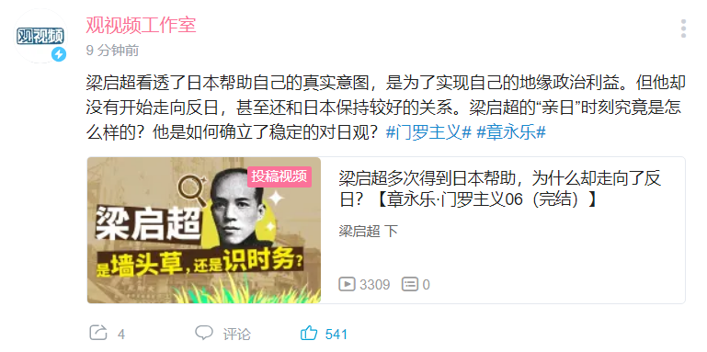
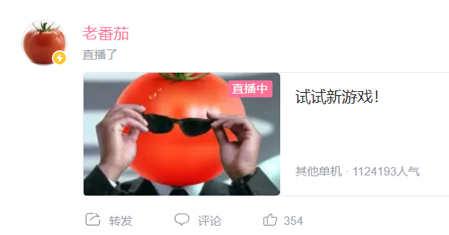

Slide 8

To too many bloggers
Too much news
Always cover the messages you want to see most

Slide 9
What does our little program do?

Slide 10
“Special concern of concern”

Slide 11
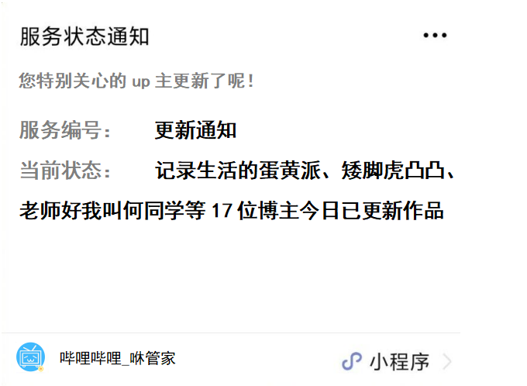
Personalized
push
"Special attention"
video update push
Reserve message content classification for possible functional iterations
Small program associated with the public number for message push
Our small program

Slide 12
Address the pain point
of native solutions
Notes:
解决原生方案的痛点，通过我们的小程序，你可以精准的得到你想特别关心的up主的视频推送、直播信息、番剧更新，帮助你不错过每一次的更新。从此妈妈再也不用担心我错过好看的视频啦

Slide 13
What is our innovation?

Slide 14
Accurate personalized push
“想用户之所想、急用户之所急、解用户之所困”

Slide 15
A LITTLE

Slide 16

__________
BUT VERY USEFUL

Slide 17
How do we do that?

Slide 18
Open source API library
&
Open source code
Notes:
Based on the open source API excuse library and code

Slide 19

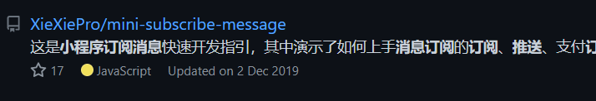
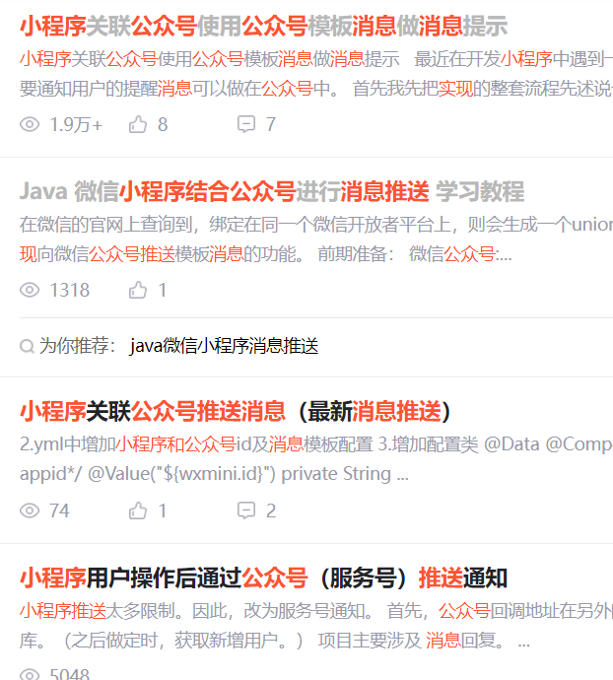
Leverage existing API libraries
&
source code from open source platforms
Message push function core source code
Bilibili API library

Slide 20
FUTURE

Slide 21
Incremental Model

Slide 22
More functions
More details

Slide 23
“What users want is where we are going”
—— Mission of Our Team

Slide 24
EXPECT THE STORY TO HAPPEN

