Slide 1
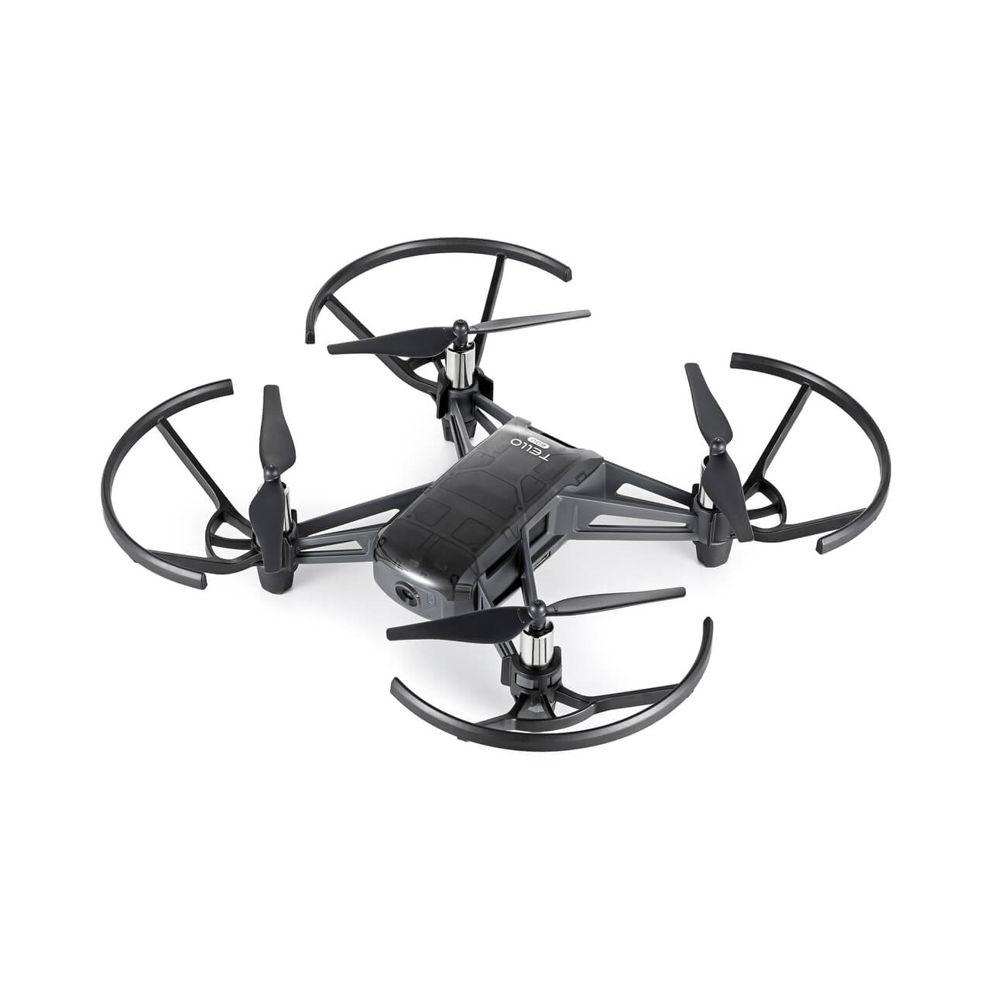
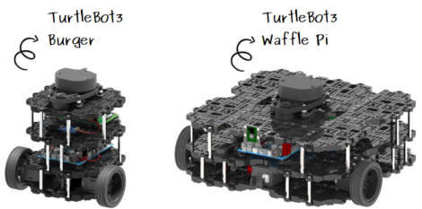
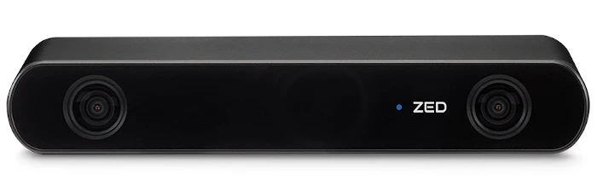
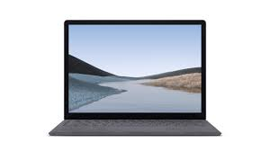
Robot
Drone
Stereo Camera
TF
/zed/zed_node/left/camera_info
/zed/zed_node/right/camera_info
/zed/zed_node/left/image_rect_color(bgra8)
/zed/zed_node/right/image_rect_color(bgra8)
/tb3/cmd_vel
navigation stage
uoa_robot_drone
mapping &
localization &
drone delivery
stages
/uoa/left/image_rect_color(bgr8)
/uoa/right/image_rect_color(bgr8)
Jetson Orin Nano
teleop_keyboard
rtabmap
mapping &
localization &
drone delivery
stages
/uoa/auto_delivery
/uoa/cs5917/left/image_rect_color/compressed
/uoa/cs5917/left/image_rect_color/compressed
navigation stage
navigation2
Personal Computer
/map
/localization_pose
/goal_pose
/vo/odom
/uoa/cs5917/left/image_rect_color
/uoa/cs5917/left/image_rect_color
rtabmap_viz
rviz2
database
map
image_data
/cloud_obstacles

Slide 2
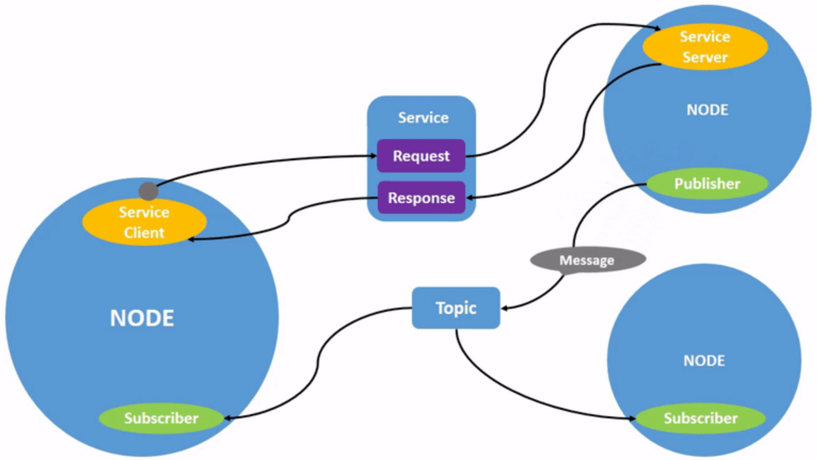

Slide 3
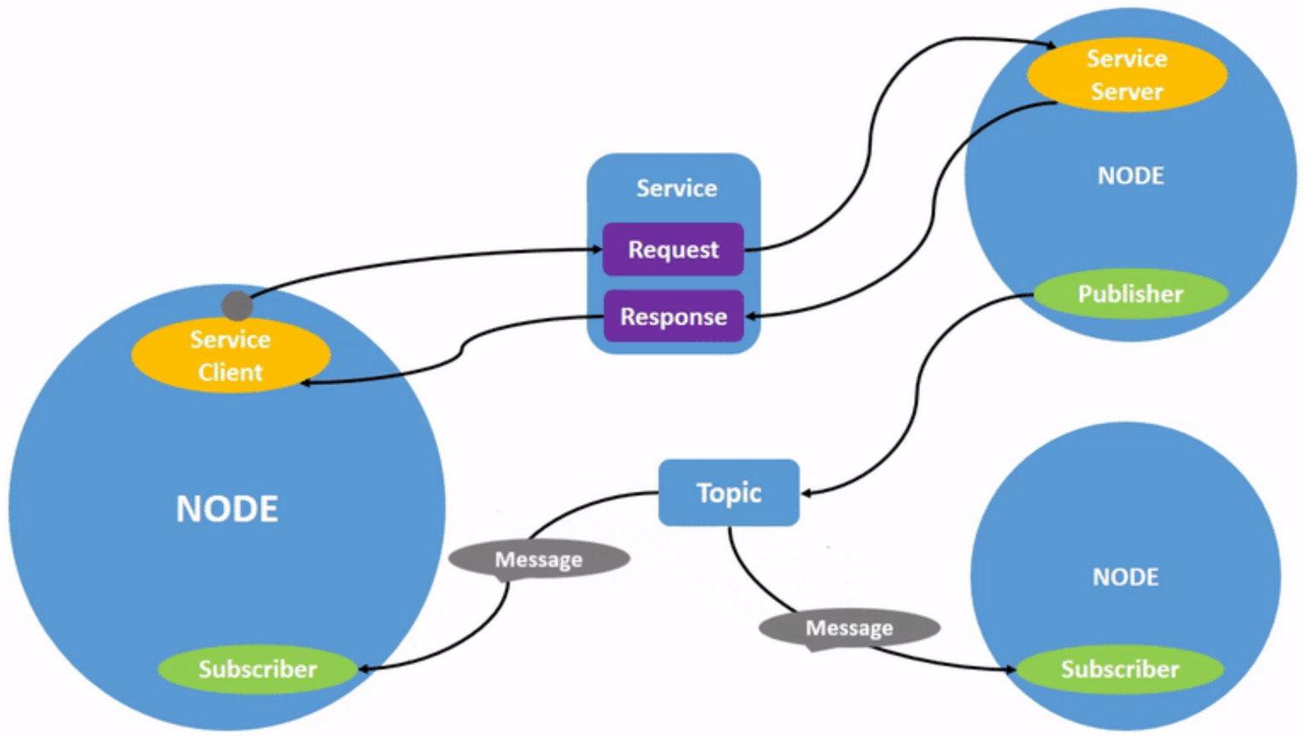

Slide 4
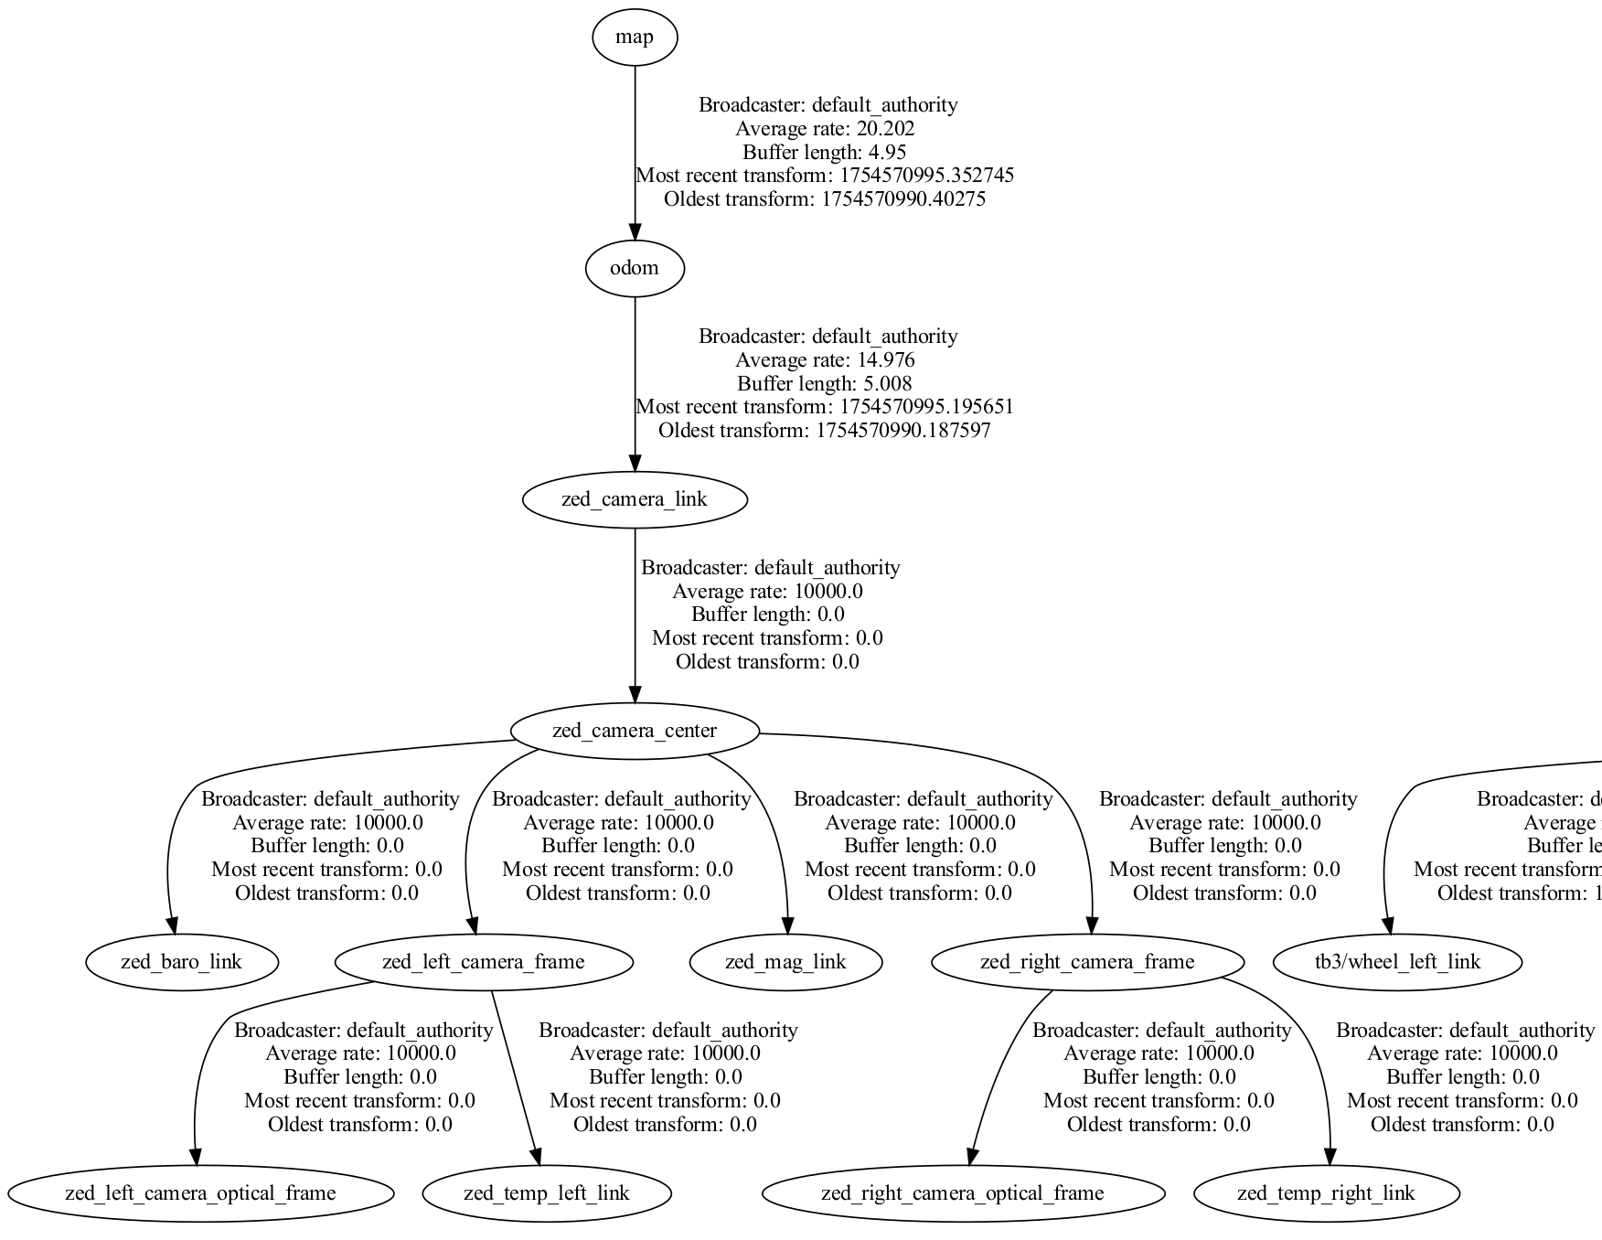

Slide 5
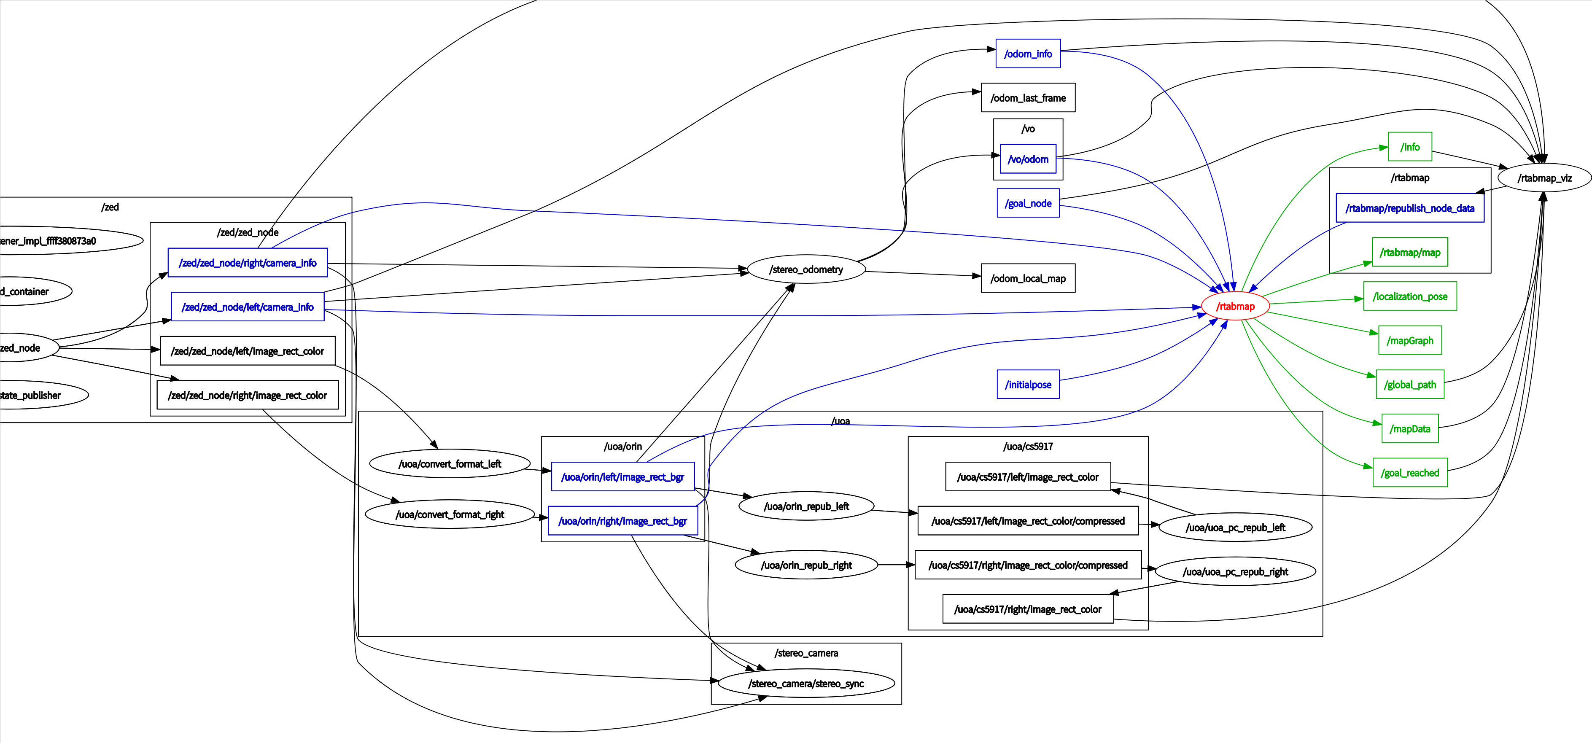

Slide 6
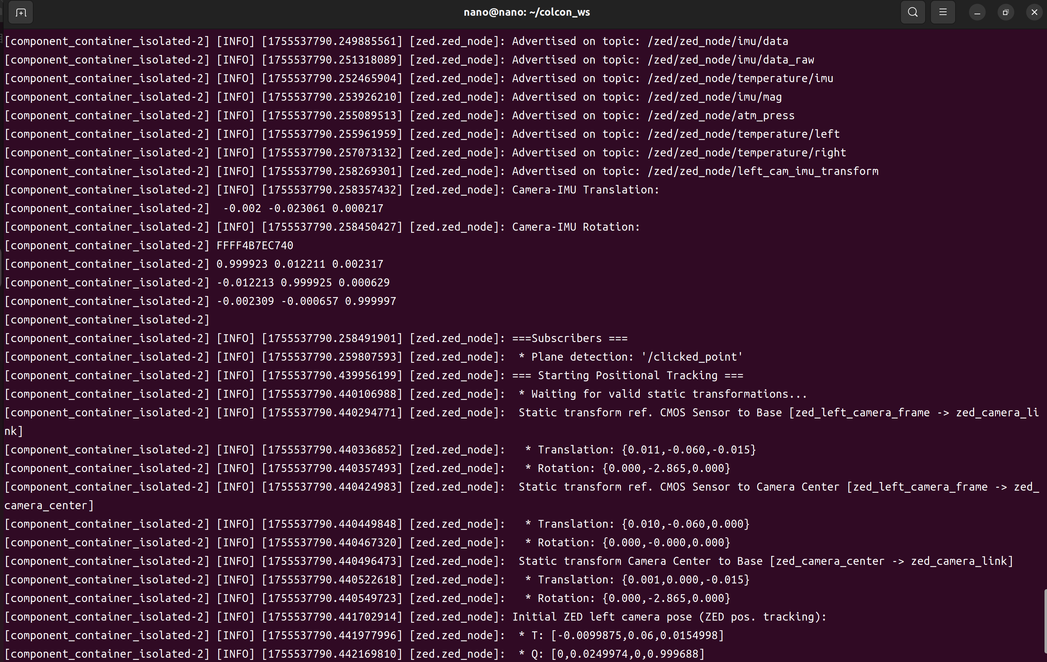

Slide 7
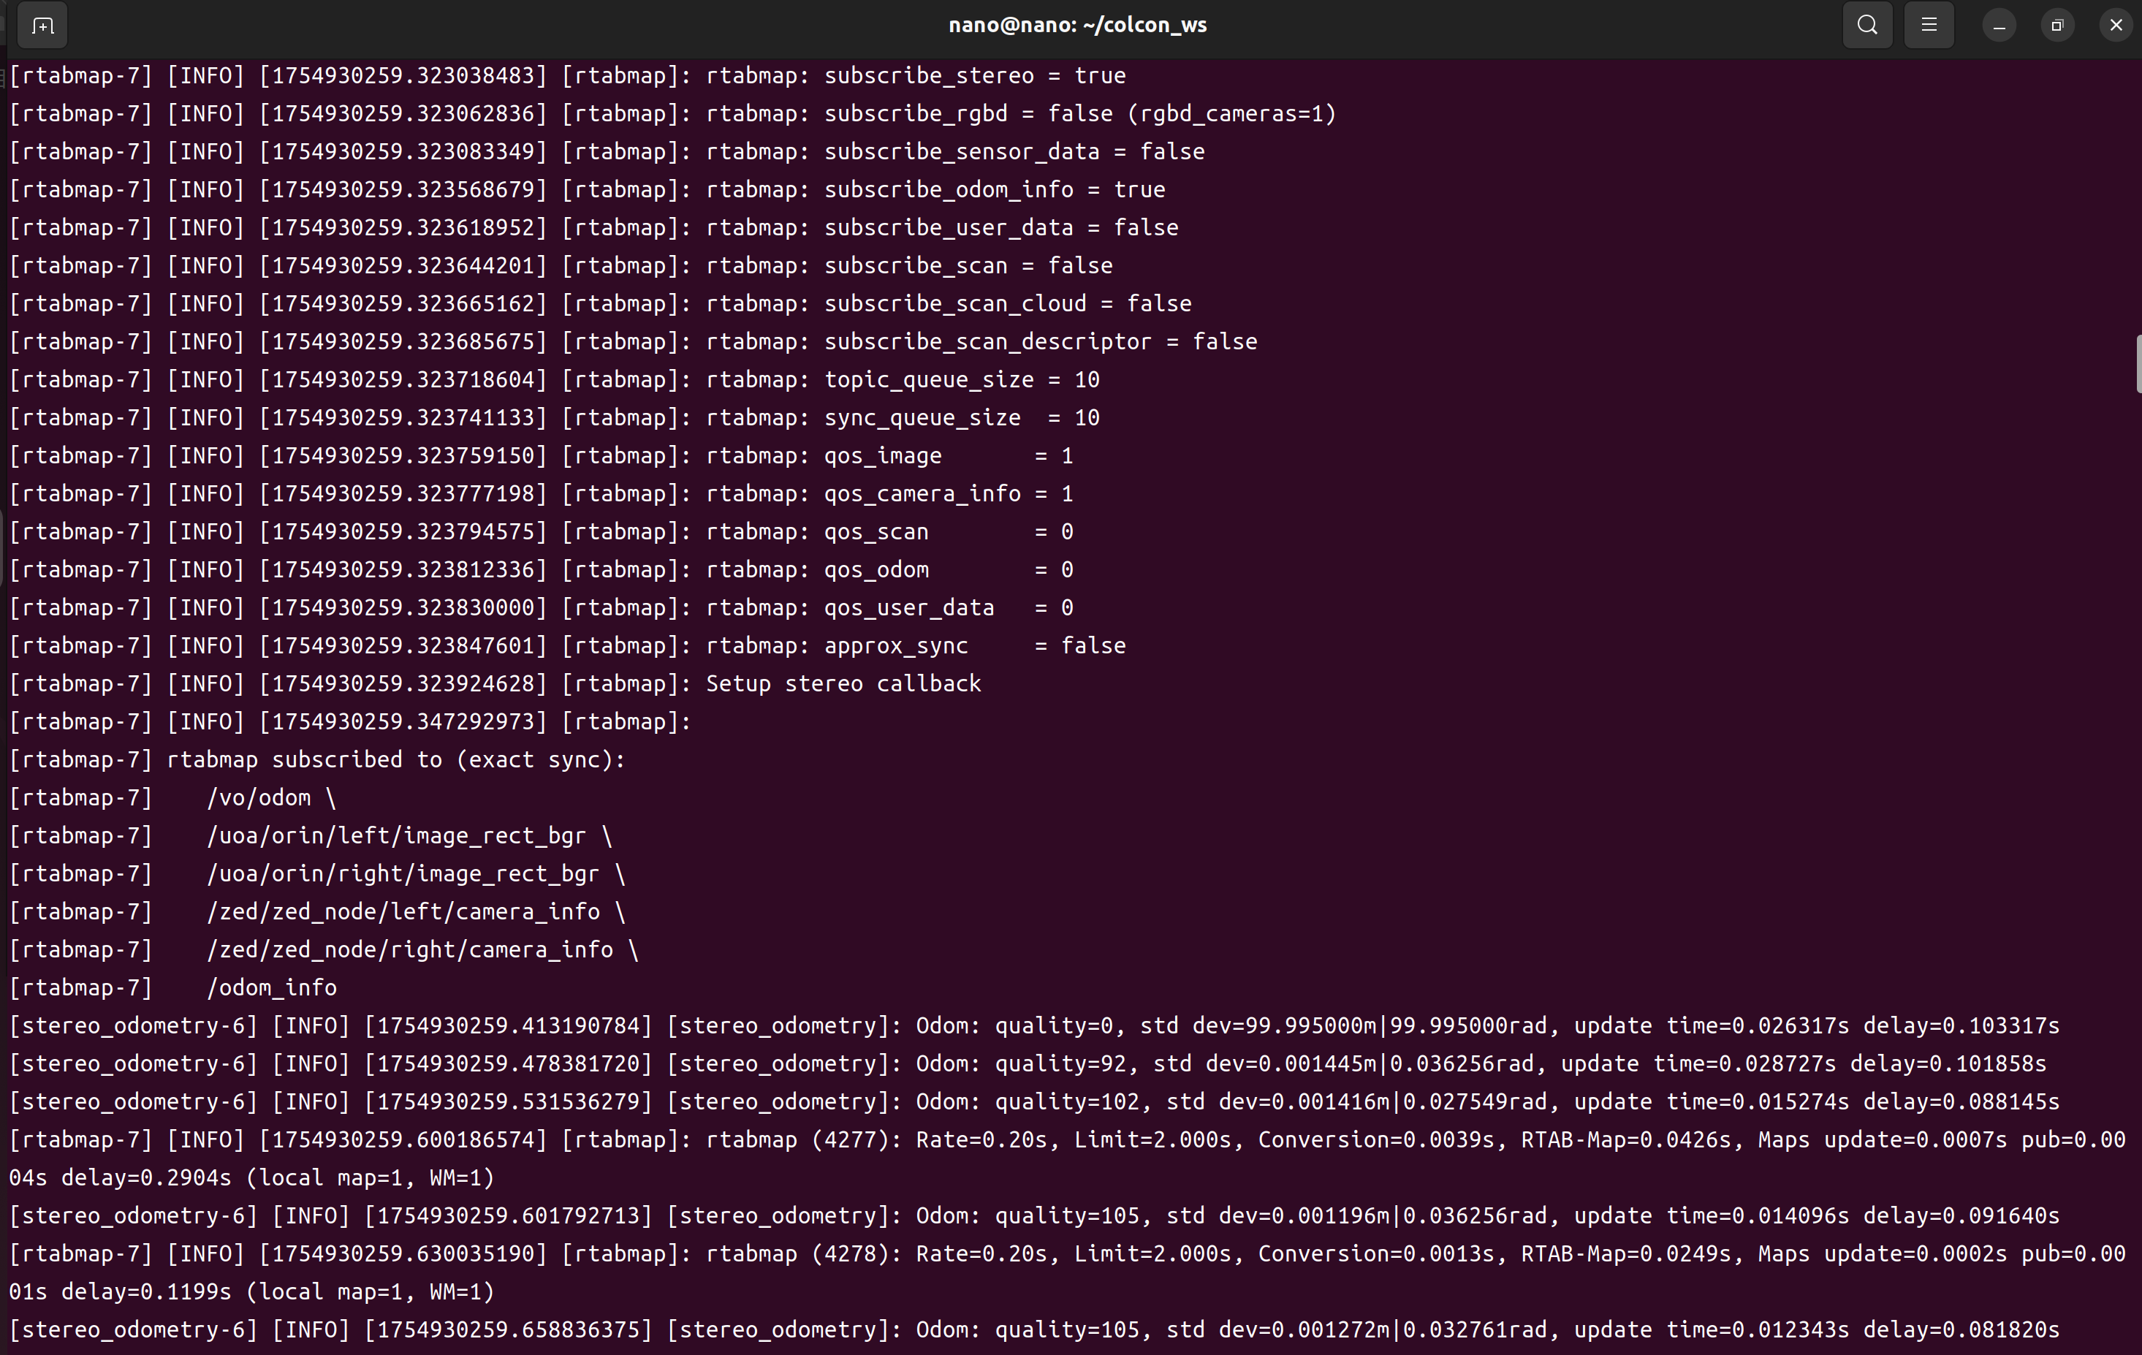

Slide 8
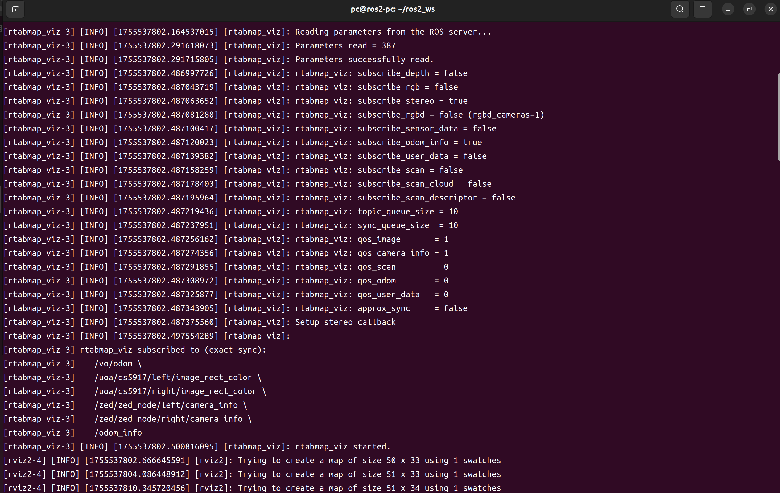

Slide 9
Engineering System Architecture
UoA Robot Drone
Raspberry Pi
Jetson Orin Nano
Personal Coumputer
Turtlebot3
RTAB-Map
uoa_robot_drone
Display Monitor
turtlebot3_bringup
Visual Odometry
Convertor
Rviz2
rtabmap_viz
turtlebot3-msgs
Visual SLAM
Compressor
uoa_robot_drone
ZED
Decompressor
Auto Delivery
Dynamixel SDK
zed-ros2-wrapper
Position Listener
Voice Control
python3-colcon
ZED SDK
DJITelloPy
coin_d4_driver
NVIDIA CUDA
Navigation2
teleop_keyboard
OpenCR
python3-colcon
python3-colcon
ROS2 Humble Hawksbill
ROS2 Humble Hawksbill
ROS2 Humble Hawksbill
Ubuntu Server (L4T)
22.04 LTS
Jet Pack Jetson Linux (L4T) 22.04 LTS
Ubuntu Desktop (L4T) 22.04 LTS
ROS Middleware (RMW) [topics] [services] [actions]

Slide 10
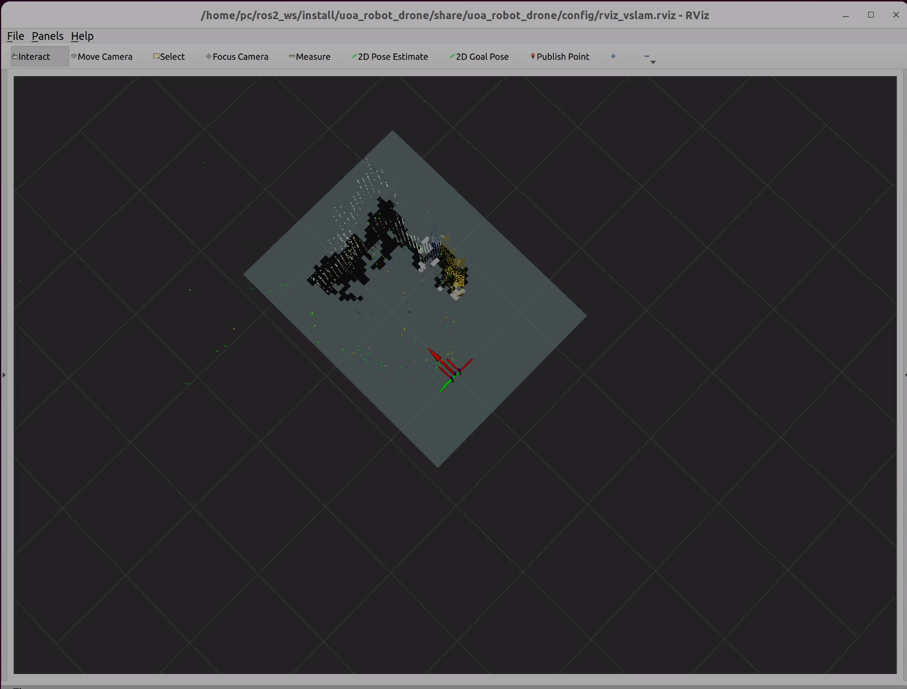
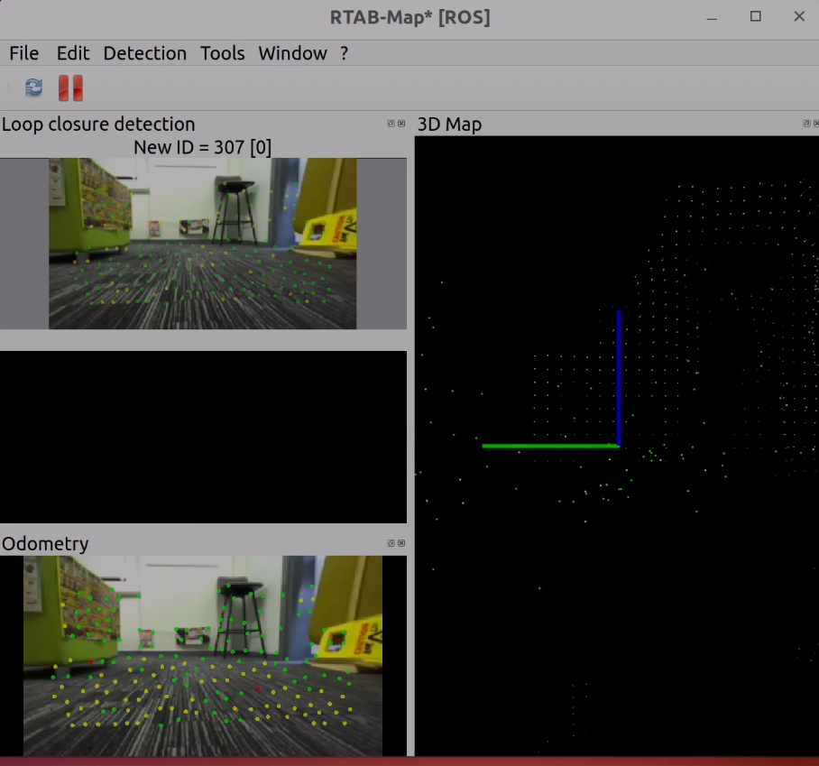

Slide 11
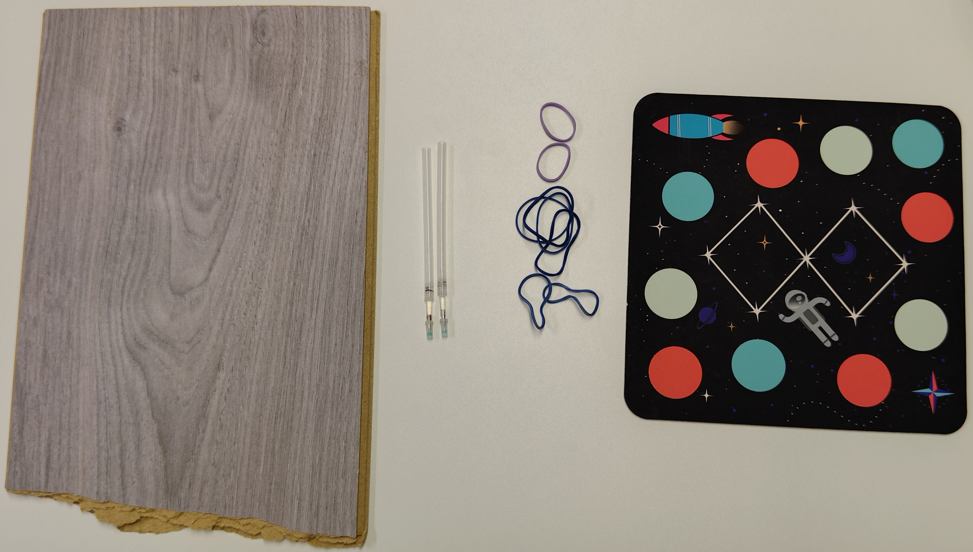

Slide 12
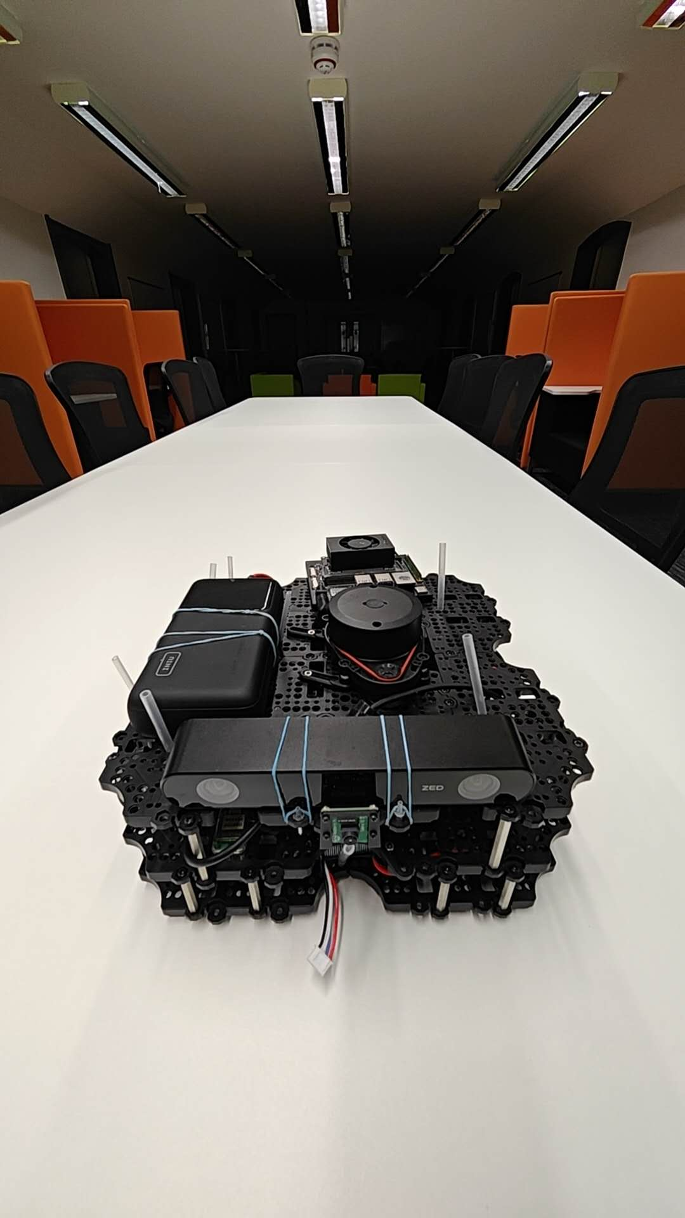
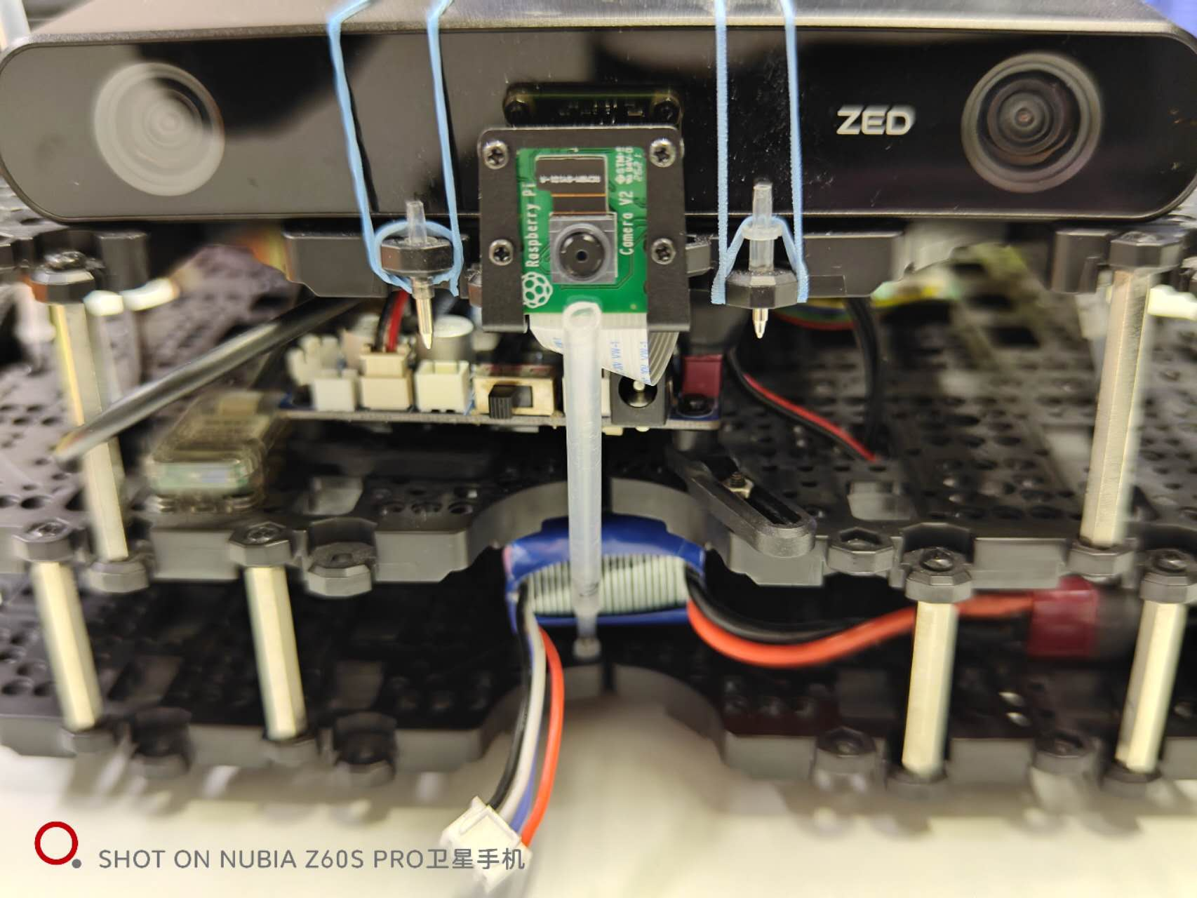
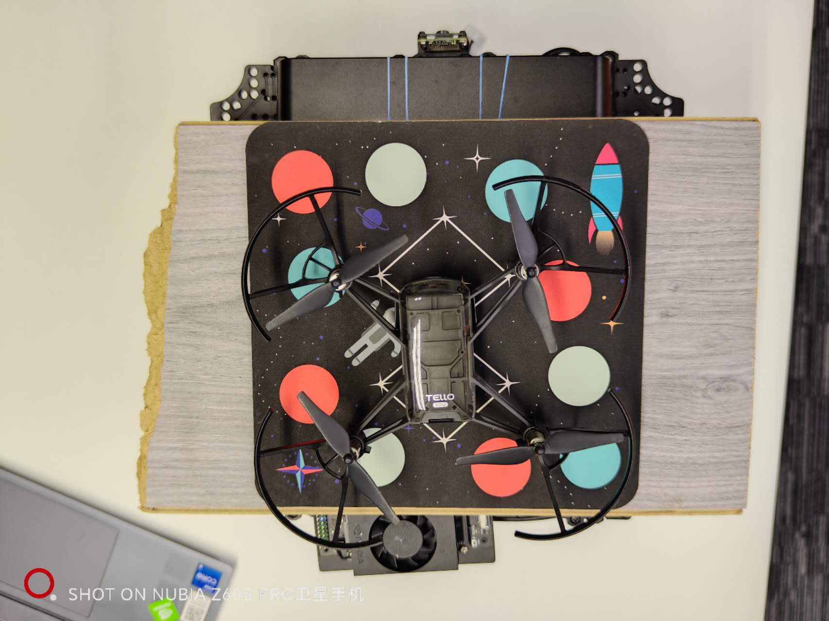
(a)
(b)
(c)

Slide 13
