Slide 1
Class 2
2020.5.4

Slide 2
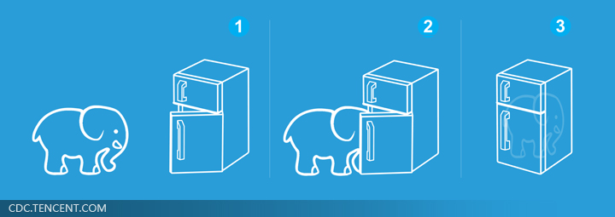
Three Steps for Deep Learning
Step 1: define a set of function
Step 2: goodness of function
Step 3: pick the best function
Neural
Network
Deep Learning is so simple ……
Notes:
http://www.twword.com/wiki/%E8%85%A6%E6%88%B6%E7%A9%B4
http://ukenglish.pixnet.net/blog/post/105691160-%E3%80%90%E5%8F%B0%E5%8D%97%E5%B8%82%E5%AD%B8%E8%8B%B1%E8%AA%9E%EF%BC%8C%E5%84%AA%E9%85%B7%E8%8B%B1%E8%AA%9E%E6%96%87%E7%90%86%E5%85%AC%E5%91%8A%E3%80%91%E6%9C%AC%E4%B8%AD%E5%BF%83
http://onepiece1234567890.blogspot.tw/2013/12/blog-post_8.html

Slide 3
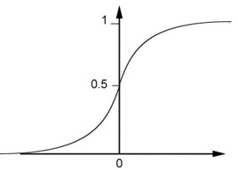
Fully Connect Feedforward Network
1
4
0.98
1
-2
1
-1
-2
0.12
-1
1
0
Sigmoid Function
Notes:
Ignore +

Slide 4
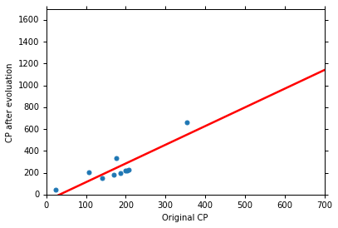
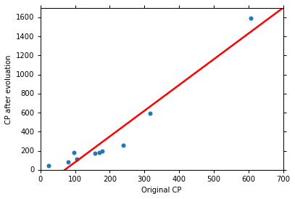


Parallel Universes
In different universes, we use the same model, but obtain different $f^{∗}$
Universe 123
Universe 345
y = b + w $∙$ x_{cp}
y = b + w $∙$ x_{cp}

Slide 5
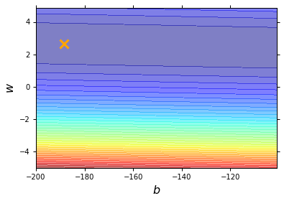



Step 2: Goodness of Function
$$L\left(w,b\right)=\sum_{n=1}^{10}{{\left({\hat{y}}^{n}−\left(b+w∙x_{cp}^{n}\right)\right)}^{2}}$$
Loss Function
Each point in the figure is a function
smallest
y = - 180 - 2 $∙$ x_{cp}
The color represents $L\left(w,b\right)$.
Very large
(true example)

Slide 6




Step 3: Gradient Descent
http://chico386.pixnet.net/album/photo/171572850
$$w^{∗}=arg\min_{w}{L\left(w\right)}$$
Consider loss function 𝐿(𝑤) with one parameter w:
(Randomly) Pick an initial value w⁰
Compute $\frac{dL}{dw}|_{w=w^{0}}$
Loss
$$L\left(w\right)$$
Negative
Increase w
Positive
Decrease w
w⁰

Slide 7


Step 3: Gradient Descent
http://chico386.pixnet.net/album/photo/171572850
$$w^{∗}=arg\min_{w}{L\left(w\right)}$$
Consider loss function 𝐿(𝑤) with one parameter w:
(Randomly) Pick an initial value w⁰
Compute $\frac{dL}{dw}|_{w=w^{0}}$
$$w^{1}←w^{0}−η\frac{dL}{dw}|_{w=w^{0}}$$
Loss
$$L\left(w\right)$$
η is called “learning rate”
w⁰
$$−η\frac{dL}{dw}|_{w=w^{0}}$$

Slide 8


Step 3: Gradient Descent
$$w^{∗}=arg\min_{w}{L\left(w\right)}$$
Consider loss function 𝐿(𝑤) with one parameter w:
(Randomly) Pick an initial value w⁰
Compute $\frac{dL}{dw}|_{w=w^{0}}$
$$w^{1}←w^{0}−η\frac{dL}{dw}|_{w=w^{0}}$$
Loss
$$L\left(w\right)$$
Compute $\frac{dL}{dw}|_{w=w^{1}}$
$$w^{2}←w^{1}−η\frac{dL}{dw}|_{w=w^{1}}$$
…… Many iteration
Local minima
global minima
w⁰
w¹
w²
w^{T}

Slide 9







Step 3: Gradient Descent
$$\left[\begin{aligned}\frac{∂L}{∂w} \\ \frac{∂L}{∂b}\end{aligned}\right]$$
$$∇L=$$
gradient
How about two parameters?
$$w^{∗},b^{∗}=arg\min_{w,b}{L\left(w,b\right)}$$
(Randomly) Pick an initial value w⁰, b⁰
Compute $\frac{∂L}{∂w}|_{w=w^{0},b=b^{0}}$, $\frac{∂L}{∂b}|_{w=w^{0},b=b^{0}}$
$$w^{1}←w^{0}−η\frac{∂L}{∂w}|_{w=w^{0},b=b^{0}}$$
$$b^{1}←b^{0}−η\frac{∂L}{∂b}|_{w=w^{0},b=b^{0}}$$
Compute $\frac{∂L}{∂w}|_{w=w^{1},b=b^{1}}$, $\frac{∂L}{∂b}|_{w=w^{1},b=b^{1}}$
$$w^{2}←w^{1}−η\frac{∂L}{∂w}|_{w=w^{1},b=b^{1}}$$
$$b^{2}←b^{1}−η\frac{∂L}{∂b}|_{w=w^{1},b=b^{1}}$$
Notes:
鄭凱文

Slide 10



Two Classes
Estimating the Probabilities
From training data
Class 1
Class 2
P(C₁)
P(C₂)
P(x|C₁)
P(x|C₂)
Given an x, which class does it belong to
$$=\frac{P\left(x|C_{1}\right)P\left(C_{1}\right)}{P\left(x|C_{1}\right)P\left(C_{1}\right)+P\left(x|C_{2}\right)P\left(C_{2}\right)}$$
$$P\left(C_{1}|x\right)$$
Generative Model
$$P\left(x\right)$$
$$=P\left(x|C_{1}\right)P\left(C_{1}\right)+P\left(x|C_{2}\right)P\left(C_{2}\right)$$
Notes:
Outlier detection

Slide 11
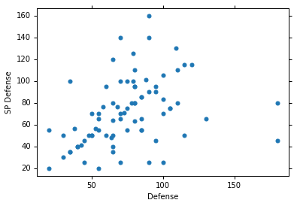






Probability from Class - Feature
Considering Defense and SP Defense
$$\left[\begin{aligned}48 \\ 50\end{aligned}\right]$$
$x^{1},x^{2},x^{3},$ …… ,$x^{79}$
$$\left[\begin{aligned}65 \\ 64\end{aligned}\right]$$
P(x|Water)=?
0?
Assume the points are sampled from a Gaussian distribution.
$$\left[\begin{aligned}103 \\ 45\end{aligned}\right]$$
Water
Type

Slide 12
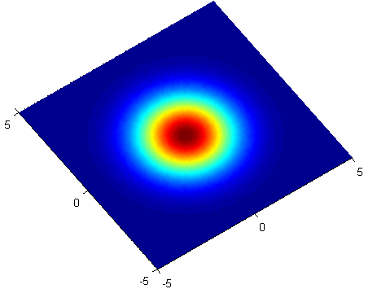
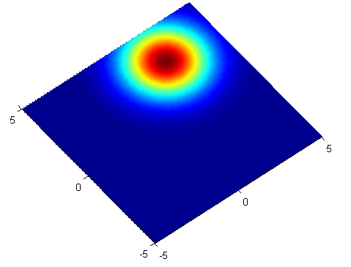





Gaussian Distribution
https://blog.slinuxer.com/tag/pca
$$f_{μ,Σ}\left(x\right)=\frac{1}{{\left(2π\right)}^{D/2}}\frac{1}{{\left|Σ\right|}^{1/2}}exp\left\{−\frac{1}{2}{\left(x−μ\right)}^{T}Σ^{−1}\left(x−μ\right)\right\}$$
Input: vector x, output: probability of sampling x
The shape of the function determines by mean $μ$ and covariance matrix $Σ$
$$μ=\left[\begin{aligned}0 \\ 0\end{aligned}\right]$$
$$\sum{=}\left[\begin{matrix}2 & 0 \\ 0 & 2\end{matrix}\right]$$
$$μ=\left[\begin{aligned}2 \\ 3\end{aligned}\right]$$
$$\sum{=}\left[\begin{matrix}2 & 0 \\ 0 & 2\end{matrix}\right]$$
$$x_{2}$$
$$x_{2}$$
$$x_{1}$$
$$x_{1}$$

Slide 13






Maximum Likelihood
We have the “Water” type Pokémons:
$x^{1},x^{2},x^{3},$ …… ,$x^{79}$
We assume $x^{1},x^{2},x^{3},$ …… ,$x^{79}$ generate from the Gaussian ($μ^{∗},Σ^{∗}$) with the maximum likelihood
$$L\left(μ,Σ\right)$$
$$=f_{μ,Σ}\left(x^{1}\right)f_{μ,Σ}\left(x^{2}\right)f_{μ,Σ}\left(x^{3}\right)……f_{μ,Σ}\left(x^{79}\right)$$
$$f_{μ,Σ}\left(x\right)=\frac{1}{{\left(2π\right)}^{D/2}}\frac{1}{{\left|Σ\right|}^{1/2}}exp\left\{−\frac{1}{2}{\left(x−μ\right)}^{T}Σ^{−1}\left(x−μ\right)\right\}$$
$$μ^{∗},Σ^{∗}=arg\max_{μ,Σ}{L\left(μ,Σ\right)}$$
$$μ^{∗}=\frac{1}{79}\sum_{n=1}^{79}{x^{n}}$$
$$Σ^{∗}=\frac{1}{79}\sum_{n=1}^{79}{\left(x^{n}−μ^{∗}\right)}{\left(x^{n}−μ^{∗}\right)}^{T}$$
average

Slide 14







Now we can do classification ☺
$$f_{μ^{1},Σ^{1}}\left(x\right)=\frac{1}{{\left(2π\right)}^{D/2}}\frac{1}{{\left|Σ^{1}\right|}^{1/2}}exp\left\{−\frac{1}{2}{\left(x−μ^{1}\right)}^{T}{\left(Σ^{1}\right)}^{−1}\left(x−μ^{1}\right)\right\}$$
P(C1)
= 79 / (79 + 61) =0.56
$$μ^{1}=\left[\begin{aligned}75.0 \\ 71.3\end{aligned}\right]$$
$$Σ^{1}=\left[\begin{matrix}874 & 327 \\ 327 & 929\end{matrix}\right]$$
$$=\frac{P\left(x|C_{1}\right)P\left(C_{1}\right)}{P\left(x|C_{1}\right)P\left(C_{1}\right)+P\left(x|C_{2}\right)P\left(C_{2}\right)}$$
$$P\left(C_{1}|x\right)$$
$$f_{μ^{2},Σ^{2}}\left(x\right)=\frac{1}{{\left(2π\right)}^{D/2}}\frac{1}{{\left|Σ^{2}\right|}^{1/2}}exp\left\{−\frac{1}{2}{\left(x−μ^{2}\right)}^{T}{\left(Σ^{2}\right)}^{−1}\left(x−μ^{2}\right)\right\}$$
P(C2)
= 61 / (79 + 61)
=0.44
$$μ^{2}=\left[\begin{aligned}55.6 \\ 59.8\end{aligned}\right]$$
$$Σ^{2}=\left[\begin{matrix}847 & 422 \\ 422 & 685\end{matrix}\right]$$
If $P\left(C_{1}|x\right)>0.5$
x belongs to class 1 (Water)

Slide 15



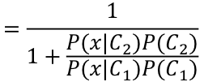

Posterior Probability
$$P\left(C_{1}|x\right)=\frac{P\left(x|C_{1}\right)P\left(C_{1}\right)}{P\left(x|C_{1}\right)P\left(C_{1}\right)+P\left(x|C_{2}\right)P\left(C_{2}\right)}$$
$$=\frac{1}{1+\frac{P\left(x|C_{2}\right)P\left(C_{2}\right)}{P\left(x|C_{1}\right)P\left(C_{1}\right)}}$$
$$=\frac{1}{1+exp\left(−z\right)}$$
$$=σ\left(z\right)$$
Sigmoid function
$$z=ln\frac{P\left(x|C_{1}\right)P\left(C_{1}\right)}{P\left(x|C_{2}\right)P\left(C_{2}\right)}$$

Slide 16








$$P\left(C_{1}|x\right)$$
$$=σ\left(z\right)$$
$$z=ln\frac{{\left|Σ^{2}\right|}^{1/2}}{{\left|Σ^{1}\right|}^{1/2}}$$
$$−\frac{1}{2}x^{T}{\left(Σ^{1}\right)}^{−1}x+{\left(μ^{1}\right)}^{T}{\left(Σ^{1}\right)}^{−1}x−\frac{1}{2}{\left(μ^{1}\right)}^{T}{\left(Σ^{1}\right)}^{−1}μ^{1}$$
$$+\frac{1}{2}x^{T}{\left(Σ^{2}\right)}^{−1}x−{\left(μ^{2}\right)}^{T}{\left(Σ^{2}\right)}^{−1}x+\frac{1}{2}{\left(μ^{2}\right)}^{T}{\left(Σ^{2}\right)}^{−1}μ^{2}$$
$$+ln\frac{N_{1}}{N_{2}}$$
$$Σ_{1}=Σ_{2}=Σ$$
$$z={\left(μ^{1}−μ^{2}\right)}^{T}Σ^{−1}x−\frac{1}{2}{\left(μ^{1}\right)}^{T}Σ^{−1}μ^{1}+\frac{1}{2}{\left(μ^{2}\right)}^{T}Σ^{−1}μ^{2}+ln\frac{N_{1}}{N_{2}}$$
$$w^{T}$$
$$b$$
$$P\left(C_{1}|x\right)=σ\left(w∙x+b\right)$$
How about directly find w and b?
In generative model, we estimate $N_{1},$ $N_{2}$, $μ^{1}$, $μ^{2}$, $Σ$
Then we have w and b

Slide 17
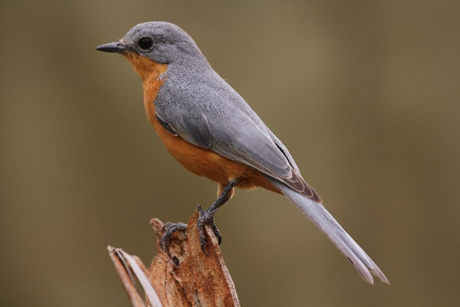
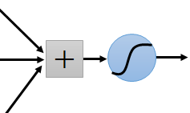
Why CNN for Image
Some patterns are much smaller than the whole image
A neuron does not have to see the whole image to discover the pattern.
Connecting to small region with less parameters
“beak” detector

Slide 18
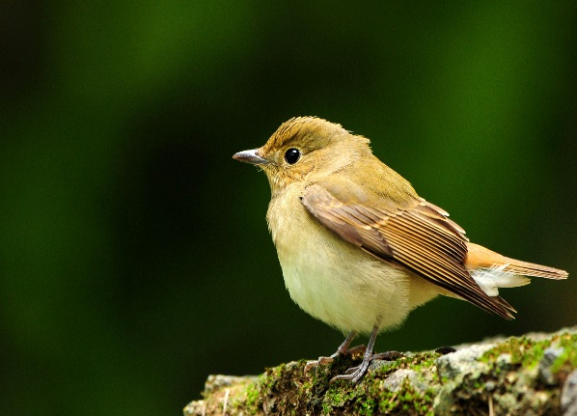
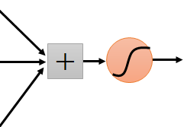
Why CNN for Image
The same patterns appear in different regions.
“upper-left beak” detector
Do almost the same thing
They can use the same set of parameters.
“middle beak” detector

Slide 19
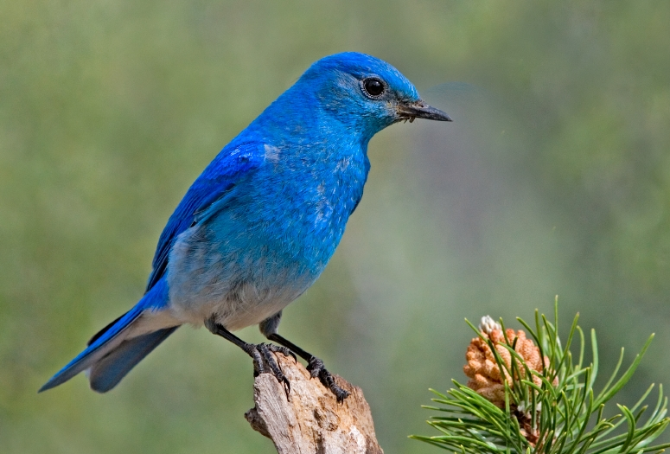

Why CNN for Image
Subsampling the pixels will not change the object
bird
bird
subsampling
We can subsample the pixels to make image smaller
Less parameters for the network to process the image

Slide 20
CNN – Convolution
Those are the network parameters to be learned.
1 | -1 | -1
-1 | 1 | -1
-1 | -1 | 1
1 | 0 | 0 | 0 | 0 | 1
0 | 1 | 0 | 0 | 1 | 0
0 | 0 | 1 | 1 | 0 | 0
1 | 0 | 0 | 0 | 1 | 0
0 | 1 | 0 | 0 | 1 | 0
0 | 0 | 1 | 0 | 1 | 0
Filter 1
Matrix
-1 | 1 | -1
-1 | 1 | -1
-1 | 1 | -1
Filter 2
Matrix
……
6 x 6 image
Each filter detects a small pattern (3 x 3).
Property 1

Slide 21
CNN – Convolution
1 | -1 | -1
-1 | 1 | -1
-1 | -1 | 1
Filter 1
stride=1
1 | 0 | 0 | 0 | 0 | 1
0 | 1 | 0 | 0 | 1 | 0
0 | 0 | 1 | 1 | 0 | 0
1 | 0 | 0 | 0 | 1 | 0
0 | 1 | 0 | 0 | 1 | 0
0 | 0 | 1 | 0 | 1 | 0
3
-1
6 x 6 image

Slide 22
CNN – Convolution
1 | -1 | -1
-1 | 1 | -1
-1 | -1 | 1
Filter 1
stride=1
1 | 0 | 0 | 0 | 0 | 1
0 | 1 | 0 | 0 | 1 | 0
0 | 0 | 1 | 1 | 0 | 0
1 | 0 | 0 | 0 | 1 | 0
0 | 1 | 0 | 0 | 1 | 0
0 | 0 | 1 | 0 | 1 | 0
3
-1
-3
-1
-3
1
0
-3
-3
-3
0
1
3
-2
-2
-1
6 x 6 image
Property 2

Slide 23
CNN – Convolution
-1 | 1 | -1
-1 | 1 | -1
-1 | 1 | -1
Filter 2
stride=1
Do the same process for every filter
1 | 0 | 0 | 0 | 0 | 1
0 | 1 | 0 | 0 | 1 | 0
0 | 0 | 1 | 1 | 0 | 0
1 | 0 | 0 | 0 | 1 | 0
0 | 1 | 0 | 0 | 1 | 0
0 | 0 | 1 | 0 | 1 | 0
3
-1
-3
-1
-1
-1
-1
-1
-3
1
0
-3
-1
-1
-2
1
Feature
Map
-3
-3
0
1
-1
-1
-2
1
3
-2
-2
-1
6 x 6 image
-1
0
-4
3
4 x 4 image

Slide 24
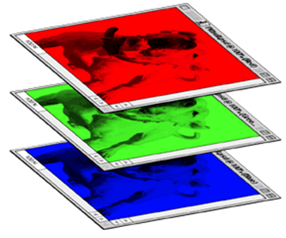
CNN – Colorful image
1 | -1 | -1
-1 | 1 | -1
-1 | -1 | 1
-1 | 1 | -1
-1 | 1 | -1
-1 | 1 | -1
1 | -1 | -1
-1 | 1 | -1
-1 | -1 | 1
-1 | 1 | -1
-1 | 1 | -1
-1 | 1 | -1
1 | -1 | -1
-1 | 1 | -1
-1 | -1 | 1
-1 | 1 | -1
-1 | 1 | -1
-1 | 1 | -1
Filter 1
Filter 2
Colorful image
1 | 0 | 0 | 0 | 0 | 1
0 | 1 | 0 | 0 | 1 | 0
0 | 0 | 1 | 1 | 0 | 0
1 | 0 | 0 | 0 | 1 | 0
0 | 1 | 0 | 0 | 1 | 0
0 | 0 | 1 | 0 | 1 | 0
1 | 0 | 0 | 0 | 0 | 1
0 | 1 | 0 | 0 | 1 | 0
0 | 0 | 1 | 1 | 0 | 0
1 | 0 | 0 | 0 | 1 | 0
0 | 1 | 0 | 0 | 1 | 0
0 | 0 | 1 | 0 | 1 | 0
1 | 0 | 0 | 0 | 0 | 1
0 | 1 | 0 | 0 | 1 | 0
0 | 0 | 1 | 1 | 0 | 0
1 | 0 | 0 | 0 | 1 | 0
0 | 1 | 0 | 0 | 1 | 0
0 | 0 | 1 | 0 | 1 | 0

Slide 25
CNN – Max Pooling
1 | -1 | -1
-1 | 1 | -1
-1 | -1 | 1
-1 | 1 | -1
-1 | 1 | -1
-1 | 1 | -1
Filter 1
Filter 2
3
-1
-3
-1
-1
-1
-1
-1
-3
1
0
-3
-1
-1
-2
1
-3
-3
0
1
-1
-1
-2
1
3
-2
-2
-1
-1
0
-4
3

Slide 26
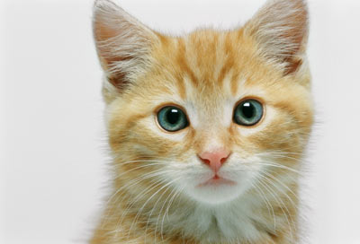
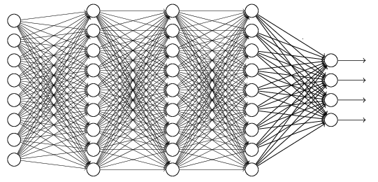
The whole CNN
cat dog ……
Convolution
Max Pooling
A new image
Fully Connected Feedforward network
Convolution
Max Pooling
A new image
Flatten

Slide 27
Flatten
3
0
1
3
0
-1
1
3
3
1
-1
0
3
Flatten
1
Fully Connected Feedforward network
0
3

Slide 28










Logistic Regression + Square Error
$$f_{w,b}\left(x\right)=σ\left(\sum_{i}{w_{i}x_{i}}+b\right)$$
Step 1:
Step 2:
Training data: $\left(x^{n},{\hat{y}}^{n}\right)$, ${\hat{y}}^{n}$: 1 for class 1, 0 for class 2
$$L\left(f\right)=\frac{1}{2}\sum_{n}{{\left(f_{w,b}\left(x^{n}\right)−{\hat{y}}^{n}\right)}^{2}}$$
Step 3:
$$\frac{∂f_{w,b}\left(x\right)}{∂z}$$
$$\frac{∂z}{∂w_{i}}$$
$$=2\left(f_{w,b}\left(x\right)−\hat{y}\right)$$
$$\frac{∂ {(f_{w,b}\text{(}\text{x}\text{)−}\hat{y})}^{2} }{∂w_{i}}$$
$$=2\left(f_{w,b}\left(x\right)−\hat{y}\right)f_{w,b}\left(x\right)\left(1−f_{w,b}\left(x\right)\right)x_{i}$$
$${\hat{y}}^{n}=0$$
If $f_{w,b}\left(x^{n}\right)=1$
(far from target)
$${∂L}/{∂w_{i}}=0$$
If $f_{w,b}\left(x^{n}\right)=0$
(close to target)
$${∂L}/{∂w_{i}}=0$$

Slide 29

Logistic Regression
Linear Regression
$$f_{w,b}\left(x\right)=σ\left(\sum_{i}{w_{i}x_{i}}+b\right)$$
$$f_{w,b}\left(x\right)=\sum_{i}{w_{i}x_{i}}+b$$
Step 1:
Output: between 0 and 1
Output: any value
Step 2:
Step 3:
Notes:
The standard logistic function is the logistic function with parameters (k = 1, x₀ = 0, L = 1) which yields sigmoid

Slide 30





Logistic Regression
Linear Regression
$$f_{w,b}\left(x\right)=σ\left(\sum_{i}{w_{i}x_{i}}+b\right)$$
$$f_{w,b}\left(x\right)=\sum_{i}{w_{i}x_{i}}+b$$
Step 1:
Output: between 0 and 1
Output: any value
Training data: $\left(x^{n},{\hat{y}}^{n}\right)$
Training data: $\left(x^{n},{\hat{y}}^{n}\right)$
Step 2:
${\hat{y}}^{n}$: 1 for class 1, 0 for class 2
${\hat{y}}^{n}$: a real number
$$L\left(f\right)=\sum_{n}{l\left(f\left(x^{n}\right),{\hat{y}}^{n}\right)}$$
$$L\left(f\right)=\frac{1}{2}\sum_{n}{{\left(f\left(x^{n}\right)−{\hat{y}}^{n}\right)}^{2}}$$
Cross entropy:
$$l\left(f\left(x^{n}\right),{\hat{y}}^{n}\right)=−\left[{\hat{y}}^{n}lnf\left(x^{n}\right)+\left(1−{\hat{y}}^{n}\right)ln\left(1−f\left(x^{n}\right)\right)\right]$$
Notes:
The standard logistic function is the logistic function with parameters (k = 1, x₀ = 0, L = 1) which yields sigmoid

Slide 31

Logistic Regression
Linear Regression
$$f_{w,b}\left(x\right)=σ\left(\sum_{i}{w_{i}x_{i}}+b\right)$$
$$f_{w,b}\left(x\right)=\sum_{i}{w_{i}x_{i}}+b$$
Step 1:
Output: between 0 and 1
Output: any value
Training data: $\left(x^{n},{\hat{y}}^{n}\right)$
Training data: $\left(x^{n},{\hat{y}}^{n}\right)$
Step 2:
${\hat{y}}^{n}$: 1 for class 1, 0 for class 2
${\hat{y}}^{n}$: a real number
$$L\left(f\right)=\sum_{n}{l\left(f\left(x^{n}\right),{\hat{y}}^{n}\right)}$$
$$L\left(f\right)=\frac{1}{2}\sum_{n}{{\left(f\left(x^{n}\right)−{\hat{y}}^{n}\right)}^{2}}$$
$$w_{i}←w_{i}−η\sum_{n}{−\left({\hat{y}}^{n}−f_{w,b}\left(x^{n}\right)\right)x_{i}^{n}}$$
Logistic regression:
Step 3:
$$w_{i}←w_{i}−η\sum_{n}{−\left({\hat{y}}^{n}−f_{w,b}\left(x^{n}\right)\right)x_{i}^{n}}$$
Linear regression:
Notes:
The standard logistic function is the logistic function with parameters (k = 1, x₀ = 0, L = 1) which yields sigmoid

Slide 32

Multi-class Classification
(3 classes as example)
C₁:
$$z_{1}=w^{1}∙x+b_{1}$$
Probability:
$1>y_{i}>0$
$\sum_{i}{y_{i}=1}$
$$w^{1},b_{1}$$
C₂:
$$w^{2},b_{2}$$
$$z_{2}=w^{2}∙x+b_{2}$$
C₃:
$$w^{3},b_{3}$$
$$z_{3}=w^{3}∙x+b_{3}$$
Softmax
3
20
0.88
1
2.7
0.12
-3
0.05
≈0
Notes:
2 class

Slide 33










Multi-class Classification
[Bishop, P209-210]
(3 classes as example)
$$z_{1}=w^{1}∙x+b_{1}$$
Cross Entropy
$$x$$
$$z_{2}=w^{2}\text{∙}x+b_{2}$$
Softmax
$$−\sum_{i=1}^{3}{{\hat{y}}_{i}lny_{i}}$$
$$z_{3}=w^{3}\text{∙}x+b_{3}$$
target
If x $∈$ class 1
If x $∈$ class 2
If x $∈$ class 3
$$\left[\begin{aligned}1 \\ 0 \\ 0\end{aligned}\right]$$
$$\left[\begin{aligned}0 \\ 1 \\ 0\end{aligned}\right]$$
$$\left[\begin{aligned}0 \\ 0 \\ 1\end{aligned}\right]$$
$$\hat{y}=$$
$$\hat{y}=$$
$$\hat{y}=$$
$$−lny_{1}$$
$$−lny_{2}$$
$$−lny_{3}$$

Slide 34
ReLU
$$a$$
$$a=z$$
$$a=0$$
$$z$$
0
0
0
0

Slide 35
ReLU
$$a$$
$$a=z$$
A Thinner linear network
$$a=0$$
$$z$$
Do not have smaller gradients

Slide 36
Learning Rate
Set the learning rate η carefully
If there are more than three parameters, you cannot visualize this.
Loss
Very Large
small
Large
Loss
Just make
No. of parameters updates
But you can always visualize this.

Slide 37
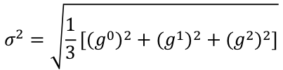

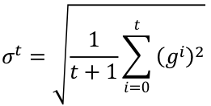
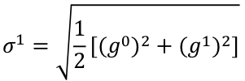




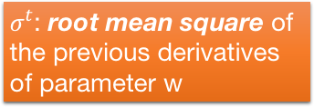

Adagrad
$σ^{t}$: root mean square of the previous derivatives of parameter w
$$w^{1}←w^{0}−\frac{{\text{η}}^{0}}{σ^{0}}g^{0}$$
$$σ^{0}=\sqrt{{\left(g^{0}\right)}^{2}}$$
$$σ^{1}=\sqrt{\frac{1}{2}\left[{\left(g^{0}\right)}^{2}+{\left(g^{1}\right)}^{2}\right]}$$
$$w^{2}←w^{1}−\frac{{\text{η}}^{1}}{σ^{1}}g^{1}$$
$$σ^{2}=\sqrt{\frac{1}{3}\left[{\left(g^{0}\right)}^{2}+{\left(g^{1}\right)}^{2}+{\left(g^{2}\right)}^{2}\right]}$$
$$w^{3}←w^{2}−\frac{{\text{η}}^{2}}{σ^{2}}g^{2}$$
$$……$$
$$σ^{t}=\sqrt{\frac{1}{t+1}\sum_{i=0}^{t}{{\left(g^{i}\right)}^{2}}}$$
$$w^{t+1}←w^{t}−\frac{{\text{η}}^{t}}{σ^{t}}g^{t}$$
Notes:
Why square

Slide 38
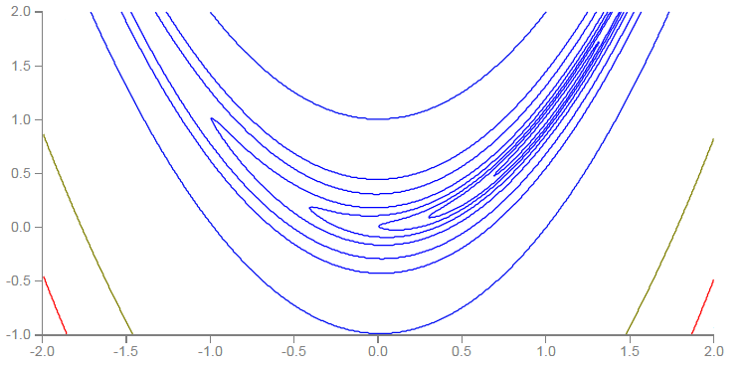
RMSProp
Error Surface can be very complex when training NN.
Smaller Learning Rate
$$w_{2}$$
Larger Learning Rate
$$w_{1}$$

Slide 39









RMSProp
$$w^{1}←w^{0}−\frac{η}{σ^{0}}g^{0}$$
$$σ^{0}=g^{0}$$
$$w^{2}←w^{1}−\frac{η}{σ^{1}}g^{1}$$
$$σ^{1}=\sqrt{{α\left(σ^{0}\right)}^{2}+\left(1−α\right){\left(g^{1}\right)}^{2}}$$
$$w^{3}←w^{2}−\frac{η}{σ^{2}}g^{2}$$
$$σ^{2}=\sqrt{{α\left(σ^{1}\right)}^{2}+\left(1−α\right){\left(g^{2}\right)}^{2}}$$
$$……$$
$$w^{t+1}←w^{t}−\frac{η}{σ^{t}}g^{t}$$
$$σ^{t}=\sqrt{{α\left(σ^{t−1}\right)}^{2}+\left(1−α\right){\left(g^{t}\right)}^{2}}$$
Root Mean Square of the gradients with previous gradients being decayed
Notes:
Root Mean Squares of gradients

Slide 40
In physical world ……
Momentum
How about put this phenomenon in gradient descent?
Notes:
Momentum: 動量

Slide 41














Review: Vanilla Gradient Descent
$$∇L\left(θ^{0}\right)$$
Start at position $θ^{0}$
$$∇L\left(θ^{1}\right)$$
Compute gradient at $θ^{0}$
$$θ^{0}$$
$$θ^{1}$$
Move to $θ^{1}$ = $θ^{0}$ - η$∇L\left(θ^{0}\right)$
$$∇L\left(θ^{2}\right)$$
Compute gradient at $θ^{1}$
$$θ^{2}$$
Gradient
Move to $θ^{2}$ = $θ^{1}$ – η$∇L\left(θ^{1}\right)$
Movement
$$∇L\left(θ^{3}\right)$$
$$θ^{3}$$
……
Stop until $∇L\left(θ^{t}\right)≈0$
Notes:
平凡的；普通的；乏味的

Slide 42







Momentum
Movement: movement of last step minus gradient at present
Start at point $θ^{0}$
Movement v⁰=0
$$∇L\left(θ^{0}\right)$$
Compute gradient at $θ^{0}$
$$∇L\left(θ^{1}\right)$$
$$θ^{0}$$
Movement v¹ = λv⁰ - η$∇L\left(θ^{0}\right)$
$$θ^{1}$$
Move to $θ^{1}$ = $θ^{0}$ + v¹
$$∇L\left(θ^{2}\right)$$
Compute gradient at $θ^{1}$
$$θ^{2}$$
Gradient
Movement v² = λv¹ - η$∇L\left(θ^{1}\right)$
Movement
Move to $θ^{2}$ = $θ^{1}$ + v²
$$θ^{3}$$
$$∇L\left(θ^{3}\right)$$
Movement not just based on gradient, but previous movement.
Movement
of last step

Slide 43
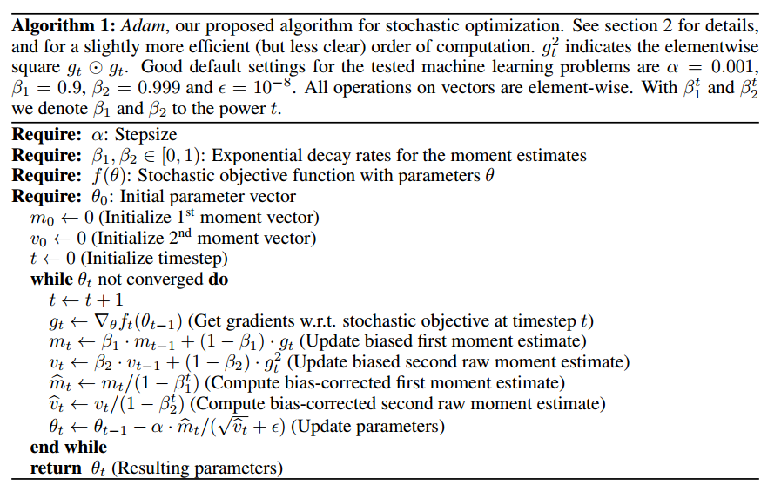
Adam
RMSProp + Momentum
for momentum
for RMSprop
Notes:
http://sebastianruder.com/optimizing-gradient-descent/
http://cs231n.github.io/neural-networks-3/
Original paper: https://arxiv.org/pdf/1412.6980.pdf

