Slide 1
Project Title: Demand Forecasting in Supply Chain using Machine Learning Subtitle: A project using Scikit-learn and Random Forest Regressor
Presented by: Jianlumei Kamei
Date:25-06-2025

Slide 2
Problem Statement
Goal: To predict the number of products sold using past supply chain data.
Why is it important?
Helps in better inventory management
Reduces overstock/understock
Supports strategic planning in supply chain

Slide 3
Dataset Overview
Source: supply_chain_data.csv Features include:
Product details (e.g., category)
Sales history
Added synthetic date for temporal analysis

Slide 4
Data Preprocessing
Handled missing values (removed rows with nulls)
Added synthetic Date column (daily sequence)
Extracted features: Month, DayOfWeek, Quarter
Applied one-hot encoding to categorical variables
Standardized numeric features using StandardScaler

Slide 5
Model Building
Model used: RandomForestRegressor (Scikit-learn) Why Random Forest?
Handles non-linear relationships well
Robust to outliers
Works great with structured/tabular data
Training:
80% training, 20% testing
Feature scaling applied
Model trained with 100 trees

Slide 6
Model Evaluation
Evaluation metric: Mean Squared Error (MSE)
MSE on Test Set: 162706.44
Scatter plot used to visualize predicted vs true values
Good fit with reasonable error

Slide 7
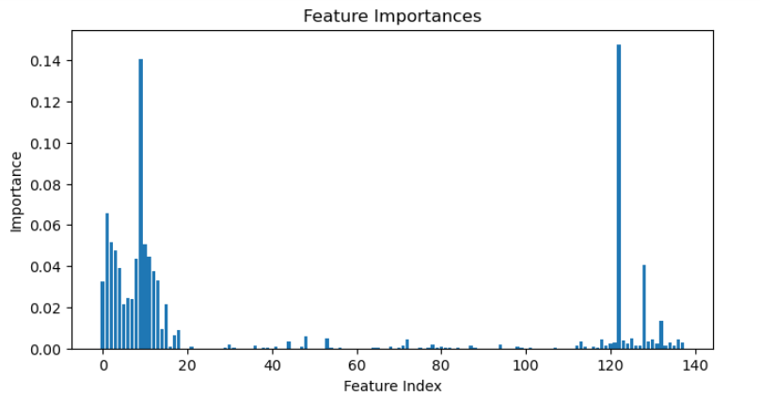
Feature Importance
Random Forest provides feature importance scores
Helped identify which features influenced sales most
Month, Promotion, etc.

Slide 8
Deployment
Model saved using joblib as .pkl
Scaler also saved for consistent future preprocessing
Simple input interface used for prediction with new data

Slide 9
Conclusion
Successfully implemented a demand forecasting model
Used Random Forest for accurate predictions
Extracted useful time-based and categorical insights
Model ready for production or dashboard integration

Slide 10
Thank You
Questions?
Contact : kameiluh1@gmail.com

