Slide 1
Project Title: Cybersecurity-Suspicious Web Threat Interaction Presented by: Jianlumei Kamei
Tools Used : Python, Jupyter Notebook, Isolation Forest, AWS CloudWatch

Slide 2
OBJECTIVE
Goal : Detect and analyze suspicious or potentially harmful web traffic using unsupervised machine learning.

Slide 3
1. Dataset Overview
Source : AWS CloudWatch logs
Web server traffic data
Key fields :
Bytes In/Out
Source IP/Country Code
Protocols, Ports, Timestamps

Slide 4
2. Data Preprocessing
Filled missing bytes_in with median
Dropped nulls from critical fields (IP addresses)
Converted time columns to datetime

Slide 5
3. Feature Engineering
Session Duration: end_time – creation_time
Average Packet Size: (bytes_in + bytes_out)/ session_duration

Slide 6
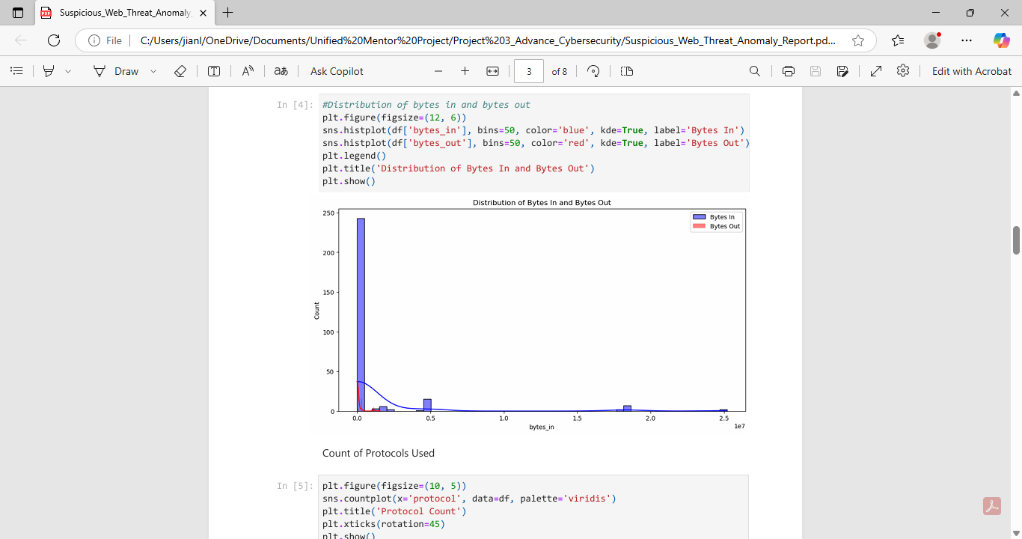
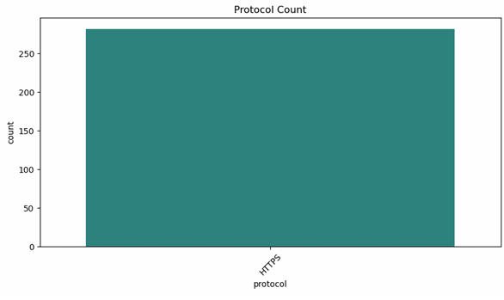
4. Exploratory Data Analysis
Distribution of Bytes In/ Out Protocol and Port usage
Source Country analysis
Detected traffic concentration from specific IP regions

Slide 7
5. Anomaly Detection (Isolation Forest)
Model: Isolation Forest (contamination = 0.05)
Trained on:
Bytes_in, bytes_out
Session_duration, avg_packet_size
Output labelled as Normal or Suspicious

Slide 8
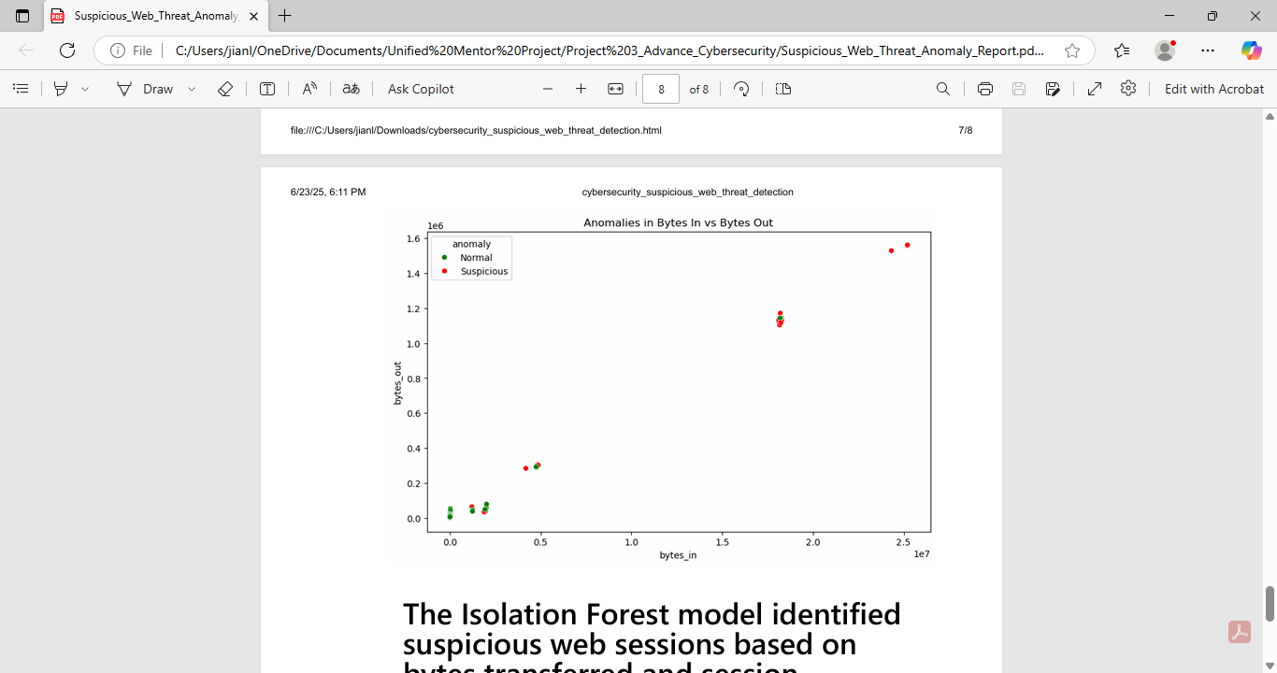
6. Visualization of Anomalies
Scatter plot: bytes_in vs bytes_out
Red dots = Suspicious sessions
Anomalies were clear outliers in data volume or traffic patterns

Slide 9
Results Summary
Several sessions flagged as suspicious
Patterns matched traffic with unusual volume or behavior
Useful for automated threat detection without labels

Slide 10
Conclusion
Successfully applied unsupervised anomaly detection
No labelled data needed
Visual and data patterns confirm model’s utility
Future work: integrate real-time alerts or supervised classification

Slide 11
Thank You
Questions?
Contact: kameiluh1@gmail.com

