Slide 1
K-d Trees (p.48, 49)
Binary tree where the underlying space is partitioned on the basis of the value of just an attribute per level.
Difference from quad tree is only 1 value is tested when determining the direction in which a branch is to be made.

Slide 2
Point k-d tree (p. 50)
(100,0)
(100,100)
Name | X | y
Chicago | 35 | 42
Mobile | 52 | 10
Toronto | 62 | 77
Buffalo | 82 | 65
Denver | 5 | 45
Omaha | 27 | 35
Atlanta | 85 | 15
Miami | 90 | 5
(62,77)
Toronto
(82,65)
Buffalo
Order of insertion
(5,45)
Denver
(35,42)
Chicago
(27,35)
Omaha
(85,15)
Atlanta
(52,10)
Mobile
(90,5)
Miami
(0,0)
(100,0)

Slide 3
K-d tree structure (p.50)
Chicago
Mobile
(62,77)
Toronto
Denver
(82,65)
Buffalo
Omaha
Toronto
(5,45)
Denver
(35,42)
Chicago
Miami
Buffalo
(27,35)
Omaha
(85,15)
Atlanta
(52,10)
Mobile
Atlanta
(90,5)
Miami
Shape of the resulting k-d tree depends on the order in which the nodes are inserted into it

Slide 4
Insertion
Insertion is the same as the binary search tree.
Resulting k-d tree depends on the order in which the nodes are inserted into it.
Amount of work expended in building a k-d tree is equal to the total path length (TPL) of the tree as it reflects the cost of searching for all of the elements
Insertion shown on previous slide.

Slide 5
Deletion
More complex than its binary search tree.
Because every subtree of the k-d tree might not be a k-d tree itself.
Complex in determining how to delete and replacement etc.

Slide 6
Search (p. 55)
find all cities within three units of a point with coordinate values (88,6).
(100,0)
(100,100)
Anything to the left is < 35
Chicago
x = 35
(62,77)
Toronto
Mobile
y = 10
Denver
y = 45
(82,65)
Buffalo
(5,45)
Denver
Toronto
x = 62
(35,42)
Chicago
Omaha
Miami
Buffalo
y = 65
(27,35)
Omaha
(85,15)
Atlanta
(52,10)
Mobile
Atlanta
Search q(88,6)
(90,5)
Miami
(0,0)
(100,0)

Slide 7
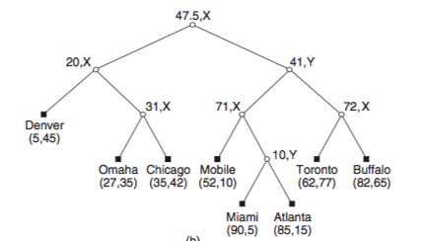
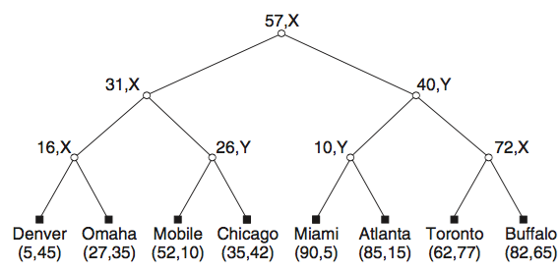
Point K-d Tree Variants (p.57)
Common choice is to use the median so that the structure is balanced. (Adaptive k-d tree)
Use the values that splits the range in half. (Fair-split tree)

Slide 8
Trie-based k-d tree (p. 71)
Name | X | y
Chicago | 35 | 42
Mobile | 52 | 10
Toronto | 62 | 77
Buffalo | 82 | 65
Denver | 5 | 45
Omaha | 27 | 35
Atlanta | 85 | 15
Miami | 90 | 5
(62,77)
Toronto
(82,65)
Buffalo
(5,45)
Denver
(35,42)
Chicago
(27,35)
Omaha
(85,15)
Atlanta
(52,10)
Mobile
(90,5)
Miami
(0,0)
(0,0)
(100,0)
(100,0)

Slide 9
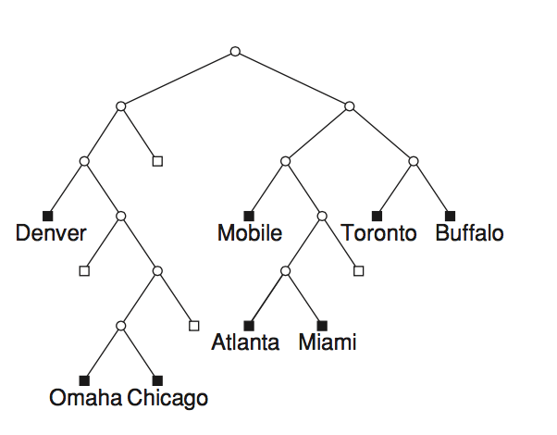
Trie-based k-d tree structure
(62,77)
Toronto
(82,65)
Buffalo
(5,45)
Denver
(35,42)
Chicago
(27,35)
Omaha
(85,15)
Atlanta
(52,10)
Mobile
(90,5)
Miami
(0,0)
(0,0)
(100,0)
(100,0)

Slide 10
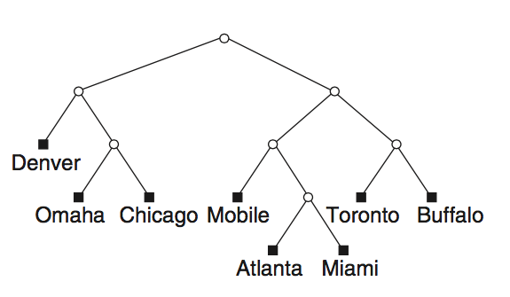
Sliding-Midpoint K-d Tree (p.72)
(62,77)
Toronto
(82,65)
Buffalo
(5,45)
Denver
(35,42)
Chicago
(27,35)
Omaha
(85,15)
Atlanta
(52,10)
Mobile
(90,5)
Miami
(0,0)
(0,0)
(100,0)
(100,0)

Slide 11
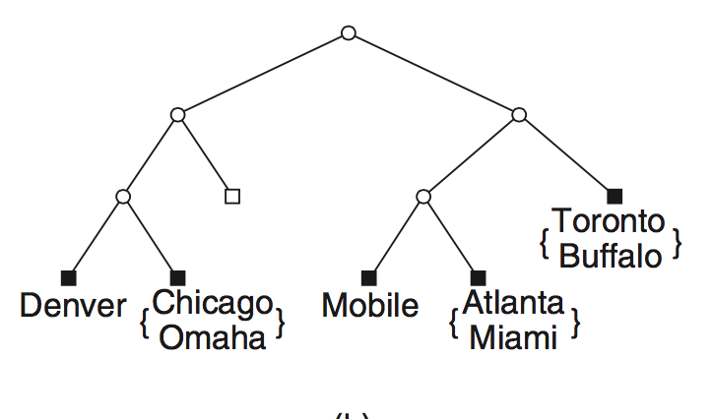
Bucket PR K-d Tree (p. 75)
Splitting threshold introduced.
Given a splitting threshold b, we say that if a block c contains more than b points, then it is split once, and only once
Avoid many splits.
(62,77)
Toronto
(82,65)
Buffalo
(5,45)
Denver
(35,42)
Chicago
(27,35)
Omaha
(85,15)
Atlanta
(52,10)
Mobile
(90,5)
Miami
(0,0)
Figure 1.51
(100,0)

Slide 12
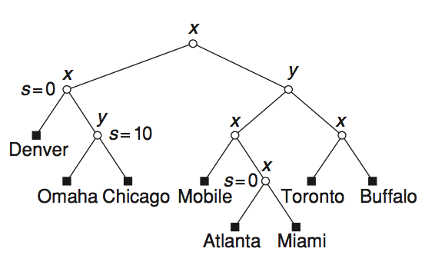
Path-Compressed PR K-d Tree (p.75)
The application of path compression to a PR k-d tree involves taking parts of paths that consist of nonleaf nodes, all of whose siblings are empty (i.e., NIL), and compressing them so that all nonleaf nodes that have just one non-NIL child are eliminated.
(62,77)
Toronto
(82,65)
Buffalo
(5,45)
Denver
(35,42)
Chicago
(27,35)
Omaha
(85,15)
Atlanta
(52,10)
Mobile
(90,5)
Miami
(0,0)
(0,0)
Figure 1.52
(100,0)
(100,0)

Slide 13
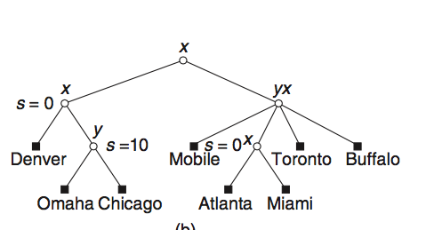
Path-Level Compressed PR K-d Tree (p.77)

Slide 14
Trie vs Path-Compressed vs Path-Level Compressed PR k-d Tree
Trie
Path-Compressed
Path-Level Compressed

Slide 15
BD-trees (Binary Division p.79)
Created because path-compressed and path level compressed trees are not always balanced.
Constructed in incremental fashion
Each nonleaf node a in the BD- tree contains a variable-length bit string—termed a discriminator zone expression (DZE)
All nonleaf nodes are labeled with their DZEs, assuming a sequence of alternating x,y,x,y,... tests, starting at the left end of the DZE.

Slide 16
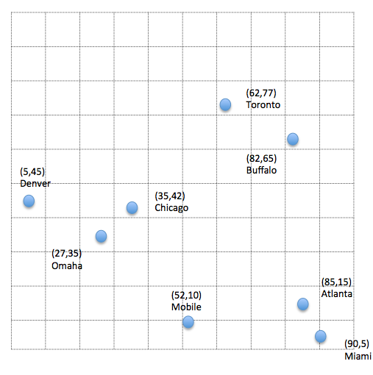
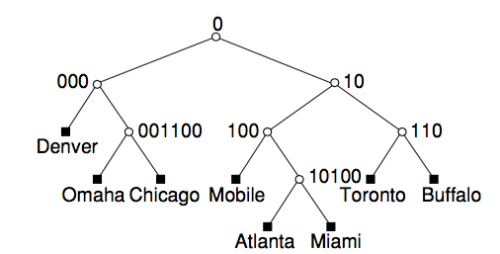
BD-trees cont. (p.81)
Order is
Chicago, Mobile, Toronto, Buffalo, Denver, Omaha, Atlanta
DZE | Value
0 | x < 50
10 | x >= 50, y < 50
000 | x < 50, y < 50, x < 25 x < 25 , y < 50
100 | x >= 50, y < 50, x < 75 50 <= x < 75, y < 50
110 | X >=50, y >= 50, x < 75 50 <= x < 75, y >= 50
001100 | X < 50, y < 50, x >= 25, y >= 25, x < 37.5 , y < 37.5 25 <= x <= 37.5, 25 <= y < 37.5
10100 | x >= 50, y < 50, x >= 75, y < 25, x < 97.5 75 <= x < 97.5, 25 < y < 50

Slide 17
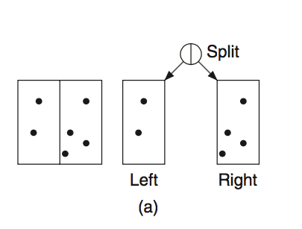
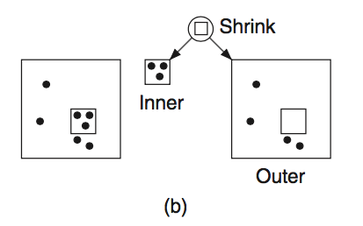
Balanced Box-Decomposition (BBD-Tree p.83)
Given a region and a subset of the points.
Each stage of the algorithm determines how to sub-divide the current region.
Either split of shrink and then distributes the points.

Slide 18
Balanced Box Decomposition cont
The simplest strategy is to apply split and shrink operations at alternate levels of the tree.
Process is repeated until a region is obtained with at most one point (or at most as many points as the bucket capacity in case of the use of bucketing), after which a leaf node is generated.

Slide 19
Conjugation Tree (p.88)
Find a line L that bisects S into three subsets S_{left}(L), S_{right}(L), and S_{on}(L),
The size of each of the subsets S_{left} (L) and S_{right} (L) is bounded by N/2.

Slide 20
Conjugation Tree p.89
(62,77)
Toronto
(82,65)
Buffalo
(5,45)
Denver
(35,42)
Chicago
(27,35)
Omaha
(85,15)
Atlanta
(52,10)
Mobile
(90,5)
Miami

