Slide 1



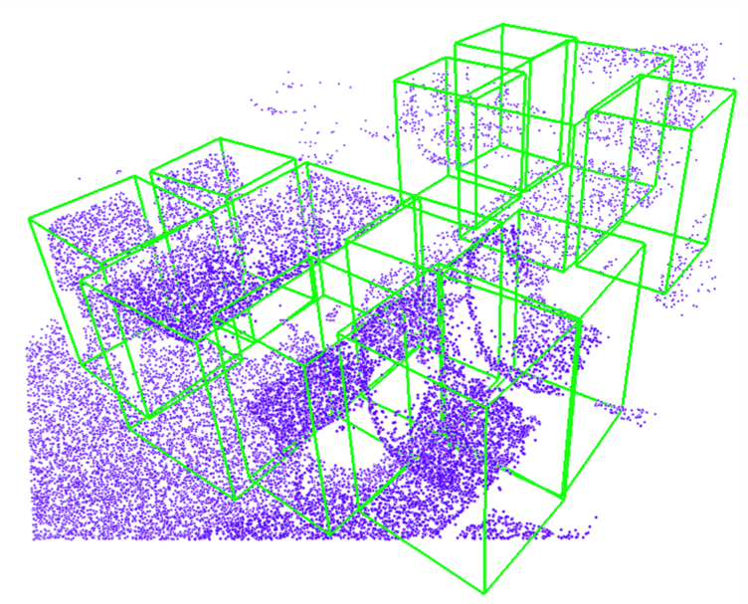
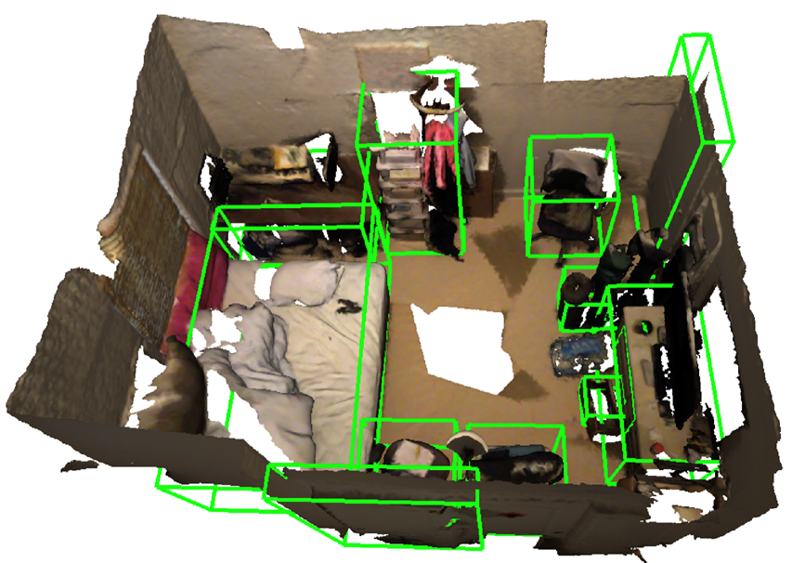
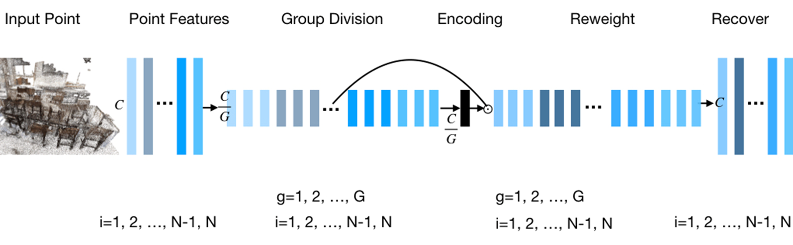
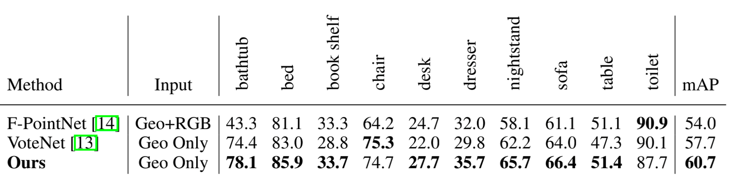
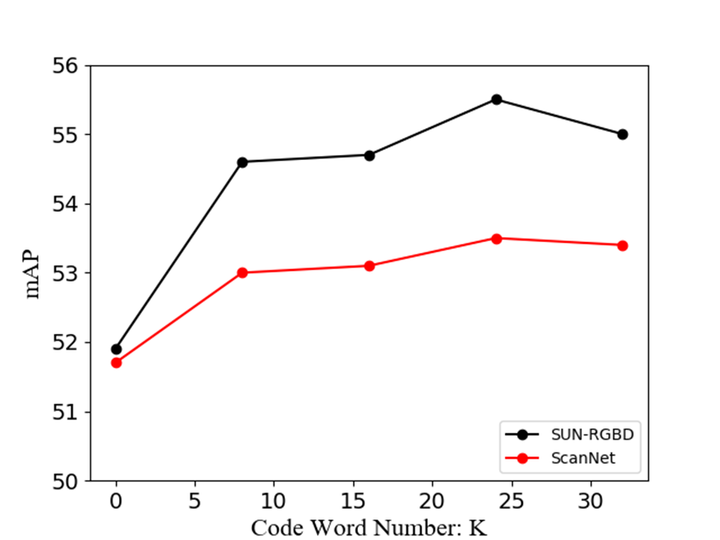
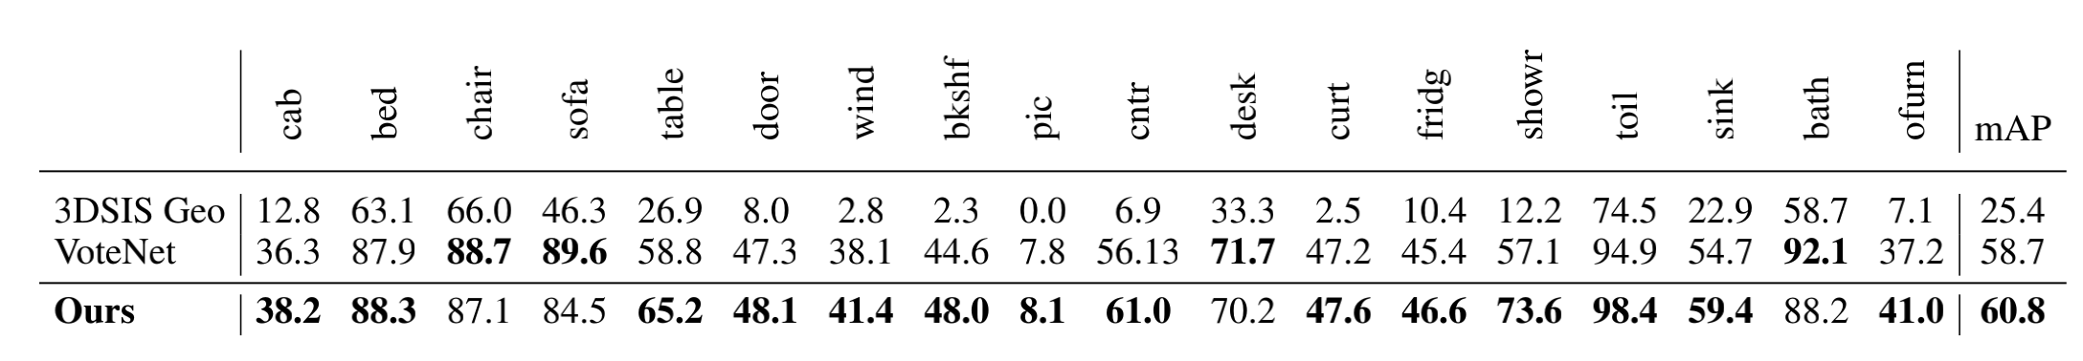
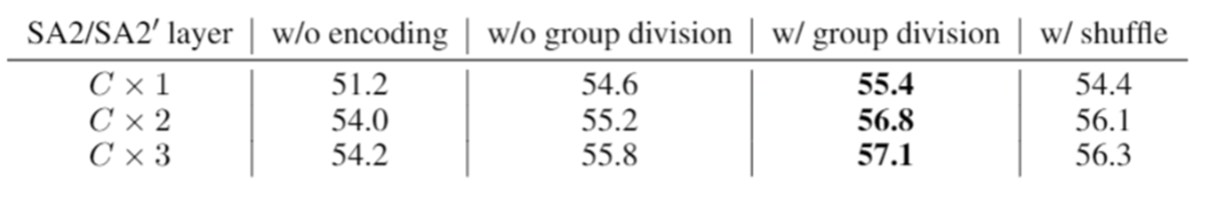
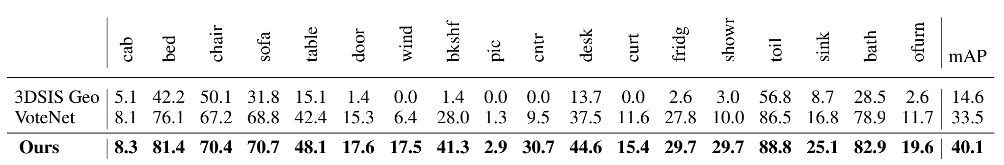
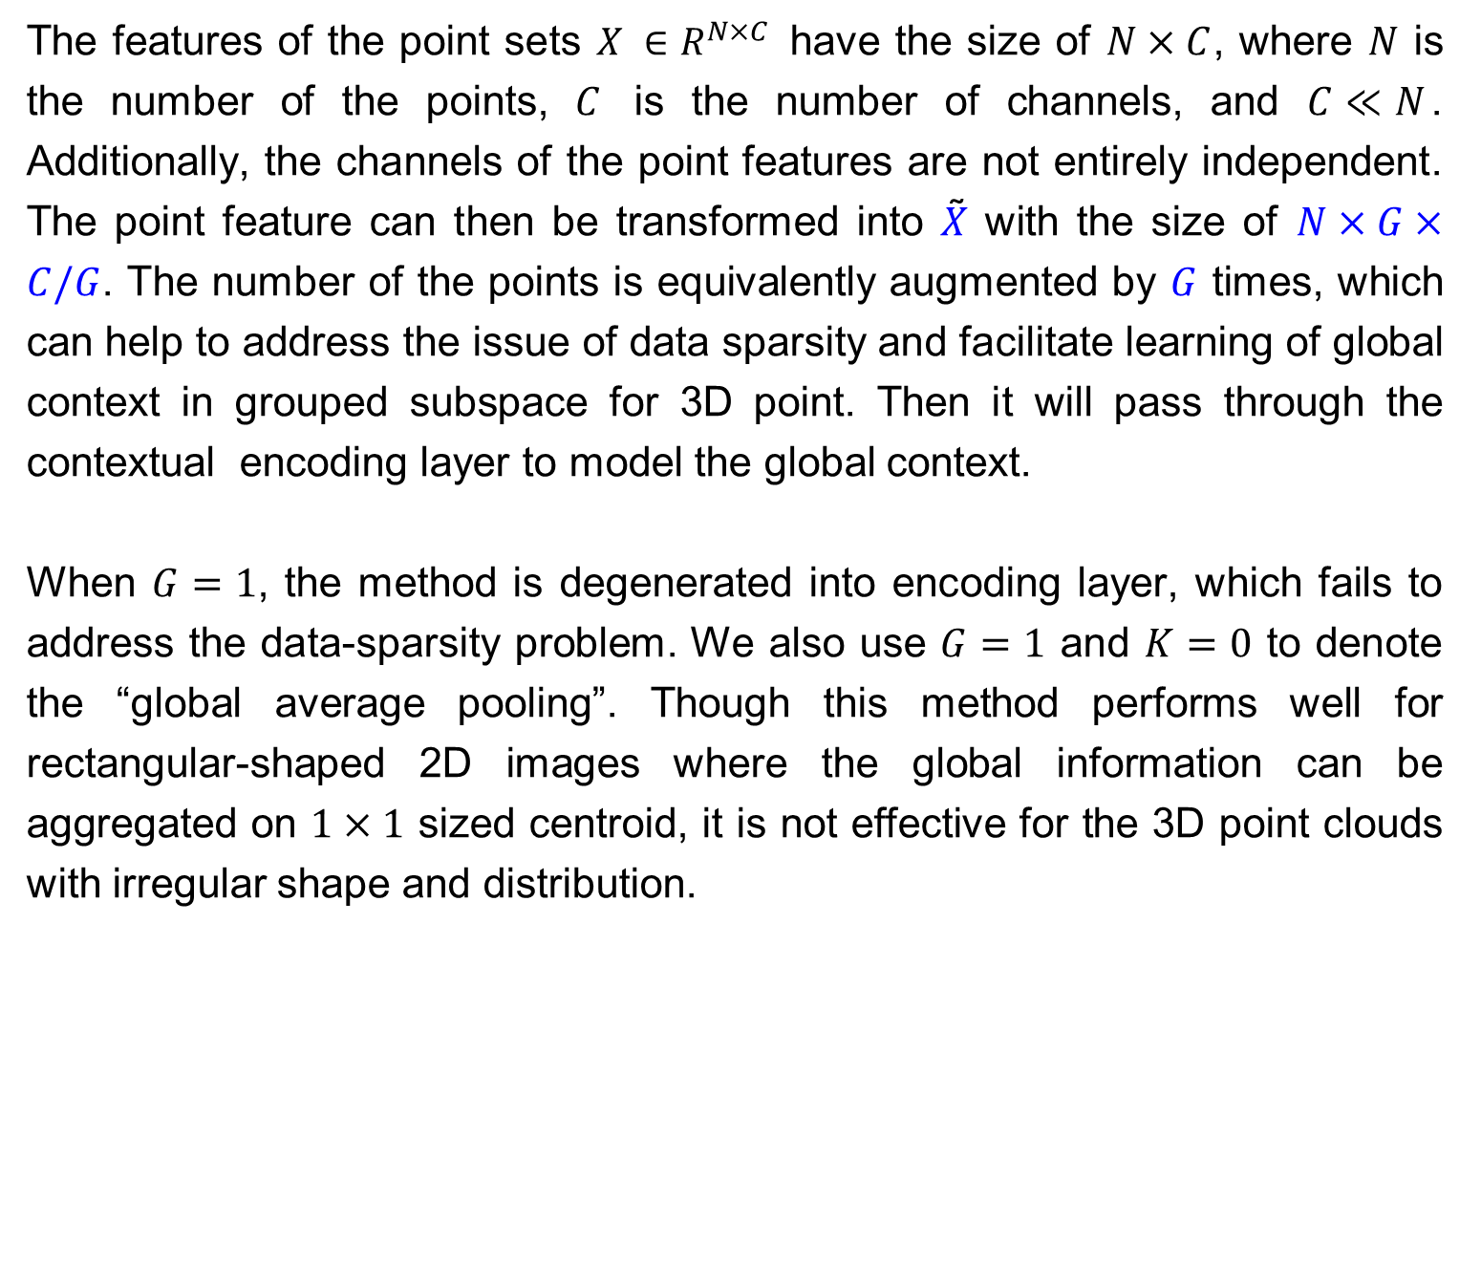
Group Contextual Encoding for 3D Point Clouds
Xu Liu^{1,2}, Chengtao Li³, Jian Wang⁴, Jingbo Wang⁵, Boxin Shi⁶, Xiaodong He²
¹The Univ. of Tokyo, ²JD AI Research, ³MIT,
⁴Snap Inc., ⁵CUHK, ⁶Peking Univ.
Motivation
Method
Experiments
We propose a group contextual encoding method which groups channel features and then performs encoding on group-divided feature vectors, so we can learn global context in grouped subspace for 3D point cloud effectively.
We evaluate our method on three widely-studied 3D point cloud tasks and observed 6.57 mAP@0.5 gain on ScanNet when compared to VoteNet.
Our method: “Group Contextual Encoding”
To better model the global contextual information efficiently
We extend the encoding layer to 3D point cloud scenarios to learn the global context effectively.
We propose grouping the channel features to address the data-sparsity problem of 3D point cloud scenarios.
New SOTA has been established on multiple benchmarks, significant improvements observed over previous baselines.
The result on SUN-RGBD
The result on ScanNet
The features of the point sets $X ∈R^{N×C}$ have the size of $N×C$, where $N$ is the number of the points, $C$ is the number of channels, and $C≪N$. Additionally, the channels of the point features are not entirely independent. The point feature can then be transformed into $X$̃ with the size of $N×G×C/G$. The number of the points is equivalently augmented by $G$ times, which can help to address the issue of data sparsity and facilitate learning of global context in grouped subspace for 3D point. Then it will pass through the contextual encoding layer to model the global context.
When $G=1$, the method is degenerated into encoding layer, which fails to address the data-sparsity problem. We also use $G=1$ and $K=0$ to denote the “global average pooling”. Though this method performs well for rectangular-shaped 2D images where the global information can be aggregated on $1×1$ sized centroid, it is not effective for the 3D point clouds with irregular shape and distribution.
Quantitative Evaluation
Intuition
The quantitative result on SUN-RGBD, evaluated with mAP@ 0.25
The encoding layer is an efficient method for modeling global context for 2D data.
Compared to 2D scenarios, data sparsity becomes a major issue in 3D point cloud scenarios, and the performance of contextual encoding quickly saturates when the number of code words increases. So we propose a group contextual encoding method which divides the channel into groups and then performs encoding on group-divided feature vectors. This method facilitates learning of global context in grouped subspace for 3D point clouds.
The quantitative result on ScanNet, evaluated with mAP@0.25
Ablation studies w.r.t. encoding and grouping methods
The quantitative result on ScanNet, evaluated with mAP@0.5
Saturation of performance w.r.t. the code word $K$
Code: https://github.com/AsahiLiu/PointDetectron
NeurIPS 2020 Poster ID: 540

