Slide 1




Radon Transform Imaging
Aswin C. Sankaranarayanan
Jian Wang
Mohit Gupta
Notes:
Good afternoon, every one.
The paper I am going to talk about is a novel imaging architecture for video compressive sensing

Slide 2
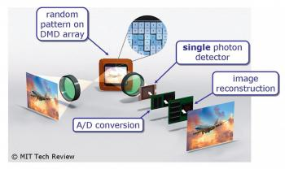
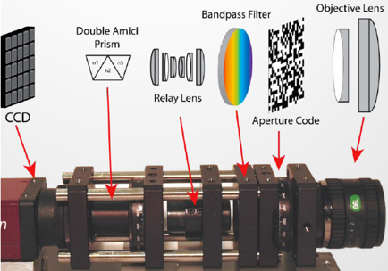
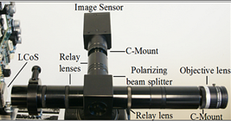
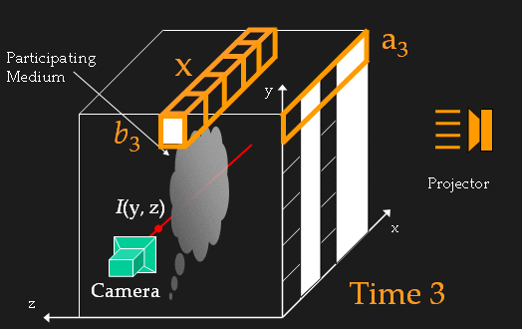
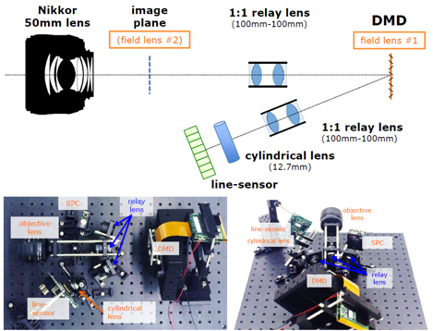
Compressive Imaging
single pixel camera
(Duarte et al. 2007)
CASSI
(Gehm et al. 2007,
Wagadarikar et al. 2008)
High-speed imaging
(Reddy et al. 2011, Hitomi et al. 2011, Holloway et al. 2012)
light transport/scattering media
(Gu et al. 2008, Peers et al. 2008, S. 2009,
Sen and Darabi 2009)
multi-pixel multiplexing cameras
(Mahalanobis et al. 2014, Kerviche et al. 2014,
Wang et al. 2015, Chen et al. 2015)

Slide 3
Spatial Multiplexing
Optically super-resolve a low-resolution sensor using a spatial light modulator
Table courtesy of Gehm and Brady, Applied Optics, 2015

Slide 4


Spatial Multiplexing
Optically super-resolve a low-resolution sensor using a spatial light modulator
objective lens
digital
micromirror device
(DMD)
~ ~ ~
photo-
detector
relay lens
ADC

Slide 5

Spatial Multiplexing
Optically super-resolve a low-resolution sensor using a spatial light modulator
objective lens
digital
micromirror device
(DMD)
~ ~ ~
Low-resolution array
relay lens
ADC
Low-resolution sensor
DMD

Slide 6
Key Limitations
Achievable spatial resolution is limited to that of the DMD
2-4 megapixels today
At least, half-the-light is lost due to spatial light modulator
Extended optical axis leads to vignetting and/or blur
objective lens
digital
micromirror device
(DMD)
~ ~ ~
Low-resolution array
relay lens
ADC

Slide 7
Key Limitations
Achievable spatial resolution is limited to that of the DMD
2-4 megapixels today
At least, half-the-light is lost due to spatial light modulator
Extended optical axis leads to vignetting and/or blur
Benefits of CS are magnified at high-resolutions
objective lens
digital
micromirror device
(DMD)
~ ~ ~
Low-resolution array
relay lens
ADC

Slide 8


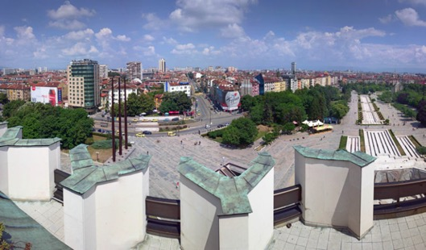



Sparsity of natural images
10 megapixel image

Slide 9
Sparsity of natural images
keep largest
K coefficients,
set others to zero
wavelet
transform
reconstruct
the image
N pixels,
N coefficients
K - # of non-zero coefficients
K/N – non-zero ratio

Slide 10

Sparsity of natural images
Reconstruction
SNR [dB]
Non-zero ratio
K/N
128128
35
0.1
SNR > 25 dB
30
K/N = 0.1
1 MP
25
20
0.01
20 MP
K/N = 0.01
1E4
1E5
1E6
1E7
1E4
1E5
1E6
1E7
128x128
1MP
10MP
N [in pixels]
N [in pixels]
K - # of non-zero coefficients
N - # of pixels

Slide 11
Key Limitations
Achievable spatial resolution is limited to that of the DMD
2-4 megapixels today
At least half-the-light is lost
Long optical chain leads to vignetting and/or blur
Benefits of CS are magnified at high-resolutions
We need a light-modulator free design for compressive imaging

Slide 12


Radon Transform Imaging
Tomographic measurements
Key idea underlying many medical imaging techniques including CT, MRI, etc.
Key question:
Can we achieve tomographic measurements optically (for imaging in visible/infrared) ?

Slide 13

Optical Setup
objective lens
optical
axis
line-sensor
rotation
stage
cylindrical
lens

Slide 14
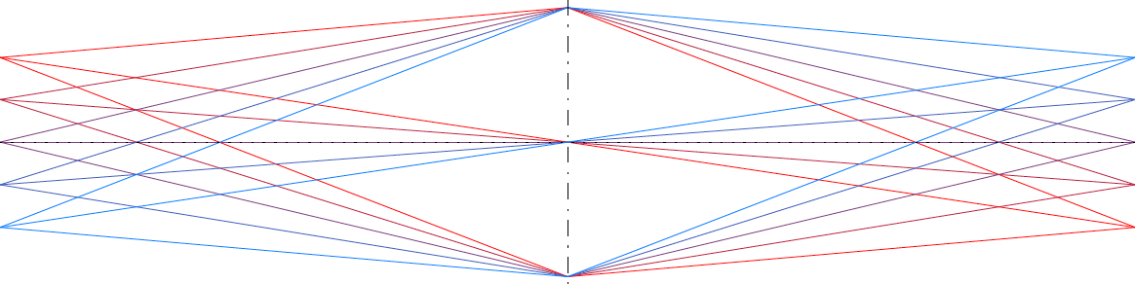
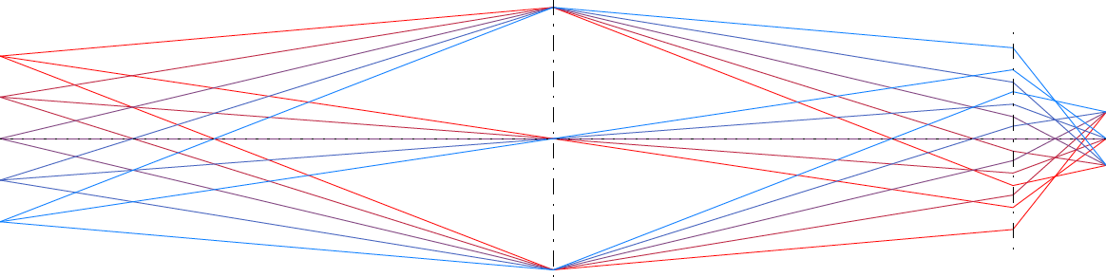
Optical Setup
Objective lens
Cylindrical lens
(focal length )
Line Sensor
scene plane
x
z
Line Sensor
scene plane
y
z
Objective lens
Cylindrical lens
(focal length )

Slide 15
Optical Setup
objective lens
optical
axis
line-sensor
rotation
stage
cylindrical
lens
Key properties
(i) Focuses light in the direction along the line-sensor
(ii)Defocuses light in the direction perpendicular to the line-sensor

Slide 16

Radon Transform Imaging
Recovering an image (or a video) is by solving a linear inverse problem
Many efficient solvers thanks to advances in CS and tomography/MRI.
x – image
y – measurements
A – measurement operator
Ψ – sparsifying prior
image x
measurement y

Slide 17
Benefits of Radon Transform Imaging
Given a line-sensor with N pixels, we can (in theory) achieve a spatial resolution of NxN
Hence, capable of achieving extremely high resolutions

Slide 18

Benefits of Radon Transform Imaging
Given a line-sensor with N pixels, we can (in theory) achieve a spatial resolution of NxN
Hence, capable of achieving extremely high resolutions
Fast implementation (via Fourier Slice Theorem)

Slide 19
Benefits of Radon Transform Imaging
Given a line-sensor with N pixels, we can (in theory) achieve a spatial resolution of NxN
Hence, capable of achieving extremely high resolutions
Fast implementation (via Fourier Slice Theorem)
No light loss
Requires careful design of optical elements
No long light paths (no vignetting etc)
Limitations: Moving components

Slide 20
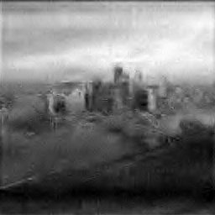
256x256
17.7 dB
10x Comp.

Slide 21
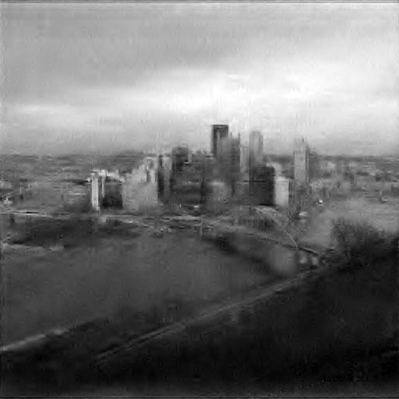
512x512
20.4 dB
10x Comp.

Slide 22

1024x1024
22.1 dB
10x Comp.

Slide 23

2048x2048
23.4 dB
10x Comp.

Slide 24
Summary
A spatial light modulator free design for imaging in visible/IR
Hence, capable of achieving extremely high resolutions
Has many desirable properties
Co-axial components
Little light loss with careful design of optical elements
Fast implementation via the Fourier transform

