Slide 1
STA 4103/5107
Computational Methods in Statistics II
Department of Statistics
Florida State University
Class 3
January 17, 2017

Slide 2



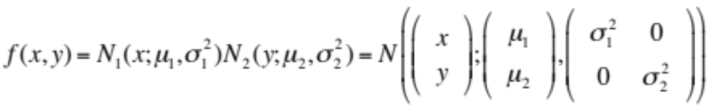
Some notes
Covariance on random vectors: X, Y in R^{n},
Properties of covariance: A in R^{mxn}
Two marginal normals do NOT always have a joint normal
But that is true for independent case

Slide 3
Review: Poisson Process
We model the times of occurrences, also called the arrival times. (e.g. ringing of a phone). The time lapses between the arrival times are called inter-arrival times.
Denote the arrival times by t_{i}s and the inter-arrival times by τ_{i}s. They are related according to:
t_{i} = t_{i−1} + τ_{i−1} .
A homogeneous Poisson process with intensity λ, is a process where τ_{i}s are assumed to be i.i.d. according to the exponential density with intensity λ, i.e.
f(τ) = λ exp(−λτ) τ ≥ 0
(note: Eτ_{i} = 1/ λ)

Slide 4
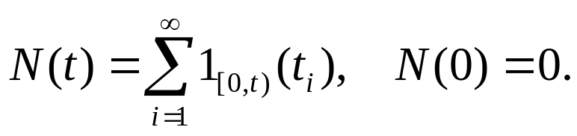
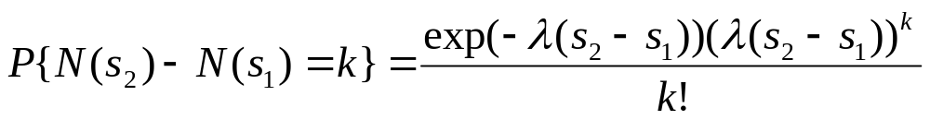
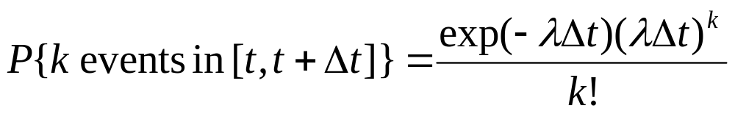
Review: Homogeneous Poisson Process
The resulting Poisson counting process can defined as follows:
N(t) counts the number of arrivals, or the occurrences, till time t.
Theorem 1: The inter-arrival time τ ∼ λ exp(−λτ) if and only if for any s₁ < s₂, and k = 0, 1, 2, …
Definition 1: A homogeneous Poisson process is a process with a constant intensity λ. That is, for any time interval [t, t+Δt],

Slide 5
Main Theorem
Theorem 1: The inter-arrival time τ ∼ λ exp(−λτ) if and only if for k = 0, 1, 2, …
Proof: (if) Let τ represent time distance between two events in a homogeneous Poisson process with rate λ. Then, for any T > 0
P{τ > T}= P{no event in [0, T]} = e ^{– λT} .
Therefore,
P{τ ≤ T}=1 – e ^{– λT} ,
and the p.d.f.
f(τ) = λ exp(−λτ )

Slide 6
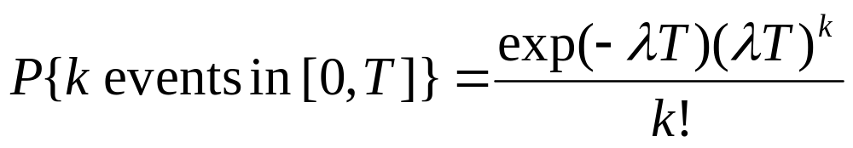
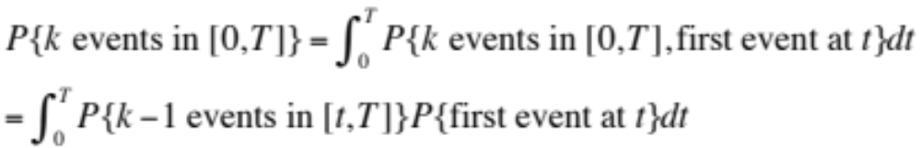
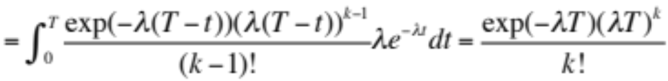
Main Theorem
(only if) Simplification: we only show that for any T > 0,
We use mathematical induction.
k = 0: P{no events in [0, T]} = P{inter-arrival time τ > T} = e ^{– λT} .
Assume the conclusion holds with k – 1 events. Then,

Slide 7
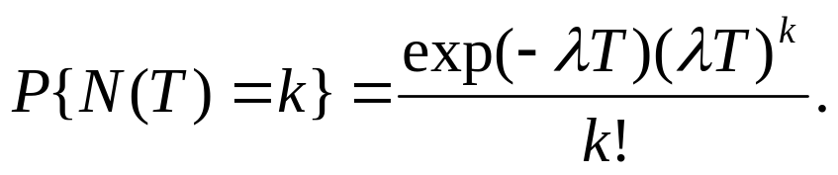
Mathematical Definition
Definition 1: A homogeneous Poisson process is a process with a constant rate λ. That is, for any time interval [t, t+Δt],
Therefore, event count in [0, T] follows a Poisson distribution with rate λT. That is,
Then,

Slide 8
Simulation
Simulation of a homogeneous Poisson process with rate λ on [0, T]:
Method 1:
Generate τ_{i}s from the exponential density, and use the equation t_{i} = t_{i−1} + τ_{i−1} to compute the arrival times. Stop when t_{i} > T.
Method 2:
Step 1: Sample k from Poisson distribution with mean λT.
Step 2: Sample s₁, …, s_{k} i.i.d. from uniform [0, T].

Slide 9
Example
Simulate a homogeneous Poisson process with intensity λ = 0.2 over the interval [0, 100]. Generate 30 sample paths and display them on the same plot.
Show the overall histogram.
Count the number of events occurring in the interval [10, 80]. Plot a histogram of 30 realizations of this random number. Compare the sample to a Poisson distribution with the same mean.
Both methods 1 and 2 can be used.

