Slide 1
Monte Carlo Methods
Introduction

Slide 2
Random Numbers
In 1955, RAND Corporation introduced a table of one million digits produced from electronic noise. Mechanical faults in the recording mechanism were later found which spoiled the “randomness” suggested by the theory of electronics!
Notes:
The other question, “Who messed up my random numbers” should not be taken literally. It was actually inspired by a joke told to me, by an algebraist/topologist, Melvin Henriksen. Here is the joke:…………
There is actually a truth to this joke. In 1955….

Slide 3
What really is a random number?
What really is a random number sequence?
Which one of these binary strings look random?
00000000000000000000
01101010000010011110
11011110011101011111
They all have the same probability of occurrence (1/2)²⁰
Notes:
Is 5 a random number? Is Pi a random number? This question does not really make much sense does it? We really want to talk about sequences of numbers, not a single number, so let’s rephrase as: What really is a random number sequence? Let’s concentrate on binary digits, 0’s and 1’s, and try to figure out the meaning of randomness for such numbers. In other words, we are considering the tosses of a fair coin, with the two outcomes labeled as 0 and 1. Now let’s look at 3 finite sequences of digits, and explore the randomness of them.
We would probably agree that the first sequence does not look random at all, but the others look random. Why makes us think this way? Does this intuition have anything to do with the probability of occurrence of these sequences? Not really…
However, many people would actually disagree with this result, when it is presented in a less mathematical setting:

Slide 4
Gambler’s Fallacy: In a game of chance, after a sequence of losses there will be a sequence of gains
70% of the population of Ontario, Canada, believes that if a slot machine has just paid out three times in a row, the chance of winning on the next pull are lower than would otherwise be the case (Turner, & Liu, 1999)
Notes:
Perhaps there is a good reason for this misconception. Perhaps the reason for this misconception is because we know that the empirical distribution of, say a sequence of tosses of a fair coin, should be about 50% of each outcome. Therefore when we see a long sequence of, say, “heads” we expect the sequence to “correct” itself by a long sequence of “tails”.
The problem with this argument is that the coin, does not have a clue on the outcomes it produced earlier! Every time we flip it, it falls to the ground following the laws of nature. So if you really think the sequence should correct itself after a long run of one outcome, then you should ask mother nature to do this correction!
Believe it or not, this turns out to be a common thought in early 1900’s. Let’s read the following taken from a classic book on probability.

Slide 5
From “An Introduction to Probability Theory and Its Applications”, W. Feller:
“The man in the street, and also the philosopher K. Marbe (Die Gleichformigkeit in der Welt, Munich, 1916) believe that after a run of seventeen heads a tail becomes more probable. This argument has nothing to do with imperfections of physical coins; it endows nature with memory, or, in our terminology, it denies the stochastic independence of successive trials. Marbe’s theory cannot be refuted by logic but it is rejected because of lack of empirical support.”

Slide 6
Back to…
Which one of these binary strings look random?
00000000000000000000
01101010000010011110
11011110011101011111
These sequences are obtained from:
constant string
first 20 binary digits of (2^{1/2} - 1)
actual coin tossing
Notes:
Let’s go back to the question we raised earlier about random digits. Now we know that the probability of occurrence does not play a role here. Perhaps the reason we think the first sequence is not random is because it is easy to predict it; or, equivalently, it is easy to generate it.
The first sequence is obvious, but how about the 2nd and 3rd? Is it easier to generate one than the other? What if I gave you more information:
So we have a procedure to generate the first 2 strings; the first procedure is much easier to implement than the other, and the sequence it produces looks less random than the 2nd one. There is no known procedure to generate the 3rd sequence.
This line of thought takes us to the notion of incompressibility and randomness through incompressibility.

Slide 7
Randomness as Incompressibility
Binary string
x₁x₂…x_{n}
Procedure that generates string
coded as a binary digit of length n
coded as a binary digit of length m
If m << n , then the string is not "random"

Slide 8
00000000000000000000 → "print zero 20 times": can be coded using a little more than log₂ 20 bits
11011110011101011111 → no pattern: write each digit one by one, requiring 20 bits

Slide 9
The algorithmic complexity K(x₁x₂…x_{n}) of a string x₁x₂…x_{n} is defined as the size of the smallest input program p that outputs the string, when fed to a Turing machine
|input program|= p
TM
x₁x₂…x_{n}
Kolmogorov: A sequence is random (incompressible) if it has initial segments of high algorithmic complexity
x = x₁x₂…x_{n} is incompressible when there exists a constant c such that
for all n
Notes:
The concepts, “procedure” and “coding of procedures” are made rigorous in the following way.

Slide 10
Randomness as Typicality
Concentrate on infinite sequences of binary digits
00101000101000…
For it to qualify as a random sequence, we would expect the sequence to satisfy
Relative frequencies of 0 and 1 converge to ½
…
…
…
Notes:
The first condition here is merely the law of large numbers. There are, of course, many other laws satisfied by truly random sequences

Slide 11
Typical sequence
satisfies all properties that occur with probability 1
satisfies all Turing computable properties that occur with probability 1
Martin-Löf random sequence
Notes:
A typical sequence, in some sense, a featurless sequence. A sequence not easy to identify. It should then satisfy all the properties satisfied by “most” of the sequences. This definition turns out to be overly restrictive – giving the set of typical sequences empty sets in some cases.
Martin-Lof obtained a way of restricting the requirements.

Slide 12
Theorem: These two notions of randomness (typicality and compressibility) are equivalent

Slide 13
A Martin-Löf random sequence: A sequence that passes infinitely many tests
Question: Can we see an example of such a sequence?
Answer: No! An element of this sequence is noncomputable!

Slide 14
How do we generate random numbers for practical use?
Pseudorandom numbers: They satisfy only finitely many properties (statistical tests) that occur with probability 1
Example: Linear Congruential Generators
Notes:
But we need random numbers in applications – what are we going to do? Well, we settle with less, and require that the sequence only passes finitely many tests, statistical tests, instead of infinitely many tests. We call such sequences pseudorandom sequences.
An active area of research in MC is the generation of pseudorandom numbers, and advances in this field helps us use pseudorandom numbers with better statistical properties, and improve our basic MC computations.

Slide 15
What is the Monte Carlo method?
Notes:
Now back to our title, and to last question it raises: What is Monte Carlo? Or more accurately, What is the Monte Carlo method?

Slide 16
Solving Problems using Games of Chance: Two Popular Examples
Buffon’s needle problem (G. Comte de Buffon-1777)
Distance of d
Needle of
length L
Assume: L ≤ d
Java Simulation
Written by Michael J. Hurben

Slide 17
Finding the area under a curve by throwing darts!
1
*
*
*
*
*
*
0
1
AREA ≈
Java simulation
Written by Julian Devlin

Slide 18
Mathematical Foundation of Monte Carlo
We want to estimate
Draw X₁, X₂,…, X_{n} from the uniform distribution on (0,1)^{s}
to construct
We have

Slide 19
PROPERTIES:
Dimension independent probabilistic error bound
O(N^{-1/2})
Error can be measured by sample standard deviation
Requires generation of “random” numbers (pseudorandom numbers)

Slide 20
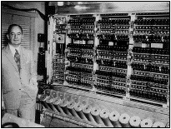
Developed in 1940’s by Metropolis, Ulam, von Neumann, Fermi.
(Manhattan Project - Los Alamos Lab)
Used to solve integro-differential equations

Slide 21
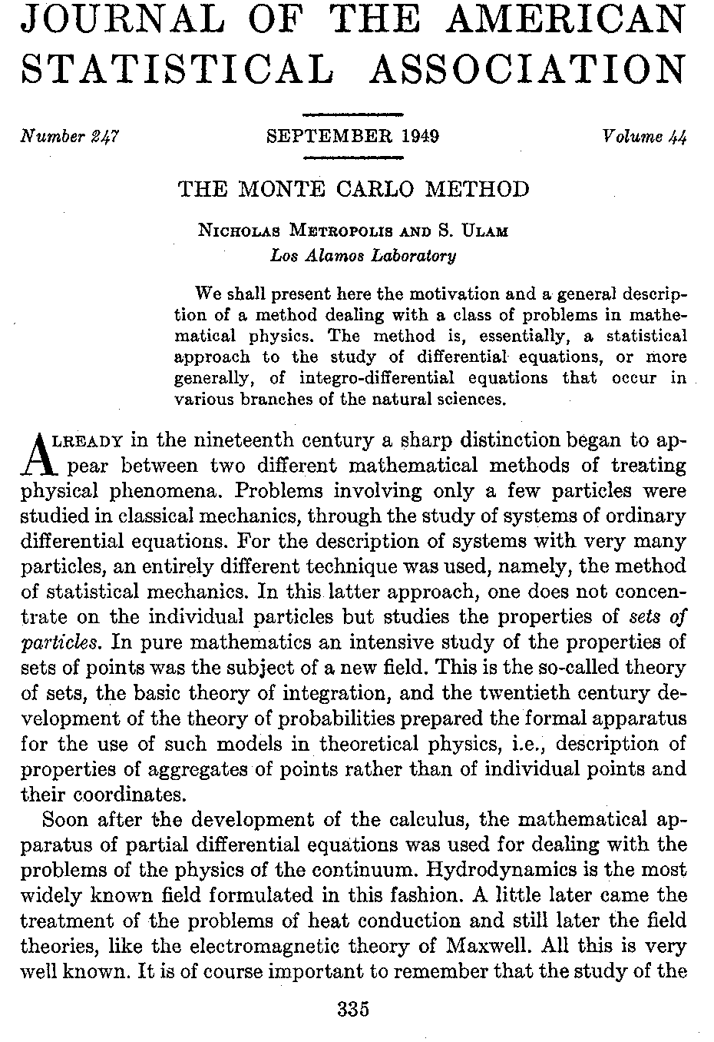

Slide 22
Problem/System
OUTPUT
Monte Carlo simulation:
1. Roll the dice, and get an output x_{i}
2. Average over all x_{i}’s
Notes:
In a nut shell, here is how I can describe MC: There is a problem you want to solve, but there is a dice in it! In other words, the problem has uncertaintly, a stochastic component, in itself. This makes the output, a random variable, a random output as well. You then simulate the problem, by rolling the dice, and read the corresponding output. By rolling the dice multiple times, and averaging over the outcomes, you obtain an estimate for the output.

Slide 23
Two kinds of problems where we use Monte Carlo:
Problems that are intrinsically stochastic – and we use pseudorandom numbers to simulate the stochastic feature
Problems that do not have any randomness to start with
Notes:
I will now give examples. These are examples from problems that I worked on in the past. I will also extend our scope a little and will talk about randomized algorithms.

Slide 24
Problems that are intrinsically stochastic
Modeling the behavior of stock price
Modeling the behavior of a molecule immersed in liquid
Modeling the growth of an insect population on the basis of certain statistics of survival and reproduction
Notes:
An example of the first kind is the financial calculators.

Slide 25
Problems that are not intrinsically stochastic
Numerical Integration:
Solving matrix equations: x = P x + a
Solving integral equations
Finding the extreme values of a function
Finding the trace of a large matrix
Notes:
In all these problems, you construct an appropriate probability space, and write the unknown quantity that you are trying to estimate as the expected value of a random variable over the probability space. Then you estimate this expected value by sample averages. So, good things can happen when you “randomize” a deterministic problem! In fact, some of the early leaders in Monte carlo research advocated the use of the Monte Carlo name only for methods designed to solve these type of problems. Now, let’s broaden our scope a little bit, and talk about the other good things than can happen when you randomize deterministic algorithms.

Slide 26
Some application areas:
    Numerical solution of integral equations, inverse problems
    Computational finance
    Numerical linear algebra
    Mathematical biology

Slide 27
Issues in Monte Carlo
Improving the basic MC estimator using variance reduction techniques
  Importance sampling
  Control variates
  Antithetic variates
  Stratified sampling
  Conditional Monte Carlo
  …
Using quasi-MC, randomized quasi-MC, etc, to improve estimates

Slide 28
Using Monte Carlo Simulation to Price Options
Discretize the continuous time interval [0,T] into n time intervals of length Δt;
Generate N price paths for the underlying security
using the recursion
Compute the option value for each path, take the average over all paths, and find its present value

Slide 29
Example: Pricing an Asian arithmetic option
Payoff function for Asian arithmetic option
Payoff function for Asian geometric option
Notes:
There is no analytical formula for the price of an Asian arithmetic option, so we have to use a numerical approach. In contrast, a close relative, Asian geometric options can be evaluated exactly.
One would expect that these two options would be related, or correlated, because of the similarities. In such situations, we have the powerful control variate method that improves the basic MC estimator

Slide 30
Numerical results
σ | E | Crude Monte Carlo | (Std. Dev.) | Control Variate | (Std. Dev.)
 | 35 | 12.5811 | 3.26311 | 12.6139 | 0.580052
0.2 | 40 | 10.7969 | 3.28483 | 10.8298 | 0.587144
 | 45 | 9.03738 | 3.26559 | 9.05305 | 0.58854
 | 35 | 12.6293 | 4.9981 | 12.6268 | 0.929305
0.3 | 40 | 10.8417 | 4.97065 | 10.8378 | 0.928284
 | 45 | 9.07297 | 4.97768 | 9.05811 | 0.928032
 | 35 | 12.6059 | 6.68868 | 12.6143 | 1.32207
0.4 | 40 | 10.8199 | 6.75828 | 10.8532 | 1.35542
 | 45 | 9.10499 | 6.62169 | 9.12881 | 1.34907

Slide 31
Control variates
The solution of the other problem
The original MC estimator
An estimator for another problem
FACT: Var Y < Var X, if X and Y are correlated problems

Slide 32
What are Quasi-Monte Carlo Methods?
"Any one who considers arithmetical methods of producing random digits is, of course, in a state of sin. For, as has been pointed out several times, there is no such thing as a random number-there are only methods to produce random numbers, and a strict arithmetical procedure is of course not such a method. (It is true that a problem we suspect of being solvable by random methods may be solvable by some rigorously defined sequence, but this is a deeper mathematical question than we can go into now.)"
John von Neumann

Slide 33
Low-discrepancy sequences
Van der Corput sequence in base 2
Mathematica simulation

Slide 34
Other low-discrepancy sequences
Halton sequence – obtained by combining van der Corput sequences in relatively prime basis
Faure sequence
Sobol’ sequence
Niederreiter (constructed two sequences)

Slide 35
Math used in constructions
Ergodic theory
Number theory
Algebraic geometry

Slide 36
Problem:

Slide 37
Integrating

Slide 38
Course Outline
Introduction and History of Monte Carlo Methods
Chapter 1: Pseudorandom Number Generation
Chapter 2: Statistical Tests for Randomness
Chapter 3. Generation of Random Variables
Chapter 4: Generation of Stochastic Processes
Chapter 5: Quasi-Monte Carlo Methods
Chapter 6: Variance Reduction Techniques
Chapter 7: Estimating Sensitivities

