Slide 1
Thread synchronization
More about portability
Mutex
Conditional variables

Slide 2
More about portability
Some system calls are only supported in certain versions of UNIX
  E.g. kill
Compiled with –ansi –std=c99 –Wall will give a warning.
  See lect6/example5.c

Slide 3
More about portability
How to get rid of that warning?
  Use the man page which version that the system call belongs to
  Identify the program as that particular version
    See /usr/include/features.h on linux, or /usr/include/sys/feastures.h in solaris to know how to do this
    Example: Programs that should work on BSD
      #define _BSD_SOURCE at the beginning of the code
      Add –D_BSD_SOURCE to gcc flags.

Slide 4
Thread synchronization
Threads in mm_pthread.c and pi_pthread.c have very minor interactions.
  All computations are independent (essential for parallel execution)
Dependencies in a program can cause problems in parallel execution.
  for (i=0; i<100; i++) for(i=0; i<100; i++)
  a[i] = 0; a[i] = a[i-1]+1;

Slide 5
Thread synchronization
Most of threaded programs have threads that interact with one another.
  Interaction in the form of sharing access to variables.
    Multiple concurrent reads (ok)
    Multiple concurrent writes (not ok, outcome non-deterministic)
    One write, multiple reads (not ok, outcome non-deterministic)
  Needs to make sure that the outcome is deterministic.
    Synchronization: allowing concurrent accesses to variables, removing non-deterministic outcome by enforcing the order of thread execution.

Slide 6


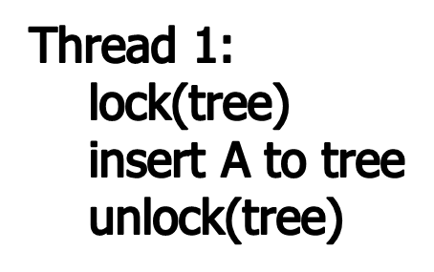
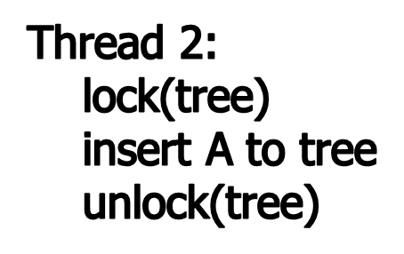
Thread synchronization
Typical types of synchronizations.
  Mutual exclusion (mutex in pthread):

Slide 7
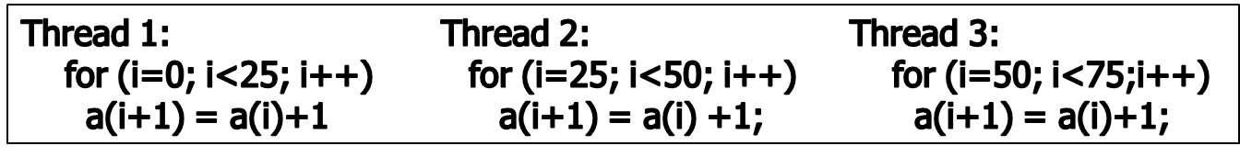
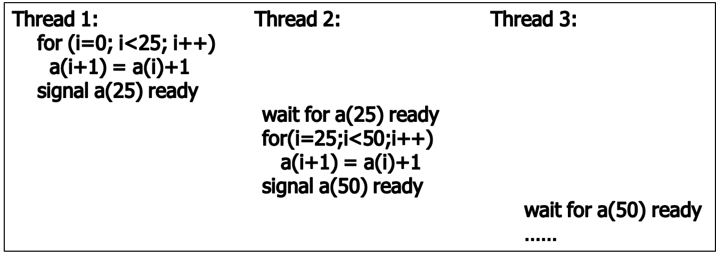
Thread synchronization
Signal (ordering the execution of threads, condition variable)

Slide 8
A pthread example (example1.c)
int counter = 0;
void *thread_producer(void *arg)
{
int val;
/* produce a product */
counter++;
return NULL;
}
Could there be any problem in this code?

Slide 9
An example (example1.c)
int counter = 0;
void *thread_producer(void *arg)
{
int val;
/* produce a product */
counter++; /* this may not be atomic */
return NULL;
}
Most constructs in the high level language are not atomic!!
Need to make them atomic explicitly in a threaded program. Solution: mutex

Slide 10
Mutex variables
Mutex = abbreviation for “mutual exclusion”
  Primary means of implementing thread synchronization and protecting shared data with multiple concurrent writes.
A mutex variable acts like a lock
  Multple threads can try to lock a mutex, only one will be successful; other threads will be blocked until the owning thread unlock that mutex.

Slide 11
Mutex variables
A typical sequence in the use of a mutex is as follows:
  Create and initialize a mutex variable
  Several threads attempt to lock the mutex
  Only one succeeds and that thread owns the mutex
  The owner thread performs some set of actions
  The owner unlocks the mutex
  Another thread acquires the mutex and repeats the process
  Finally the mutex is destroyed

Slide 12
Mutex operations
Creation:
  pthread_mutex_t my = PTHREAD_MUTEX_INITIALIZER
Destroying:
  pthread_mutex_destroy(pthread_mutex_t *mutex);
Locking and unlocking mutexes
  pthread_mutex_lock(pthread_mutex_t *mutex);
  pthread_mutex_trylock(pthread_mutex_t *mutex);
  pthread_mutex_unlock(pthread_mutex_t *mutex);

Slide 13
Mutex example (example2.c)
int counter = 0;
ptread_mutex_t mutex = PTHREAD_MUTEX_INITIALIZER;
void *thread_func(void *arg)
{
int val;
/* protected by mutex */
Pthread_mutex_lock( &mutex );
val = counter;
counter = val + 1;
Pthread_mutex_unlock( &mutex );
return NULL;
}
How about
Making mutex a local variable?

Slide 14
Condition Variable
Waiting and signaling on condition variables
Routines
  pthread_cond_wait(condition, mutex)
    Blocks the thread until the specific condition is signalled.
    Should be called with mutex locked
    Automatically release the mutex lock while it waits
    When return (condition is signaled), mutex is locked again
  pthread_cond_signal(condition)
    Wake up a thread waiting on the condition variable.
    Called after mutex is locked, and must unlock mutex after
  pthread_cond_broadcast(condition)
    Used when multiple threads blocked in the condition

Slide 15
Condition Variable – for signaling
Think of Producer – consumer problem
Producers and consumers run in separate threads.
Producer produces data and consumer consumes data.
Producer has to inform the consumer when data is available
Consumer has to inform producer when buffer space is available

Slide 16
Without Condition Variables

Slide 17
  /* Globals */
  int data_avail = 0;
  pthread_mutex_t data_mutex = PTHREAD_MUTEX_INITIALIZER;
  void *producer(void *)
  {
  Pthread_mutex_lock(&data_mutex);
  Produce data
  Insert data into queue;
  data_avail=1;
  Pthread_mutex_unlock(&data_mutex);
  }

Slide 18
  void *consumer(void *)
  {
  while( !data_avail );
  /* do nothing – keep looping!!*/
  Pthread_mutex_lock(&data_mutex);
  Extract data from queue;
  if (queue is empty)
  data_avail = 0;
  Pthread_mutex_unlock(&data_mutex);
  consume_data();
  }

Slide 19
With Condition Variables

Slide 20
  int data_avail = 0;
  pthread_mutex_t data_mutex = PTHREAD_MUTEX_INITIALIZER;
  pthread_cont_t data_cond = PTHREAD_COND_INITIALIZER;
  void *producer(void *)
  {
  Pthread_mutex_lock(&data_mutex);
  Produce data
  Insert data into queue;
  data_avail = 1;
  Pthread_cond_signal(&data_cond);
  Pthread_mutex_unlock(&data_mutex);
  }

Slide 21
  void *consumer(void *)
  {
  Pthread_mutex_lock(&data_mutex);
  while( !data_avail ) {
  /* sleep on condition variable*/
  Pthread_cond_wait(&data_cond, &data_mutex);
    }
  /* woken up */
  Extract data from queue;
  if (queue is empty)
  data_avail = 0;
  Pthread_mutex_unlock(&data_mutex);
  consume_data();
  }

Slide 22
A multi-threaded application: the Traveling Salesman problem (TSP)
Input: a list a city and a matrix of distances between them, and a starting city.
Goal: Find the shortest tour in which all cities are visited exactly once.
An example of a well-known NP-complete problem

Slide 23
The branch and bound algorithm for TSP
Initialization:
  Go from the starting city to each of the remaining cities
  Put resulting partial path into priority queue, order by its current length
Further (repeatedly):
  Take head element out of priority queue
  Expand by each one remaining cities
  Put resulting partial path into the priority queue.

Slide 24
Finding the solution
When a complete path is found, check if the path is better than the current best tour, and update the best tour if needed.
When the priority queue is empty, best path is found.

Slide 25
Bound
Once a tour is found, the upper bound on the length of the shortest is known
  No need to exploring partial paths that are already longer than the bound
  Remove from the queue.

Slide 26
Sequential TSP (omit bounding)
Init_q(); init_best();
While ((p=de_queue())!=NULL) {
for each expansion by one city {
q = add_city(p);
if (complete(q)) {update_best(q);}
else {en_queue(q);}
}
}

Slide 27
Parallel TSP
Have each thread do one expansion.
Have each thread do expansion of one partial path.
Have each thread do expansion of multiple partial paths.
All correct, a matter of performance/granularity.

Slide 28
Parallel TSP
Thread i:
while ((p = de_queue()) != NULL) {
for each expansion by one city {
q = add_city(p);
if (complete(q)) {update_best(q)}
}
}

Slide 29
Synchronization in Parallel TSP
In De_queue: wait if q is empty
  Done with all threads are in de_queue.
In en_queue: signal that q is no longer empty.
Q(en_queue and de_queue) and best are shared: should be protected by mutex.

