Slide 1
Introduction to OpenMP
Introduction
OpenMP basics
OpenMP directives, clauses, and library routines

Slide 2
Motivation
Look at lect9/mm.c and lect9/mm_pthread.c
  What we really want is to run the loop using multiple threads
  pthread is too tedious
  A better interface: just say the loop needs to be executed in parallel by multiple threads, let the compiler do the rest -- this is what OpenMP does. See mm_omp.c

Slide 3
What is OpenMP?
What does OpenMP stands for?
  Open specifications for Multi Processing via collaborative work between interested parties from the hardware and software industry, government and academia.
OpenMP is an Application Program Interface (API) that may be used to explicitly direct multi-threaded, shared memory parallelism.
    API components: Compiler Directives, Runtime Library Routines. Environment Variables
OpenMP is a directive-based method to invoke parallel computations on share-memory multiprocessors

Slide 4
What is OpenMP?
OpenMP API is specified for C/C++ and Fortran.
OpenMP is not intrusive to the orginal serial code: instructions appear in comment statements for fortran and pragmas for C/C++.
See mm.c and mm_omp.c
OpenMP website: http://www.openmp.org
  Materials in this lecture are taken from various OpenMP tutorials in the website and other places.

Slide 5
Why OpenMP?
OpenMP is portable: supported by HP, IBM, Intel, SGI, SUN, and others
  It is the de facto standard for writing shared memory programs.
  To become an ANSI standard?
    Already supported by gcc (version 4.2 and up)
OpenMP can be implemented incrementally, one function or even one loop at a time.
  Very nice way to get a parallel program from a sequential program.

Slide 6
How to compile and run OpenMP programs?
Gcc 4.2 and above supports OpenMP 3.0
  gcc –fopenmp a.c
To run: ‘a.out’
  To change the number of threads:
    setenv OMP_NUM_THREADS 4 (tcsh) or export OMP_NUM_THREADS=4(bash)

Slide 7
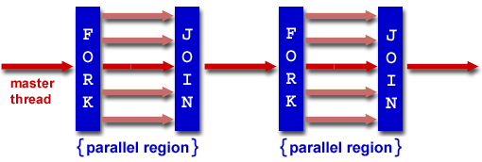
OpenMP programming model
OpenMP uses the fork-join model of parallel execution.
  All OpenMP programs begin with a single master thread.
  The master thread executes sequentially until a parallel region is encountered, when it creates a team of parallel threads (FORK).
  When the team threads complete the parallel region, they synchronize and terminate, leaving only the master thread that executes sequentially (JOIN).

Slide 8
OpenMP general code structure
#include <omp.h>
main () {
int var1, var2, var3;
Serial code
. . .
/* Beginning of parallel section. Fork a team of threads. Specify variable scoping*/
#pragma omp parallel private(var1, var2) shared(var3)
{
/* Parallel section executed by all threads */
. . .
/* All threads join master thread and disband*/
}
Resume serial code
. . .
}

Slide 9
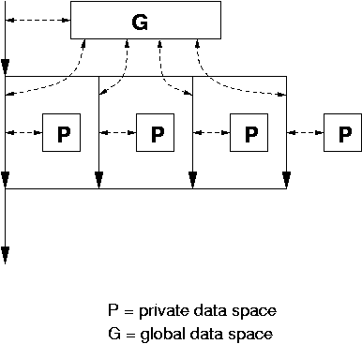
Data model
Private and shared variables
  Variables in the global data space are accessed by all parallel threads (shared variables).
  Variables in a thread’s private space can only be accessed by the thread (private variables)
    several variations, depending on the initial values and whether the results are copied outside the region.

Slide 10
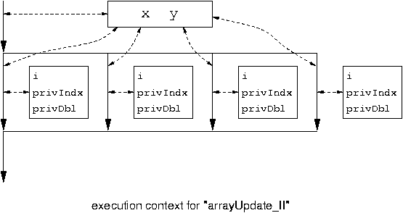
#pragma omp parallel for private( privIndx, privDbl )
for ( i = 0; i < arraySize; i++ ) {
for ( privIndx = 0; privIndx < 16; privIndx++ ) { privDbl = ( (double) privIndx ) / 16;
y[i] = sin( exp( cos( - exp( sin(x[i]) ) ) ) ) + cos( privDbl );
}
}
Parallel for loop index is
Private by default.

Slide 11
When can we mark a loop a parallel loop?
  How should we declare variables shared or private?
for ( i = 0; i < arraySize; i++ ) {
for ( privIndx = 0; privIndx < 16; privIndx++ ) {
privDbl = ( (double) privIndx ) / 16;
y[i] = sin( exp( cos( - exp( sin(x[i]) ) ) ) ) + cos( privDbl );
}
}
Parallel loop: executing each iteration concurrently is the same
as executing each iteration sequentially.
  no loop carry dependencies: an iteration does not produce
  any data that will be consumed by another iteration.
    y[i] is different for each iteration. privDbl is not (must
    make it private to be correct).

Slide 12
OpenMP directives
Format:
  #pragma omp directive-name [clause,..] newline
  (use ‘\’ for multiple lines)
Example:
  #pragma omp parallel default(shared) private(beta,pi)
Scope of a directive is a block of statements { …}

Slide 13
Parallel region construct
A block of code that will be executed by multiple threads.
  #pragma omp parallel [clause …]
  {
  ……
  } (implied barrier)
  Example clauses: if (expression), private (list), shared (list), default (shared | none), reduction (operator: list), firstprivate(list), lastprivate(list)
  if (expression): only in parallel if expression evaluates to true
  private(list): everything private and local (no relation with variables outside the block).
  shared(list): data accessed by all threads
  default (none|shared)

Slide 14
The reduction clause:
Sum = 0.0;
#pragma parallel default(none) shared (n, x) private (I) reduction(+ : sum)
{
For(I=0; I<n; I++) sum = sum + x(I);
}
  Updating sum must avoid race condition
  With the reduction clause, OpenMP generates code such that the race condition is avoided.
  See example3.c and example3a.c

Slide 15
Work-sharing constructs
#pragma omp for [clause …]
#pragma omp section [clause …]
#pragma omp single [clause …]
The work is distributed over the threads
Must be enclosed in parallel region
No implied barrier on entry, implied barrier on exit (unless specified otherwise)

Slide 16
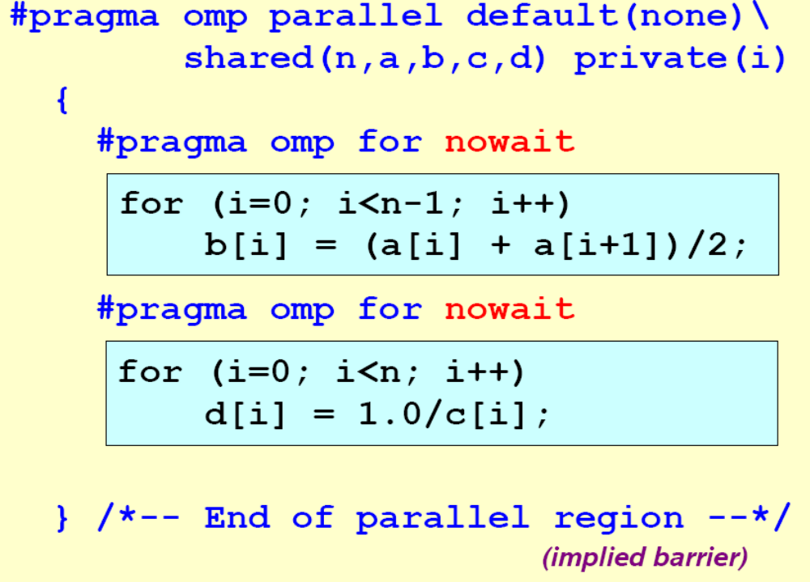
The omp for directive: example

Slide 17
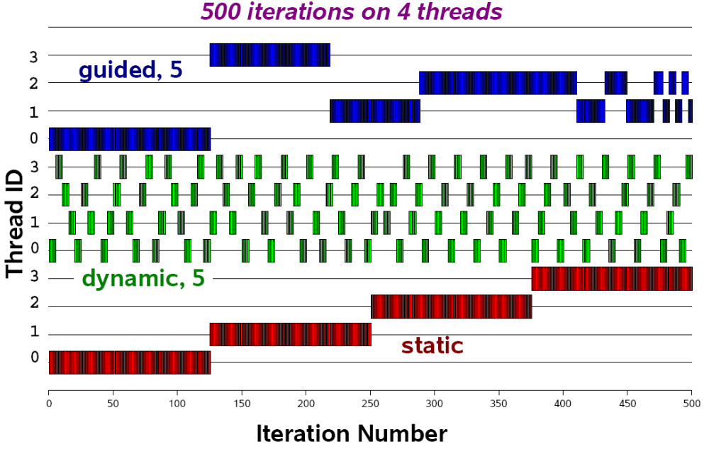
Schedule clause (decide how the iterations are executed in parallel):
  schedule (static | dynamic | guided [, chunk])

Slide 18
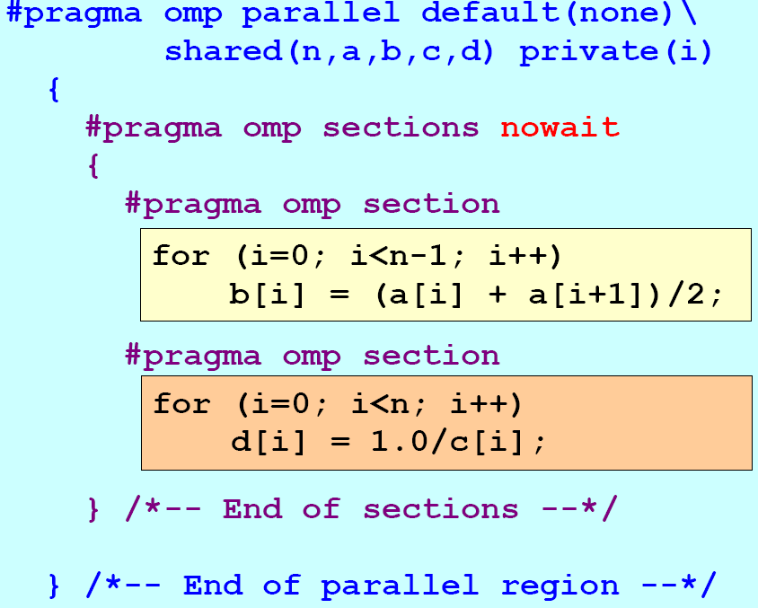
The omp session clause - example

Slide 19
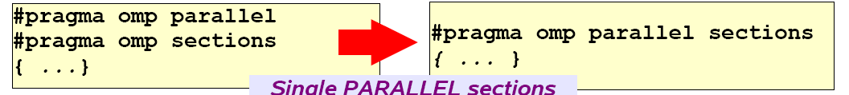

Slide 20
Synchronization: barrier
For(I=0; I<N; I++)
a[I] = b[I] + c[I];
For(I=0; I<N; I++)
d[I] = a[I] + b[I]
Both loops are in parallel region
With no synchronization in between.
What is the problem?
Fix:
For(I=0; I<N; I++)
a[I] = b[I] + c[I];
#pragma omp barrier
For(I=0; I<N; I++)
d[I] = a[I] + b[I]

Slide 21
Critical session
For(I=0; I<N; I++) {
……
sum += A[I];
……
}
Cannot be parallelized if sum is shared.
Fix:
For(I=0; I<N; I++) {
……
#pragma omp critical
{
sum += A[I];
}
……
}

Slide 22
OpenMP environment variables
OMP_NUM_THREADS
OMP_SCHEDULE

Slide 23
OpenMP runtime environment
omp_get_num_threads()
omp_get_thread_num()
omp_in_parallel
Routines related to locks
……

Slide 24
Lock related routines
Will only discuss simple lock: may not be locked if already in a locked state.
Simple lock interface:
  Type: omp_lock_t
  Operations:
    omp_init_lock(omp_lock_t *a)
    omp_destroy_lock(omp_lock_t *a)
    omp_set_lock(omp_lock_t *a)
    omp_unset_lock(omp_lock_t *a)
    omp_test_lock(omp_lock_t *a)

Slide 25
Openmp lock routines
omp_init_lock initializes the lock. After the call, the lock is unset.
omp_destroy_lock destroys the lock. The lock must be unset before this call.
omp_set_lock attempts to set the lock. If the lock is already set by another thread, it will wait until the lock is no longer set, and then sets it.
omp_unset_lock unsets the lock. It should only be called by the same thread that set the lock; the consequences of doing otherwise are undefined.
omp_test_lock attempts to set the lock. If the lock is already set by another thread, it returns 0; if it managed to set the lock, it returns 1.

Slide 26
Openmp lock routines
Can the lock mechanism used for loop carried dependence?
See loopcarry_omp.c – is it easy to fix this using lock? See loopcarry_omp_f.c.

Slide 27
Realizing customized reduction
#pragma omp parallel default(none) shared (n, x) private (I) reduction(f : sum)
{
For(I=0; I<n; I++) sum = sum + x(I);
}
#pragma omp parallel default (none) shared(n, x, localsum, nthreads) private(I)
{
nthreads = omp_get_num_threads();
#pragma omp for
for (I=0; I<n; I++) {
localsum[omp_get_thread_num()] += x(I);
}
For (I=0; I<nthreads; I++) sum += localsum[I];

Slide 28
Summary:
  OpenMP provides a compact, yet powerful programming model for shared memory programming
  OpenMP preserves the sequential version of the program
  Developing an OpenMP program:
    Start from a sequential program
    Identify the code segment that takes most of the time.
    Determine whether the important loops can be parallelized
      The loops may have critical sections, reduction variables, etc
    Determine the shared and private variables.
    Add directives.
    See for example pi.c and piomp.c program.

Slide 29
Challenges in developing correct openMP programs
  Dealing with loop carried dependence
  Removing unnecessary dependencies
  Managing shared and private variables

