Slide 1
Today’s topic: Basic TCP API
  Socket
  Bind
  Listen
  Connect
  Accept
  Read
  Write
  Close

Slide 2
Basic connection-oriented client/server application
Server gets ready to service clients
  Creates a socket
  Binds a local address (port) to the socket
    Server publishes the local address (port) so clients know who to talk to
Client contacts the server
  Creates a socket
  Connects to the server
    Client has to supply the address of the server
Server accepts connection requests
Further communication is specific to the application.

Slide 3
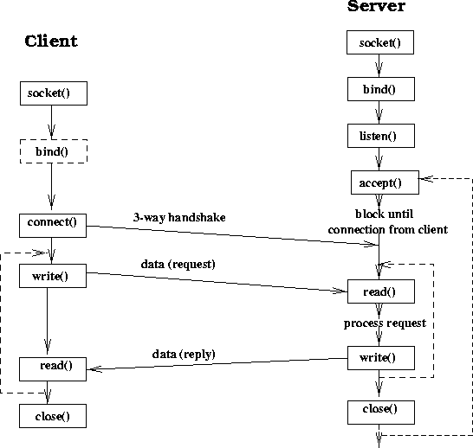
A basic sequential server

Slide 4
Socket:
  #include <sys/socket.h>
  int socket(int family, int type, int protocol);
    Family: AF_INET, AF_INET6, AF_LOCAL, AF_ROUTE, AF_KEY.
    Type: SOCK_STREAM, SOCK_DGRAM, SOCK_RAW
      TCP: AF_INET, SOCK_STREAM
      UDP: AF_INET, SOCK_DGRAM
      IPv4: AF_INET, SOCK_RAW
    Protocol: usually 0 except for raw sockets
    Return descriptor (like file descriptor), -1 on error.
  AF_XXX and PF_XXX

Slide 5
Connect:
  #include <sys/socket.h>
  int connect(int sockfd, const struct sockaddr *servaddr,
  socklen_t addrlen);
    Servaddr: socket address structure (ip address and port)
  Connect actively starts the TCP connection establishment phase.
    Possible errors:
      No response: retry a number of times before it quits.
      Get response RST (not SYN/ACK), ECONNREFUSED, nobody is listening in that port
      Get ICMP response, keep trying, EHOSTUNREACH or ENETUNREACH.

Slide 6
Socket Address structure:
    struct in_addr {
    in_addr_t s_addr;
    }
    struct sockaddr_in {
    uint8_t sin_len;
    sa_family_t sin_family;
    in_port_t sin_port;
    struct in_addr sin_addr;
    char sin_zero[8];
    }
    Always use sockaddr_in type for manipulation and convert it to sockaddr. See example1.c.
struct sockaddr {
uint8_t sa_len;
sa_family_t sa_family;
char sa_data[14];
}

Slide 7
Bind
  Client does not have to bind, system assigns a dynamic port number.
    #include <sys/socket.h>
    Int bind(int sockfd, const struct sockaddr &myaddr, socklen_t addlen);
    Myaddr constains its own address.
  Address port result
  INADDR_ANY 0 system selects addr and port
  INADDR_ANY !=0 system selects addr, user selects port
  Local IP address 0 user selects addr, system selects port
  Local IP address !=0 user selects both addr and port
    See example2.c

Slide 8
Listen
  Convert a socket into a passive socket
    #include <sys/socket.h>
    int listen(int sockfd, int backlog)
    Backlog: number of pending connections that the kernel should queue for the socket.
      The socket will refuse connections if the queue is full.
    Backlog not well defined.
    E.g: backlog= 5: AIX 4.2(8), Linux2.0.27(5), SunOS4.1.4(8), Solaris2.5.1(6).

Slide 9
Accept:
    Blocking by default
    #include <sys/socket.h>
    int accept (int sockfd, struct sockaddr *cliaddr, socklen_t *addrlen);
    Return client’s address in cliaddr
    See example2.c

Slide 10
Network Byte Order
What happen when we run example2.c as server on program and example1.c as client on linprog?
  Sockaddr_in revisit
    sin_port and sin_addr must be in network byte order.

Slide 11
Some useful functions
converting the byte orders
      #include <netinet/in.h>
      uint16_t htons(uint16_t host16bitvalue);
      uint32_t htonl(uint32_t host32bitvalue);
      uint16_t ntohs(uint16_t net16bitvalue);
      uint32_t ntohl(uint32_t net32bitvalue);
Byte manipulations
  #include <string.h>
  void *memset(void *dst, int c, size_t len);
  void *memcpy(void *dst, void *src, size_t nbytes);
  void *memcmp(const void *ptr1, const void *ptr2, size_t nbytes);

Slide 12
Address conversion functions
    inet_aton/inet_addr/inet_ntoa
Information about socket
  getsockname and getpeername
  getsockopt and setsockopt
Name and address conversions
  gethostbyname, gethostbyaddr
  getservbyname, getservbyport
  getaddrinfo, gai_strerror, freeaddrinfo

Slide 13
Echo client and server
See echo_client.cpp and echo_server.cpp

