Slide 1
Today’s topic:
  File operations
  I/O redirection
  Inter-process communication through pipes

Slide 2
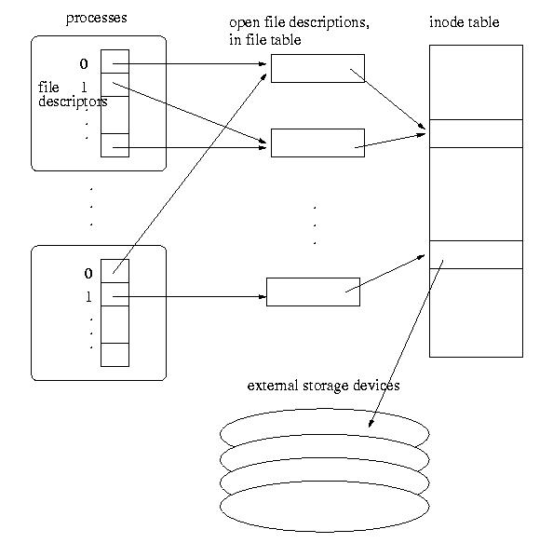
User space
OS
Device
(disk)
Accessing
files in
UNIX

Slide 3
UNIX file descriptor/open file descriptions/inode table organization
  File descriptor table -- in process
    Each process has a table.
    nonnegative integer used to identify an entry in the file table
    The table size is limited, which limits the number of files that can be opened in a process (see example0.c)
  Open file table – in OS
    The whole system shares the table
    The entries are called open file descriptions, which are records of how files are currently accessed.
      File offset: the byte position in the open file description that decides where to access the file through the open file description.
      Why here, why not in file descriptor table or in inode table?

Slide 4
Implication of the file descriptor/open file descriptions/inode table organization in UNIX.
  open and create
    Linear search for the first empty slot in the process file descriptor table.
    allocate an open file description in the file table, which has a pointer to the inode table.
      Open and create do not share file access
    See example1.c
    The O_APPEND flag:
      Fore offset in open file table to the end of the file before each write
      See example1a.c

Slide 5
Implication of the file descriptor/open file descriptions/inode table organization in UNIX.
  dup, dup2
    Duplication the file descriptor in the process file descriptor table, sharing the same open file descriptor
      Collaborated file access
    See example2.c
  A note: when fork() duplicating the process image, what is the semantic?
    Only the per-process data structures are duplicated, the system wide open file table is not changed.
      Share access or not?

Slide 6
Predefined files:
  All UNIX processes have three predefined files open: stdin, stdout, stderr. STDIN_FILENO (0), STDOUT_FILENO (1) and STDERR_FILENO (2).
  cout or printf → write (STDOUT_FILENO, …)
  cin or scanf → read (STDIN_FILENO, …)
  See example15.c

Slide 7
Predefine file:
  All UNIX processes have three predefined files open: stdin, stdout, stderr. STDIN_FILENO (0), STDOUT_FILENO (1) and STDERR_FILENO (2).
    Predefined files behave the same as regular files
      Open, close, and dup have the same semantics
  What happens when we read and write to a non-exist file? See example3.c, example3b.c, example16.cpp

Slide 8
I/O redirection:
  Close a predefined file and open a new file
    The new file will be using the standard I/O/err file number: the standard I/O/err file is now redirect to/from the new file.
    See example3a.c
  There are complications when I/O library routines are used together with I/O system calls within a program
    See example4.c
    Where is the buffer for the standard output/error messages?
    Order enforcer: fflush();

Slide 9
I/O redirection:
    Execise: Given mycat1.c program, what is the best way to extend to program such that it can display multiple files listed in the command line?
  When happens in read when the end of file is reached?

Slide 10
Pipes:
  two types of pipes, named pipes and unnamed pipes
  name pipes:
    like a file (create a named pipe (mknod), open, read/write)
    can be shared by any process
    will not be discussed in detail.
  Unnamed pipes:
    An unnamed pipe does not associate with any physical file.
    It can only be shared by related processes (descendants of a process that creates the unnamed pipe).
    Created using system call pipe().

Slide 11
The pipe system call
  syntax
    int pipe(int fds[2])
  semantic
    creates a pipe and returns two file descriptors fds[0] and fds[1], both for reading and writing
    a read from fds[0] accesses the data written to fds[1] (POSIX) and a read from fds[1] accesses the data written to fds[0] (non standard).
    the pipe has a limited size (64K in some systems) -- cannot write to the pipe infinitely.
    Writing to a pipe with no reader: broken pipe error
    Reading from a pipe with no writer?
  See example7.c, example7a.c example8.c, example9.c.

Slide 12
Once the processes can communicate with each other, the execution order of the processes can be controlled.
  See example11.c.
The execv system call revisit:
  Format: int execv(const char * path, char * argv[])
    Execute the path command and wipe out ALMOST everything in the original process.
    ALMOST: the file descriptor table is kept.
    We can manipulate the I/O for the execution of the path command by manipulating the file descriptor table.
    See example14.c

Slide 13
Implementing pipe in shell.
  E.g. /usr/bin/ps -ef | /usr/bin/more
How does the shell realize this command?
  Create a process to run ps -ef
  Create a process to run more
  Create a pipe from ps -ef to more
    the standard output of the process to run ps -ef is redirected to a pipe streaming to the process to run more
    the standard input of the process to run more is redirected to be the pipe (from the process running ps –ef)
  See example12.c and example13.c (need to be careful about the open files)

Slide 14
Today’s Summary
What is the difference between open and dup?
How to redirect the standard output to file xxx?
How does read know that the end of file is reached?
When is the end of file reached in a pipe?
How to realize ‘xxx | yyy’?

