Slide 1
Outline
Matlab tutorial
  How to start and exit Matlab
  Matlab basics

Slide 2
Starting Matlab
At this time, Matlab is only available on program1.cs.fsu.edu
  First you need to ssh to program1.cs.fsu.edu
    If you need to use the graphics and visualization tools in Matlab, make sure that X forwarding is enabled. You can do this by
      ssh –X program1.cs.fsu.edu
  Starting Matlab
    matlab &
    This starts the standard Matlab desktop as a background process

Slide 3
Starting Matlab – cont.
  matlab –nodesktop
    This starts Maltab with a command line interface
Help and documentation
  Matlab documentation site is available http://www.mathworks.com/access/helpdesk/help/techdoc/matlab.html
  In Matlab, you can get help
    help function-name to get help on a function
    doc function-name to get documentation on a function
    type function-name to show source code for a function
  Matlab is case sensitive so "a" and "A" are two different names.
  Comment statements are preceded by a “%”

Slide 4
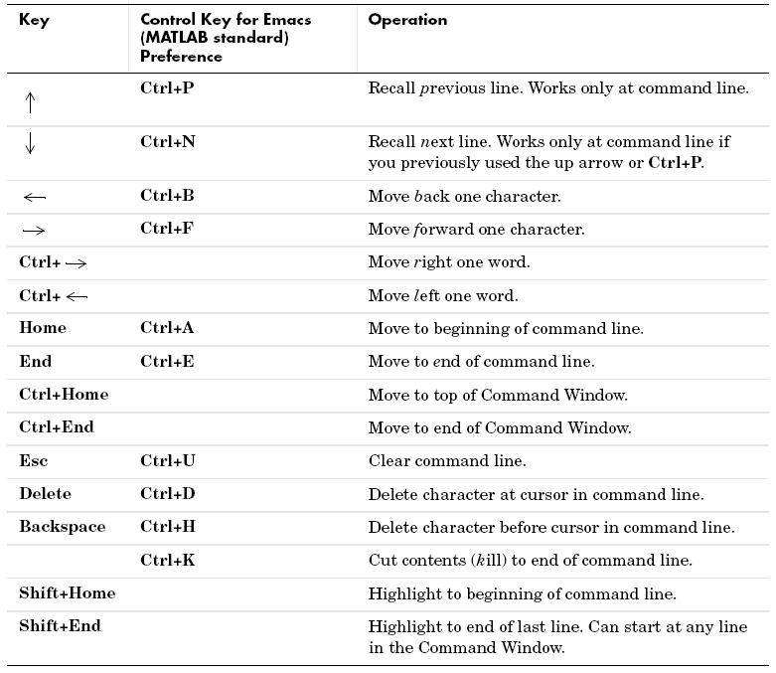
Command-Line Editing

Slide 5
What is Matlab
Matlab core is based on matrix and vector algebra; even scalars are treated as 1x1 matrices
  With an extended list of plotting and visualization tools
  Its functionality is also extended by toolboxes
It provides an interactive environment (it is an interpreter language) for matrix operations
It is also a programming/scripting language
  Many function names are similar to the standard C functions

Slide 6
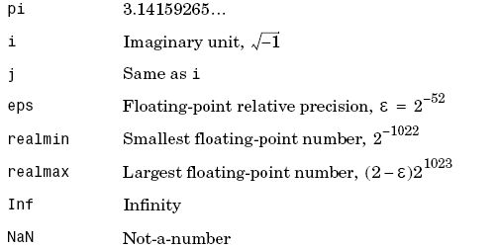
MATLAB Basics
Definition of Variables
  Variables are assigned numerical values by typing the expression directly, for example: a = 1+2 yields: a = 3
  The answer will not be displayed when a semicolon is put at the end of an expression, for example type a = 1+2;
  When a variable that has defined is used, Matlab creates a new variable
  Predefined variables which can be used at any time:

Slide 7
Definition of Matrices
Lets creates a 1x4 vector with elements 1, 3, 5 and 7
  v = [1 3 5 7];
  twoXthree= [1 2 4; 3 6 8];
  [M,N] = size(twoXthree) returns the number of rows (2) and columns (3) in separate output variables.
  Lets creates the matrices: t = 0:10; x = cos(t*pi);
  x with elements equal to cos(t*pi) for t = 0, 1,..., 10.
  X➔ [cos(0) cos(pi) cos(2*pi)…..cos(10*pi)]

Slide 8
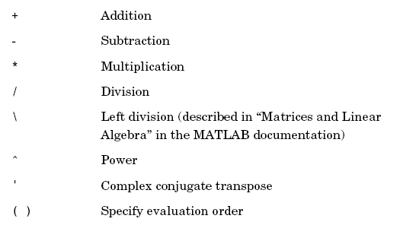
Arithmetic Operators

Slide 9
Logical and Relational Operators
Logical operations
  &, &&, |, ||, ~, and xor
Relational operators
  ==, ~=, <, <=, >=, >
Logical functions
  Any, all, isnan, isinf, isfinite, isempty, isequal

Slide 10
Accessing Matrices
The element in row i and column j of A is denoted by A(i,j)
  Using the colon (:) operator, one can refer more than one element in a matrix

Slide 11
Advanced Data Structures
You can have multi-dimensional arrays (more than 2 dimensions)
You can define a cell structure to hold elements of different sizes using cell
You can also have data structures by using
  struct

Slide 12

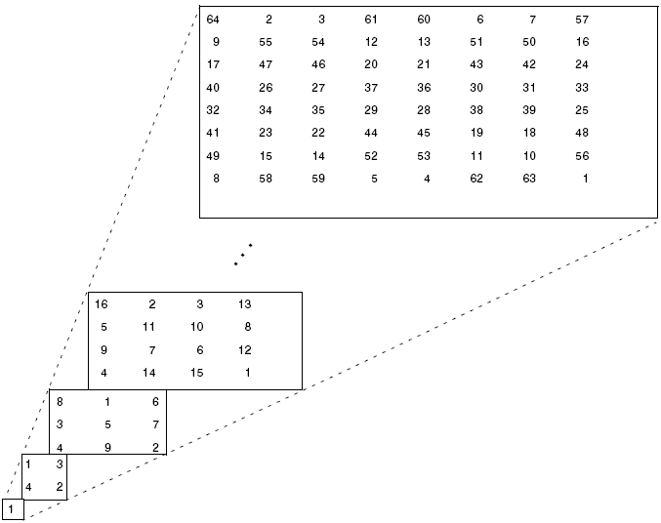
Advanced Data Structures

Slide 13
Plotting
Commands covered: plot, xlabel, ylabel, title grid, axis, stem, subplot
xlabel('time (sec)'); ylabel('step response'); title('My Plot');
  To plot more than one graph on the screen, use the command subplot(mnp) which partitions the screen into an mxn grid where p determines the position of the particular graph counting the upper left corner as p=1. For example,
  subplot(211),semilogx(w,magdb);
  subplot(212),semilogx(w,phase);

Slide 14
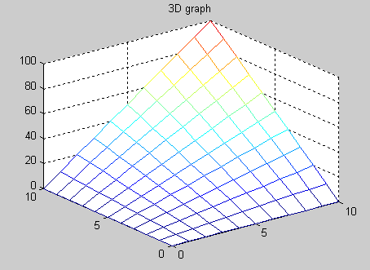
3D - Plotting example
x=[0:10]; y=[0:10]; z=x’*y;
mesh(x,y,z); title(‘3-D Graph’);

Slide 15
Loading and Saving Data
When using MATLAB, you may wish to leave the program but save the vectors and matrices you have defined. To save the file to the working directory, type
save filename
where "filename" is a name of your choice. To retrieve the data later, type
load “filename”

Slide 16
M-files
M-files are macros of MATLAB commands that are stored as ordinary text files with the extension "m", that is filename.m
example of an M-file that defines a function, create a file in your working directory named yplusx.m that contains the following commands:
  Write this file:
  function z = yplusx(y,x)
  z = y + x;
  -save the above file(2lines) as yplusx.m
  x = 2; y = 3;
  z = yplusx(y,x) → 5
  Get input by prompting on m-file:
  T = input('Input the value of T: ')

Slide 17
M-files – cont.
There are two kinds of M files
  Scripting
    It consists a list of commands and statements that will be executed in order
  Function
    It defines one or more functions that can be called
    In Matlab, a function is similar to a C function
    There are different kinds of Matlab functions
      Anonymous functions, which do not require a .m file but only a single Matlab expression
    Primary and subfunctions

Slide 18
M-files – cont.
Primary functions
  Primary functions are required to define a primary function
  A number of subfunctions can be defined in the same file
  Primary functions can be invoked from anywhere while subfunctions can only be invoked within the corresponding primary function
Nested functions
  Defined with the body of a Matlab function

Slide 19
M-files – cont.
Global variables
  You can define global variables that can be accessed from different functions by using global in all the functions
Each function takes a number of input arguments and a number of output arguments
The eval function
  It is a power text macro facility which uses the Matlab interpreter to evaluate the expression

Slide 20
M-files – cont.
Function handles
  You reference a function though a function handle
There are also function functions
  That is, one function works on another function

Slide 21
Flow Control
Matlab provides several flow control constructs
  “if”
  “switch and case”
  “for”
  “while”
  “continue”
  “break”
  “try – catch”
  “return”

Slide 22
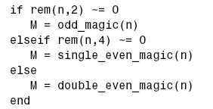
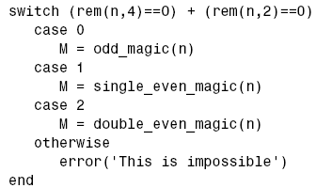
Flow Control
If
Switch and case

Slide 23
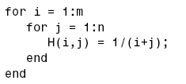
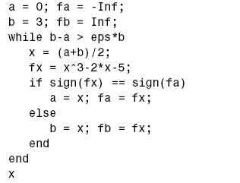
Flow Control
For
while

Slide 24
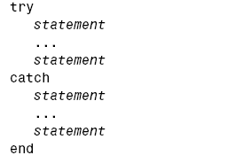
Flow Control
Try and catch

Slide 25
File Operations in Matlab
Similar to C standard functions
  Reading from a file
    First you need to open a file using fopen
    Then you can read from the file using fscanf and fread
  Writing to a file
    First you need to open a file using fopen
    Then you can write to a file using fprintf and fwrite
  After you are done with a file, use fclose to close the file

Slide 26
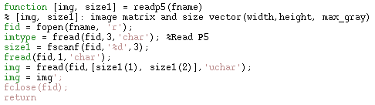
File Operations in Matlab
Example
  Readp5 to read an image in pgm format

Slide 27
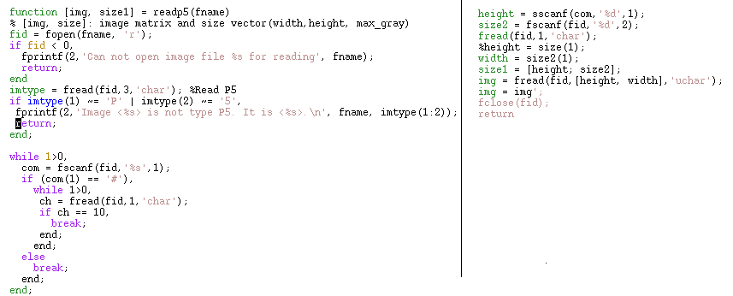
Readp5.m with Error Checking

Slide 28
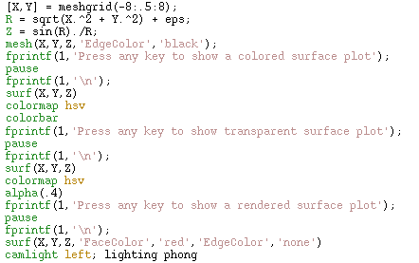
Advanced Matlab Features
Visualization in Matlab becomes sophisticated

Slide 29
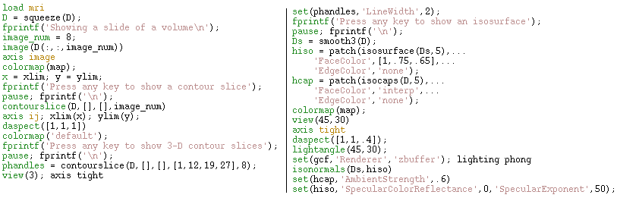
3-D Visualization

Slide 30
Advanced Features
Matlab compilers
  There are also Matlab compilers which can generate C/C++ or programs automatically from your .m Matlab programs
You can also mix Matlab with C/C++ programs or programs in other programming language in two ways
  Through mex compiler
  Through a Matlab engine and a library

Slide 31
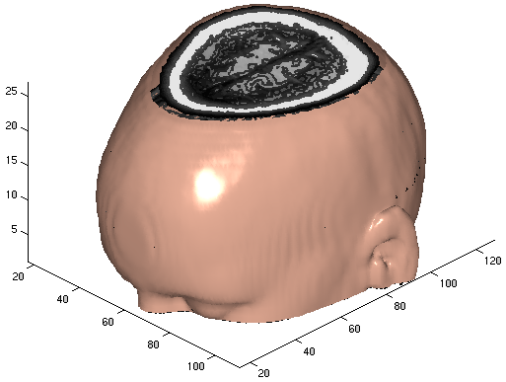
3-D Visualization

Slide 32
GUIDE
Matlab also provides a graphical user interface development environment for creating graphical user interfaces
  Layout editor
  GUIDE automatically generates an M-file that controls how the GUI operates

Slide 33
Debugging
Keyboard statement stops a Matlab function and allows one to interactively check variables
You can also set breakpoints and so on if you use the Matlab editor

Slide 34
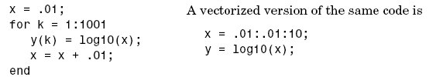
Ways to Make Matlab Run Faster
Vectorization
Preallocation

