Slide 1
Outline
Introduction to Stereopsis
Camera models
  Intrinsic camera parameters
  Extrinsic camera parameters
  Projective camera model
Some slides were based on notes by Luke Fletcher
Notes:
CIS5370 vision-05-camera.ppt
Dr. Xiuwen Liu

Slide 2
3D Reconstruction
The general problem of 3D reconstruction is to recover 3D information (and possible camera models) from a set of images
  The difficulties depend on the assumptions, the known information, and the purpose
    Whether the images are calibrated (i.e., whether the intrinsic camera parameters are known)
    Whether correspondences are available or not
    Single view, two views, three, or more views
  There are different approaches to this problem
    We will cover the most basic one first
Notes:
CIS5370 vision-05-camera.ppt
Dr. Xiuwen Liu

Slide 3
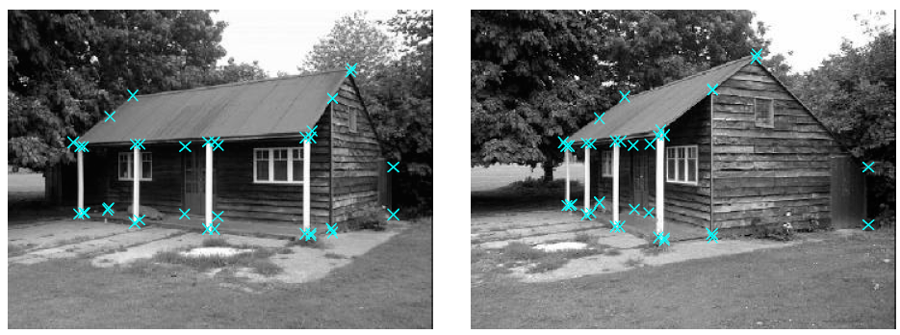
Calibrated 3D Reconstruction from Two Views
The basic problem we have is
  We have two views of the same scene with correspondence points marked
  We want to compute the 3D points
Notes:
CIS5370 vision-05-camera.ppt
Dr. Xiuwen Liu

Slide 4
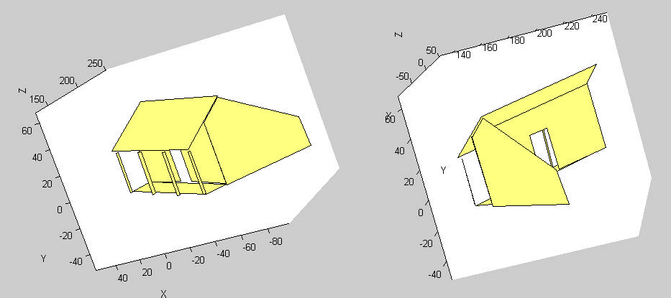
Calibrated 3D Reconstruction from Two Views
Notes:
CIS5370 vision-05-camera.ppt
Dr. Xiuwen Liu

Slide 5
Assumptions
Here we assume the scene is static
  Is not relevant if we have two cameras taking pictures simultaneously
  Is important if the images are taken by one camera or taken at different time
We assume that the corresponding points are marked correctly in both images
  We need at least eight points
We assume the cameras are pin-hole cameras
  With known parameters
  At least the cameras can be approximated well by a pin-hole model
Notes:
CIS5370 vision-05-camera.ppt
Dr. Xiuwen Liu

Slide 6
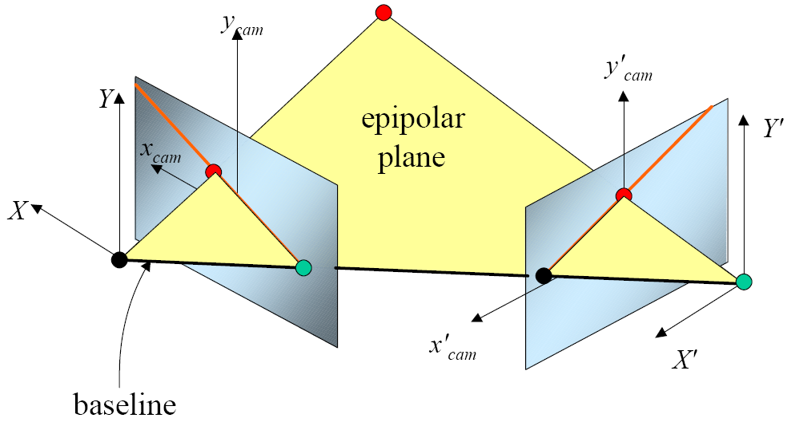
The Basic Idea
Notes:
CIS5370 vision-05-camera.ppt
Dr. Xiuwen Liu

Slide 7
Necessary Components
Camera models – how to relate a 3D point to its corresponding pixel in an image
Epipolar geometry – how to recover relative extrinsic camera parameters from correspondences and how to recover points in 3D
Notes:
CIS5370 vision-05-camera.ppt
Dr. Xiuwen Liu

Slide 8
Relevant Chapters in Book
Several chapters in the textbook are related to this topic
  Chapter 2 on camera models and geometric primitives
  Chapter 6 on pose estimation
  Chapter 7 on structure from motion
  Chapter 11 on stereopsis
  Chapter 12 on 3D reconstruction
  Here I will take a different approach
    I will cover the most basic case thoroughly, i.e., after the relevant lectures, you should be able to understand related models and do 3D reconstruction from images
    I will cover the structure from motion later in the semester
Notes:
CIS5370 vision-05-camera.ppt
Dr. Xiuwen Liu

Slide 9
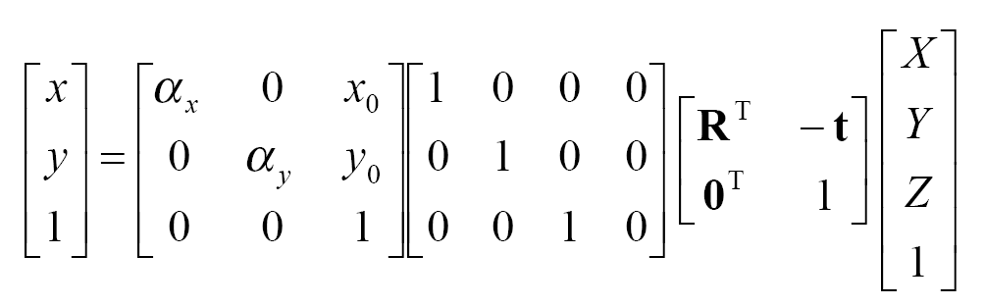
Camera Model: Lookahead
After we integrate all the components, we will have
  Which relates the measures (positions in the 3D world) to pixel coordinates in an image
Notes:
CIS5370 vision-05-camera.ppt
Dr. Xiuwen Liu

Slide 10
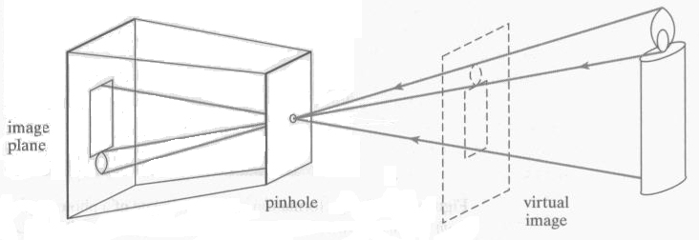
Perspective Projection
Known as the pinhole camera model or perspective camera model
Notes:
CIS5370 vision-05-camera.ppt
Dr. Xiuwen Liu

Slide 11
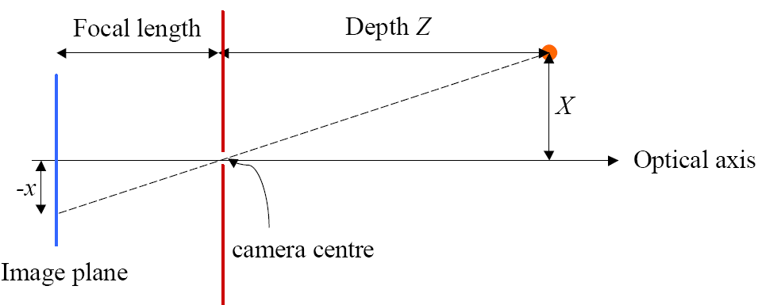
Perspective Projection – cont.
Notes:
CIS5370 vision-05-camera.ppt
Dr. Xiuwen Liu

Slide 12
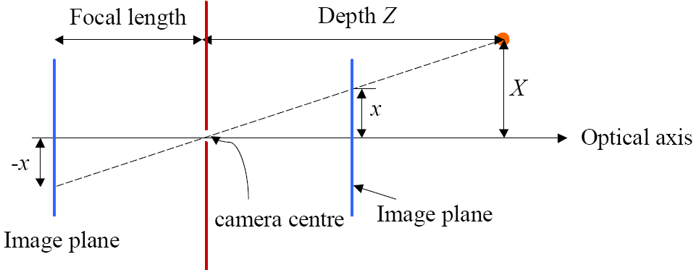
Perspective Projection – cont.
Conventionally, we use the virtual image plane
Notes:
CIS5370 vision-05-camera.ppt
Dr. Xiuwen Liu

Slide 13
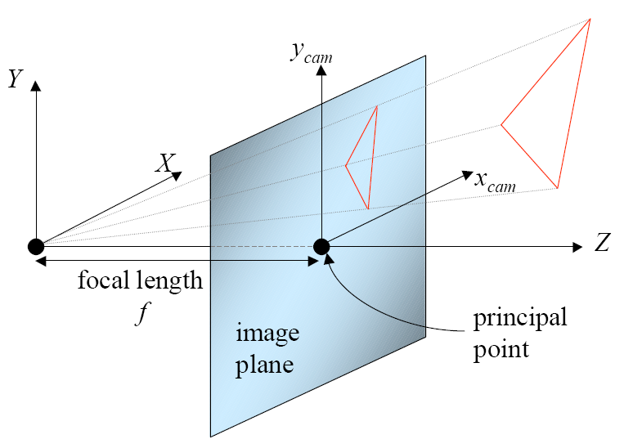
Perspective Projection – cont.
Before we continue formally, we first set up a coordinate system
  The origin is at the pinhole (the optical center)
  The X and Y axes form axes of the image plane
  The Z axis (also the optical axis) is perpendicular to the image plane
  The distance from the optical center to the image plane is the focal length
Notes:
CIS5370 vision-05-camera.ppt
Dr. Xiuwen Liu

Slide 14
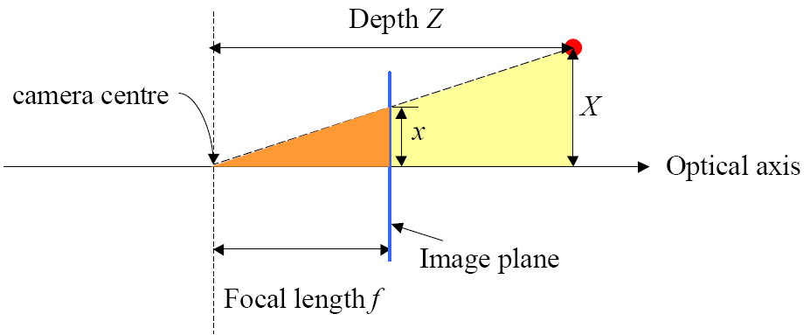
Perspective Projection – cont.
Given a 3D point (X, Y, Z)^{T} in the given camera coordinate system, what is its image on the image plane?
Notes:
CIS5370 vision-05-camera.ppt
Dr. Xiuwen Liu

Slide 15
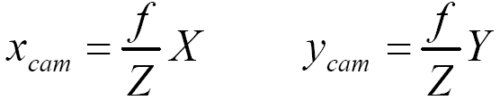
Perspective Projection – cont.
Given a 3D point (X, Y, Z)^{T} in the given coordinate system, what is its image on the image plane?
Notes:
CIS5370 vision-05-camera.ppt
Dr. Xiuwen Liu

Slide 16
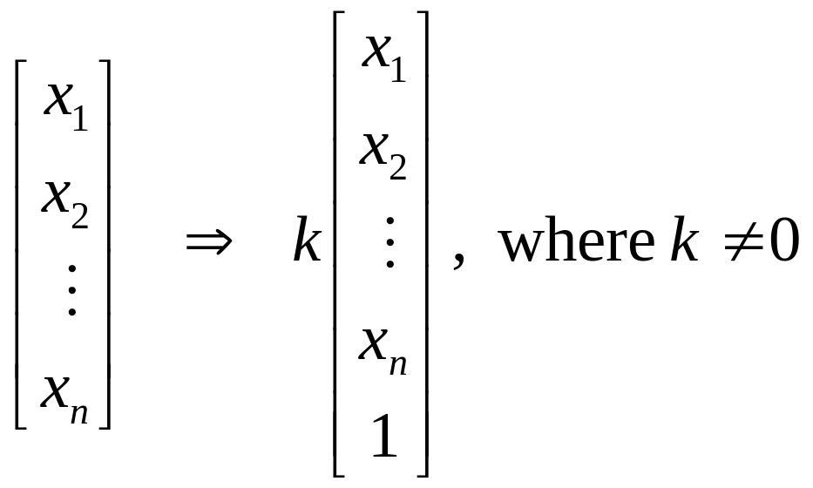
Homogenous Coordinates
Homogenous coordinates are introduced to represent a certain family of operations using matrix operations
  The homogeneous coordinates of a point of dimension n are given by
Notes:
CIS5370 vision-05-camera.ppt
Dr. Xiuwen Liu

Slide 17
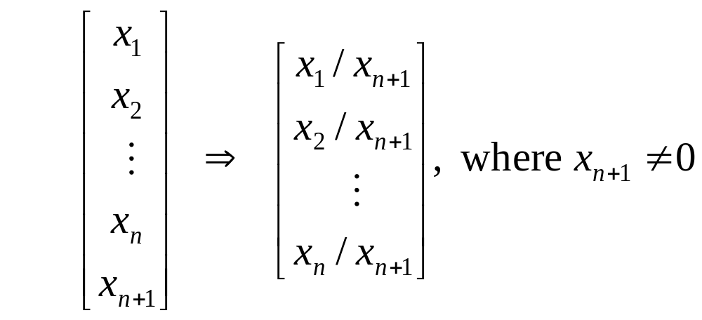
Homogenous Coordinates – cont.
From homogenous coordinates to inhomogenous coordinates
  What happens if x_{n+1} = 0?
Notes:
CIS5370 vision-05-camera.ppt
Dr. Xiuwen Liu

Slide 18
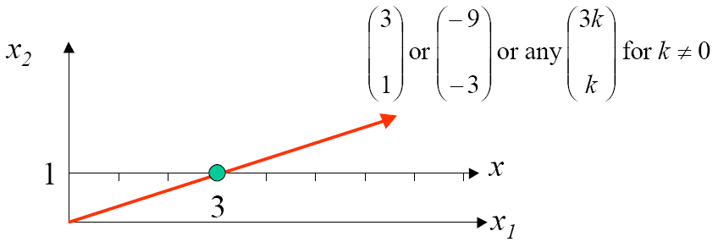
Homogenous Coordinates – cont.
1D case example
Notes:
CIS5370 vision-05-camera.ppt
Dr. Xiuwen Liu

Slide 19
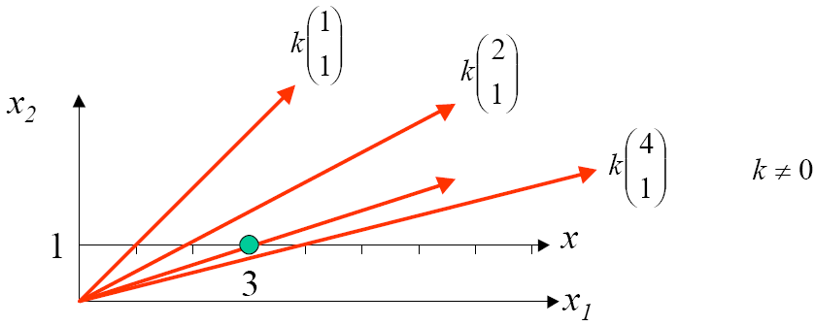
Homogenous Coordinates – cont.
1D case example
Notes:
CIS5370 vision-05-camera.ppt
Dr. Xiuwen Liu

Slide 20
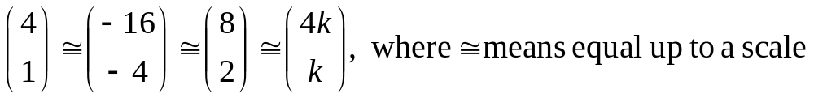
Note on Homogeneous Coordinates
1D case example
  Rigorously speaking, we should define a new relationship
  This applies to all “=” signs involving homogenous coordinates
Notes:
CIS5370 vision-05-camera.ppt
Dr. Xiuwen Liu

Slide 21

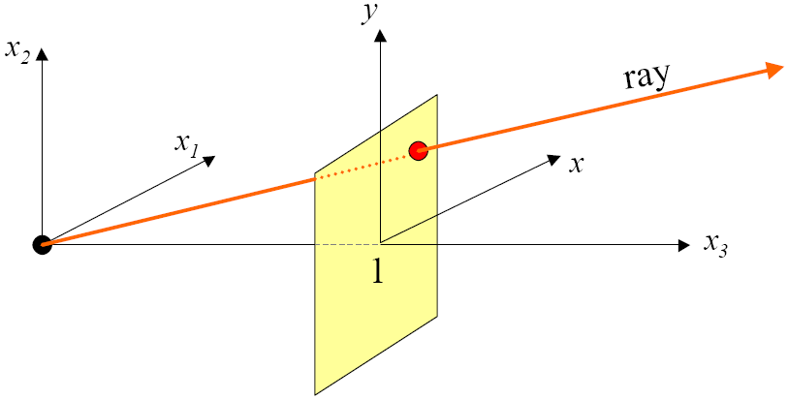
Homogenous Coordinates – cont.
2D Example
  In the normal inhomogeneous coordinates a 2D point is given by (x, y)^{T}
  In the homogeneous coordinate system, a 2D point is represented by a 3-vector
Notes:
CIS5370 vision-05-camera.ppt
Dr. Xiuwen Liu

Slide 22
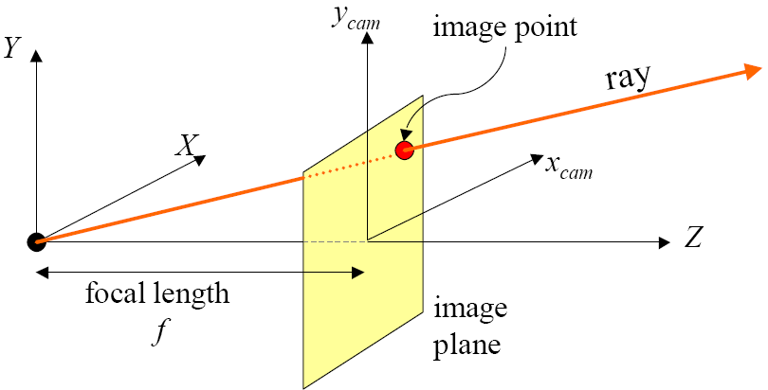
Perspective Projection – cont.
This is essentially the same as the pinhole camera model
Physically, a camera can only see points in front of it, what does that imply?
Notes:
CIS5370 vision-05-camera.ppt
Dr. Xiuwen Liu

Slide 23
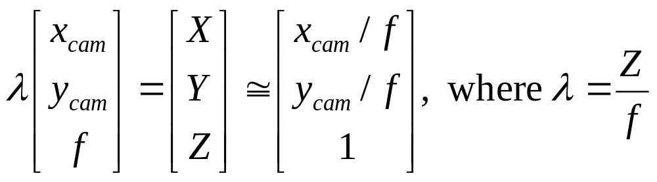
Perspective Projection – cont.
Notes:
CIS5370 vision-05-camera.ppt
Dr. Xiuwen Liu

Slide 24
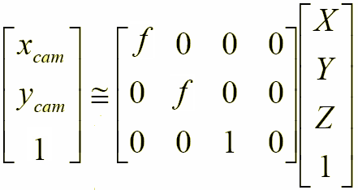
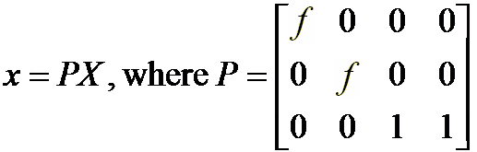
Perspective Projection – cont.
Using homogeneous coordinates, we can write it as
Notes:
CIS5370 vision-05-camera.ppt
Dr. Xiuwen Liu

Slide 25
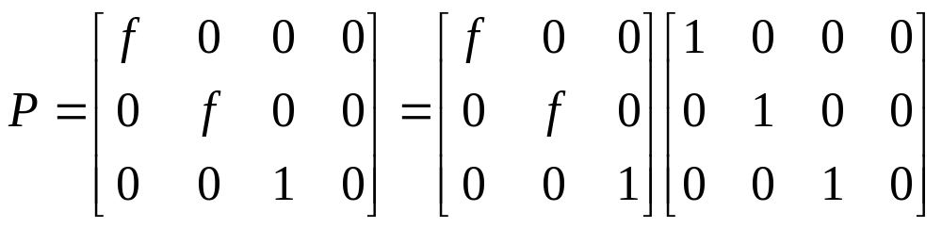
Perspective Projection – cont.
For future use, note that we can write P as
Notes:
CIS5370 vision-05-camera.ppt
Dr. Xiuwen Liu

Slide 26
Intrinsic Camera Parameters
But the measures we have are given in pixel coordinates in images
  What do we need to relate 3D points to pixels?
Notes:
CIS5370 vision-05-camera.ppt
Dr. Xiuwen Liu

Slide 27
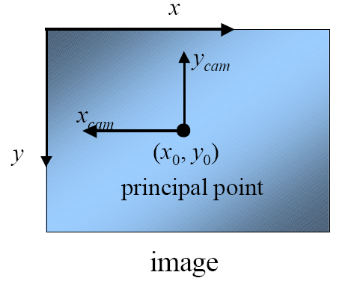
Intrinsic Camera Parameters – cont.
We need to relate the pixel coordinates to projected points
Notes:
CIS5370 vision-05-camera.ppt
Dr. Xiuwen Liu

Slide 28
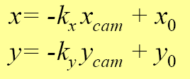
Intrinsic Camera Parameters – cont.
We need to relate the pixel coordinates to projected points
Where x₀ and y₀ are the principal point in the pixel coordinates, and k_{x} and k_{y} are pixels / unit
If the pixels are square, then k_{x} = k_{y}
Notes:
CIS5370 vision-05-camera.ppt
Dr. Xiuwen Liu

Slide 29
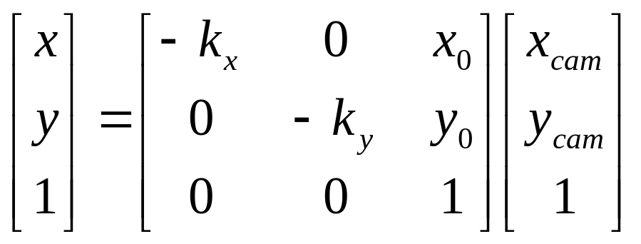
Intrinsic Camera Parameters – cont.
Write the relation in the homogeneous coordinates, we have
Notes:
CIS5370 vision-05-camera.ppt
Dr. Xiuwen Liu

Slide 30
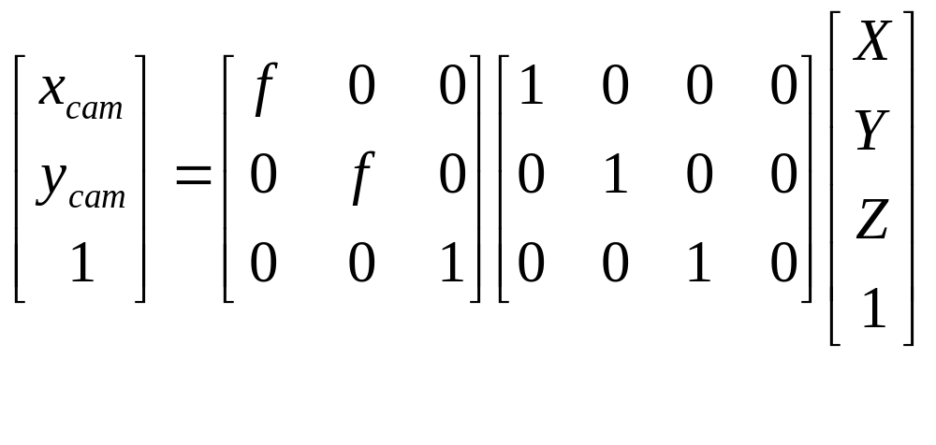
From Pixel to 3D Points
Notes:
CIS5370 vision-05-camera.ppt
Dr. Xiuwen Liu

Slide 31
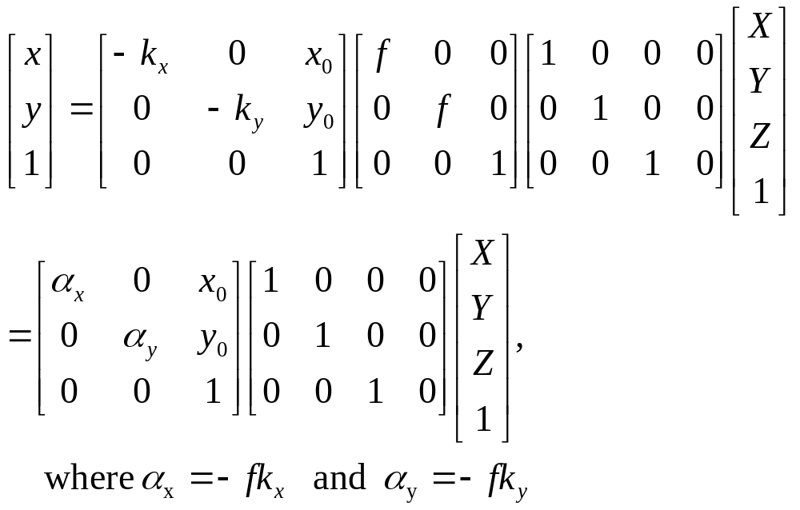
From Pixel to 3D Points
Notes:
CIS5370 vision-05-camera.ppt
Dr. Xiuwen Liu

Slide 32

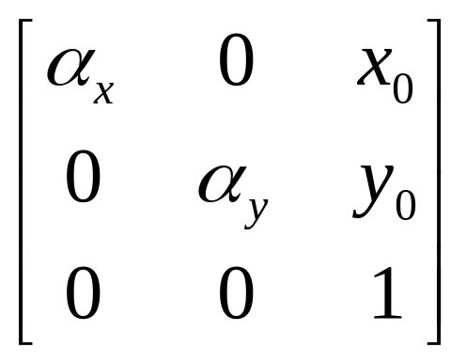
Intrinsic Camera Parameters
are intrinsic camera parameters
  Keep in mind they are for a simplified camera
Notes:
CIS5370 vision-05-camera.ppt
Dr. Xiuwen Liu

Slide 33
Normalized Image Plane
When we derive the essential matrix, we need to use the normalized image plane
  A virtual (and equivalent) image plane with focal length of 1
  If we know the focal length f, then
Notes:
CIS5370 vision-05-camera.ppt
Dr. Xiuwen Liu

Slide 34
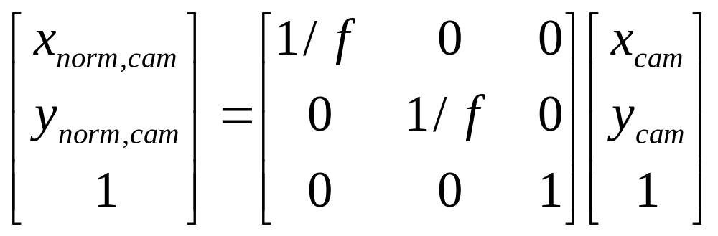
Normalized Image Plane
When we derive the essential matrix, we need to use the normalized image plane
  A virtual (and equivalent) image plane with focal length of 1
  If we know the focal length, then
Notes:
CIS5370 vision-05-camera.ppt
Dr. Xiuwen Liu

Slide 35
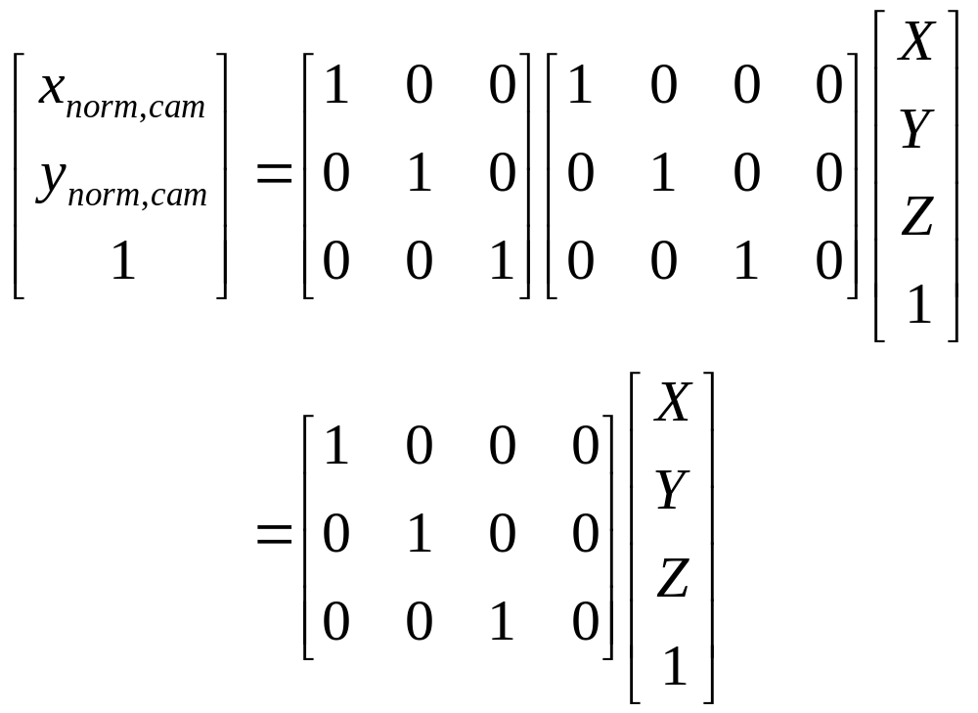
Normalized Image Plane
If we relate measurements on the normalized image plane to 3D points, we have
Notes:
CIS5370 vision-05-camera.ppt
Dr. Xiuwen Liu

Slide 36
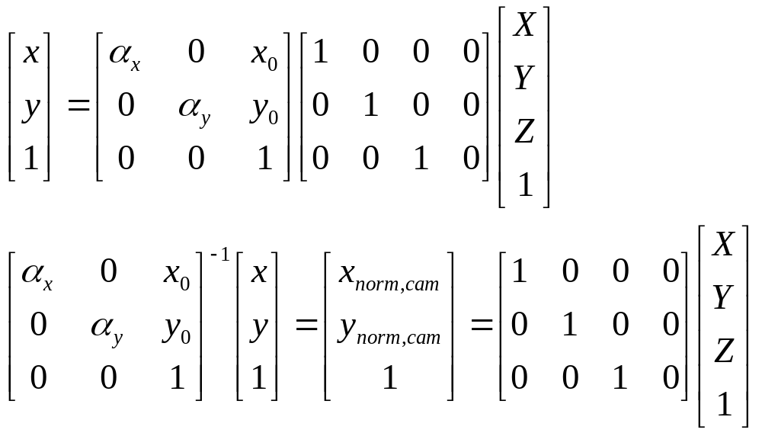
Intrinsic Parameters and Normalized Image Plane
In other words, intrinsic parameters of a camera determine the normalized image plane
Notes:
CIS5370 vision-05-camera.ppt
Dr. Xiuwen Liu

Slide 37
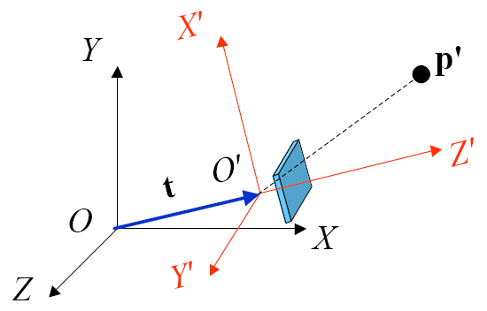
Extrinsic Camera Parameters
Additionally, a camera may be located in a different coordinate system
Notes:
CIS5370 vision-05-camera.ppt
Dr. Xiuwen Liu

Slide 38
Extrinsic Camera Parameters
So far we know how to relate 3D points to their corresponding pixel coordinates in the camera coordinate system
Notes:
CIS5370 vision-05-camera.ppt
Dr. Xiuwen Liu

Slide 39
Extrinsic Camera Parameters
However, we need to consider the situation of how to relate 3D points in a different world coordinate system to their pixel coordinates for two reasons
  The camera can move and thus the same 3D points will have different representations at different times if we use the camera coordinate system
  Generally we may have more than one camera
    In the basic case, there are two cameras; if we use the second camera’s coordinate system, then we have to represent the first one with respect to the second’s
Notes:
CIS5370 vision-05-camera.ppt
Dr. Xiuwen Liu

Slide 40
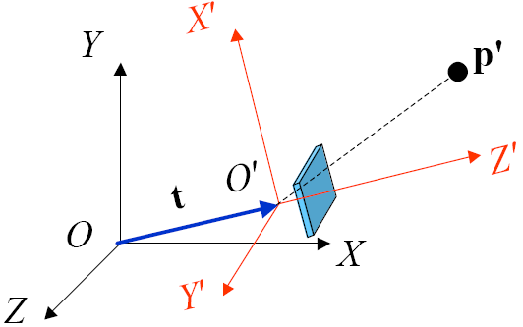
Extrinsic Camera Parameters – cont.
The general setting
  World reference frame O_{XYZ}
  Camera reference frame O'_{X'Y'Z'}
  R and t are the rotation matrix and translation vector going from O'_{X'Y'Z'} to O_{XYZ}
Notes:
CIS5370 vision-05-camera.ppt
Dr. Xiuwen Liu

Slide 41
Rigid Body Transformations
The situation here is the same as to describe a rigid body in space
  A rigid body is an object that cannot deform
  It is completely described by its position and orientation with respect to a given reference frame
Let us review coordinate systems
Notes:
CIS5370 vision-05-camera.ppt
Dr. Xiuwen Liu

Slide 42
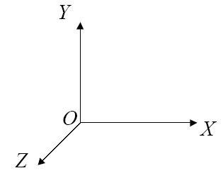
A Coordinate System
Let O_{XYZ} be the orthonormal reference frame and X,Y,Z be the unit vectors oriented along the frame axes.
Notes:
CIS5370 vision-05-camera.ppt
Dr. Xiuwen Liu

Slide 43


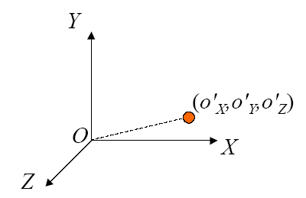
A Point in a Coordinate System
The position of a 3D point
Notes:
CIS5370 vision-05-camera.ppt
Dr. Xiuwen Liu

Slide 44

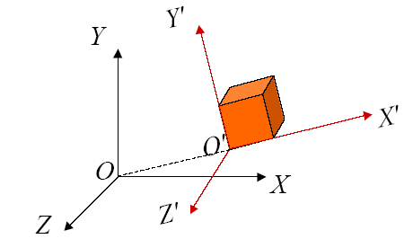
Object in a Coordinate System
To describe an object, we assume the object has its own reference frame
  To describe the object, we only need to describe with respect to the given coordinate with the assumption that it is a rigid body
Notes:
CIS5370 vision-05-camera.ppt
Dr. Xiuwen Liu

Slide 45


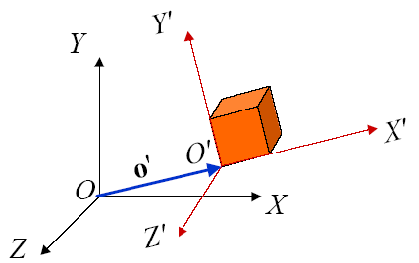
Object in a Coordinate System
The position is relatively simple
  It is simply the vector
Notes:
CIS5370 vision-05-camera.ppt
Dr. Xiuwen Liu

Slide 46
Object in a Coordinate System
The pose is given by a rotation matrix
  It describes the axes of with respect to the given coordinate
  We can also describe the rotation matrix by rotation around the given axes, given by three 2D rotation
  We can also describe the rotation matrix by rotation around an axis that can be any direction
Notes:
CIS5370 vision-05-camera.ppt
Dr. Xiuwen Liu

Slide 47
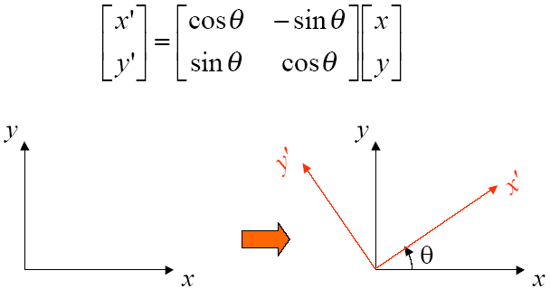
2D Rotation
In the 2D case, we can rotate points about the origin by an angle θ
Notes:
CIS5370 vision-05-camera.ppt
Dr. Xiuwen Liu

Slide 48
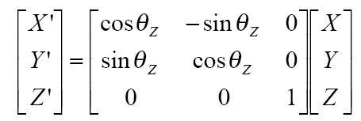
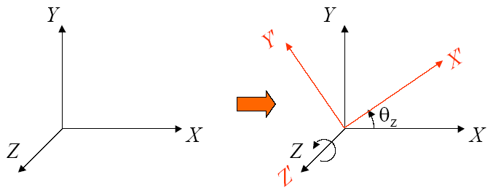
Rotation about the Z-axis in 3D
Identical (almost) to the 2D rotation
Notes:
CIS5370 vision-05-camera.ppt
Dr. Xiuwen Liu

Slide 49
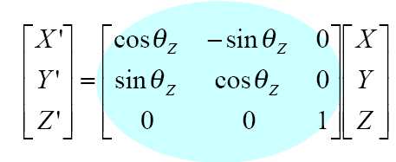

Rotation about the Z-axis in 3D
Identical (almost) to the 2D rotation
Notes:
CIS5370 vision-05-camera.ppt
Dr. Xiuwen Liu

Slide 50
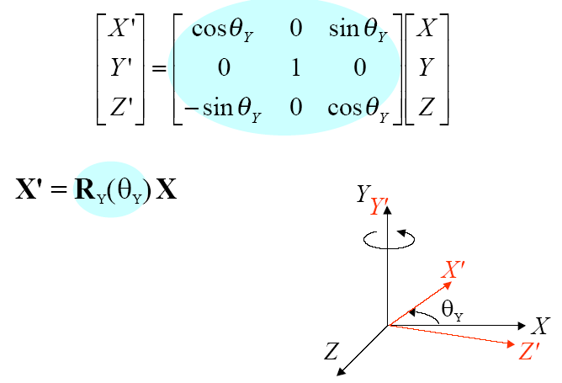
Rotation about the Y-axis in 3D
Similarly, we have rotation about the Y-axis
Notes:
CIS5370 vision-05-camera.ppt
Dr. Xiuwen Liu

Slide 51
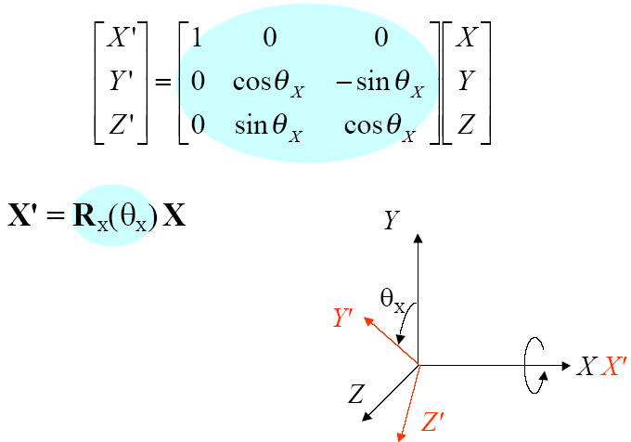
Rotation about the X-axis in 3D
Notes:
CIS5370 vision-05-camera.ppt
Dr. Xiuwen Liu

Slide 52
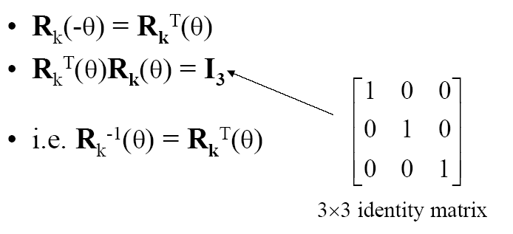
Inverse of Rotation
Notes:
CIS5370 vision-05-camera.ppt
Dr. Xiuwen Liu

Slide 53
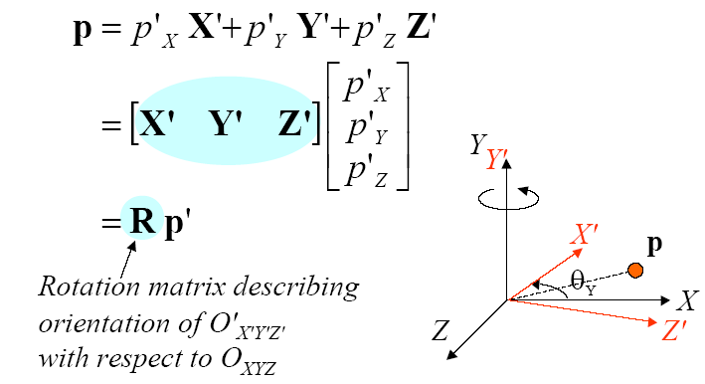
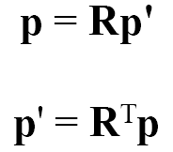
Meaning of Rotation Matrix
Given a point p in O_{XYZ}, for another frame O’_{X’Y’Z’} whose origin coincides with O
Notes:
CIS5370 vision-05-camera.ppt
Dr. Xiuwen Liu

Slide 54
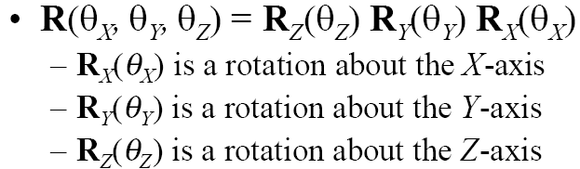
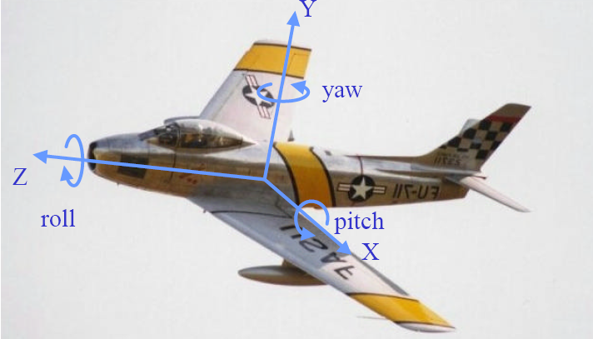
Roll, Pitch, and Yaw Angles
Notes:
CIS5370 vision-05-camera.ppt
Dr. Xiuwen Liu

Slide 55
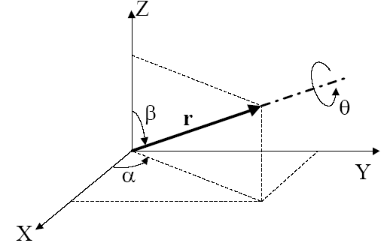
Rotation about an Arbitrary Axis
Suppose an axis is given by
Notes:
CIS5370 vision-05-camera.ppt
Dr. Xiuwen Liu

Slide 56
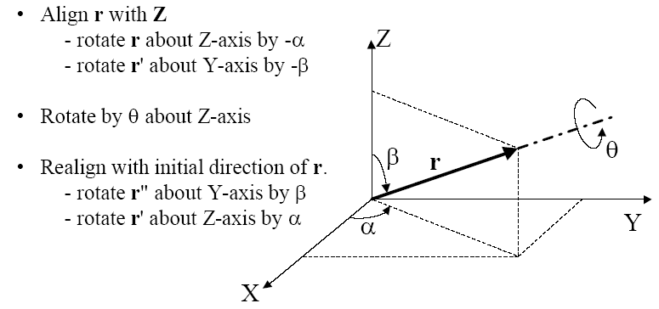
Rotation about an Arbitrary Axis
Notes:
CIS5370 vision-05-camera.ppt
Dr. Xiuwen Liu

Slide 57
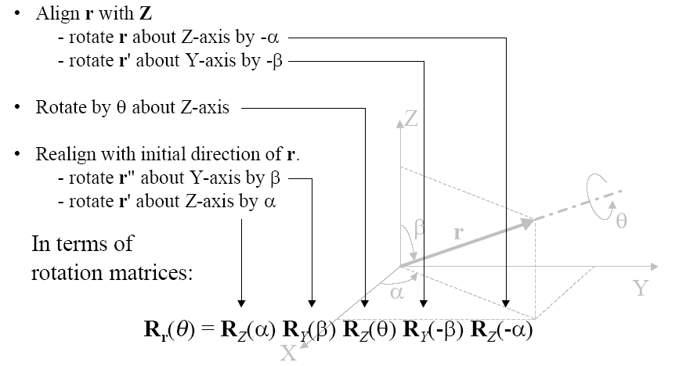
Rotation about an Arbitrary Axis
Notes:
CIS5370 vision-05-camera.ppt
Dr. Xiuwen Liu

Slide 58


Rotation About an Arbitrary Axis
You can actually construct the rotation matrix given r and θ explicitly
Notes:
CIS5370 vision-05-camera.ppt
Dr. Xiuwen Liu

Slide 59
Parametrization of 3D Rotations
The book has details regarding different parametrizations of 3D rotations (2.1.4)
  Axis and a rotation angle is one of them
  We can use three rotation angles around the three axes
    But it is not used in computer vision as the angles are order dependent
  Unit quaternions is another one for smoothing rotation
Notes:
CIS5370 vision-05-camera.ppt
Dr. Xiuwen Liu

Slide 60

3D Coordinate Transform
Notes:
CIS5370 vision-05-camera.ppt
Dr. Xiuwen Liu

Slide 61

3D Coordinate Transform
If we use homogeneous coordinates, we have
Notes:
CIS5370 vision-05-camera.ppt
Dr. Xiuwen Liu

Slide 62

Extrinsic Camera Parameters – cont.
Given a point p as (X’, Y’, Z’)^{T} in the camera coordinate system, its representation in the world coordinate system is given by
Notes:
CIS5370 vision-05-camera.ppt
Dr. Xiuwen Liu

Slide 63

Extrinsic Camera Parameters – cont.
Given a point p as (X’, Y’, Z’)^{T} in the camera coordinate system, its representation in the world coordinate system is given by
Notes:
CIS5370 vision-05-camera.ppt
Dr. Xiuwen Liu

Slide 64


Combining Everything Together
After we integrate all the components, we have
Notes:
CIS5370 vision-05-camera.ppt
Dr. Xiuwen Liu

Slide 65

Projective Camera Model
Projective camera is a linear mapping between homogeneous coordinate systems.
Notes:
CIS5370 vision-05-camera.ppt
Dr. Xiuwen Liu

Slide 66

Projective Camera Models
A projective camera is an angle measuring device.
  A point on the image can correspond to any 3D location on the ray from the center of projection through that point on the image plane.
Notes:
CIS5370 vision-05-camera.ppt
Dr. Xiuwen Liu

Slide 67

Image Color Model
It involves several components
  Explained in Chapter 2
  They are not required for this class
Notes:
CIS5370 vision-05-camera.ppt
Dr. Xiuwen Liu

Slide 68
Summary
Based on a pinhole camera model, we can relate a point in 3D to its corresponding pixel in the image
  The mapping is determined by the intrinsic parameters and extrinsic parameters of the camera
Next time: epipolar geometry for 3D reconstruction
Notes:
CIS5370 vision-05-camera.ppt
Dr. Xiuwen Liu

