Slide 1
Outline
Epipolar geometry
Eight-point algorithm
Recovering R and T from E
Some slides were based on notes by Luke Fletcher
Notes:
CIS5370 vision-05-epipolar.ppt
Dr. Xiuwen Liu

Slide 2
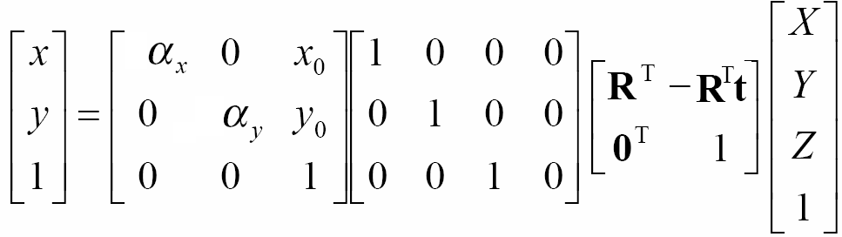
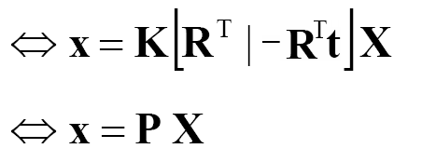
From 3D Points to Pixels
Notes:
CIS5370 vision-05-epipolar.ppt
Dr. Xiuwen Liu

Slide 3
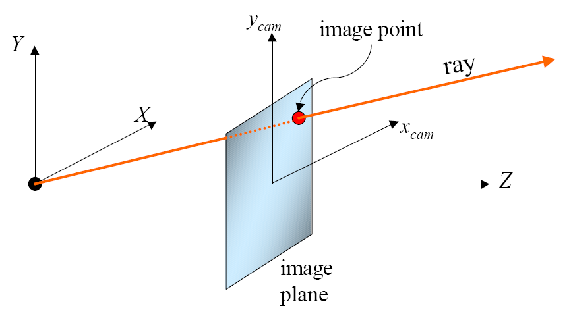
The Epipolar Geometry
Notes:
CIS5370 vision-05-epipolar.ppt
Dr. Xiuwen Liu

Slide 4
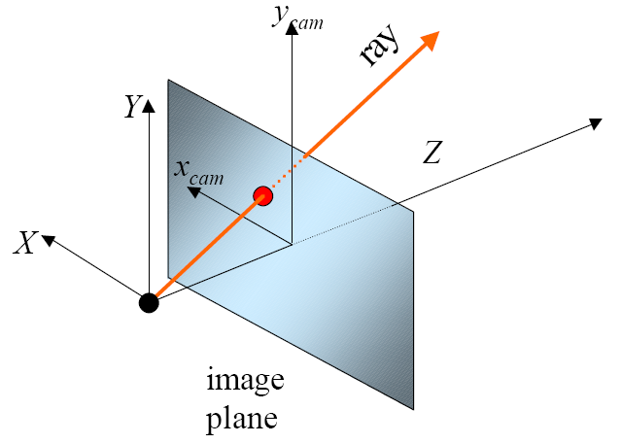
The Epipolar Geometry
Notes:
CIS5370 vision-05-epipolar.ppt
Dr. Xiuwen Liu

Slide 5
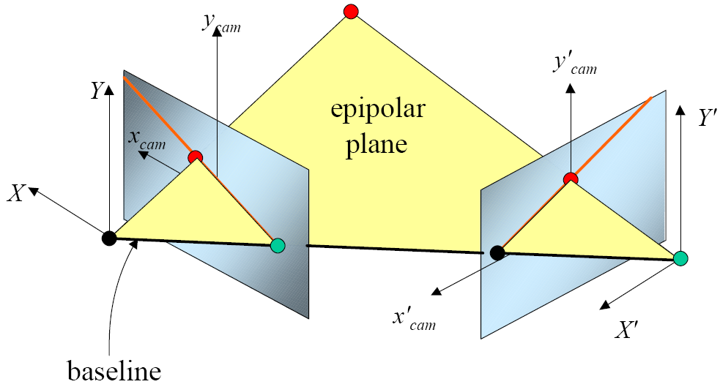
The Epipolar Geometry
Assume that we have a set of correspondences
Notes:
CIS5370 vision-05-epipolar.ppt
Dr. Xiuwen Liu

Slide 6
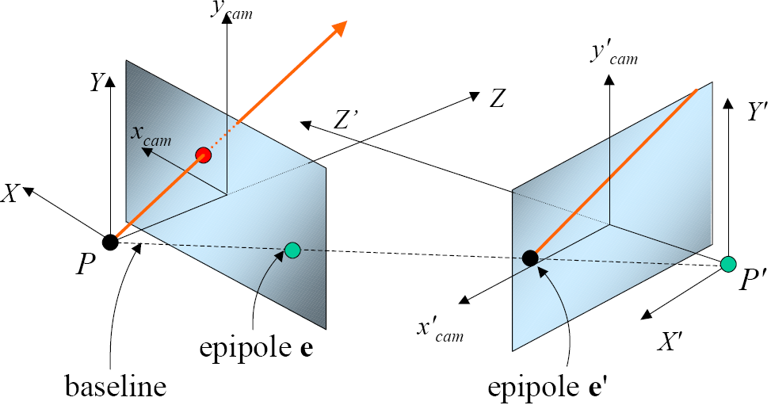
The Epipolar Geometry
Notes:
CIS5370 vision-05-epipolar.ppt
Dr. Xiuwen Liu

Slide 7
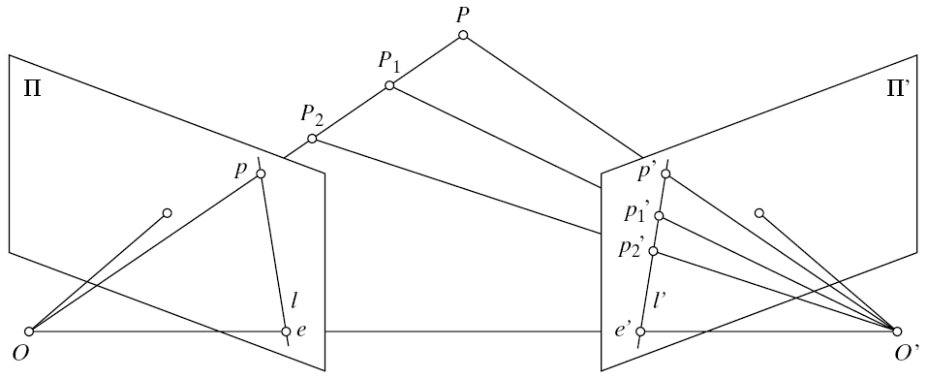
Epipolar Lines
Notes:
CIS5370 vision-05-epipolar.ppt
Dr. Xiuwen Liu

Slide 8
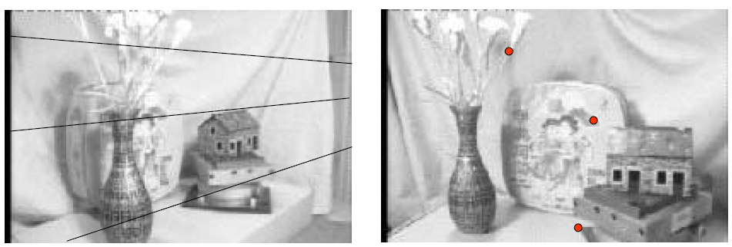
The Epipolar Geometry
Notes:
CIS5370 vision-05-epipolar.ppt
How can you tell which one is which?
Dr. Xiuwen Liu

Slide 9
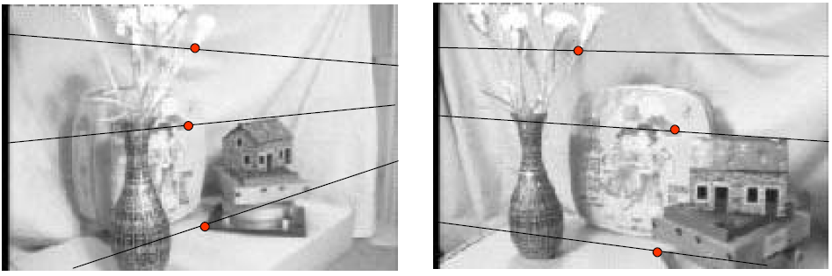
The Epipolar Geometry
Notes:
CIS5370 vision-05-epipolar.ppt
Dr. Xiuwen Liu

Slide 10
Epipolar Geometry continued
  All of the epipolar lines in each image pass through the epipole in that image
Epipolar lines
Epipoles
Left Image
Right Image
Notes:
CIS5370 vision-05-epipolar.ppt
Dr. Xiuwen Liu

Slide 11
Consequences
  The epipolar constraint
    For every point observed in the left image we know that its correspondence must lie along the corresponding epipolar line in the right image
    For every epipolar line in the left image there is a corresponding epipolar line in the right image
  This observation can substantially simplify the search for correspondences
Notes:
CIS5370 vision-05-epipolar.ppt
Dr. Xiuwen Liu

Slide 12
Epipolar Geometry
Depending on the location of 3D points, the epipolar plane rotates about the baseline
  The family is called epipolar pencil
Notes:
CIS5370 vision-05-epipolar.ppt
Dr. Xiuwen Liu

Slide 13
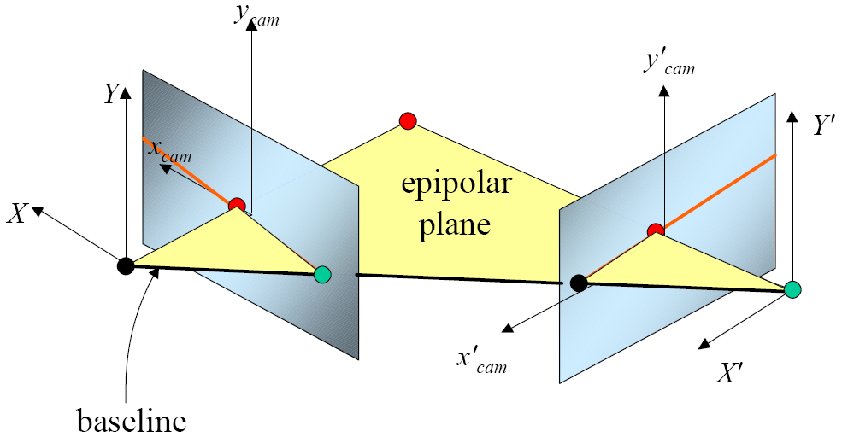
Epipolar Geometry
Notes:
CIS5370 vision-05-epipolar.ppt
Dr. Xiuwen Liu

Slide 14
Special Case
P
O_{l}
O_{r}
Notes:
CIS5370 vision-05-epipolar.ppt
Dr. Xiuwen Liu

Slide 15
Special Case
  In the special case of the stereo setup shown in the previous slide where the image planes are aligned with each other, the epipolar lines correspond to rows in the image
  That is the epipoles in both images are at infinity along the x axis.
  Note that it is often possible to rectify a stereo pair so that it appears to have this special structure.
Notes:
CIS5370 vision-05-epipolar.ppt
Dr. Xiuwen Liu

Slide 16
We can always achieve this geometry with image rectification
Image reprojection
  Reproject image planes onto common
  plane parallel to line between optical centers
Notice, only focal point of camera really matters
(Seitz)
Notes:
CIS5370 vision-05-epipolar.ppt
Dr. Xiuwen Liu

Slide 17
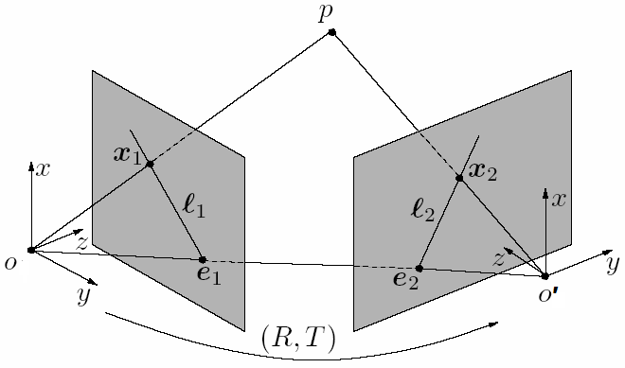

Epipolar Geometry
Normalized image planes
: direction of vector OP,
T : direction of vector O’O
x2 : direction of vector O’P
These three vectors form a plane
Note: R, T specify the left camera’s pose and position in the right camera’s coordinate
Notes:
CIS5370 vision-05-epipolar.ppt
Dr. Xiuwen Liu

Slide 18
Cross Product
X is normal to both v and w
Notes:
CIS5370 vision-05-epipolar.ppt
Dr. Xiuwen Liu

Slide 19

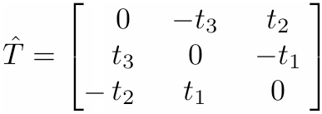
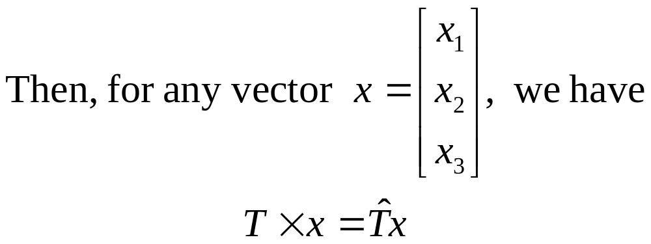
Skew-symmetric matrix
Notes:
CIS5370 vision-05-epipolar.ppt
Dr. Xiuwen Liu

Slide 20
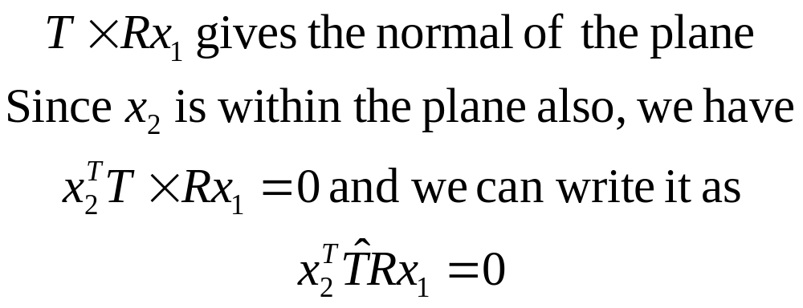
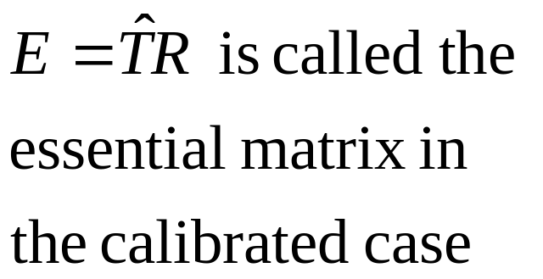
Epipolar Geometry
Notes:
CIS5370 vision-05-epipolar.ppt
Dr. Xiuwen Liu

Slide 21




Epipolar Geometry
Rigid transformation between two cameras
Denote as cross product T x:
Notes:
CIS5370 vision-05-epipolar.ppt
Dr. Xiuwen Liu

Slide 22



Epipolar Geometry
Therefore:
Notes:
CIS5370 vision-05-epipolar.ppt
Dr. Xiuwen Liu

Slide 23
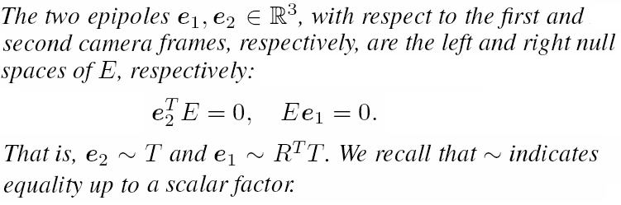
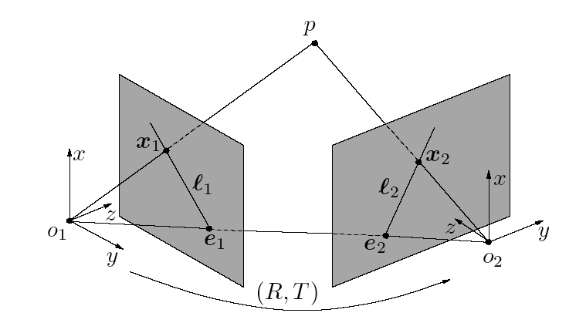
Notes:
CIS5370 vision-05-epipolar.ppt
Dr. Xiuwen Liu

Slide 24
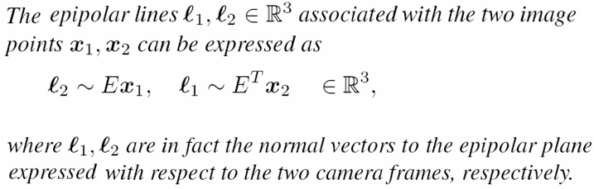
Notes:
CIS5370 vision-05-epipolar.ppt
Dr. Xiuwen Liu

Slide 25


A Line in a Plane
An epipolar line on an image plane can be described by the general equation for a line
  The coefficients of an epipolar line are given by
Notes:
CIS5370 vision-05-epipolar.ppt
Dr. Xiuwen Liu

Slide 26
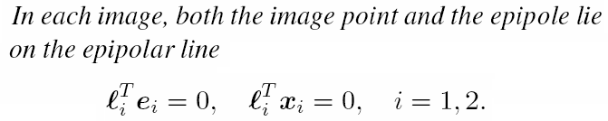
Notes:
CIS5370 vision-05-epipolar.ppt
Dr. Xiuwen Liu

Slide 27
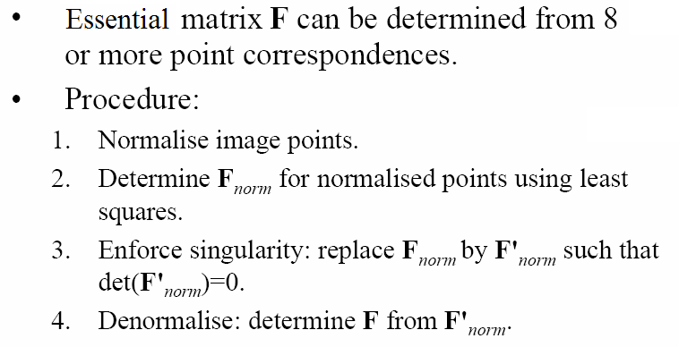
Normalized 8 Point Algorithm
Notes:
CIS5370 vision-05-epipolar.ppt
Dr. Xiuwen Liu

Slide 28
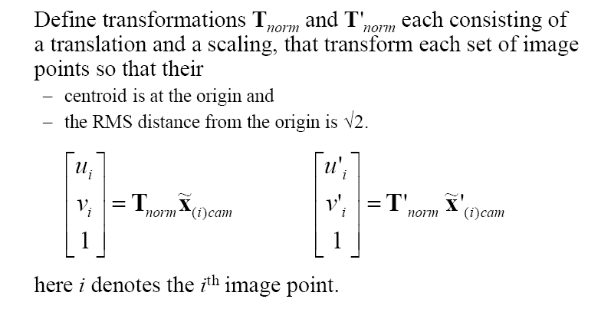
Normalized 8 Point Algorithm
Notes:
CIS5370 vision-05-epipolar.ppt
Dr. Xiuwen Liu

Slide 29
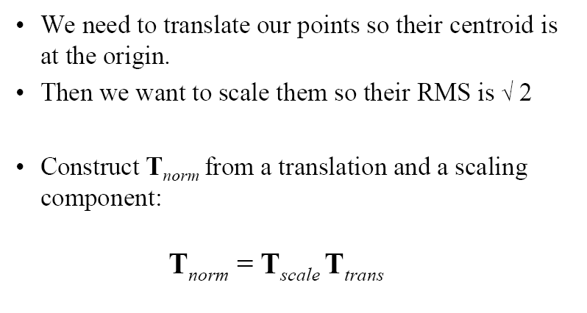
Normalized 8 Point Algorithm
Notes:
CIS5370 vision-05-epipolar.ppt
Dr. Xiuwen Liu

Slide 30
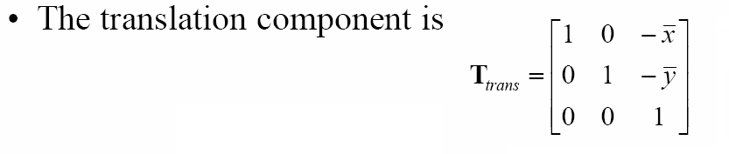
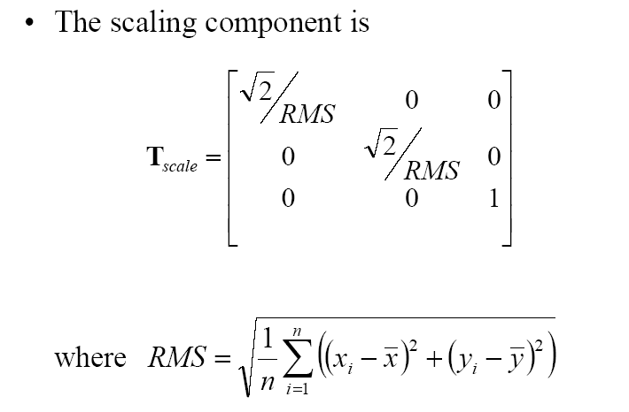
Normalized 8 Point Algorithm
Notes:
CIS5370 vision-05-epipolar.ppt
Dr. Xiuwen Liu

Slide 31
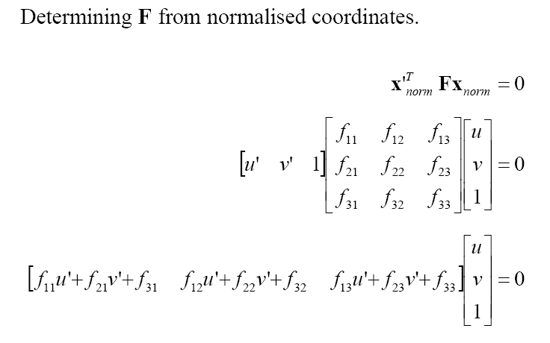
Normalized 8 Point Algorithm
Notes:
CIS5370 vision-05-epipolar.ppt
Dr. Xiuwen Liu

Slide 32
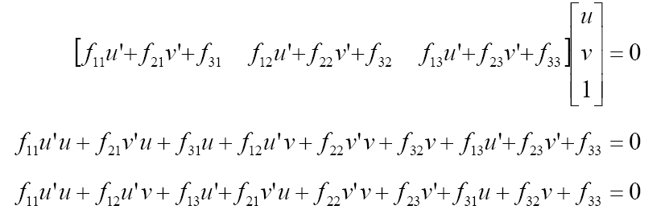
Normalized 8 Point Algorithm
Notes:
CIS5370 vision-05-epipolar.ppt
Dr. Xiuwen Liu

Slide 33
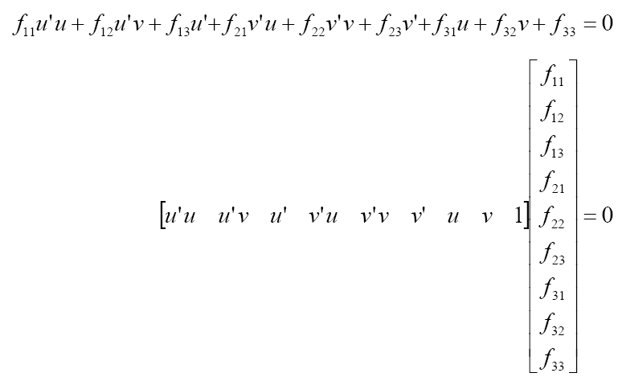
Normalized 8 Point Algorithm
Notes:
CIS5370 vision-05-epipolar.ppt
Dr. Xiuwen Liu

Slide 34
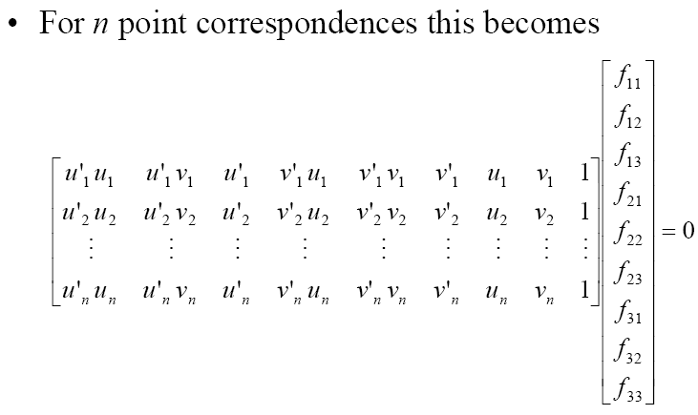
Normalized 8 Point Algorithm
Notes:
CIS5370 vision-05-epipolar.ppt
Dr. Xiuwen Liu

Slide 35
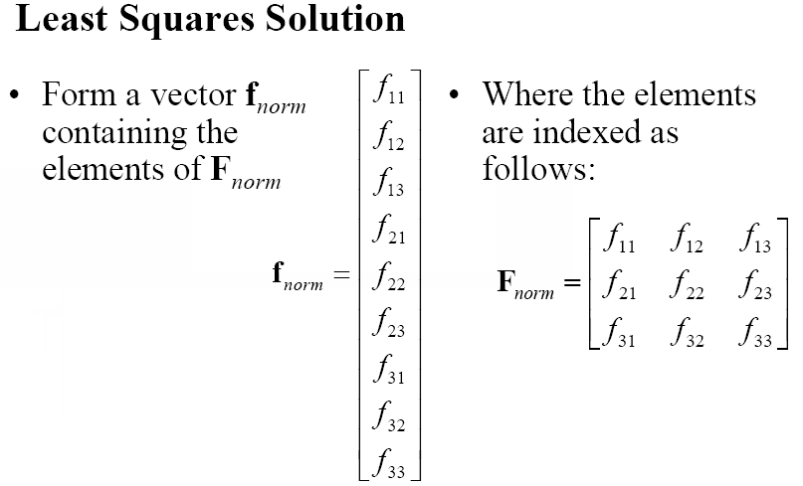
Normalized 8 Point Algorithm
Notes:
CIS5370 vision-05-epipolar.ppt
Dr. Xiuwen Liu

Slide 36
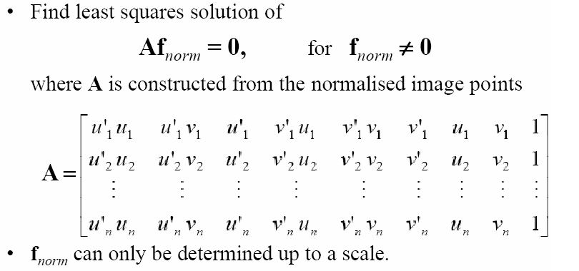
Normalized 8 Point Algorithm
Notes:
CIS5370 vision-05-epipolar.ppt
Dr. Xiuwen Liu

Slide 37
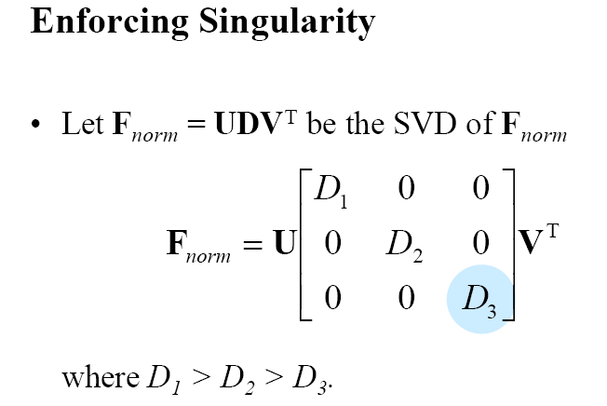
Normalized 8 Point Algorithm
Notes:
CIS5370 vision-05-epipolar.ppt
Dr. Xiuwen Liu

Slide 38
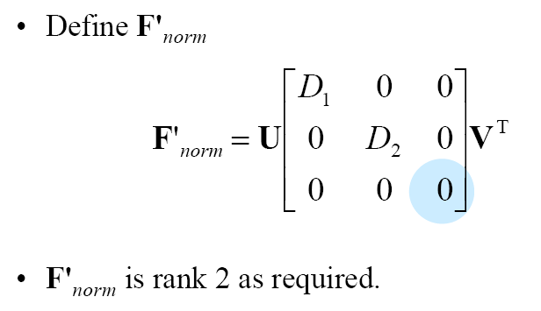
Normalized 8 Point Algorithm
Notes:
CIS5370 vision-05-epipolar.ppt
Dr. Xiuwen Liu

Slide 39
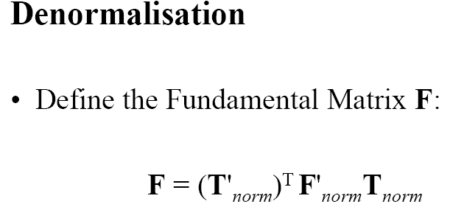
Normalized 8 Point Algorithm
Notes:
CIS5370 vision-05-epipolar.ppt
Dr. Xiuwen Liu

Slide 40
Normalized 8 Point Algorithm
Notes:
CIS5370 vision-05-epipolar.ppt
Dr. Xiuwen Liu

Slide 41
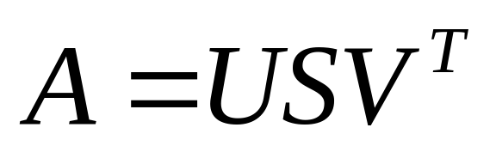
Normalized 8 Point Algorithm
The solution is to choose f_{norm} to be the eigenvector associated with the smallest eigenvalue of A^{T}A
It can also be obtained from the singular value decomposition (SVD) of A
  Choose f_{norm} to be the last column of V (corresponding to the smallest singular value)
Notes:
CIS5370 vision-05-epipolar.ppt
Dr. Xiuwen Liu

Slide 42
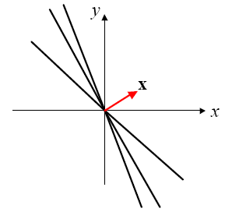
Why the Eigenvector of the Smallest Eigenvalue of A^{T}A?
Note that we can only determine f_{norm} up to a scale
  In the 2D case, this means that we find a direction that is most perpendicular to all the n lines
Notes:
CIS5370 vision-05-epipolar.ppt
Dr. Xiuwen Liu

Slide 43
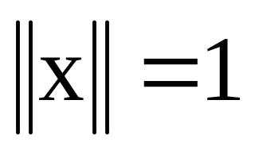
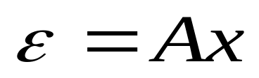
Why the Eigenvector of the Smallest Eigenvalue of A^{T}A?
Since the scaling is arbitrary, we fix the scale by
We define
  Since we want Ax to be zero (but we can not in general), we can do the best we can by choosing x to minimize ||Ax||²
Notes:
CIS5370 vision-05-epipolar.ppt
Dr. Xiuwen Liu

Slide 44
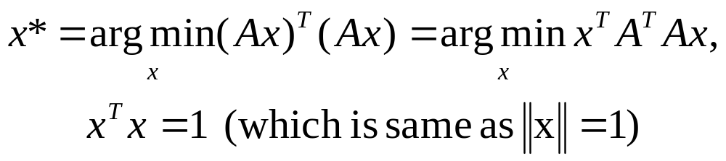

Why the Eigenvector of the Smallest Eigenvalue of A^{T}A?
The problem is a constrained optimization one
We use the method of Lagrange multipliers and define V
  Here λ is a Lagrange multiplier
Notes:
CIS5370 vision-05-epipolar.ppt
Dr. Xiuwen Liu

Slide 45
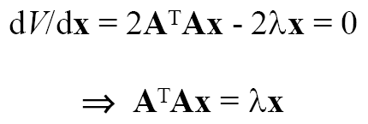
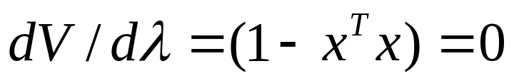
Why the Eigenvector of the Smallest Eigenvalue of A^{T}A?
To find the minima of V, we take the derivative with respect to x and λ, and set them to zero
  The solution must be an eigenvector (of unit length) of A^{T}A
Notes:
CIS5370 vision-05-epipolar.ppt
Dr. Xiuwen Liu

Slide 46

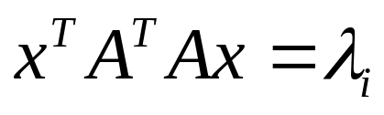
Why the Eigenvector of the Smallest Eigenvalue of A^{T}A?
Which one?
  Note that we want to minimize
  Suppose x is the unit length eigenvector associated with eigenvalue λ_{i}
  To minimize , we want to choose the eigenvector of A^{T}A associated with the smallest eigenvalue
Notes:
CIS5370 vision-05-epipolar.ppt
Dr. Xiuwen Liu

Slide 47
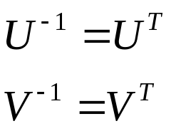
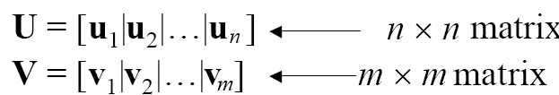
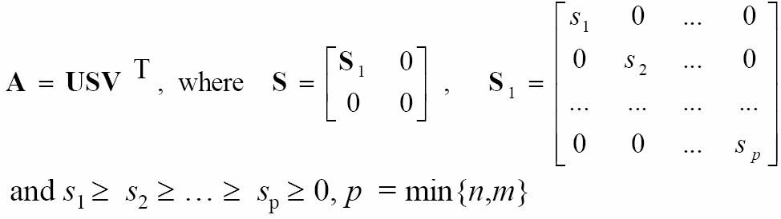
Why Singular Value Decomposition?
Let us look at the singular value decomposition of A
  For any n x m matrix A, there exist unitary matrices U (n x n) and V (m x m) such that
Notes:
CIS5370 vision-05-epipolar.ppt
Dr. Xiuwen Liu

Slide 48
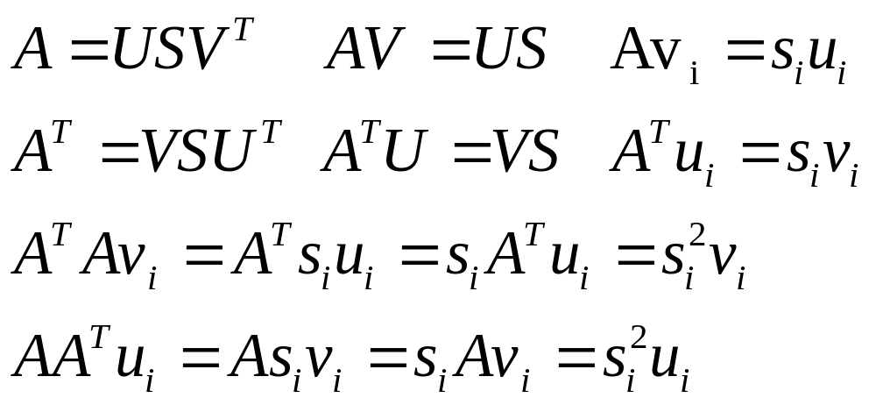
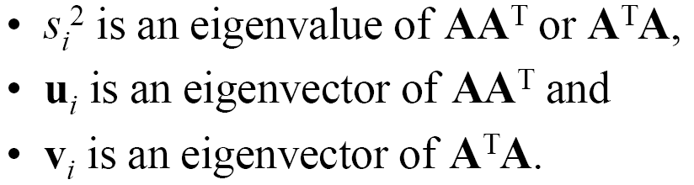
Why Singular Value Decomposition?
We have the following
Notes:
CIS5370 vision-05-epipolar.ppt
Dr. Xiuwen Liu

Slide 49
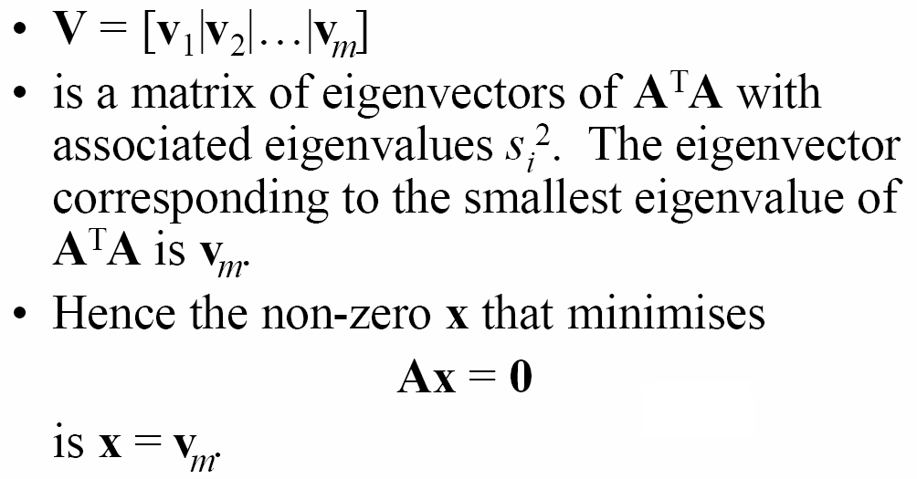
Why Singular Value Decomposition?
Notes:
CIS5370 vision-05-epipolar.ppt
Dr. Xiuwen Liu

Slide 50
Normalized 8 Point Algorithm
Notes:
CIS5370 vision-05-epipolar.ppt
Dr. Xiuwen Liu

Slide 51
Normalized 8 Point Algorithm
Why?
Notes:
CIS5370 vision-05-epipolar.ppt
Dr. Xiuwen Liu

Slide 52
Normalized 8 Point Algorithm
Notes:
CIS5370 vision-05-epipolar.ppt
Dr. Xiuwen Liu

Slide 53

Estimating Essential Matrix
Note that in the calibrated case, we assume that the intrinsic camera parameters are known, we can compute the essential matrix from F by
  Where K and K’ are the camera parameters for the left and right cameras
Notes:
CIS5370 vision-05-epipolar.ppt
Dr. Xiuwen Liu

Slide 54

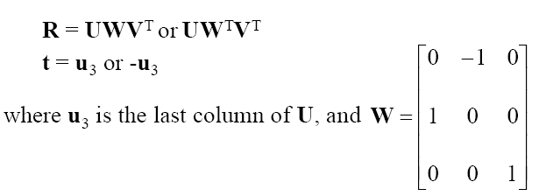
Estimating R and T from E
We need to know the relative positions of two cameras
  We do singular value decomposition of E
  Then rotation and translation are given by
Notes:
CIS5370 vision-05-epipolar.ppt
Dr. Xiuwen Liu

Slide 55
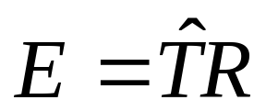

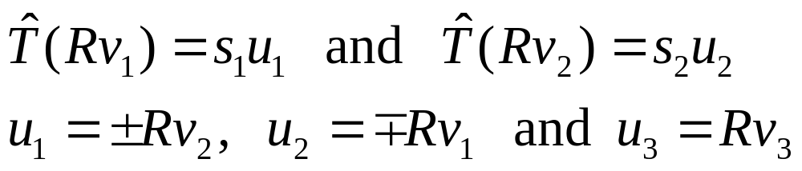
Why?
Note that E has a special form
  Which means U, S, and RV are SVD of
  We thus have (according to the properties of SVD)
Notes:
CIS5370 vision-05-epipolar.ppt
Dr. Xiuwen Liu

Slide 56


Notes:
CIS5370 vision-05-epipolar.ppt
Dr. Xiuwen Liu

Slide 57
How about T?
The direction of the translation vector is given by u₃
  But we can not recover the true magnitude of the translation vector because we can only recover E up to a scale
Notes:
CIS5370 vision-05-epipolar.ppt
Dr. Xiuwen Liu

Slide 58


A Numerical Example
Notes:
CIS5370 vision-05-epipolar.ppt
Dr. Xiuwen Liu

Slide 59


Estimating R and T from E
There are four possible solutions
Notes:
CIS5370 vision-05-epipolar.ppt
Dr. Xiuwen Liu

Slide 60

Estimating R and T from E
Notes:
CIS5370 vision-05-epipolar.ppt
Source: P. 430, Computer Vision by Simon Prince.
Dr. Xiuwen Liu

Slide 61
How to Choose the Correct One
Positive depth constraints
  For the correct pair, all the data points should be in front of the both cameras
  For each pair, we can compute the 3D points of each correspondence, and check if the Z (depth) is positive in both camera coordinates
Notes:
CIS5370 vision-05-epipolar.ppt
Dr. Xiuwen Liu

Slide 62
Estimating R and T from E
Notes:
CIS5370 vision-05-epipolar.ppt
Dr. Xiuwen Liu

Slide 63
3D Reconstruction from a Pair of Correspondence
: direction of vector OP,
T : direction of vector O’O
x2 : direction of vector O’P
These three vectors form a plane
Notes:
CIS5370 vision-05-epipolar.ppt
Dr. Xiuwen Liu

Slide 64

3D Reconstruction from a Pair of Correspondence
Let P=[X Y Z W]^{T} be the 3D point in the left camera’s coordinate system
  Let [x₂, y₂, 1]^{T} be the corresponding point in the normalized image plane of the right camera
  Let [x₁, y₁, 1]^{T} be the corresponding point in the normalized image plane of the left camera
  For the left camera, we have
Notes:
CIS5370 vision-05-epipolar.ppt
Dr. Xiuwen Liu

Slide 65



3D Reconstruction from a Pair of Correspondence
For the right camera, the 3D point in its coordinate system is
  Similar to the left camera, we have
  Thus
Notes:
CIS5370 vision-05-epipolar.ppt
Dr. Xiuwen Liu

Slide 66

3D Reconstruction from a Pair of Correspondence
Thus, we have a linear problem to solve
  Due to measurement noise, we may not be able to find an exact solution
  We compute the SVD of the A matrix and take the last column of V to be the best solution
Notes:
CIS5370 vision-05-epipolar.ppt
Dr. Xiuwen Liu

Slide 67
3D Reconstruction from a Pair of Correspondence
What is the depth of the point in the left camera?
What is the depth of the point in the right camera?
To pick the correct solution among the four possible ones, pick one test point and calculate its depths in both cameras
Notes:
CIS5370 vision-05-epipolar.ppt
Dr. Xiuwen Liu

Slide 68
Putting Everything Together: A Complete Example
Here I use a synthetic example to illustrate how all the steps work
The object – a cube-like wire frame
The cameras
The projective matrices for both cameras
3D Reconstruction
  Corresponding points
  Fundamental matrices
  Essential matrices, R, and T
Notes:
CIS5370 vision-05-epipolar.ppt
Here is a synthetic example under matlab / illustration . To run, do the following in Matlab
show_cameras.m
reconstruction_ex.m
Dr. Xiuwen Liu

Slide 69

3D Models
To generate a 3D model from 3D points (called point clouds), we first need to form triangles to approximate the underlying surface
Notes:
CIS5370 vision-05-epipolar.ppt
Dr. Xiuwen Liu

Slide 70

3D Models – cont.
Notes:
CIS5370 vision-05-epipolar.ppt
Dr. Xiuwen Liu

Slide 71

Texture Mapping
To make the model more realistic, we can map textures from the original images on the planar surfaces
Notes:
CIS5370 vision-05-epipolar.ppt
Dr. Xiuwen Liu

Slide 72
Texture Mapping
In a VRML file, this can be done easily
  For each triangle,
    Specify an image using “Texture ImageTexture”
    Specify the texture coordinates using “texCooord TextureCoordinate”
    Specify the correspondence between the points for the vertices and the texture coordinates using texCoordIndex
Notes:
CIS5370 vision-05-epipolar.ppt
Dr. Xiuwen Liu

Slide 73


A VRML Example
Notes:
CIS5370 vision-05-epipolar.ppt
Dr. Xiuwen Liu

Slide 74

Texture Mapping – cont.
However, the texture mapping in VRML assumes that the texture image is taken from a front-parallel perspective
Notes:
CIS5370 vision-05-epipolar.ppt
Dr. Xiuwen Liu

Slide 75

Texture Mapping – cont.
How can we achieve that?
Notes:
CIS5370 vision-05-epipolar.ppt
Dr. Xiuwen Liu

Slide 76

Texture Mapping – cont.
Notes:
CIS5370 vision-05-epipolar.ppt
Dr. Xiuwen Liu

Slide 77

Texture Mapping – cont.
That means, the normal of the new image plane has to be parallel of the normal of the planar surface given by the triangle
Notes:
CIS5370 vision-05-epipolar.ppt
Dr. Xiuwen Liu

Slide 78

Texture Mapping – cont.
Notes:
CIS5370 vision-05-epipolar.ppt
Dr. Xiuwen Liu

Slide 79

Texture Mapping – cont.
Notes:
CIS5370 vision-05-epipolar.ppt
Dr. Xiuwen Liu

Slide 80

Texture Mapping – cont.
There is also a scaling issue
  The texture image for each triangle has to be consistent in size with other triangles
  How to resolve this problem?
Notes:
CIS5370 vision-05-epipolar.ppt
Dr. Xiuwen Liu

Slide 81
Summary
Now we know how to estimate 3D points
  Given the intrinsic camera parameters and correspondences (at least eight) in a stereo pair,
  We can recover the points in 3D and also the relative camera position (up to a scale) and pose
    By using eight point algorithms
Next time: correspondence and advanced topic
Notes:
CIS5370 vision-05-epipolar.ppt
Dr. Xiuwen Liu

