Slide 1
Outline
Real-time face detection
Notes:
CAP4730 vision-11-face-detection.ppt
Dr. Xiuwen Liu

Slide 2
Object Detection
A fundamental problem in many computer vision applications is to detect objects in images and video sequences
  If we can detect objects in real-time, we can build numerous applications
  In addition, we can then avoid segmentation, which can result in a new computer vision paradigm
Notes:
CAP4730 vision-11-face-detection.ppt
Dr. Xiuwen Liu

Slide 3
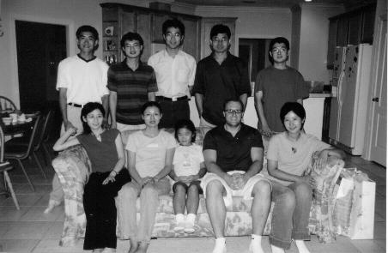
Face Detection Example
Notes:
CAP4730 vision-11-face-detection.ppt
Dr. Xiuwen Liu

Slide 4
Different Face Detection Approaches
Knowledge-based methods
  Derive rules based on knowledge of human faces
M.-H. Yang, D. Kriegman and N. Ahuja. Detecting Faces in Images: A Survey. IEEE Transactions on Pattern Analysis and Machine Intelligence, Vol. 24, No. 1, pp. 34-58. 2002.
Notes:
CAP4730 vision-11-face-detection.ppt
Dr. Xiuwen Liu

Slide 5
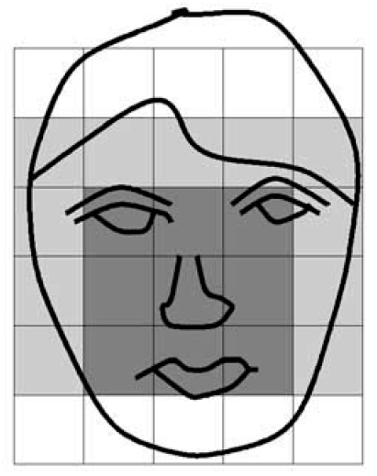
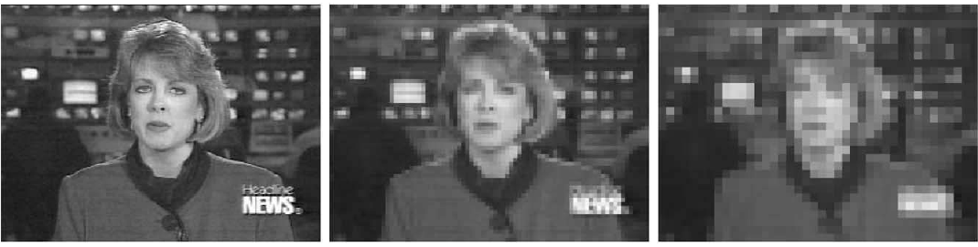
Knowledge-Based Methods
Notes:
CAP4730 vision-11-face-detection.ppt
Dr. Xiuwen Liu

Slide 6
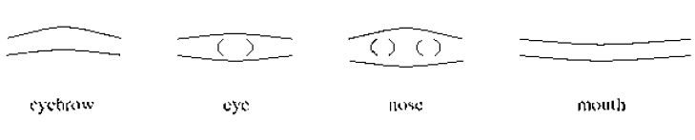
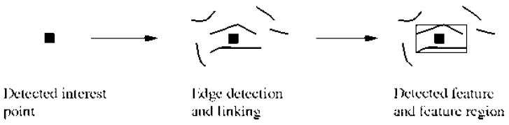
Feature-Based Methods
Notes:
CAP4730 vision-11-face-detection.ppt
Dr. Xiuwen Liu

Slide 7
Template Matching
We can use a set of typical faces as templates
  We can then try to detect faces by comparing each of the templates with each of the windows in the image
  There are many different criteria for comparison
    The simplest matching criterion is to compare pixel by pixel
Notes:
CAP4730 vision-11-face-detection.ppt
Dr. Xiuwen Liu

Slide 8
Template Matching
Notes:
CAP4730 vision-11-face-detection.ppt
Dr. Xiuwen Liu

Slide 9
Complexity of Template Matching
Suppose the image size is 720 by 480
  Which is the NTSC frame size
Assume further that we only have a face template of 21 by 21
  What is the time complexity to check all possible locations and scales in an image?
Notes:
CAP4730 vision-11-face-detection.ppt
Dr. Xiuwen Liu

Slide 10
Complexity of Template Matching
In applications, we also need to search over
  Different scales (sizes) of faces
  Different view angles (frontal or profile)
  Different facial expression
  In addition, we also have many different kinds of faces
Notes:
CAP4730 vision-11-face-detection.ppt
Dr. Xiuwen Liu

Slide 11
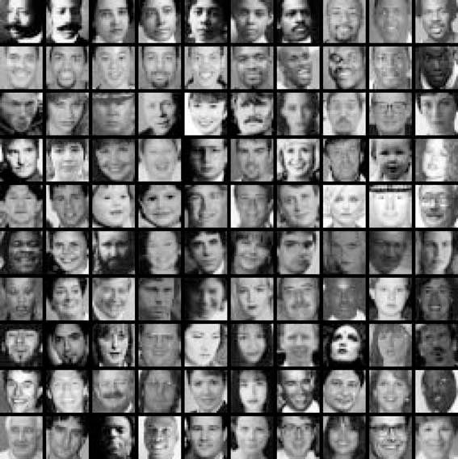
Typical Faces
Notes:
CAP4730 vision-11-face-detection.ppt
Dr. Xiuwen Liu

Slide 12
Real-time Face Detection
Observation
  Most of local windows in an image are not faces and in fact are very different from faces
    If we can reject those windows that are very different from faces, on average we can spend more time on windows that may be a face
  Note that it implies the classifier we use must have very low false positive rate as the number of non-face windows are very large
Notes:
CAP4730 vision-11-face-detection.ppt
Dr. Xiuwen Liu

Slide 13
Three Key Components
A new image representation
  The features can be computed fast and in constant time regardless of the scales
A simple and efficient (but also effective) classifier
  Based on AdaBoost for feature selection and learning classifiers
Cascade of classifiers to reduce the average detection time for an image
  A degenerated decision tree; often known as the twenty-question approach
Notes:
CAP4730 vision-11-face-detection.ppt
Dr. Xiuwen Liu

Slide 14
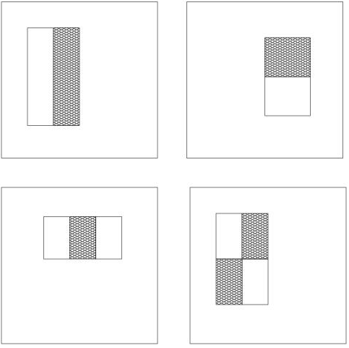
Simple Features
3 rectangular features types:
  two-rectangle feature type
    horizontal/vertical
  three-rectangle feature type
  four-rectangle feature type
Notes:
CAP4730 vision-11-face-detection.ppt
Dr. Xiuwen Liu

Slide 15
Simple Features
Simple features can capture face characteristics
  Using a 24x24 pixel base detection window, with all the possible combination of horizontal and vertical location and scale of these feature types the full set of features has 160,000 features
Notes:
CAP4730 vision-11-face-detection.ppt
Dr. Xiuwen Liu

Slide 16
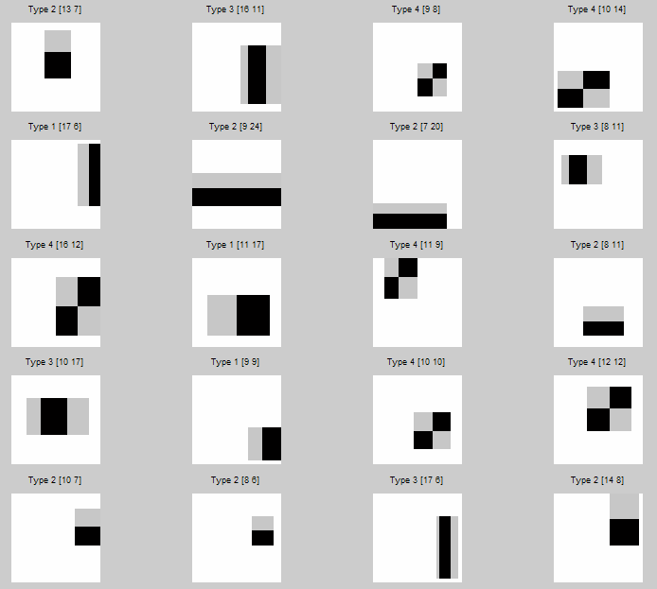
Simple Feature Examples
Notes:
CAP4730 vision-11-face-detection.ppt
Dr. Xiuwen Liu

Slide 17
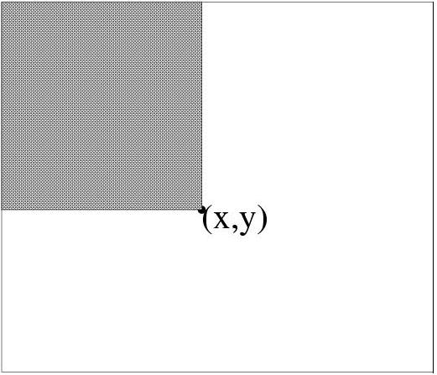
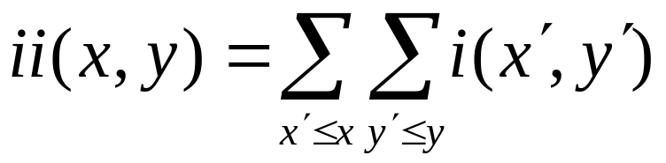
Integral Image
Integral image
Computing integral image
y
(0,0)
s(x,y) = s(x,y-1) + i(x,y)
ii(x,y) = ii(x-1,y) + s(x,y)
x
(x,y)
Notes:
CAP4730 vision-11-face-detection.ppt
Dr. Xiuwen Liu

Slide 18
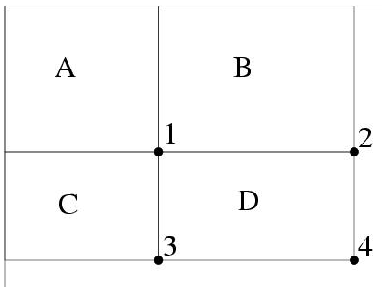
Rapid Evaluation of Rectangular Features
Using the integral image representation, one can compute the value of any rectangular sum in constant time
  For example the integral sum inside rectangle D we can compute as: ii(4) + ii(1) – ii(2) – ii(3)
Notes:
CAP4730 vision-11-face-detection.ppt
Dr. Xiuwen Liu

Slide 19
Rapid Evaluation of Rectangular Features – cont.
As a result, rectangular features can be evaluated quickly regardless of the size
How many references for each type?
  Two rectangular features?
  Three rectangular features?
  Four rectangular features?
Notes:
CAP4730 vision-11-face-detection.ppt
Dr. Xiuwen Liu

Slide 20
Challenges for Learning a Classifier
Given a feature set and labeled training set of images one can apply Bayesian classifier, support vector machines, neural networks, or other classifier
  These classifiers are not computationally efficient for detection because majority of local windows should be rejected more efficiently than the ones that are more difficult to distinguish
Notes:
CAP4730 vision-11-face-detection.ppt
Dr. Xiuwen Liu

Slide 21
Challenges for Learning a Classifier – cont.
Recall that there are 160,000 features associated with each image sub-window
  Hence the computation of all features is computationally prohibitive
Hypothesis: A combination of only a small number of these features can yield an effective classifier
  Challenge is how to find these discriminant features
Notes:
CAP4730 vision-11-face-detection.ppt
Dr. Xiuwen Liu

Slide 22
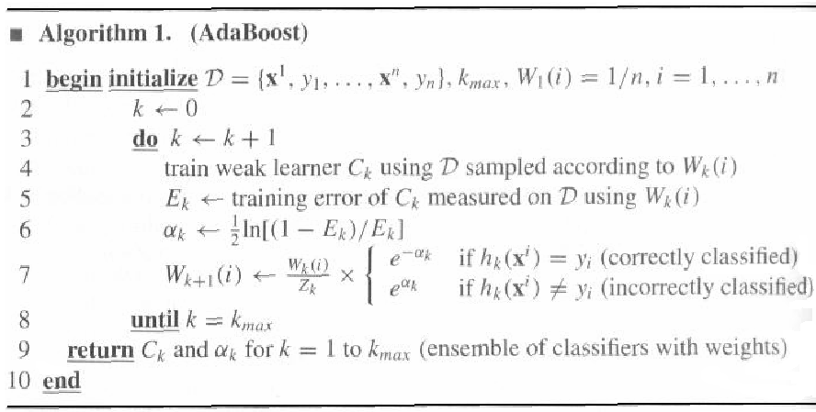
AdaBoost
Notes:
CAP4730 vision-11-face-detection.ppt
Dr. Xiuwen Liu

Slide 23
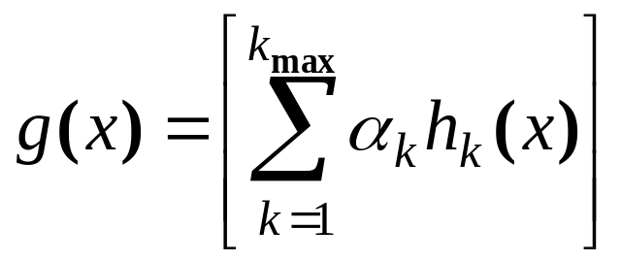
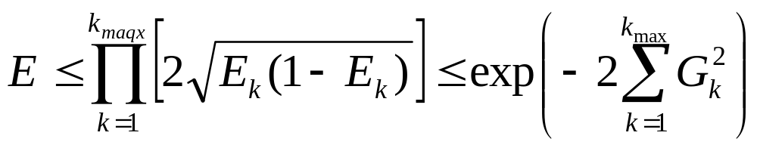
AdaBoost – cont.
The final/component classifier is given by
  The error on the training set of the final classifier is bounded to be
Notes:
CAP4730 vision-11-face-detection.ppt
Dr. Xiuwen Liu

Slide 24
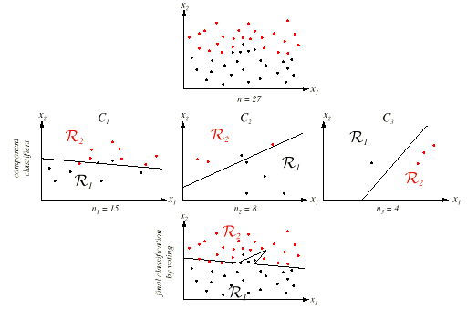
Notes:
CAP4730 vision-11-face-detection.ppt
Dr. Xiuwen Liu

Slide 25
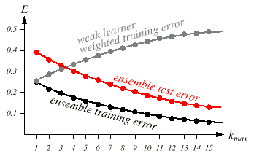
AdaBoost – cont.
Notes:
CAP4730 vision-11-face-detection.ppt
Dr. Xiuwen Liu

Slide 26
A Variant of AdaBoost for Feature Selection
Given training example images (x₁, y₁) , … , (x_{n}, y_{n})
  Where y_{i} = 0, 1 for negative and positive examples respectively
Initialize weights w_{1, i} = 1/(2m), 1/(2l) for negative and positive training example respectively
  Where m and l are the number of negatives and positives respectively
Notes:
CAP4730 vision-11-face-detection.ppt
Dr. Xiuwen Liu

Slide 27
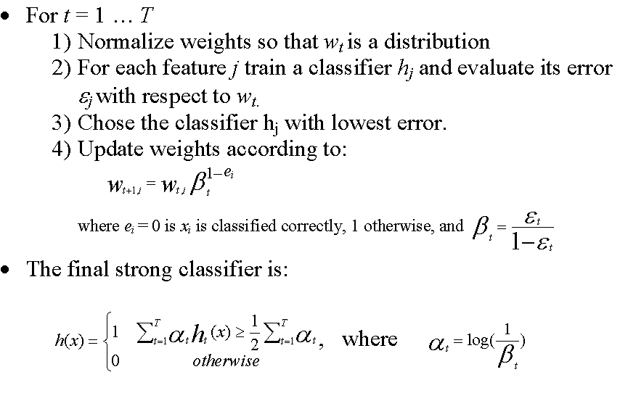
A Variant of AdaBoost for Feature Selection
Notes:
CAP4730 vision-11-face-detection.ppt
Dr. Xiuwen Liu

Slide 28
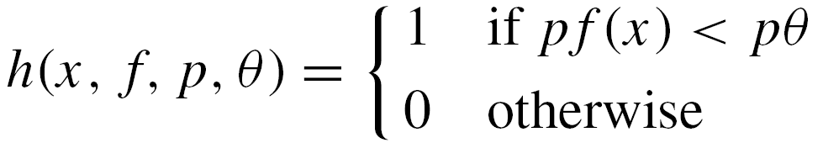
Weak Classifier
Each weak classifier is determined by a threshold and sign
  So the problem is how to find the best threshold for the criterion used in AdaBoost
    Of course, we can try all possible thresholds and pick the best one
      What is the complexity?
  How can we do it fast?
Notes:
CAP4730 vision-11-face-detection.ppt
Dr. Xiuwen Liu

Slide 29
Weak Classifier – cont.
Training samples are sorted based on the current feature
Optimal threshold is computed in a single pass over the list
Four sums are maintained and evaluated:
  The total sum of positive example weights T ⁺
  The total sum of negative example weights T ⁻
  The sum of positive weights below the current example S⁺
  The sum of negative weights below the current example S⁻
The error for a threshold which splits the range between the current and previous example in the sorted list
  How do we determine p (the sign) with the threshold?
Notes:
CAP4730 vision-11-face-detection.ppt
Dr. Xiuwen Liu

Slide 30
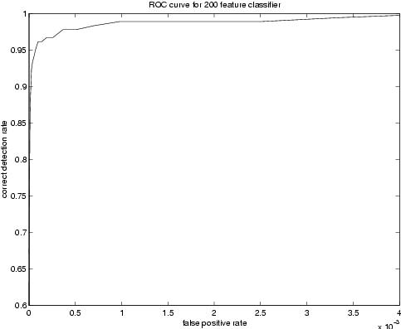
Performance of 200 Feature Face Detector
The ROC curve of the constructed classifier indicates that a reasonable detection rate of 0.95 can be achieved while maintaining an extremely low false positive rate of approximately 10⁻⁴
Notes:
CAP4730 vision-11-face-detection.ppt
Dr. Xiuwen Liu

Slide 31
Performance of 200 Feature Face Detector – cont.
First features selected by AdaBoost are meaningful and have high discriminative power
  By varying the threshold of the final classifier one can construct a two-feature classifier which has a detection rate of 1 and a false positive rate of 0.4
Notes:
CAP4730 vision-11-face-detection.ppt
Dr. Xiuwen Liu

Slide 32
Speed-up Through the Attentional Cascade(聯繫 聯合）
Simple boosted classifiers can reject many of negative sub-windows while detecting all positive instances
  Series of such simple classifiers can achieve good detection performance while eliminating the need for further processing of negative sub-windows
  The key assumption is that in a typical image vast majority of sub-windows are negative
Notes:
CAP4730 vision-11-face-detection.ppt
Dr. Xiuwen Liu

Slide 33
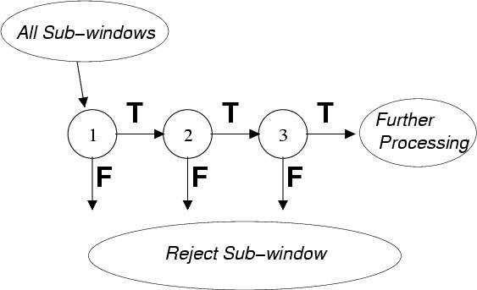
Speed-up Through the Attentional Cascade
Notes:
CAP4730 vision-11-face-detection.ppt
Dr. Xiuwen Liu

Slide 34
Processing and Training of the Attentional Cascade
Cascade is a degenerate decision tree
  Processing - only a positive result from a previous classifier triggers the evaluation of the subsequent classifier
  Training - subsequent classifiers are trained only on examples which pass through all the previous classifiers
    Hence the task faced by classifiers further down the cascade is more difficult
Notes:
CAP4730 vision-11-face-detection.ppt
Dr. Xiuwen Liu

Slide 35
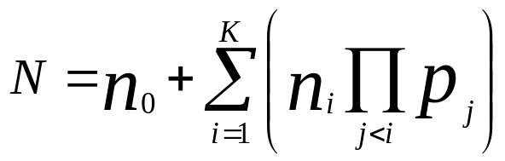
Processing of the Attentional Cascade
To achieve efficient cascade for a given false positive rate F and detection rate D we would like to minimize the expected number of features evaluated N
  Since this optimization is computationally expensive, the usual approach is to choose a minimal acceptable false positive and detection rate per layer
Notes:
CAP4730 vision-11-face-detection.ppt
Dr. Xiuwen Liu

Slide 36
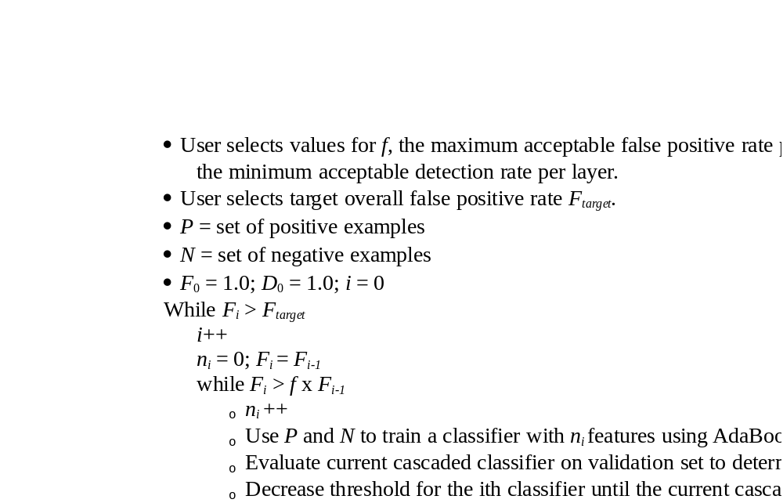
Algorithm for Training a Cascade of Classifiers
Notes:
CAP4730 vision-11-face-detection.ppt
Dr. Xiuwen Liu

Slide 37
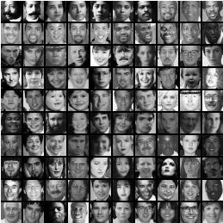
Experiments
Training set
  4916 positive training example were hand picked, aligned, normalized, and scaled to a base resolution of 24x24
  10,000 negative examples were selected by randomly picking sub-windows from 9500 images which did not contain faces
Notes:
CAP4730 vision-11-face-detection.ppt
Dr. Xiuwen Liu

Slide 38
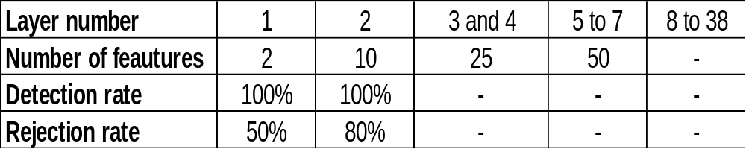
Experiments - cont.
The final detector had 38 layers and 6060 features in total
Notes:
CAP4730 vision-11-face-detection.ppt
Dr. Xiuwen Liu

Slide 39
Experiments - cont.
Speed of the detector
  On the MIT-CMU test set the average number of features evaluated is 8 (out of 6060)
  The processing time of a 384 by 288 pixel image on a conventional personal computer (700 Mhz Pentium III) about .067 second
  Processing time should linearly scale with image size, hence processing of a 3.1 mega pixel image taken from a digital camera should approximately take 2 seconds
Notes:
CAP4730 vision-11-face-detection.ppt
Dr. Xiuwen Liu

Slide 40
Operation of the Face Detector
Since training examples were normalized, image sub-windows needed to be normalized also
  This normalization of images can be efficiently done using two integral images (regular / squared).
Detection at multiple scales is achieved by scaling the detector itself.
The amount of shift between subsequent sub-windows is determined by some constant number of pixels and the current scale
Multiple detections of a face, due to the insensitivity to small changes in the image of the final detector, were combined based on overlapping bounding region.
Notes:
CAP4730 vision-11-face-detection.ppt
Dr. Xiuwen Liu

Slide 41
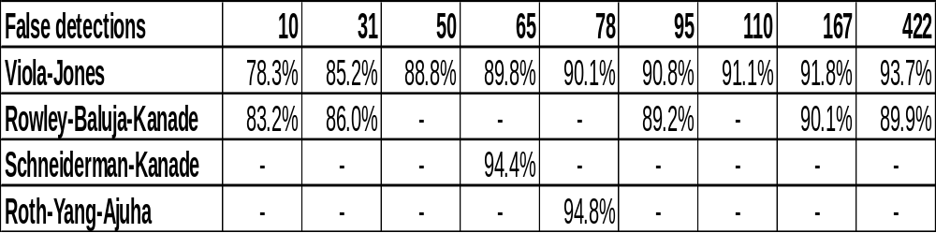
Experimental Results
Testing of the final face detector was performed using the MIT+CMU frontal face test which consists of
  130 images
  505 labeled frontal faces
Notes:
CAP4730 vision-11-face-detection.ppt
Dr. Xiuwen Liu

Slide 42
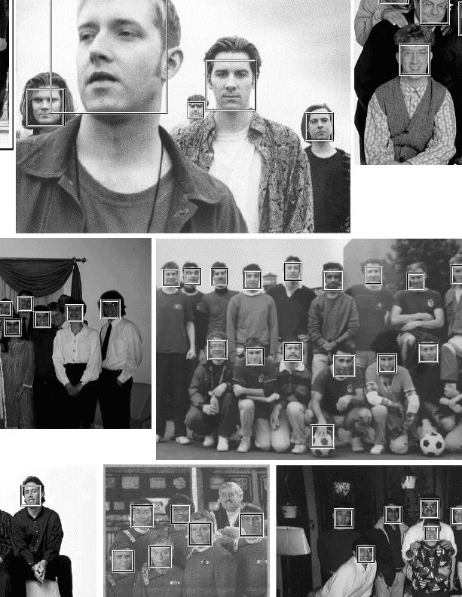
Detection Examples
Notes:
CAP4730 vision-11-face-detection.ppt
Dr. Xiuwen Liu

Slide 43
Summary
The paper presents general object detection method which is illustrated on the face detection task
  Using the integral image representation and simple rectangular features allows fast evaluation of features
  Simple modification to AdaBoost gives a general technique for efficient feature selection
  Using a cascade of homogeneous classifiers, it rejects most of the negative examples at early stages of processing, thereby significantly reducing computation time
A face detector using these techniques is presented which is comparable in classification performance to and orders of magnitude faster than the best detectors
Notes:
CAP4730 vision-11-face-detection.ppt
Dr. Xiuwen Liu

