Slide 1
Outline
“Show and Tell: A Neural Image Caption Generator”
  By Oriol Vinyals, et al.

Slide 2
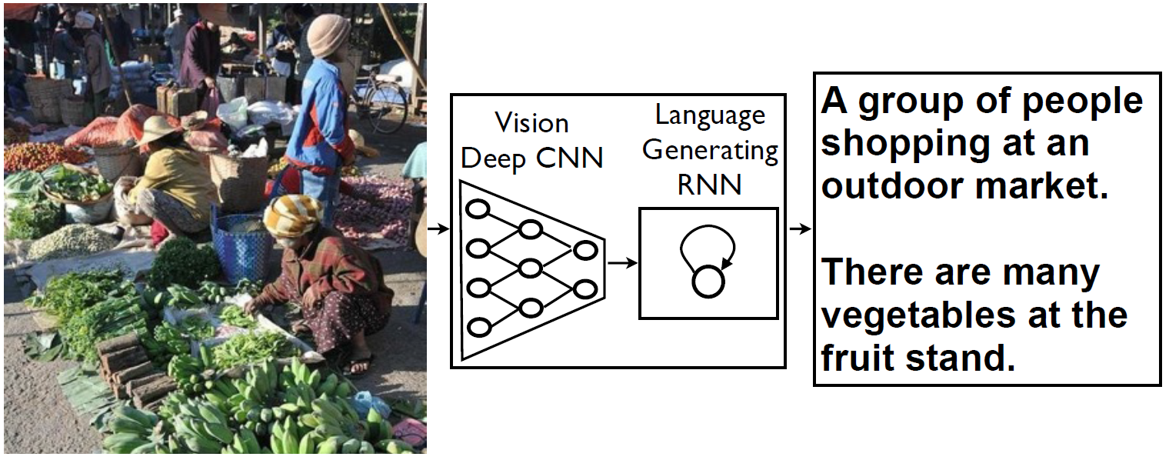
Objective
The goal is to automatically compute a natural caption for an image

Slide 3

The Model
In a probabilistic framework, try to compute the model by maximizing the probability
  Here S is the set of sentences
  How to compute a feasible solution?

Slide 4

The Model
Approximate
  Using a recurrent neural network

Slide 5
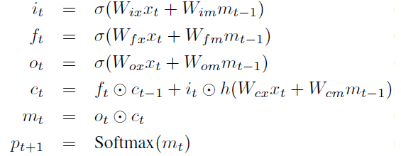
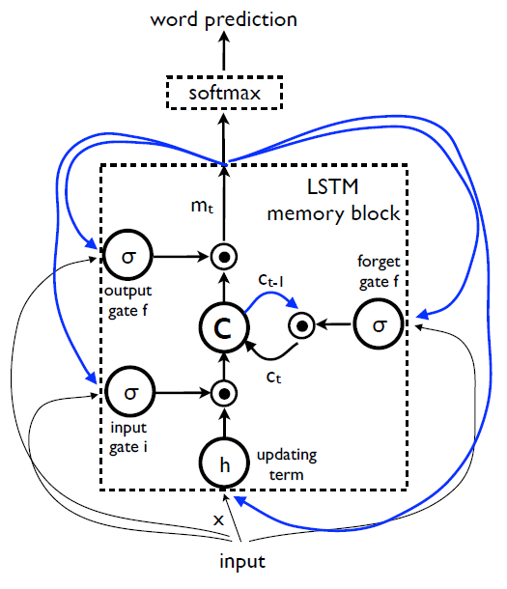
Long-Short Term Memory

Slide 6
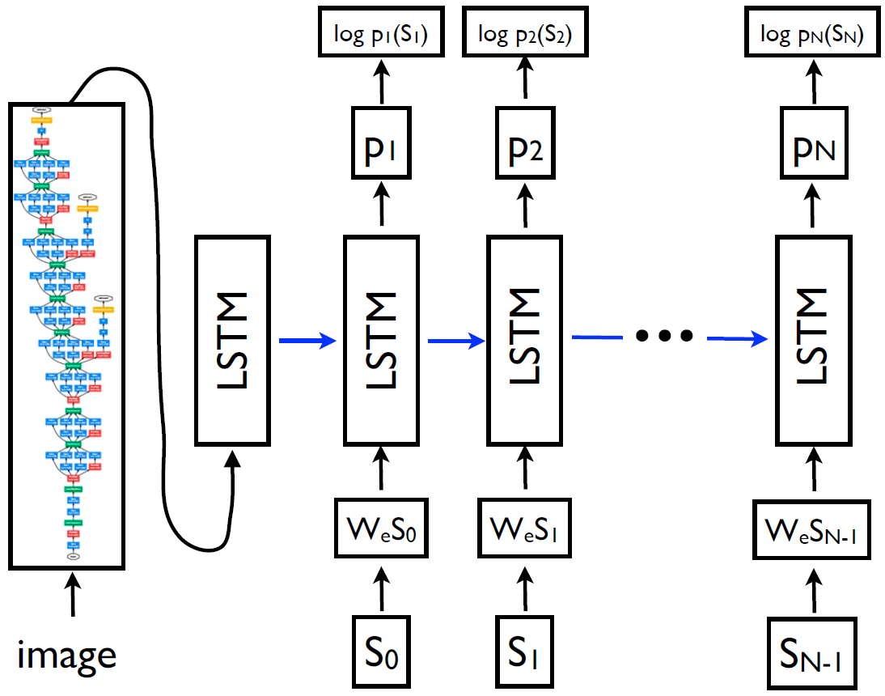
LSTM Model Combined with a CNN

Slide 7
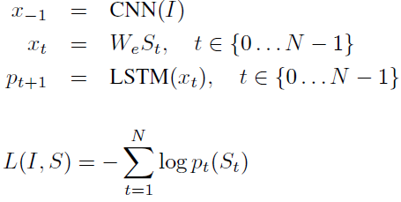
LSTM Model Combined with a CNN

Slide 8
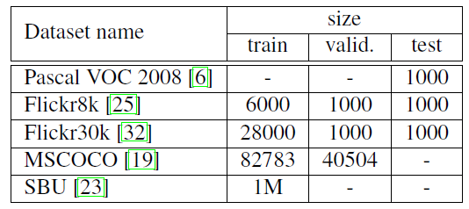
Datasets

Slide 9
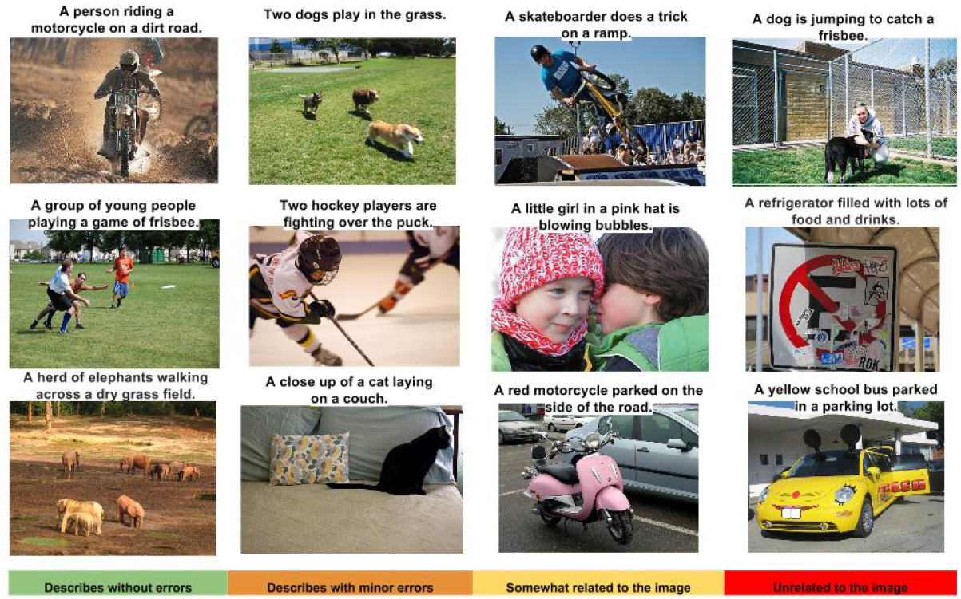
Experimental Results

Slide 10
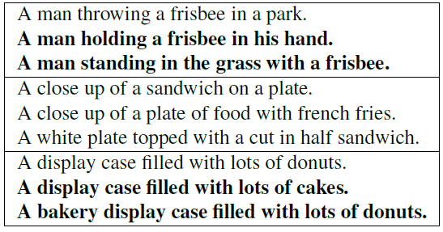
Generated Captions
Notes:
Here bold ones are not in the training set and they were created by the model.

Slide 11
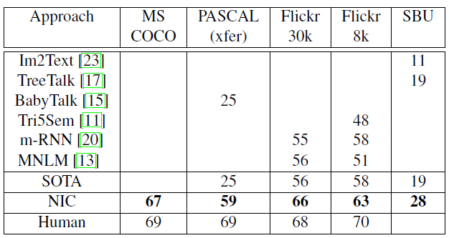
Experimental Results

Slide 12
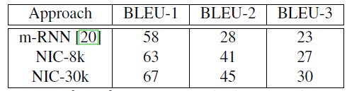
Experimental Results

Slide 13
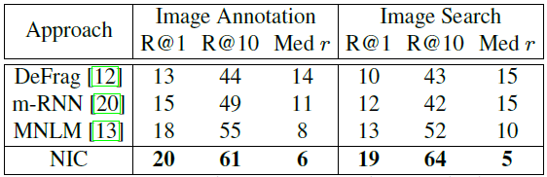
Experimental Results

Slide 14
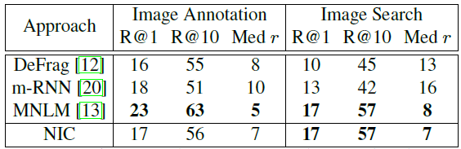
Experimental Results

Slide 15
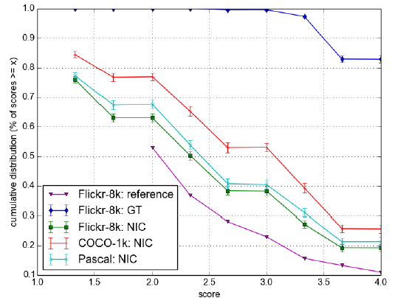
Experimental Results

Slide 16
Summary
Proposed an end-to-end system that can view an image and generate a reasonable summary in plain English
  By integrating a CNN with a LSTM-based sentence generation model
  Experimental results demonstrate the generated descriptions are similar to the ones generated by humans (at least on some datasets) measured using BLEU

