Slide 1

Presentation By
Michael Tao and Patrick Virtue

Slide 2
Agenda
History of the problem
Graph cut background
Compute graph cut
Extensions
State of the art
Continued Work

Slide 3
Agenda
History of the problem
Graph cut background
Compute graph cut
Extensions
State of the art
Continued Work

Slide 4
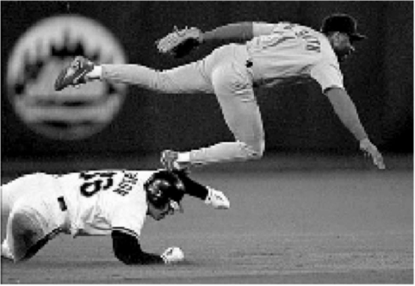
Image Segmentation : History
Computer Vision Problem Since 1970’s
Two Key Problems:
Edge detection
Image segmentation

Slide 5
Image Segmentation : History
Edge detectors, descriptors
1980 – Canny Edge Detector
No contours- just edges

Slide 6
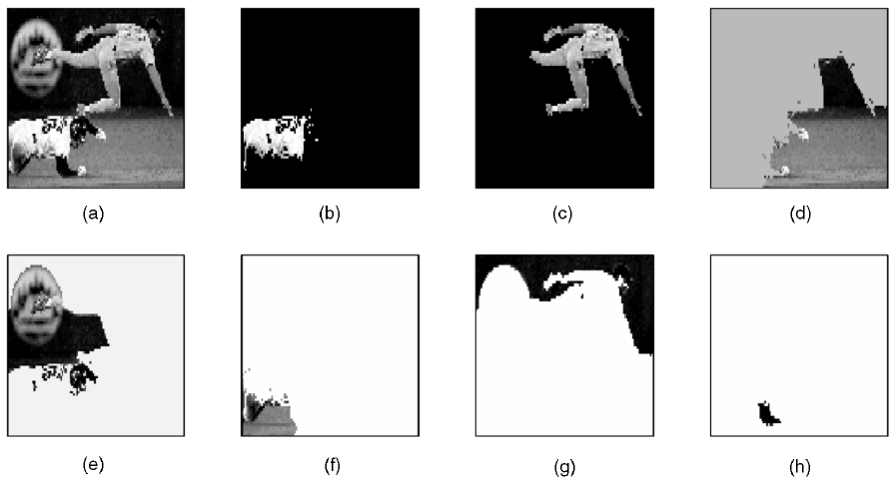
Image Segmentation : History
Image segmentation
Gives closed contours
Use: semantics, recognition, measurement

Slide 7
Image Segmentation : History
Multiple ways to solve this problem – many right answers
Before this paper: - What is the best way? - No agreement!
?

Slide 8
Agenda
History of the problem
Graph cut background
Compute graph cut
Extensions
State of the art
Continued Work

Slide 9
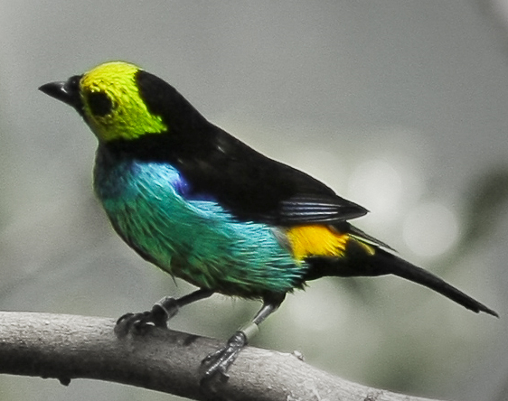
Graph Cut Background

Slide 10
Graph Cut Background
First: select a region of interest

Slide 11
Graph Cut Background
How to select the object automatically?
?

Slide 12
Graph Cut Background
We care about two terms: graph and cuts
?

Slide 13
Graph Cut Background
What are graphs?
Nodes
usually pixels
sometimes samples
Edges
weights associated (W(i,j))
E.g. RGB value difference

Slide 14
Graph Cut Background
What are cuts?
Each “cut” -> points, W(I,j)
Optimization problem
W(i,j) = |RGB(i) – RGB(j)|

Slide 15
Graph Cut Background
Go back to our selected region
Each “cut” -> points, W(I,j)
Optimization problem
W(i,j) = |RGB(i) – RGB(j)|

Slide 16
Graph Cut Background
Go back to our selected region
Each “cut” -> points, W(I,j)
Optimization problem
W(i,j) = |RGB(i) – RGB(j)|

Slide 17
Graph Cut Background
We want highest sum of weights
Each “cut” -> points, W(I,j)
Optimization problem
W(i,j) = |RGB(i) – RGB(j)|

Slide 18
Graph Cut Background
We want highest sum of weights
Each “cut” -> points, W(I,j)
Optimization problem
W(i,j) = |RGB(i) – RGB(j)|
These cuts give low points
W(i,j) = |RGB(i) – RGB(j)|is low

Slide 19
Graph Cut Background
We want highest sum of weights
Each “cut” -> points, W(I,j)
Optimization problem
W(i,j) = |RGB(i) – RGB(j)|
These cuts give high points
W(i,j) = |RGB(i) – RGB(j)|is high

Slide 20
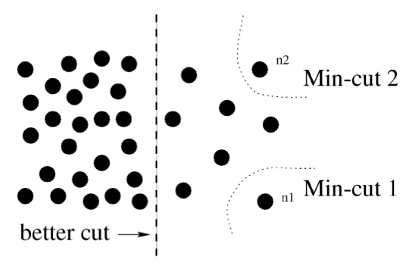

Normalized Graph Cuts
Why? – cuts can be noisy!

Slide 21
Graph Cut Background
Optimization solver
Solver Example Recursion:
Grow
If W(i,j) low
Stop
Continue

Slide 22
Graph Cut Background
Result : Isolation

Slide 23
Agenda
History of the problem
Graph cut background
Compute graph cut
Extensions
State of the art
Continued Work

Slide 24

Recall: Image Segmentation and Graph Cuts
Image Segmentation
Graph Cuts

Slide 25
The Pipeline
Input: Image
Output: Segments
Each iteration cuts into 2 pieces
Yes
Subdivide?
No
Assign W(i,j)
Solve for minimum penalty
Cut into 2
Subdivide?
No
Yes

Slide 26
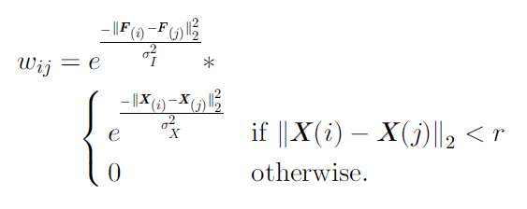
Assign W(i,j)
W(i,j) = |RGB(i) – RGB(j)| is noisy!
Could use brightness and locality
Brightness term
Locality term

Slide 27
Solve for Minimum Penalty
Summation of edge weights associated with the cut
Summation of edge weights associated with all the points in A

Slide 28
Solve for Minimum Penalty
Partition A Partition B
cut

Slide 29
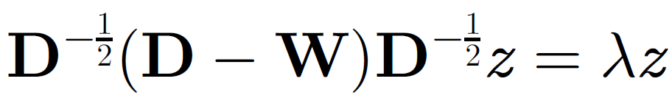
Solve for Minimum Penalty
Solve Normalized Laplacian Eigensystem
W(N x N) : weights associated with edges
D (N x N) : diagonal matrix with summation of all edge weights for the i-th pixel
N : number of pixels in the image
(N) : eigenvalues
(N x N) : eigenvectors are real-valued partition indicator
O(N^3) complexity in general
O(N^(3/2)) complexity in practice
a) Sparse local weights, b) Only need first few eigenvectors, c) Low precision

Slide 30
Subdivide?
Second largest eigenvector partitions the image into two regions
< Threshold ?
Yes – stop here
No – continue to subdivide

Slide 31
Agenda
History of the problem
Graph cut background
Compute graph cut
Extensions
State of the art
Continued Work

Slide 32




Extensions: K-way Segmentation
6
5
3
0
0.28
0.31
0.17
-0.26
Input
Image
5
5
3
0
0.31
0.31
0.17
-0.26
2nd
Eigenvector
3
3
3
0
0.17
0.17
0.17
-0.26
0
0
0
0
-0.26
-0.26
-0.26
-0.26
0.38
0.32
-0.32
0.07
-0.86
0.29
-0.027
0.001
3rd
Eigenvector
0.32
0.32
-0.32
0.07
0.29
0.29
-0.027
0.001
4th
Eigenvector
-0.32
-0.32
-0.32
0.07
-0.027
-0.027
-0.027
0.001
0.07
0.07
0.07
0.07
0.001
0.001
0.001
0.001

Slide 33
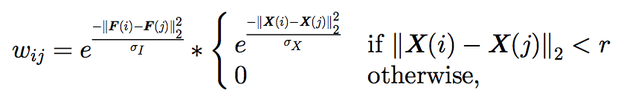



Extensions: Edge Weights
How to calculate the edge weights?
Point sets
Intensity
Color (HSV)
Texture

Slide 34
Agenda
History of the problem
Graph cut background
Compute graph cut
Extensions
State of the art
Continued Work

Slide 35
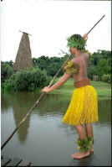
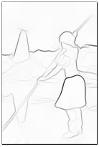
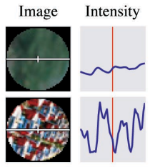
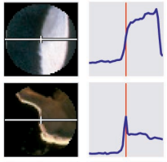
State of the Art: Edge Weights
Advancements in edge detection
Probability of boundary on line from to
No Boundary
Boundary

Slide 36
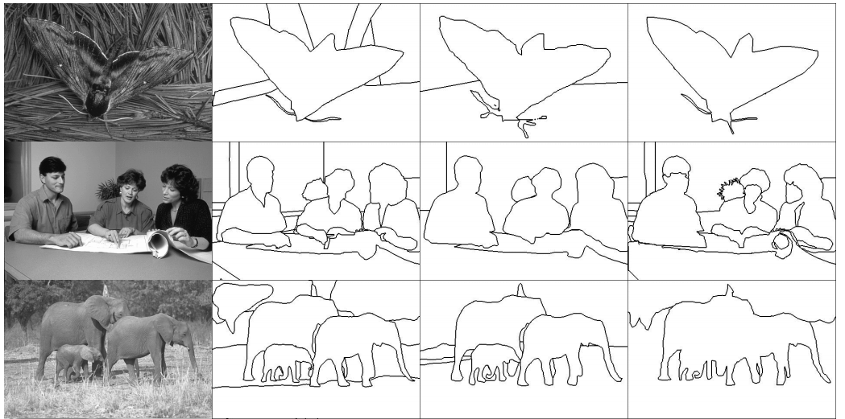
State of the Art: BSDS
Berkeley Segmentation Dataset (BSDS)

Slide 37
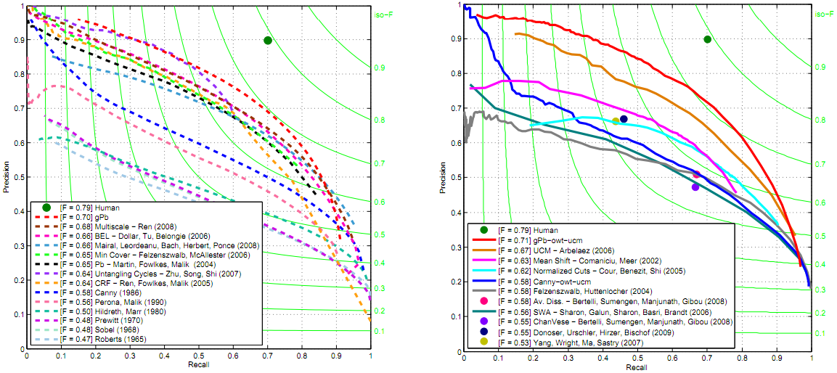
State of the Art: Best Technique
Normalized Cuts is base technique for best low level segmentation

Slide 38
Agenda
History of the problem
Graph cut background
Compute graph cut
Extensions
State of the art
Continued Work

Slide 39
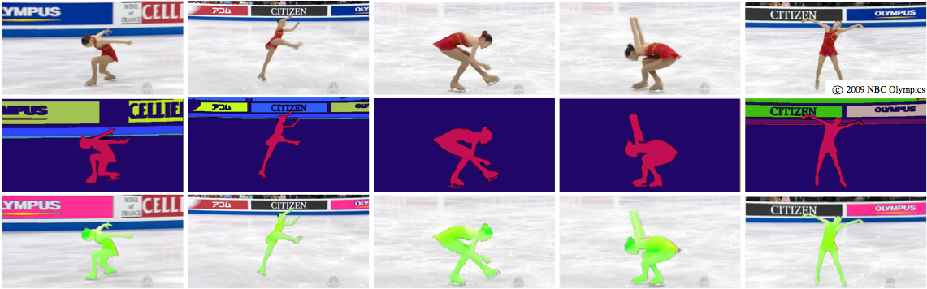
Continued Work: Video Segmentation
Incorporating video information into low-level segmentation
Graph-Based Video Segmentation: Matthias Grundmann, et al

Slide 40
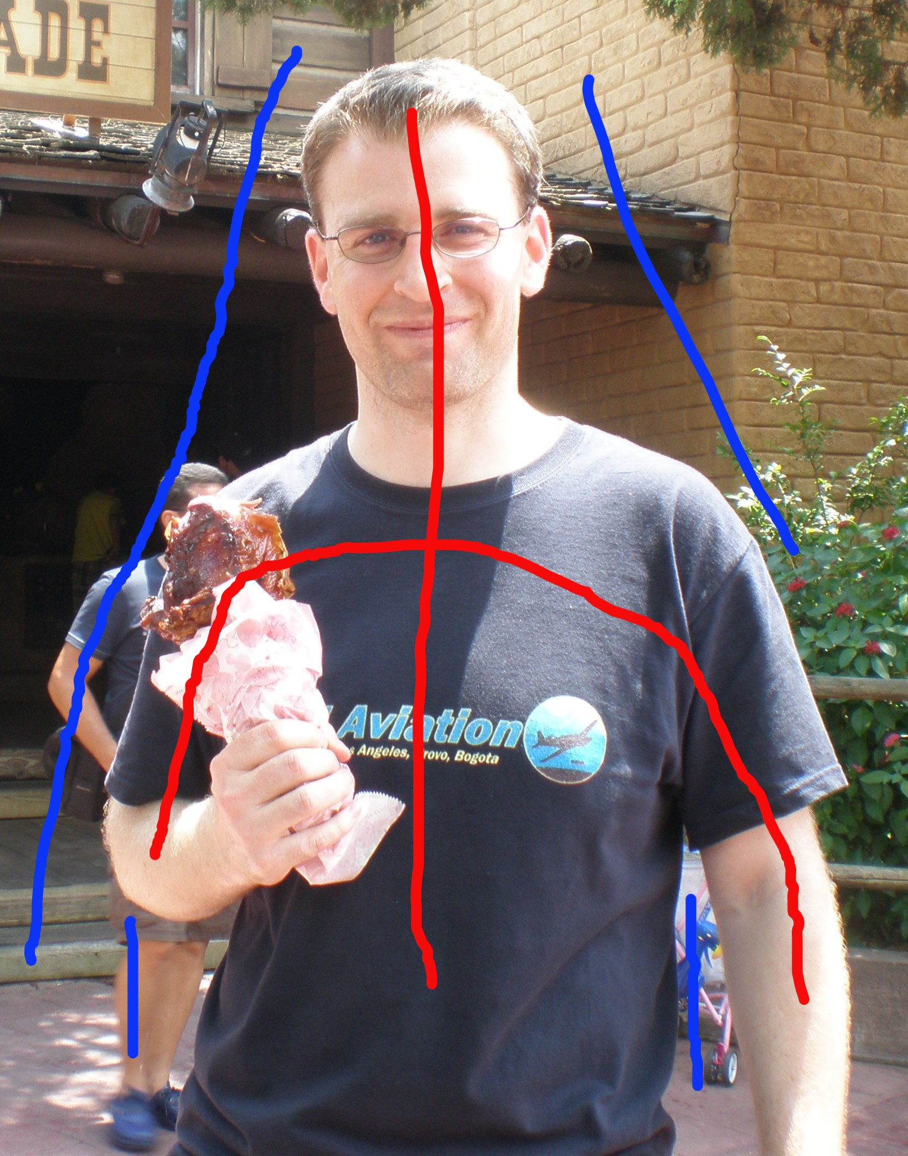
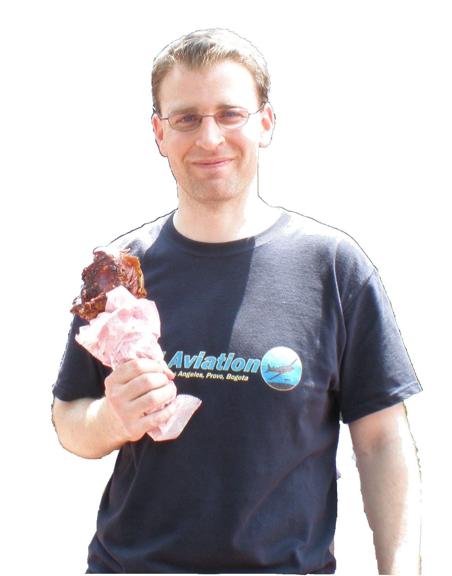
Continued Work: Semantic Segmentation
Incorporating top-down information into low-level segmentation
Interactive Graph Cuts: Yuri Boykov, et al

