Slide 1
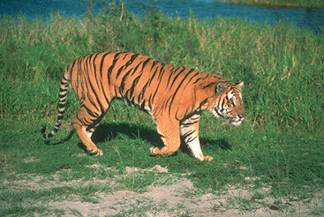
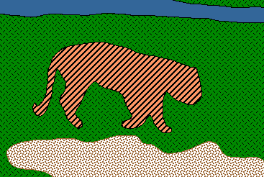
Image Segmentation
Based on the work of Shi and Malik, Carnegie Mellon and Berkley
and based on the presentation of Jianbo Shi

Slide 2
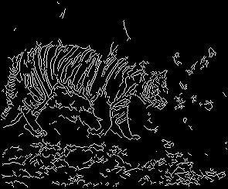
Edge-based image segmentation
Edge detection by gradient operators
Linking by dynamic programming, voting, relaxation, …
- Natural for encoding curvilinear grouping
- Hard decisions often made prematurely

Slide 3


Grouping with Bayesian Statistics
Bayes data structure = data generation model + segmentation model
Segmentation is to find a partitioning of an image, with generative models explaining each partition.
Generative models constrain the observation data, f, and the prior model constrains the discrete states, X.
The solution sought is the most probable state, or the state of the lowest energy.
f₁
f₂
Image as
observation f
Texture models
X₁
X₂
Grouping as
state X

Slide 4
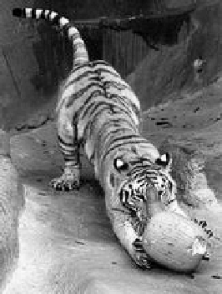
Image segmentation by pairwise similarities
Image = { pixels }
Segmentation = partition of image into segments
Similarity between pixels i and j
S_{ij} = S_{ji} ≥ 0
S_{ij}
Objective: “similar pixels, with large value of S_{ij}, should be in the same segment, dissimilar pixels should be in different segments”

Slide 5
Relational Graphs
G=(V, E, S)
  V: each node denotes a pixel
  E: each edge denotes a pixel-pixel relationship
  S: each edge weight measures pairwise similarity
Segmentation = node partitioning
  break V into disjoint sets V₁ , V₂

Slide 6
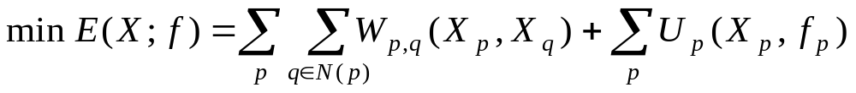
Solving MRF by Graph Partitioning
Some simple MRF models can be translated into graph partitioning
pair relationships
data measures
L1
L2

Slide 7

Weighted graph partitioning
i
Pixels i I = vertices of graph G
Edges ij = pixel pairs with S_{ij} > 0
Similarity matrix S = [ S_{ij} ]
d_{i} = Σ_{j Є G} S_{ij} degree of I
deg A = Σ_{i Є A} d_{i} degree of A G
Assoc(A,B) = Σ_{i Є A} Σ_{j Є B} S_{ij}
S_{ij}
j
i
A
A
B

Slide 8
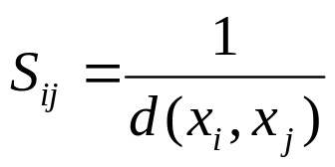
Cuts in a Graph
(edge) cut = set of edges whose removal makes a graph disconnected
weight of a cut: cut( A, B ) = Σ_{i Є A,} Σ_{j Є B} S_{ij} =Assoc(A,B)
the normalized cut
Normalized Cut criteria: minimum cut(A,Ā)
NCut( A,B ) = cut(A, B)( + )
1
deg A
1
deg B

Slide 9
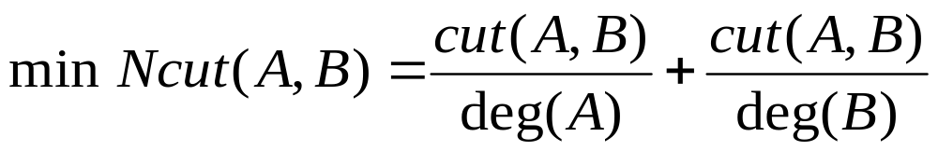
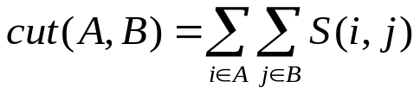
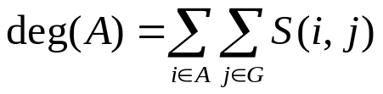

Grouping with Spectral Graph Partitioning
SGP: data structure = a weighted graph, weights describing data affinity
Segmentation is to find a node partitioning of a relational graph, with minimum total cut-off affinity.
Discriminative models are used to evaluate the weights between nodes.
The solution sought is the cuts of the minimum energy.

NP-Hard!

Slide 10
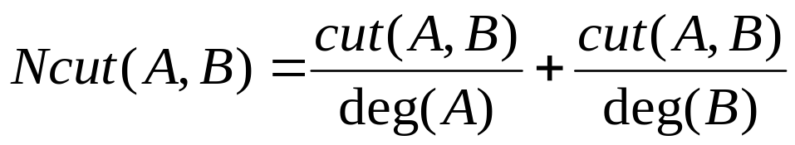
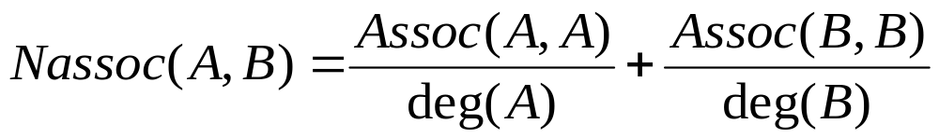
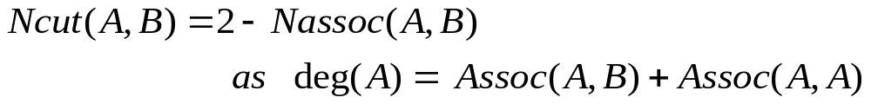
Normalized Cut and Normalized Association
Minimizing similarity between the groups, and maximizing similarity within the groups are achieved simultaneously.

Slide 11
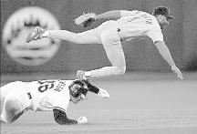
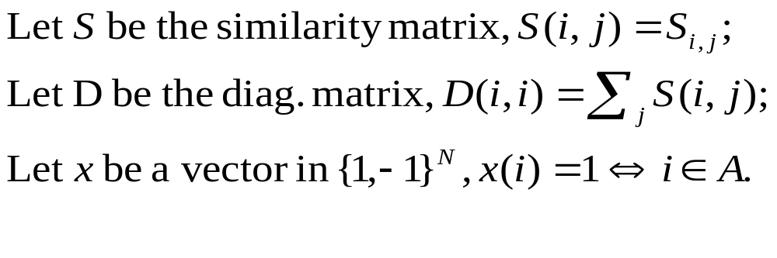
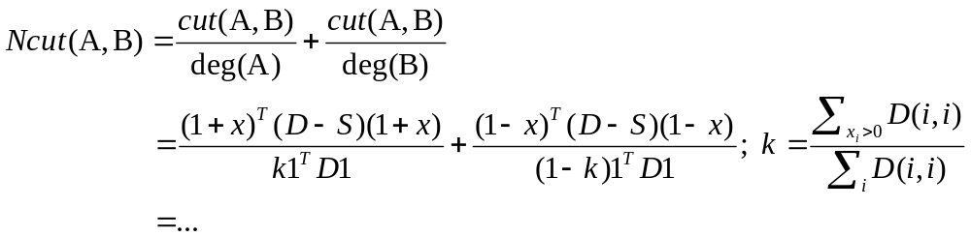
Some definitions
Rewriting Normalized Cut in matrix form:

Slide 12
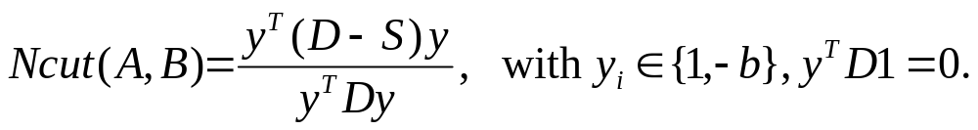

Generalized Eigenvalue problem
after simplification, we get
y²_{i}
y²_{i}
i
i
A
A

Slide 13
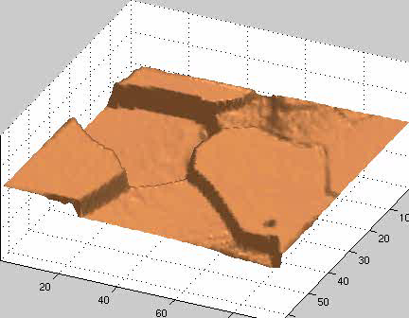


Slide 14
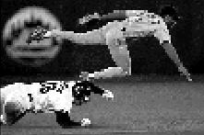







Brightness Image Segmentation

Slide 15
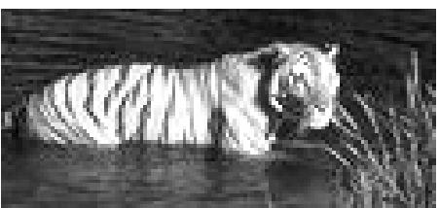
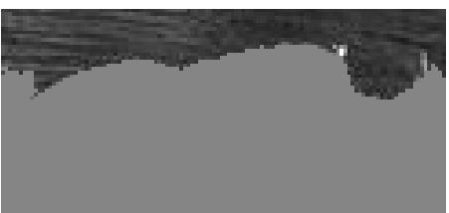
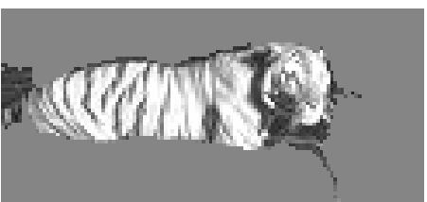
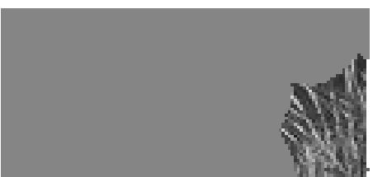
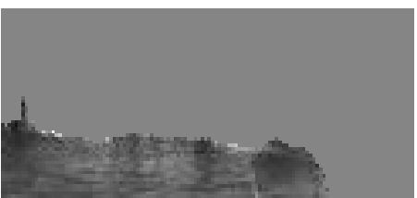
Brightness Image Segmentation

Slide 16
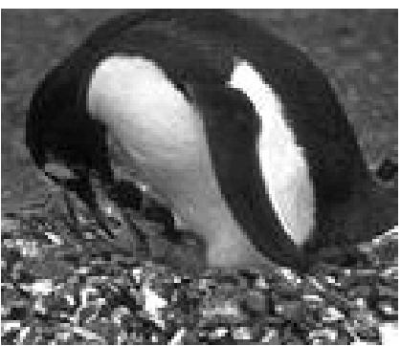
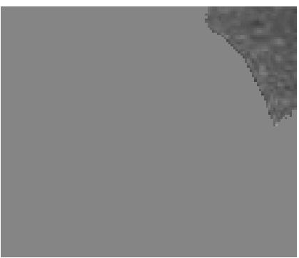
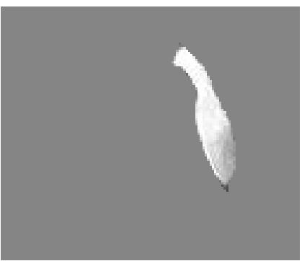
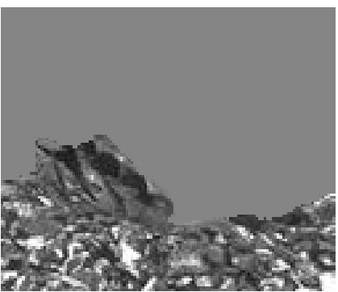
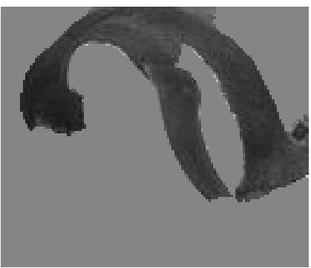
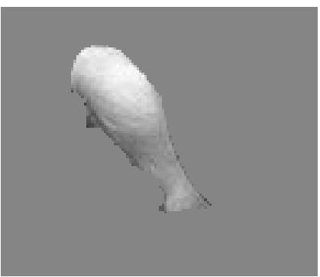
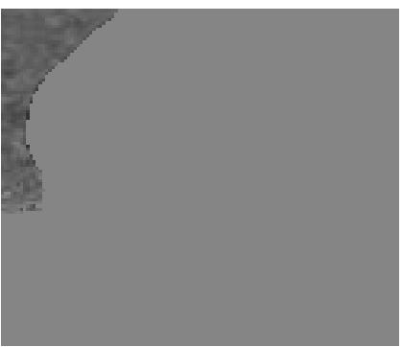

Slide 17
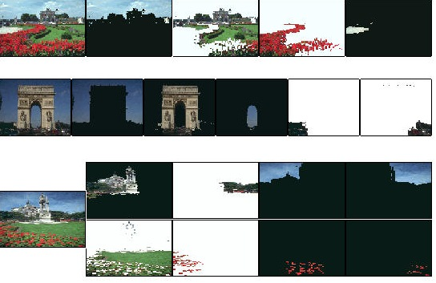
Results on color segmentation

Slide 18
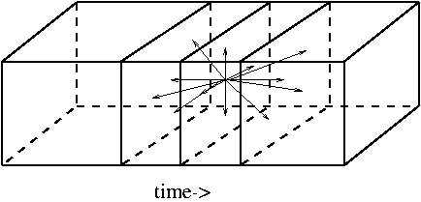
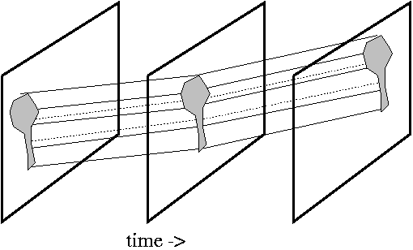
Motion Segmentation with Normalized Cuts
Networks of spatial-temporal connections:
Motion “proto-volume” in space-time

Slide 19
