Slide 1
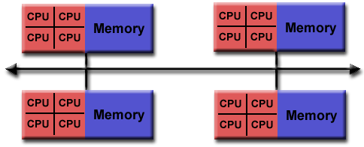
Programming distributed memory systems: Message Passing Interface (MPI)
Distributed memory systems: multiple processing units working on one task (e.g. computing PI).
The processing units are independent computers with no shared memory.
  Need communication routines, something like sockets but more user friendly.
  MPI can be viewed as a user friendlier socket interface.

Slide 2
Programming distributed memory systems: Message Passing Interface (MPI)
Introduction to MPI
Basic MPI functions
Most of the MPI materials are obtained from William Gropp and Rusty Lusk’s MPI tutorial at http://www.mcs.anl.gov/mpi/tutorial/

Slide 3
Programming distributed memory systems: Message Passing Interface (MPI)
MPI is an industrial standard that specifies library routines needed for writing message passing programs.
  Mainly communication routines
  Also include other features such as topology.
MPI allows the development of scalable portable message passing programs.
  It is a standard supported pretty much by everybody in the field.

Slide 4
MPI uses a library approach to support parallel programming.
  MPI specifies the API for message passing (communication related routines)
  MPI program = C/Fortran program + MPI communication calls.
  MPI programs are compiled with a regular compiler(e.g gcc) and linked with an mpi library.

Slide 5
MPI execution model
Separate (collaborative) processes are running all the time – the SPMD (single program multiple data)
  ‘mpirun –machinefile machines –np 16 a.out’ → The same a.out is executed on 16 machines.
  Different from the fork-join model (OpenMP).
    What about the sequential portion of an application?

Slide 6
MPI data model
No shared memory. Do local calculation, and use explicit communications whenever necessary to get data from other processes.
How to solve large problems
  Logically partition the large array and logically distribute the large array into processes.

Slide 7
MPI specification is both simple and complex.
  Almost all MPI programs can be realized with six MPI routines.
  MPI has a total of more than 100 functions and a lot of concepts.
  We will mainly discuss the simple MPI, but we will also give a glimpse of the complex MPI.
MPI is about just the right size.
  One has the flexibility when it is required.
  One can start using it after learning the six routines.

Slide 8
The hello world MPI program
#include "mpi.h"
#include <stdio.h>
int main( int argc, char *argv[] )
{
MPI_Init( &argc, &argv );
printf( "Hello world\n" );
MPI_Finalize();
return 0;
}
Mpi.h contains MPI definitioins and types.
MPI program must start with MPI_init
MPI program must exit with MPI_Finalize
MPI functions are just library routines that can be used on top of the regular C, C++, Fortran language constructs.

Slide 9
Compiling, linking and running MPI programs
MPICH is installed on linprog
To run a MPI program, do the following:
  Create a file called .mpd.conf in your home directory with content ‘secretword=cluster’
  Create a file ‘hosts’ specifying the machines to be used to run MPI programs.
  Boot the system ‘mpdboot –n 3 –f hosts’
  Check if the system is corrected setup: ‘mpdtrace’
  Compile the program: ‘mpicc hello.c’
  Run the program: mpiexec –machinefile hostmap –n 4 a.out
    Hostmap specifies the mapping
    -n 4 says running the program with 4 processes.
  Exit MPI: mpdallexit

Slide 10
Login without typing password
Key based authentication
    Password based authentication is inconvenient at times
      Remote system management
      Starting a remote program (starting many MPI processes!)
      ……
    Key based authentication allows login without typing the password.
  Key based authentication with ssh in UNIX
    Remote ssh from machine A to machine B
      Step 1: at machine A: ssh-keygen –t rsa
      (do not enter any pass phrase, just keep typing “enter”)
      Step 2: append A:.ssh/id_rsa.pub to B:.ssh/authorized_keys

Slide 11
MPI uses the SPMD model (one copy of a.out).
  How to make different process do different things (MIMD functionality)?
    Need to know the execution environment: Can usually decide what to do based on the number of processes on this job and the process id.
      How many processes are working on this problem?
        MPI_Comm_size
      What is myid?
        MPI_Comm_rank
        Rank is with respect to a communicator (context of the communication). MPI_COM_WORLD is a predefined communicator that includes all processes (already mapped to processors).
      See helloworld2.c

Slide 12
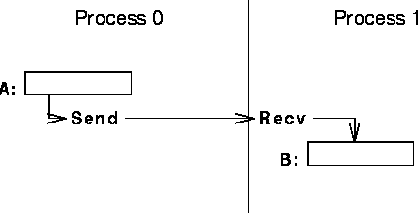
Sending and receiving messages in MPI
Questions to be answered:
  To who are the data sent?
  What is sent?
  How does the receiver identify the message

Slide 13
Send and receive routines in MPI
  MPI_Send and MPI_Recv (blocking send/recv)
  Identify peer: Peer rank (peer id)
  Specify data: Starting address, datatype, and count.
    An MPI datatype is recursively defined as:
      predefined, corresponding to a data type from the language (e.g., MPI_INT, MPI_DOUBLE)
      a contiguous array of MPI datatypes
      a strided block of datatypes
      an indexed array of blocks of datatypes
      an arbitrary structure of datatypes
      There are MPI functions to construct custom datatypes, in particular ones for subarrays
  Identifying message: sender id + tag

Slide 14
MPI blocking send
MPI_Send(start, count, datatype, dest, tag, comm)
The message buffer is described by (start, count, datatype).
The target process is specified by dest, which is the rank of the target process in the communicator comm.
When this function returns, the data has been delivered to the system and the buffer can be reused. The message may not have been received by the target process.

Slide 15
MPI blocking receive
MPI_Recv(start, count, datatype, source, tag, comm, status)
Waits until a matching (both source and tag) message is received from the system, and the buffer can be used
source is rank in communicator specified by comm, or MPI_ANY_SOURCE (a message from anyone)
tag is a tag to be matched on or MPI_ANY_TAG
receiving fewer than count occurrences of datatype is OK, but receiving more is an error (result undefined)
status contains further information (e.g. size of message, rank of the source)
See pi_mpi.c for the use of MPI_Send and MPI_Recv.

Slide 16
The Simple MPI (six functions that make most of programs work):
  MPI_INIT
  MPI_FINALIZE
  MPI_COMM_SIZE
  MPI_COMM_RANK
  MPI_SEND
  MPI_RECV
  Only MPI_Send and MPI_Recv are non-trivial.

Slide 17
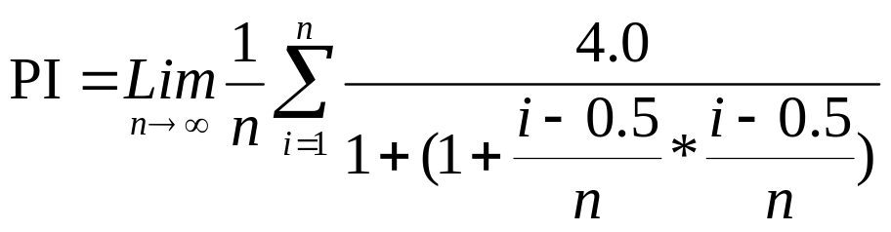
The MPI PI program
h = 1.0 / (double) n; sum = 0.0;
for (i = myid + 1; i <= n; i += numprocs) {
x = h * ((double)i - 0.5);
sum += 4.0 / (1.0 + x*x);
}
mypi = h * sum;
if (myid == 0) {
for (i=1; i<numprocs; i++) {
MPI_Recv(&tmp, 1, MPI_DOUBLE, i, 0, MPI_COMM_WORLD, &status);
mypi += tmp;
}
} else MPI_Send(&mypi, 1, MPI_DOUBLE, 0, 0, MPI_COMM_WORLD);
/* see pi_mpi.c */
h = 1.0 / (double) n;
sum = 0.0;
for (i = 1; i <= n; i++) {
x = h * ((double)i - 0.5);
sum += 4.0 / (1.0 + x*x);
}
mypi = h * sum;

Slide 18
Matrix Multiply
For (i=0; i<n; i++)
for (j=0; j<n; j++)
c[i][j] = 0;
for (k=0; k<n; k++)
c[i][j] = c[i][j] + a[i][k] * b[k][j];
MPI version? How to distribute a, b, and c? What is the communication requirement? See my_mm_mpi.c and mm_mpi.txt

Slide 19
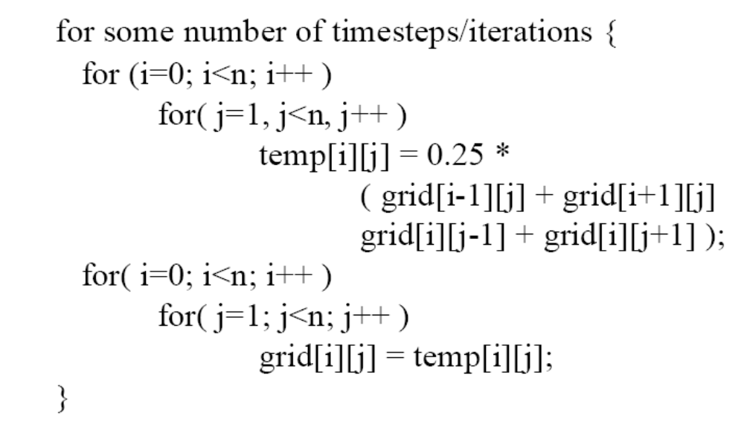
SOR: sequential version

Slide 20
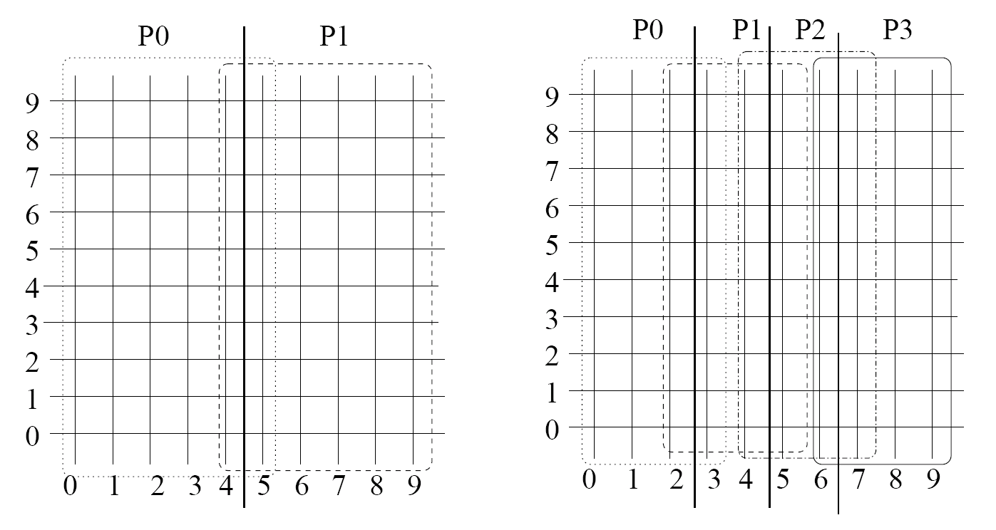
SOR: MPI version
How to partitioning the arrays?
  double grid[n+1][n/p+1], temp[n+1][n/p+1];

Slide 21
SOR: MPI version
Receive grid[1..n][0] from the process myid-1;
Receive grid[1..n][n/p] from process myid+1;
Send grid[1..n][1] to process myid-1;
Send grid[1..n][n/p-1] to process myid+1;
For (i=1; i<n; i++)
for (j=1; j<n/p; j++)
temp[i][j] = 0.25* (grid[i][j-1]+grid[i][j+1] + grid[i-1][j] + grid[i+1][j]);
Does this communication code work?

