Slide 1
Intel MIC (Many integrated Cores) architecture and programming
The content of this lecture is from the following sources:
Intel® Xeon Phi™ Coprocessor System Software Developers Guide (http://software.intel.com/en-us/articles/intel-xeon-phi-coprocessor-system-software-developers-guide)
Intel® Xeon Phi™ Coprocessor Developer's Quick Start Guide (http://software.intel.com/en-us/articles/intel-xeon-phi-coprocessor-developers-quick-start-guide).
Using the Intel Xeon Phi from TACC (https://www.tacc.utexas.edu/c/document_library/get_file?uuid=c7a40a46-a51a-4607-b8b2-234647a3bc40&groupId=13601)

Slide 2
Background
Components for exa-scale systems
Conventional components (x86-based)
Japan’s K machine (Current No. 4)
10PF rumored for $1.2 billion
High power budget
12.3 MW for 10PF
IBM Sequoia (Bluegene/Q): 7.9MW for 16.3PF
Needs lower power and low cost components? What are the general approaches?

Slide 3
Background
Needs lower power and low cost components? What are the general approaches?
Using lower power chips
State-of-the-art, IBM Bluegene, 1.6GHz powerPC chips
2Gflops/Watt ➔ 10MW for 20PF: this is the state of the art today for machine built with regular CPUs.
This approach to the extreme: using arm-based CPUs (normally for cellphones).
Major advantage: the programming paradigms remain the same.

Slide 4
Background
Needs lower power and low cost components? What are the general approaches?
Using accerlerators
Using custom design chips to reduce power per operation.
Typically, maximizing the number of ALUs and reducing everything else (cache, control units).
Small cores .vs. big cores (conventional CPU)
GPU (nVidia, AMD)
FPGA
Fusion (AMD)
The programming paradigms need to change (e.g. CUDA and OpenCL).
Example: Top 10 supercomputers in the Green500 list all use GPUs, can reach close to 4Gflops/Watt.

Slide 5
Background
Needs lower power and low cost components? What are the general approaches?
Using accerlerators
Intel’s approach: MIC, medium cores
Can keep the programming paradigms or use GPU programming paradigms.
Anything works for GPU should work for MIC
Can also use traditional approach (e.g OpenMP)
Trade-off: the number of cores is relatively small
Current core count: multi-core processors (16 cores), MIC (61 cores), GPU (thousands).
Tianhe-2, 33.86PF at 17.6MW (24MW peak), $390M, 42th in the green500 list (1.41Gflops/Watt).

Slide 6
Intel’s MIC approach high level idea
Leverage x86 architecture
Simpler x86 cores
reduce control (e.g. out of order execution) and cache
More for floating point operations (e.g. widened SIMD unit)
Using existing x86 programming models
Keep cache-coherency protocol
Implement as a separate device (connect to PCI-E like GPU).
Fast memory (GDDR5)

Slide 7
Xeon Phi
Xeon Phi is the first product of Intel MIC architecture
A PCI express card
Running a stripped down Linux operating system
A full host with a file system – one can ssh to the Xeon Phi hosts (typically by ‘ssh mic0’ from the host machine), and run programs.
Same source code, compiled with –mmic for the Xeon phi.
1.1 GHz, 61 cores, 1.074TF peak (double precision).
Tianhe-2 (No. 1) current is built with Intel Xeon and Xeon Phi
16000 nodes with each node having 2 Xeon’s and 3 Xeon phi’s
3,120,000 cores total
33PF at 17.6 MW -- similar to bluegene/Q’s power efficiency.

Slide 8
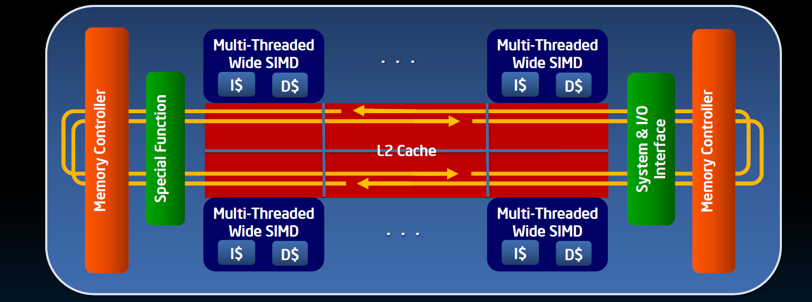
Xeon phi architecture
61 cores
In-order, short pipeline
4 hardware threads per core
512 bit vector unit
512-bit vector unit
Connected by two 1024 bit rings
Full cache coherence
Standard x86 shared memory programming.

Slide 9
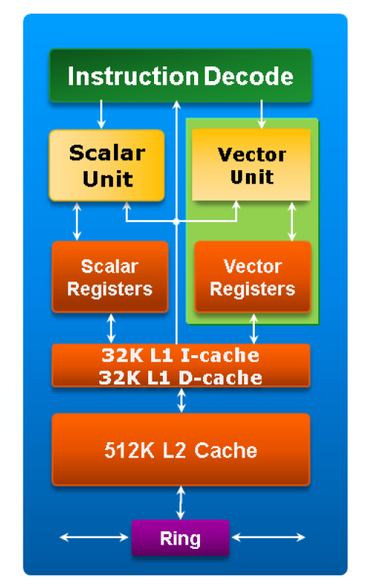
Xeon phi core
1GHz
X86 ISA, extended with 64-bit addressing
512 bit vector processing unit (VPU): SIMD vector instructions and registers.
4 hardware threads
Short pipeline – small branch mis-prediction penalty

Slide 10
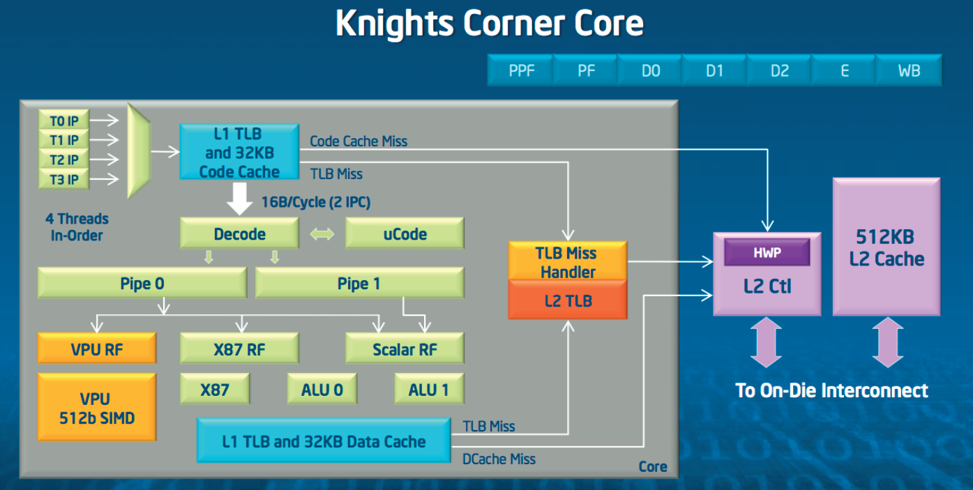
Xeon phi core, some more details

Slide 11
Programming MIC-based systems
Assumption: a regular CPU + a MIC
The MIC host can be treated as an independent linux host with its own file system, three different ways that a MIC-based system can be used.
A Homogeneous system with hybrid nodes
A homogeneous system with MIC nodes
A heterogeneous network of homogeneous nodes

Slide 12
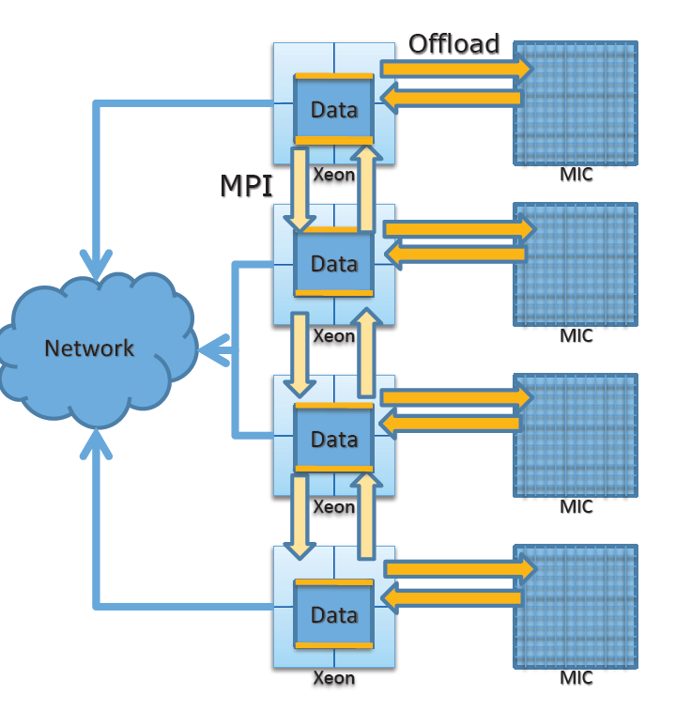
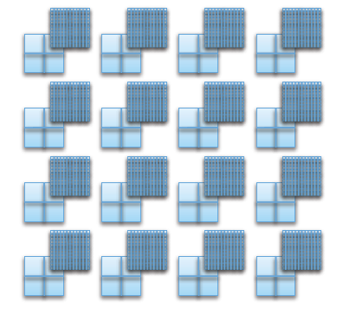
A homogenous network with hybrid nodes
MPI ranks on host only, MIC treated as an accelerator (GPU)

Slide 13
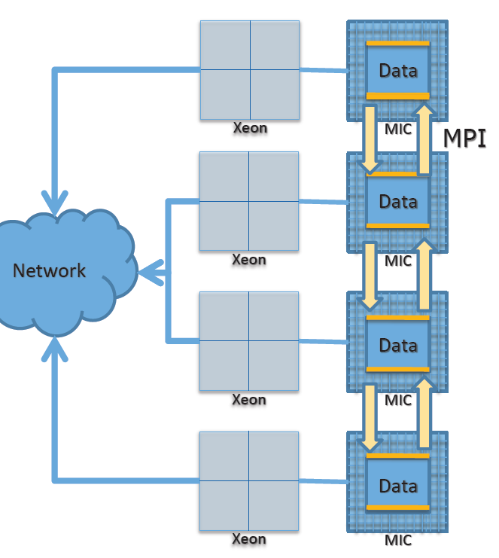
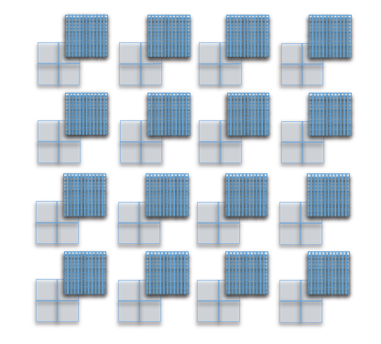
A homogenous network with MIC
MPI ranks on MIC only, ignore hosts.

Slide 14
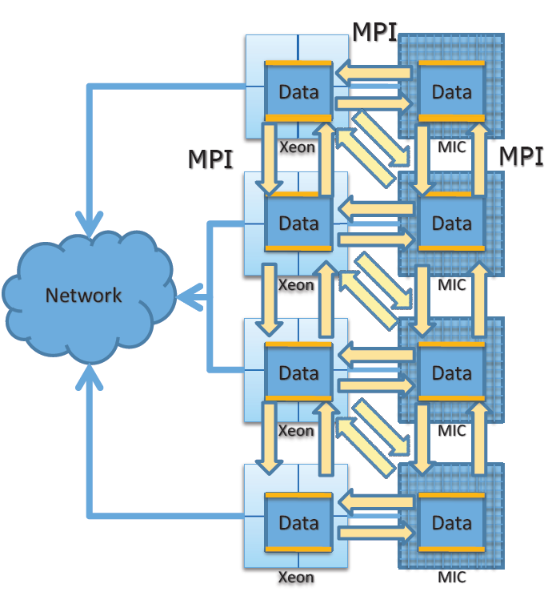
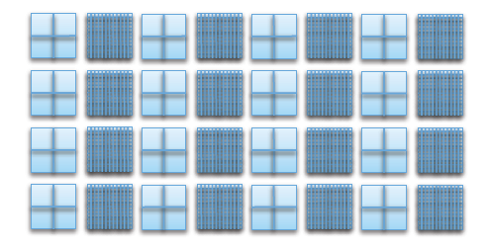
A heterogenous system
MPI ranks on both host and MIC

Slide 15
Some MIC program examples
float reduction(float *data, int size) {
float ret = 0.f;
for (int i=0; i<size; ++i) {
ret += data[i];
}
return ret; /* host code */
}
float reduction(float *data, int size) {
float ret = 0.f;
#pragma offload target(mic) in(data:length(size))
for (int i=0; i<size; ++i) {
ret += data[i];
}
return ret; /* offload version of the code */
}

Slide 16
Some MIC program examples
float reduction(float *data, int size) {
float ret = 0.f;
#pragma offload target(mic) in(data:length(size))
ret = __sec_reduce_add(data[0:size]);
return ret; /* Offload with vector reduction */
}
/* __sec_reduc_add is a built-in function, data[0:size] is Intel Cilk plus extended array notation */

Slide 17
MIC aynchronous offload and data transfer
MIC connects to CPU through PCI-E
It has the same issue as GPU for data movement when using offload
MIC has an API to do the implicit memory copy.

Slide 18
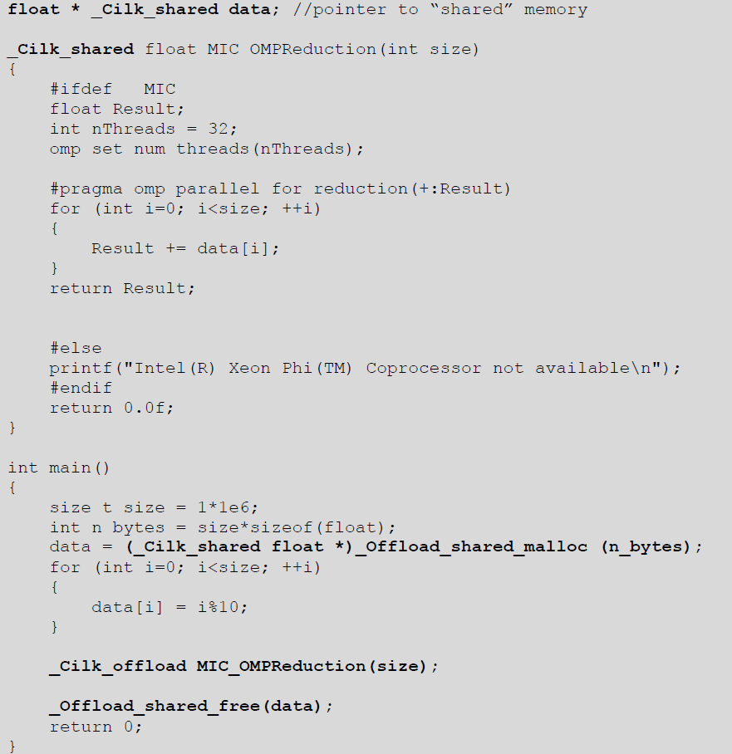
MICdata transfer example

Slide 19
Native compilation
Regular openmp programs can compile natively on Xeon Phi
Built the Xeon Phi binary on the host system
Compile with –mmic flag in icc (‘icc –mmic –openmp sample1.c’)
Copy to the mic co-processor (‘scp a.out mic0:/tmp/a.out’)
copy the shared library required (‘scp /opt/intel/composerxe/lib/mic/libiomp5.so mic0:/tmp/libiomp5.sp’
Login to coprocessor set the library path
‘ssh mic0’
‘export LD_LIBRARY_PATH=/tmp
Reset resource limits (‘ulimit –s unlimited’)
Run the program (‘cd /tmp’; ./a.out)

Slide 20
Parallel programming on Intel Xeon Phi
OpenMP, Pthreads, Intel TBB, Intel Cilk plus
Interesting resource management when multiple hosts threads offload to coprocessor.
Hybrid resource management – code may run on host if coprocessor resources are not available.
float reduction(float *data, int size) {
float ret = 0.f;
#pragma offload target(mic) in(data:length(size))
{
#pragma omp parallel for reduction (+: ret)
for (int i=0; i<size; ++i) {
ret += data[i];
}
}
return ret; /* offload version of the code */
}

Slide 21
MIC promise
Familiar programming models
HPC: C/C++, Fortran
Parallel programming: OpenMP, MPI, pthreads
Serial and scripting (anything CPU can do).
Easy transition for OpenMP code
Pragmas/directives to offload OMP parallel region
Support for MPI
MPI tasks on hosts
MPI tasks on MIC

Slide 22
Some performance consideration and early experience with Intel Xeon Phi
TACC said
• Programming for MIC is similar to programming for CPUs
Familiar languages: C/C++ and Fortran
Familiar parallel programming models: OpenMP & MPI
MPI on host and on the coprocessor
Any code can run on MIC, not just kernels
• Optimizing for MIC is similar to optimizing for CPUs
“Optimize once, run anywhere”
Optimizing can be hard; but everything you do to your code should *also* improve performance on current and future “regular” Intel chips, AMD CPUs, etc.

Slide 23
Some performance consideration and early experience with Intel Xeon Phi
TACC said
Early scaling looks good; application porting is fairly straight forward since it can run native C/C++, and Fortran code
Some optimization work is still required to get at all the available raw performance for a wide variety of applications; but working well for some apps
vectorization on these large many-core devices is key
affinitization can have a strong impact (positive/negative) on performance
algorithmic threading performance is also key; if the kernel of interest does not have high scaling efficiency on a standard x86_64 processor (8-16 cores), it will not scale on many-core
MIC optimization efforts also yield fruit on normal Xeon (in fact, you may want to optimize there first).

Slide 24
Summary
How does Intel Xeon Phi different from GPU?
Porting code is much easier
Getting the performance has similar issues
Must deal with resource constraints and exploit architecture features (both are hard)
Small per-core memory for MIC
Same programming model may make the effort worthwhile
MIC is almost like an pure CPU approach – the power efficiency is not as high as GPU
An SMP system with a large number of medium sized cores.

