Slide 1
Mapreduce and Hadoop
Introduce Mapreduce and Hadoop
Dean, J. and Ghemawat, S. 2008. MapReduce: simplified data processing on large clusters. Communication of ACM 51, 1 (Jan. 2008), 107-113. (Also, an earlier conference paper in OSDI 2004).
Hadoop materials: http://www.cs.colorado.edu/~kena/classes/5448/s11/presentations/hadoop.pdf
https://hadoop.apache.org/docs/r1.2.1/mapred_tutorial.html#Job+Configuration

Slide 2
Introduction of mapreduce
Dean, J. and Ghemawat, S. 2008. MapReduce: simplified data processing on large clusters. Communication of ACM 51, 1 (Jan. 2008), 107-113. (Also, an earlier conference paper in OSDI 2004).
Designed to process a large amount of data in Google applications
Crawled documents, web request logs, graph structure of web documents, most frequent queries in a given day, etc
Computation is conceptually simple. Input data is huge.
Deal with input complexity, support parallel execution.

Slide 3
Mapreduce programming paradigm
Computation
Input: a set of key/value pairs
Outputs: a set of key/value pairs
Computation consists of two user-defined functions: map and reduce
Map: takes an input pair and produces a set of intermediate key/value pairs
Mapreduce library groups all intermediate values for the same intermediate key to the reduce function
Reduce: takes an intermediate key and a set of values, merge the set of values to a smaller set of values for the output.

Slide 4
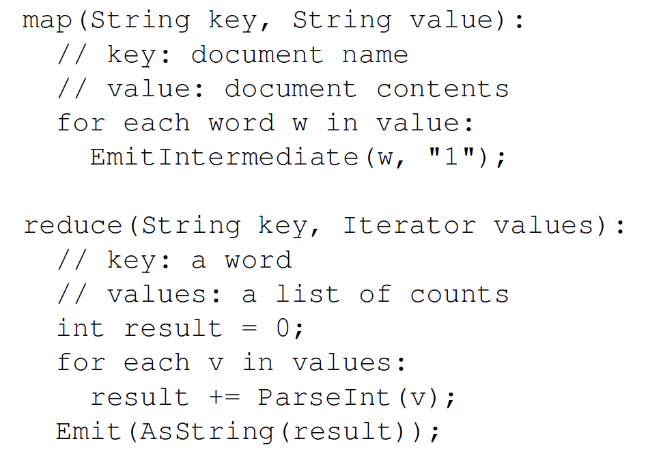
Mapreduce example: wordcount
The mapreduce runtime library takes care of most of the detailed.
Beside the map and reduce function, users also specify the mapreduce specification object (names of the Input /output files, etc).

Slide 5
Types in the map and reduce function
Map (k1, v1) → list (k2, v2)
Reduce(k2, list(v2)) → list (v2)
Input key (k1) and value (v1) are independent (from different domains)
Intermediate key (k2) and value(v2) are the same type as the output key and value.

Slide 6
More examples
Distributed grep
Map: emit a line if it matches the pattern
Reduce: copy the intemediate data to output
Count of URL access Frequency
Input URL access log
Map: emit <url, 1>
Reduce: add the value for the same url, and emit <url, total count>
Reverse web-link graph
Map: output <target, source> where target is found in a source page
Reduce: concatenate all sources and emit <target, list(source)>

Slide 7
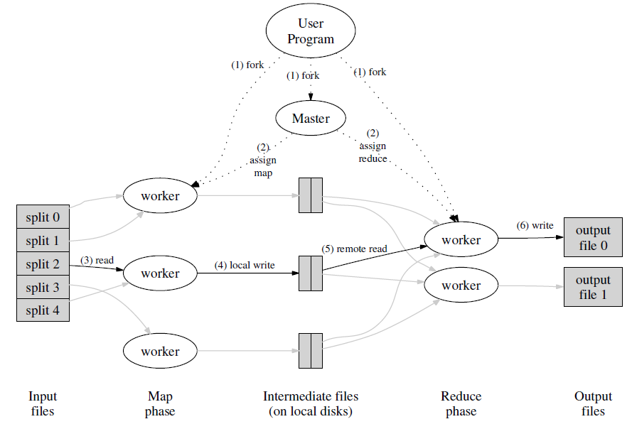
Mapreduce execution overview

Slide 8
Fault tolerance
The master keeps tracks of everything (the status of workers, the locations and size of intermediate files, etc)
Worker failure: very high chance
Master re-starts a worker on another node if it failed (not responding to ping).
Master failure: not likely
Can do checkpoint.

Slide 9
Hadoop – an implmentation of mapreduce
Two components
Mapreduce: enables application to work with thousands of nodes
Hadoop distributed file system (HDFS): allows reads and writes of data in parallel to and from multiple tasks.
Combined: a reliable shared storage and analysis system.
Hadoop mapreduce programs are mostly written in java (Hadoop streaming API supports other languages).

Slide 10

HDFS
A given file is broken down into blocks (default block size: 64MB), blocks are replicated across clusters (default number of copies: 3)
Name Node: maintains mapping of file names to blocks and data node slaves
Data Node: stores and serves blocks of data.

Slide 11
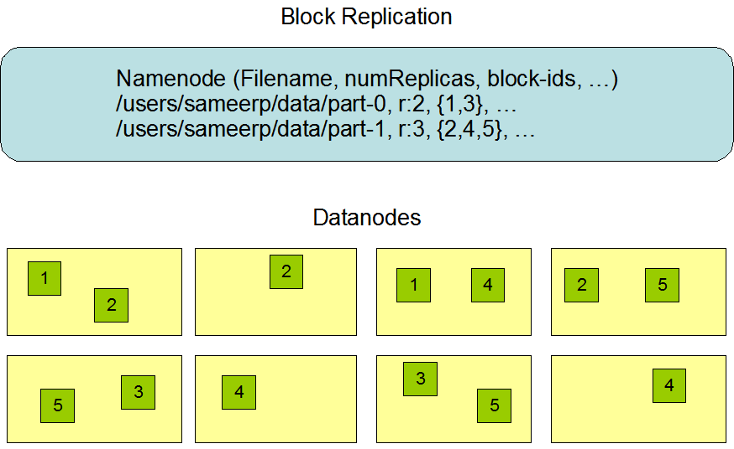
HDFS data replication
A given file is broken down into blocks (default block size: 64MB), blocks are replicated across clusters (default number of copies: 3)
Namenode uses transaction log to maintain persistent file system metadata.
Namenode uses heartbeat to make sure the datanodes are alive, automatic re-replicate and redistribution as needed

Slide 12
HDFS robustness
Design goal: reliable data in the presence of failures.
Data disk failure and network failure
Heartbeat and re-replication
Corrupted data
Typical method for data integrity: checksum
Metadata disk failure
Namenode is a single point of failure – dealing with failure in a single node is relatively easy.
E.g. use transactions.

Slide 13
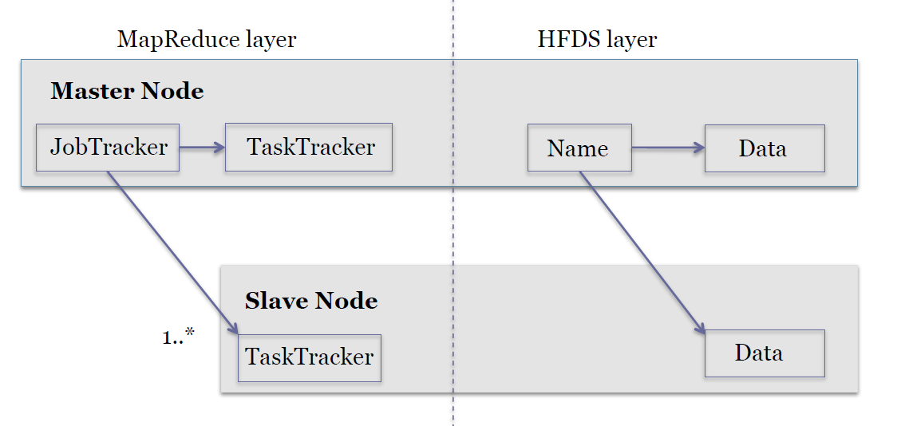
Hadoop architecture
Master/slave architecture

Slide 14
Hadoop mapreduce
One jobtracker per master
Responsible for scheduling tasks on the slaves
Monitor slave progress
Re-execute failed slaves
One tasktracker per slave
Execute tasks directed by the master

Slide 15
Hadoop mapreduce
One jobtracker per master
Responsible for scheduling tasks on the slaves
Monitor slave progress
Re-execute failed slaves
One tasktracker per slave
Execute tasks directed by the master

Slide 16
Hadoop mapreduce
Two steps map and reduce
Map step
Master node takes large problem input and and slices in into smaller sub-problems; distributes the sub-problems to worker nodes
Worker node may do the same (multi-level tree structure)
Worker processes smaller problems and returns the results
Reduce step
Master node takes the results of the map step and combines them ito get the answer to the orignal problem

Slide 17
Hadoop mapreduce data flow
Input reader: divides input into splits that are assigned a map function
Map function: maps file data to intermediate <key, value> pairs
Partition function: finds the reducer (from key and the number of reducers).
Compare function: when input for the reduce function and pull from the map intermediate output, the data are sorted based on this function
Reduce function: as defined
Output writer: write file output.

Slide 18
An implementation of the google’s mapreduce execution

Slide 19
A code example (wordcount)
Two input files:
File1: “hello world hello moon”
File2: “goodbye word goodnight moon”
Three operations
Map
Combine
reduce

Slide 20
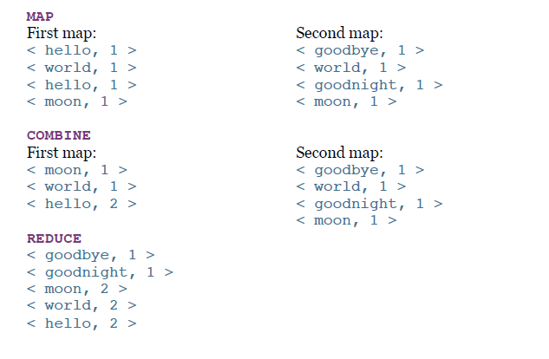
Output for each step

Slide 21
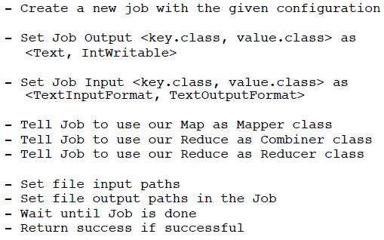
Hadoop worldcount main run method

Slide 22
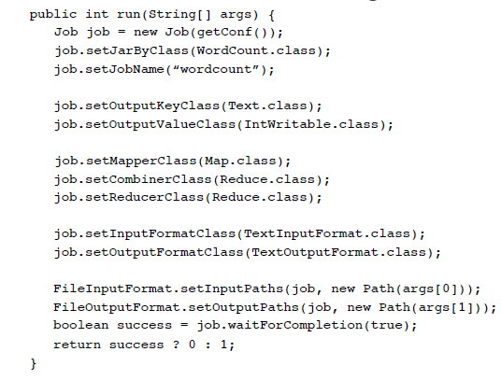
Hadoop worldcount main run method

Slide 23
Job details
Interface for a user to describe a mapreduce job to the hadoop framework for execution. User specifies
Mapper
Combiner
Partitioner
Reducer
Inputformat
Outputformat
Etc.
Jobs can be monitored
Users can chain multiple mapreduce jobs together to accomplish more complex tasks.

Slide 24
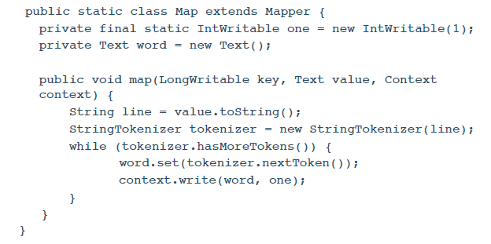
Map class
One line at a time, tokenize the line, emit <<word>, 1> to context

Slide 25
mapper
Implementing classes extend Mapper and overrid map()
Main Mapper engine: Mapper.run()
setup()
map()
cleanup()
Output data is emitted from mapper via the Context object.
Hadoop MapReduce framework spawns one map task for each logical unit of input work for a map task.

Slide 26
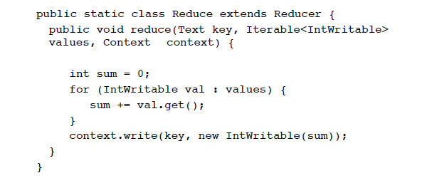
Reduce class
The framework group all pairs with the same key and passes them
To the reduce function (sorted using compare function).

Slide 27
Reducer
Sorts and partition Mapper outputs
Reduce engine
Receives a context containing job’s configuration
Reducer.run()
Setup()
Reduce() per key associated with reduce task
Cleanup()
Reducer.reduce()
Called once per key
Passed in an Iterable values associated with the key
Output to Context.write()

Slide 28
Task execution and environment
Tasktracker executes Mapper/Reducer task as a child process in a separate jvm
Child task inherits the environment of the parent TaskTracker
User can specify environmental variables controlling memory, parallel computation settings, segment size, etc.

Slide 29
running a hadoop job?
Specify the job configuration
Specify input/output locations
Supply map and reduce function
Job client then submits the job (jar/executables) and configuration to the jobtracker
‘$ bin/hadoop jar /usr/joe/wordcount.jar org.myorg.WordCount /usr/joe/wordcount/input /usr/joe/wordcount/output‘
A complete example can be found at
https://hadoop.apache.org/docs/r1.2.1/mapred_tutorial.html#Job+Configuration

Slide 30
Communication in mapreduce applications
No communication in map or reduce
Dense communication with large message size between the map and reduce stage
Need high throughput network for server to server traffic.
Network workload is differernt from HPC workload or traditional Internet application workload.

Slide 31
Mapreduce limitations
Good at dealing with unstructured data: map and reduce functions are user defined and can deal with data of any kind.
For structured data, mapreduce may not be as efficient as traditional database
Good for applications that generate smaller final data from large source data
Does not quite work for applications that require fine grain communications – this includes almost all HPC types of applications.
No communication within map or reduce

Slide 32
Summary
MapReduce is simple and elegant programming paradigm that fits certain type of applications very well.
Its main strength is in fault tolerant in large scale distributed platforms, and dealing with large unstructured data.
Mapreduce applications create a very different traffic workload than both HPC and Internet applications.
Hadoop Mapreduce is an open source framework that supports mapreduce programming paradigm.

