Slide 1
Interconnect Networks

Slide 2
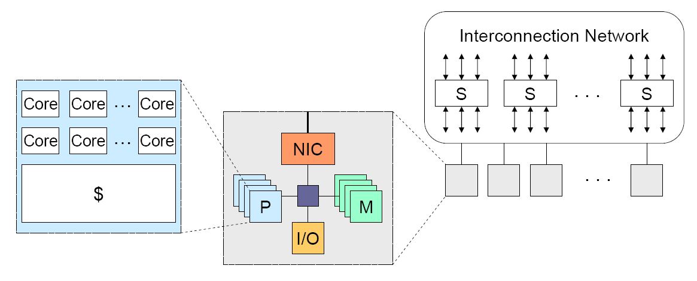
Generic scalable multiprocessor architecture
On-chip interconnects (manycore processor)
Off-chip interconnects (clusters of servers)
Network characteristics: bandwidth and latency

Slide 3
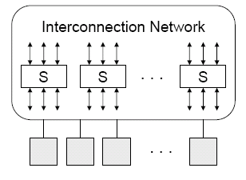
Scalable interconnection network
At the core of parallel computer architecture
Requirements and trade-offs at many levels
  Still little consensus at this time
    Interactions across levels (e.g. network level optimizations may conflict with messaging level optimizations).
    Workload
    Performance metrics
Need holistic understanding

Slide 4
Network components
Network interface (card)
  Communication between a node and the network
Link
  Bundle of wires and fibers that carry signals
Switches
  Connects a fixed number of input channels to a fixed number of output channels.
  In this community, switches may also have the router functions.

Slide 5
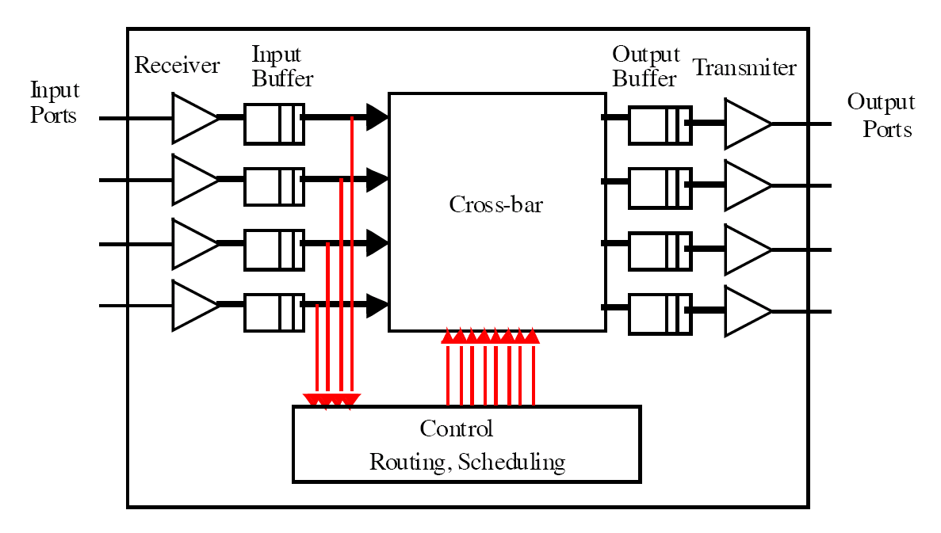
Switch
The cross-bar can realize a communication from
any input port to any output port.

Slide 6
Cross-bar functionality – all permutations can be realized simultaneously
i
n
p
u
t
1
1
1
2
2
2
3
3
3
4
4
4
1
2
3
4
1
2
3
4
1
2
3
4
output
(1,2, 3, 4)->
(3, 1, 2, 4)
(1,2,3,4)->
(4,3,2,1)
A 4x4 cross-bar
Permutation: (1, 2, 3, 4) -> (3, 1, 2, 4)
A communication pattern where each source
happens once, each destination happens once.

Slide 7
Switch example: 24-port 1Gbps Ethernet switch
24 input ports and 24 output ports – each Ethernet jacket has one input port and one output port.
  All 24 machines can send and receive simultaneously.
switch
Ethernet card
machine

Slide 8
Alternatives to cross-bars
A question: why buffers when we can always do permutation?
An N x N cross bar has O(N^2) cross points (on/off switches).
  Not scalable, expensive
An alternative for low end switches: bus and memory
  When bus and memory is fast enough, moving data between input and output ports are like memory copy in a typical computer.

Slide 9
Bus and memory alternative to crossbar
Realizing (1, 2, 3, 4) -> (4, 3, 2, 1)
  Read from input port 1 to memory A
  Read from input port 2 to memory B
  Read from input port 3 to memory C
  Read from input port 4 to memory D
  Run forwarding logic (find out the output ports)
  Write A to output port 4
  Write B to output port 3
  Write C to output port 2
  Write D to output port 1

Slide 10
Bus and memory alternative to crossbar
A typical northbridge bandwidth is a few GBps. Let us assume the bandwidth is 4GBps, how many ports can the northbridge support in 100Mbps Ethernet swithes?
This is why it can only used in low end switches!

Slide 11
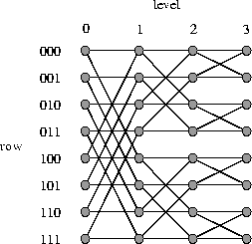
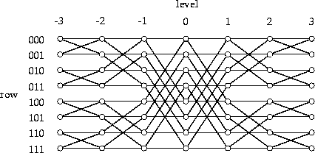
Another alternative: multistage interconnection network
Realize all permutations without controlling O(N^2) cross-points.
  Clos networks, Benes networks

Slide 12
Characteristics of a network
Topology (what)
  Physical interconnection structure of the network graph.
  Physically limits the performance of the networks.
Routing algorithm (which)
  Restricts the set of paths that messages can follow.
Switching strategy (how)
  How data in a message traverses a route (passing routers)
Flow control mechanism (when)
  When a message or portions of it traverse a route
  What happens when traffic encountered

Slide 13
Topology
How the components are connected.
Important properties
  Diameter: maximum distance between any two nodes in the network (hop count, or # of links).
  Nodal degree: how many links connect to each node.
  Bisection bandwidth: The smallest bandwidth between half of the nodes to another half of the nodes.
A good topology: small diameter, small nodal degree, large bisection bandwidth.

Slide 14
Topology
Regular topologies
  Nodes are connected with some kind of patterns.
    The graph has a structure.
  Nodes are identified by coordinates.
  Routing can usually pre-determined by the coordinates of the nodes.
Irregular topologies
  Nodes are connected arbitrarily.
    The graph does not have a structure, e.g. internet
    More extensible in comparison to regular topology.
  Usually use variations of shortest path routing.

Slide 15
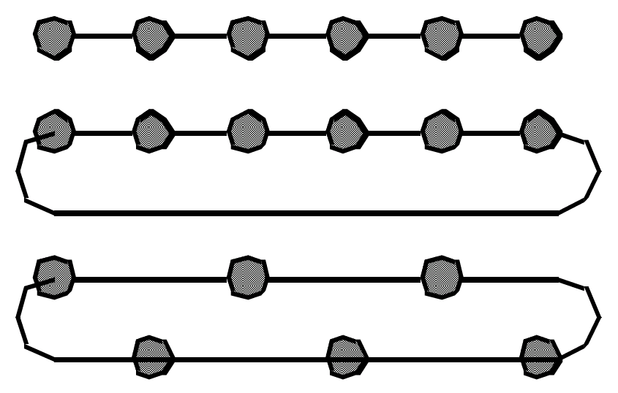
Linear Arrays and Rings
Linear array
Ring (torus)
Short wire torus
Diameter = ?, nodal = ? Bisection bandwidth = ?

Slide 16
Describing linear array and ring
Array: nodes are numbered from 0, 1, …, N-1
  Node i is connected to node i+1, 0<=i<=N-2
Ring: nodes are numbered from 0, 1, …, N-1
  Node I is connected to node (i+1) mod N, for all 0<=i<=N-1

Slide 17
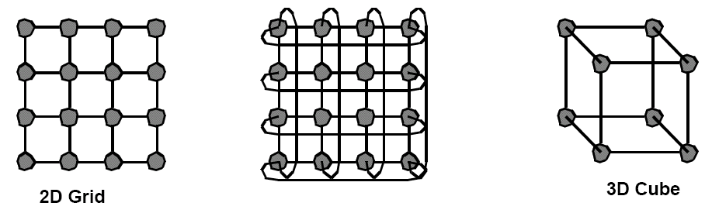
Multidimensional Meshes and Tori
d-dimensional array/torus
  N = k_{d-1} x k_{d-2} x … x d_0
  Each node is described by a d-vector of coordinate
  Node (i_{d-1} x i_{d-2} x …x d_0) is connected to ???

Slide 18
More about multi-dimensional mesh and tori
d-dimension k-ary mesh (torus)
  Each node is described by a d-vector of coordinates.
    The value of each item in the vector is between 0 and d_i-1.
  Diameter = ?
  Nodal degree = ?
  Bisection bandwidth = ?

Slide 19
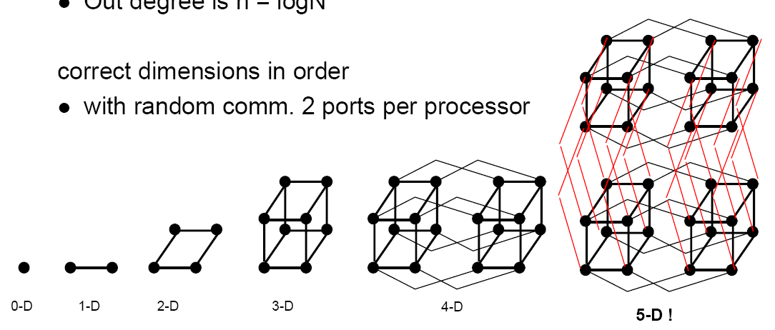
Hypercubes
Also call binary n-cubes. # of nodes = N = 2^n
Each node is described by its binary representation.
  There is a link between two nodes whose binary representations differ by one bit.
Diameter=? Nodal degree = ? Bisection bandwidth = ?

Slide 20
K-ary n-cube (n-dimensional, k-ary mesh/torus)
Extended from binary (hypercube) to k-ary
Each dimension has k elements, n dimensions
Each node is identified by a k-based number (n digits).
  Dimension order routing
4-ary 0-cube
4-ary 1-cube
4-ary 2-cube
4-ary 3-cube

Slide 21
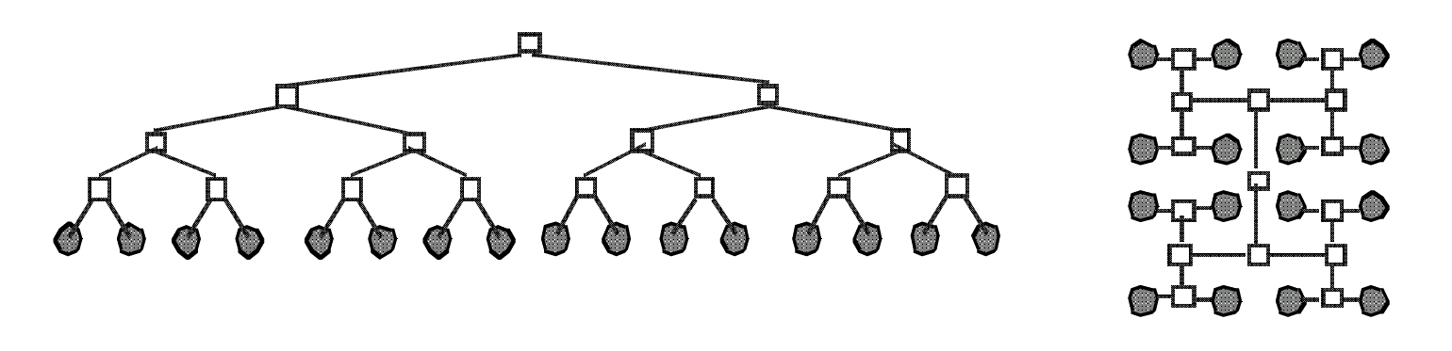
Trees
Fixed degree, log(N) diameter, O(1) bisection bandwidth.
Routing: up to the common ancestor than go down.

Slide 22
Irregular topology
Irregular topology does not any special mathmetic properties
  Can be expanded in any way.
  No easy way for routing: routes need to be computed like in the Internet.
    Routes can usually be determined in a regular network by using the coordinates of the source and destination.

Slide 23
Direct and indirect networks
All the previously discussed networks are direct networks in that the compute nodes are directly attached to the nodes in the topology.
  An example mesh system.
Each switch is a 5x5 switch

Slide 24
Indirect networks
Compute nodes are not directly attached to each switch, but are rather attached to the whole network.
  Using a central interconnect to connect all compute nodes
  The network emulate the cross-bar switch functionality.

Slide 25
Fully connected network
Different organizations:
  Connected by one switch (crossbar switch), connecting all nodes, connected with a crossbar.
All permutation communication (each node sends one message and receives one message) can be realized.

Slide 26
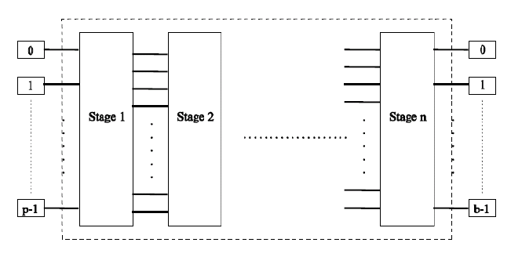
Multistage network
Try to emulate the cross-bar connection.
  Realizing permutation without blocking
  Using smaller cross-bar(2x2, 4x4) switches as the building block. Usually O(Nlg(N)) switches (lg(N) stages.

Slide 27
Multi-stage networks examples
(a) An 8-input butterfly network
(b) An 8-input Benes network
Butterfly network is blocking. There exist some permutation that results in link contention.
Benes network is non-blocking. If the permutation is known a prior, it can always be realized without link contention.

Slide 28
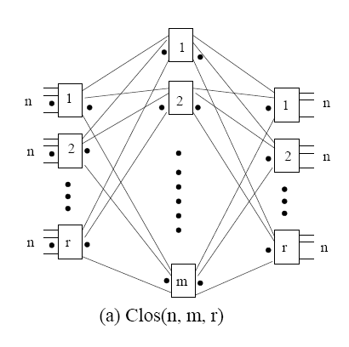
Clos Network
Three stages: ingress stage, middle stage, and egress stage
  Ingress/egress stage has r n X m switches
  Middle stage has m r X r switches
  Each switch at ingress/egress stage connects to all m middle switches (one port to each switch).

Slide 29
Clos Network
Clos network is non-blocking when m>=2n-1.

Slide 30
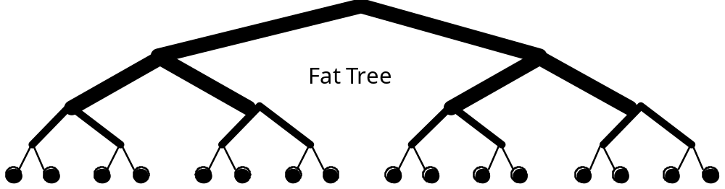
Fat-Trees
Fatter links (really more of them) as you go up, so bisection BW scales with N
  Not practical, root is an NxN switch

Slide 31
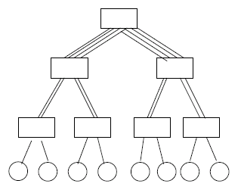
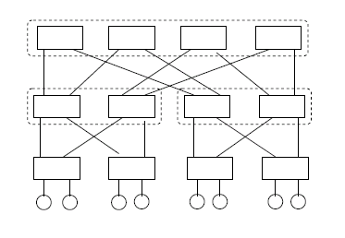
Practical Fat-trees
Use smaller switches to approximate large switches.
  Connectivity is reduced, but the topology is not implementable
  Most commodity large clusters use this topology. Also call constant bisection bandwidth network (CBB)

Slide 32
Slimmed fat-tree
Full bisection bandwidth fat-tree: the number of links going up is the same as the number of links going down
Slimmed fat-tree the number of links going up is smaller than the number of links going down – uplinks are overprovisioned at the upper level of the tree

Slide 33
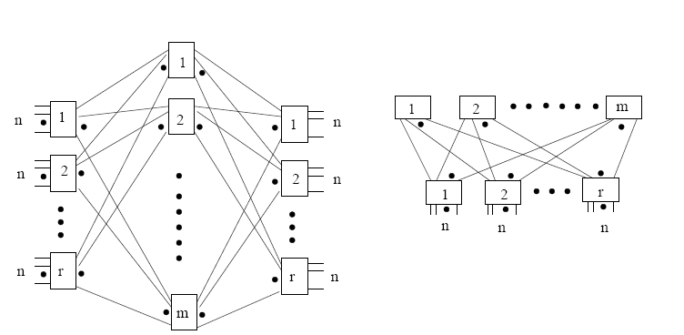
Clos network and fat-tree (folded Clos)
A generic 2-level fat-tree (folded Clos)
A generic 3-stage Clos network

Slide 34
Physical constraint on topologies
Number of dimensions.
  2 or 3 dimensions
    Can be layout physically
    Short wires, easy to build
    Many hops, low bisection bandwidth
  >=4 dimensions
    Harder to build, longer wires
    Fewer hops, better bisection bandwidth
  K-ary n-cubes provide a good framework for comparison.

Slide 35
Topologies used in the practical systems
HPC systems
  Tianhe-2 (No. 1): slimmed fat-tree with 2:1 oversubscription factor
  Titan (No. 2): Cray gemini network, 3-D torus
  Sequoia (No. 3): BlueGene/Q, 5-D torus
  K computer (No. 4): 6-D torus
  Stampede (No. 7): slimmed fat-tree with 5:4 overscription factors
  Others:
    Bluegene/L 3-D torus
    SGI ICE architecture: bristled hypercube
    A lot of full bisection bandwidth/slimmed fat-trees for commodity clusters.
Topology decides the hardware costs, the large variations of topology indicate there is no clear wins.

Slide 36
Topologies used in the practical systems
Data centers
  Slimmed fat-trees with variable over-subscription factors.
  Named multi-rooted trees.

Slide 37
Topology for exa-scale platforms
Cost and performance constraints
  We know full bisectional bandwidth fat-trees are good in performance, but large scale fat-trees are prohibitively expensive.
  Low dimensional tori do not provide sufficient bisectional bandwidth
Need something that provides sufficient bandwidth while not costing too much. Recent proposals:
  Slimmed fat-trees (reducing the number of switches at higher level of trees)
  Dragonfly (directly connect switches in a regular manner)
  Jellyfish (directly and randomly connect switches)

