Slide 1
Signal-Driven I/O
Concepts and steps for using signal-driven I/O
UDP echo server using signal-driven I/O
Readings
UNP Section 6.2, Ch25
Notes:
Last time we studied nonblocking I/O, where functions like read/write/accept/connect will return immediately if socket is not “ready”. Today we will discuss another advanced form of I/O---signal-driven I/O. We will discuss the concepts of signal-driven I/O, and the steps we must take into develop signal-driven I/O programs. We will also illustrate the concepts and steps of signal-driven I/O by developing a UDP echo server.
We emphasize here that, like nonblocking I/O, signal-driven I/O does not only apply to socket, it applies to other disk or other device access.

Slide 2
Motivation
Efficiently detecting an asynchronous event (arrival of a connection, arrival of a message, etc) is difficult.
Blocking IO: can block for a long time
Nonblocking IO: do not block for a long time, but must keep polling – tedious
How do we deal with other types of asynchronous events? E.g. input from keyboard?
Using interrupt
Corresponding to this, we have signal driven IO
Notes:
In signal-driven I/O, we do not directly try to read from a socket. Instead, we wait for the signal SIGIO, which will be generated by the kernel when something happens to a socket descriptor. When we receive the signal, then we will read data from the descriptor.
In order for us to use signal-driven I/O, we must take a few steps. The first step is to associate a signal handler with the signal SIGIO. We are familiar with this part. We can use functions signal or sigaction to set a handler for SIGIO.
The second step is to set the socket owner. Essentially, we let the system know where the signal SIGIO should be delivered. The last step is to enable the signal-driven I/O for the socket, that is, changing the socket from the default blocking socket to signal-driven socket. We will detail the last two steps in the following slides.

Slide 3
Signal-driven I/O
The kernel raises a signal (SIGIO) when something happens to a file descriptor
Three steps to use signal-driven I/O with sockets
Establish a signal handler for SIGIO
Functions signal/sigaction
Set the socket owner
fcntl with command F_SETOWN
Enable signal-driven I/O for the socket
fcntl with command O_SETFL (turn on O_ASYNC)
ioctl with request FIOASYNC
Notes:
In signal-driven I/O, we do not directly try to read from a socket. Instead, we wait for the signal SIGIO, which will be generated by the kernel when something happens to a socket descriptor. When we receive the signal, then we will read data from the descriptor.
In order for us to use signal-driven I/O, we must take a few steps. The first step is to associate a signal handler with the signal SIGIO. We are familiar with this part. We can use functions signal or sigaction to set a handler for SIGIO.
The second step is to set the socket owner. Essentially, we let the system know where the signal SIGIO should be delivered. The last step is to enable the signal-driven I/O for the socket, that is, changing the socket from the default blocking socket to signal-driven socket. We will detail the last two steps in the following slides.

Slide 4
Set Socket Owner
Function fcntl with command F_SETOWN
fcntl(int fd, int cmd, … /* int arg*/)
Set process ID or process group ID to receive SIGIO and SIGURG signals
Arg > 0: process ID == arg
Arg < 0: process group ID == |arg|
fcntl(sockfd, F_SETOWN, getpid());
Notes:
We use the function fcntl to set the socket owner. It is achieved via the command F_SETOWN. The command F_SETOWN set the process ID or process group ID to receive SIGIO and SIGURG signals. The third parameter arg informs the kernel the process ID or the group ID, depending on the value of arg. When arg is positive, it specifies the process ID.
The following line of code shows how to use fcntl to set socket owner in a program.

Slide 5
Enable Signal-Driven I/O for Socket
Function fcntl with command F_SETFL
Turn on O_ASYNC
Not widely supported yet
Function ioctl with request FIOASYNC
int flag;
flag = fcntl(sockfd, F_GETFL, 0);
fcntl(sockfd, F_SETFL, flag | O_ASYNC);
int on = 1;
ioctl(sockfd, FIOASYNC, &on);
Notes:
In order to enable signal-driven I/O, we can use either fcntl or ioctl.

Slide 6
Complication of Signal-Driven I/O
Signals are not queued when they are blocked
When SIGIO is blocked, at most one SIGIO signal will be pending even if two pieces of data arrive
No one to one mapping between number of signals and arrived data
In handler of SIGIO, we need to handle all arriving data
Read until there is no data (how?)
Nonblocking I/O needs to be used with signal-driven I/O
Notes:
One particular problem that we need to pay attention when we use signal-driven I/O is, recall that, when a signal is blocked, the kernel only maintain one instance of a signal, even if it is generated multiple times. What is the consequence for socket programming? In signal-driven I/O, when SIGIO is blocked, at most one SIGIO will be pending in the kernel even if more than one packet arrive. This means that, when we start to read data from socket after we have received the signal SIGIO, we must not make any assumption about the amount of that data that is in the receive buffer. We need to continue read until there is no data left in the receive buffer. However, if we are using a blocking socket, we will be blocked when we try to read and there is no data in the receive buffer. So how we should handle this situation? Well, we need to use signal-driven I/O together with nonblocking I/O.

Slide 7
When is SIGIO raised?
For UDP sockets
A datagram arrives
An error occurs
For TCP sockets
A connection request has completed
A disconnect request has been initiated
A disconnect request has completed
Half of a connection has been shut down
Data has arrived
Data has been sent
Too many SIGIOs for a TCP socket – rarely used
listening socket
Notes:
We said that when something happens on a socket descriptor, the signal SIGIO will be generated by the kernel. So what is “something”? Or when is SIGIO raised? It depends on the transport layer protocol we are using.
For UDP, two conditions can trigger the generation of the SIGIO signal: a datagram has arrived, or some error has occurred.
For TCP, it is much complicated. Many conditions can trigger the generation of signal SIGIO. For example, …. For this reason, signal-driven I/O is rarely used for TCP sockets. One exception is listening socket, given that the only condition to trigger SIGIO is when a connection has been established.

Slide 8
Echo Server with Signal-Driven I/O
Examples udp_echo_server.cpp and udp_echo_client.cpp
A particular use of signal-driven I/O is NTP (network time protocol)
Time sensitive.
A server needs to record the accurate arrival time of a datagram and return to client.

Slide 9
Summary of I/O models
Blocking
Nonblocking
Multiplexed
Signal driven
Asynchronous

Slide 10
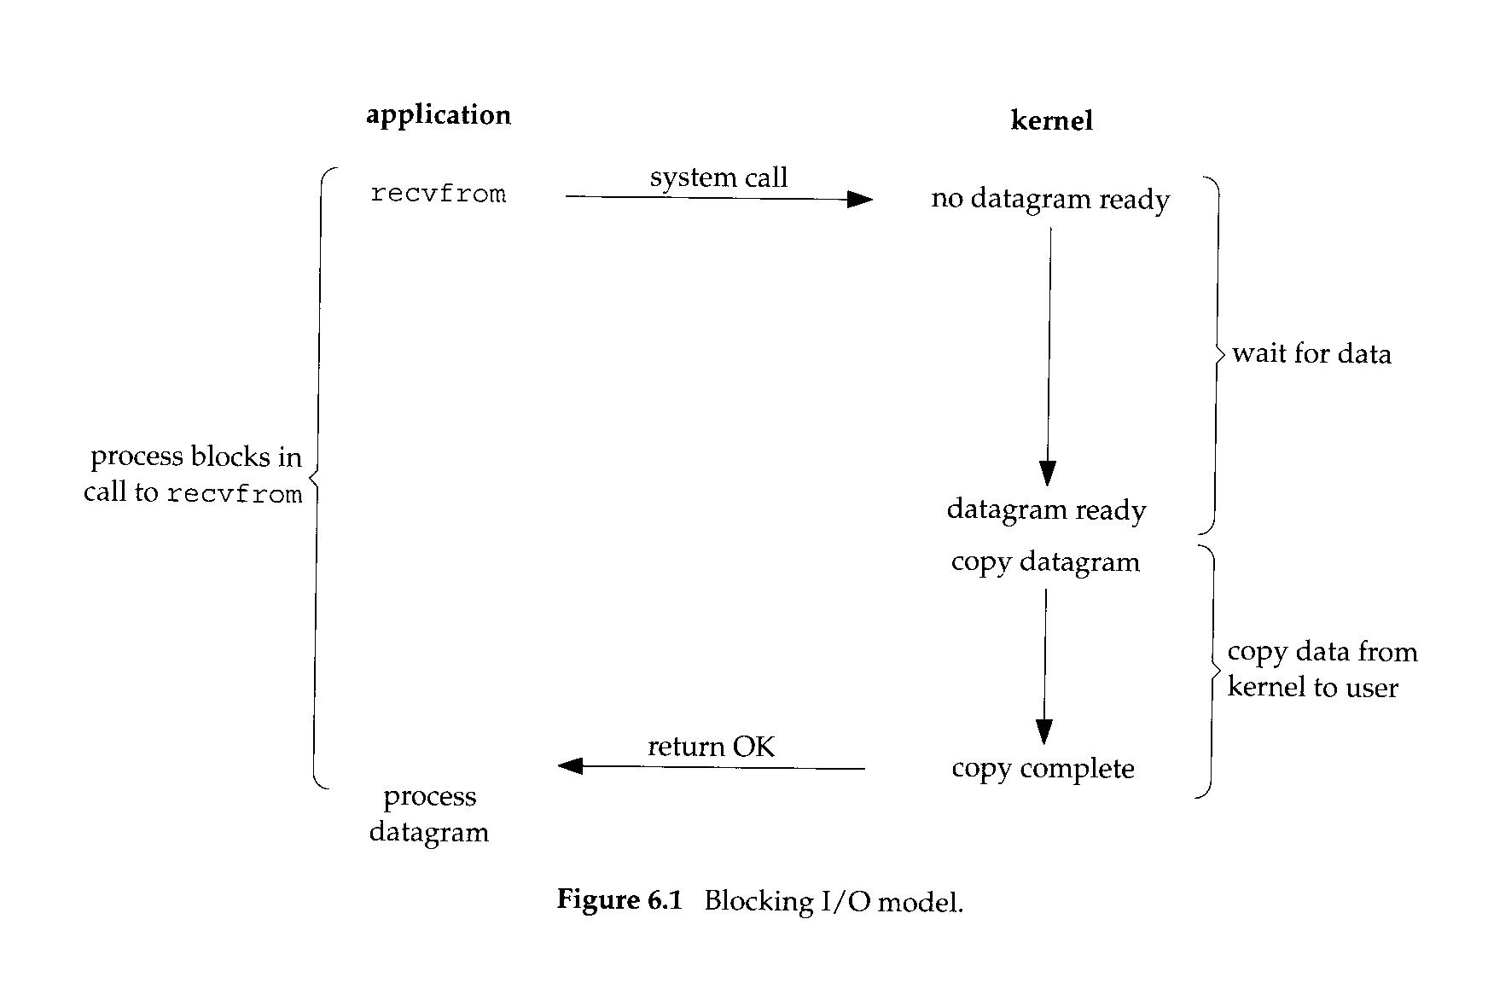
Blocking IO

Slide 11
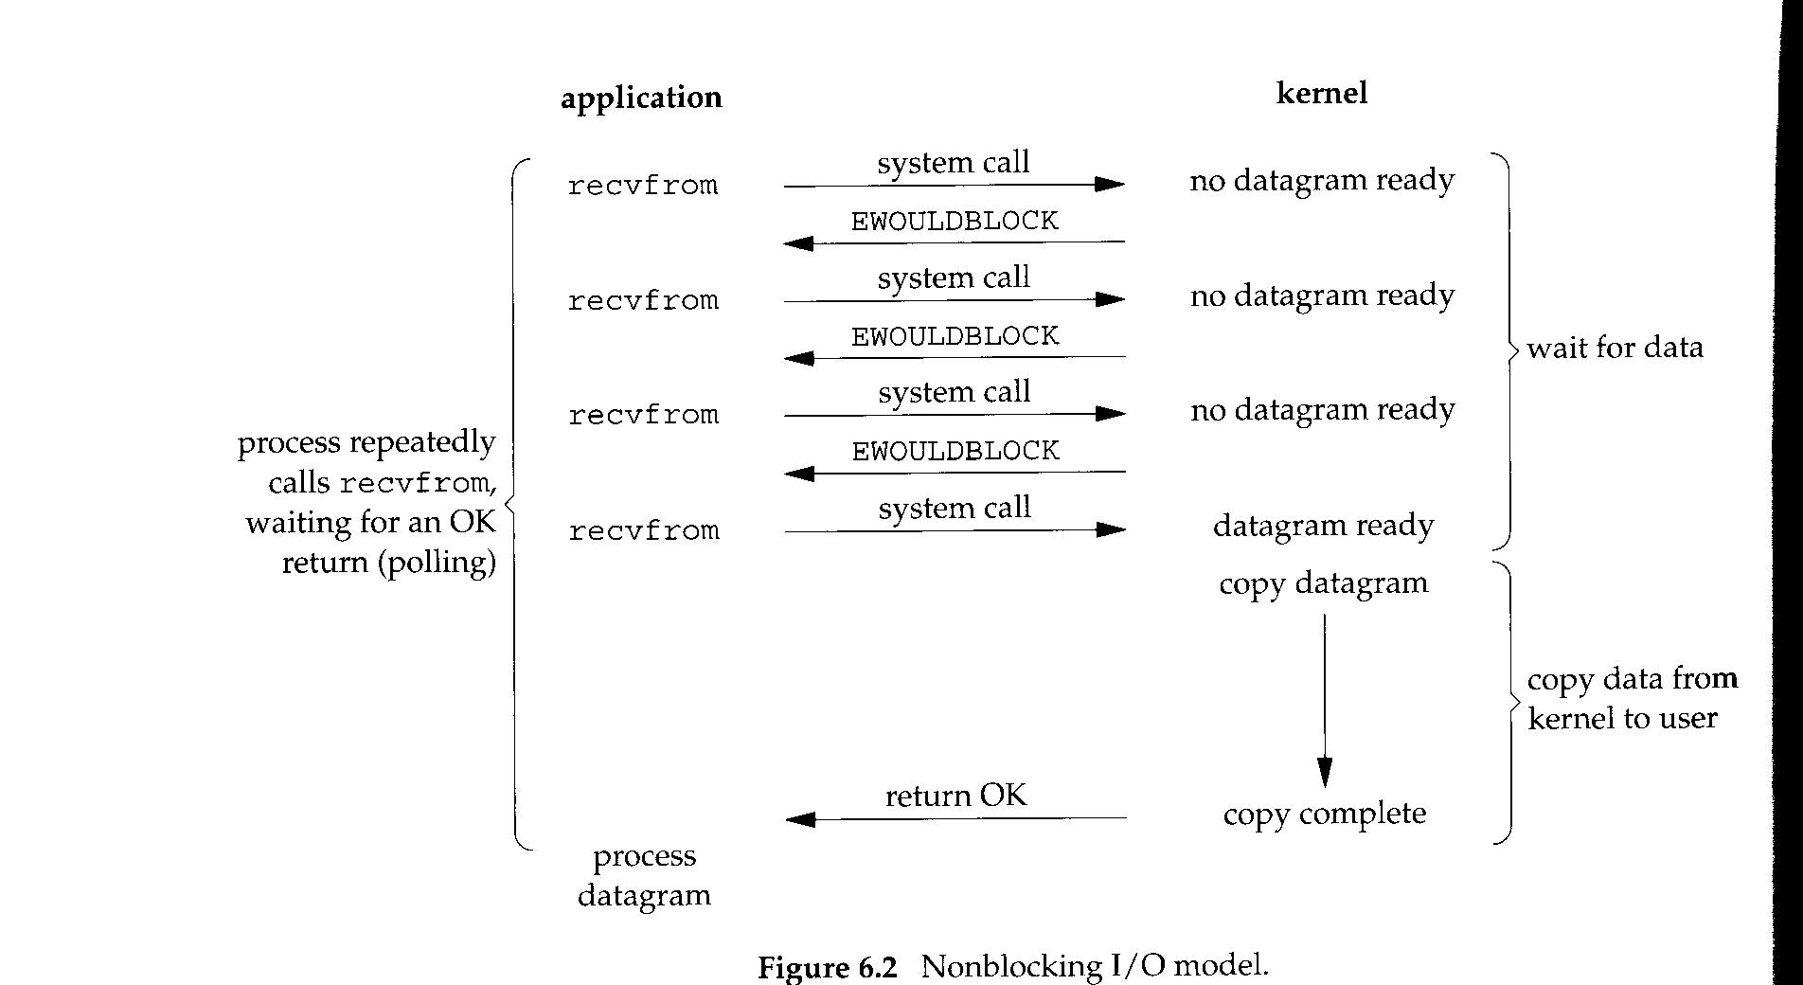
Nonblocking IO

Slide 12
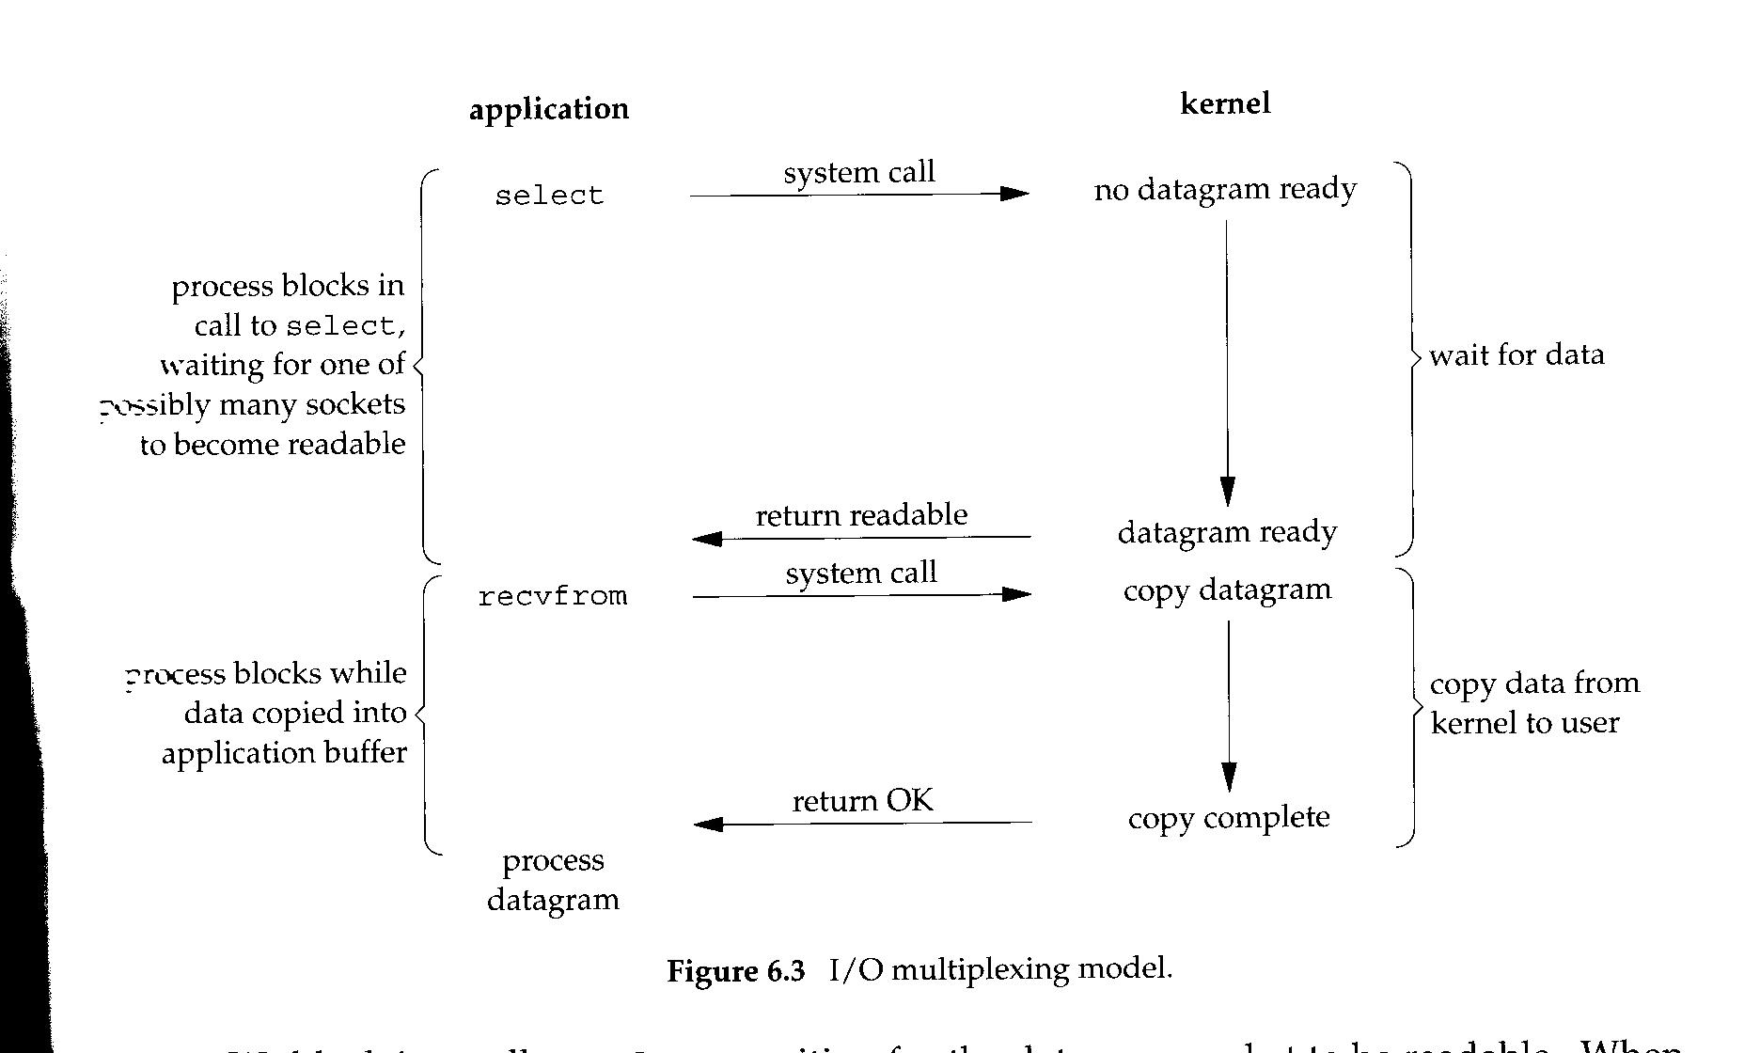
I/O Multiplexing

Slide 13
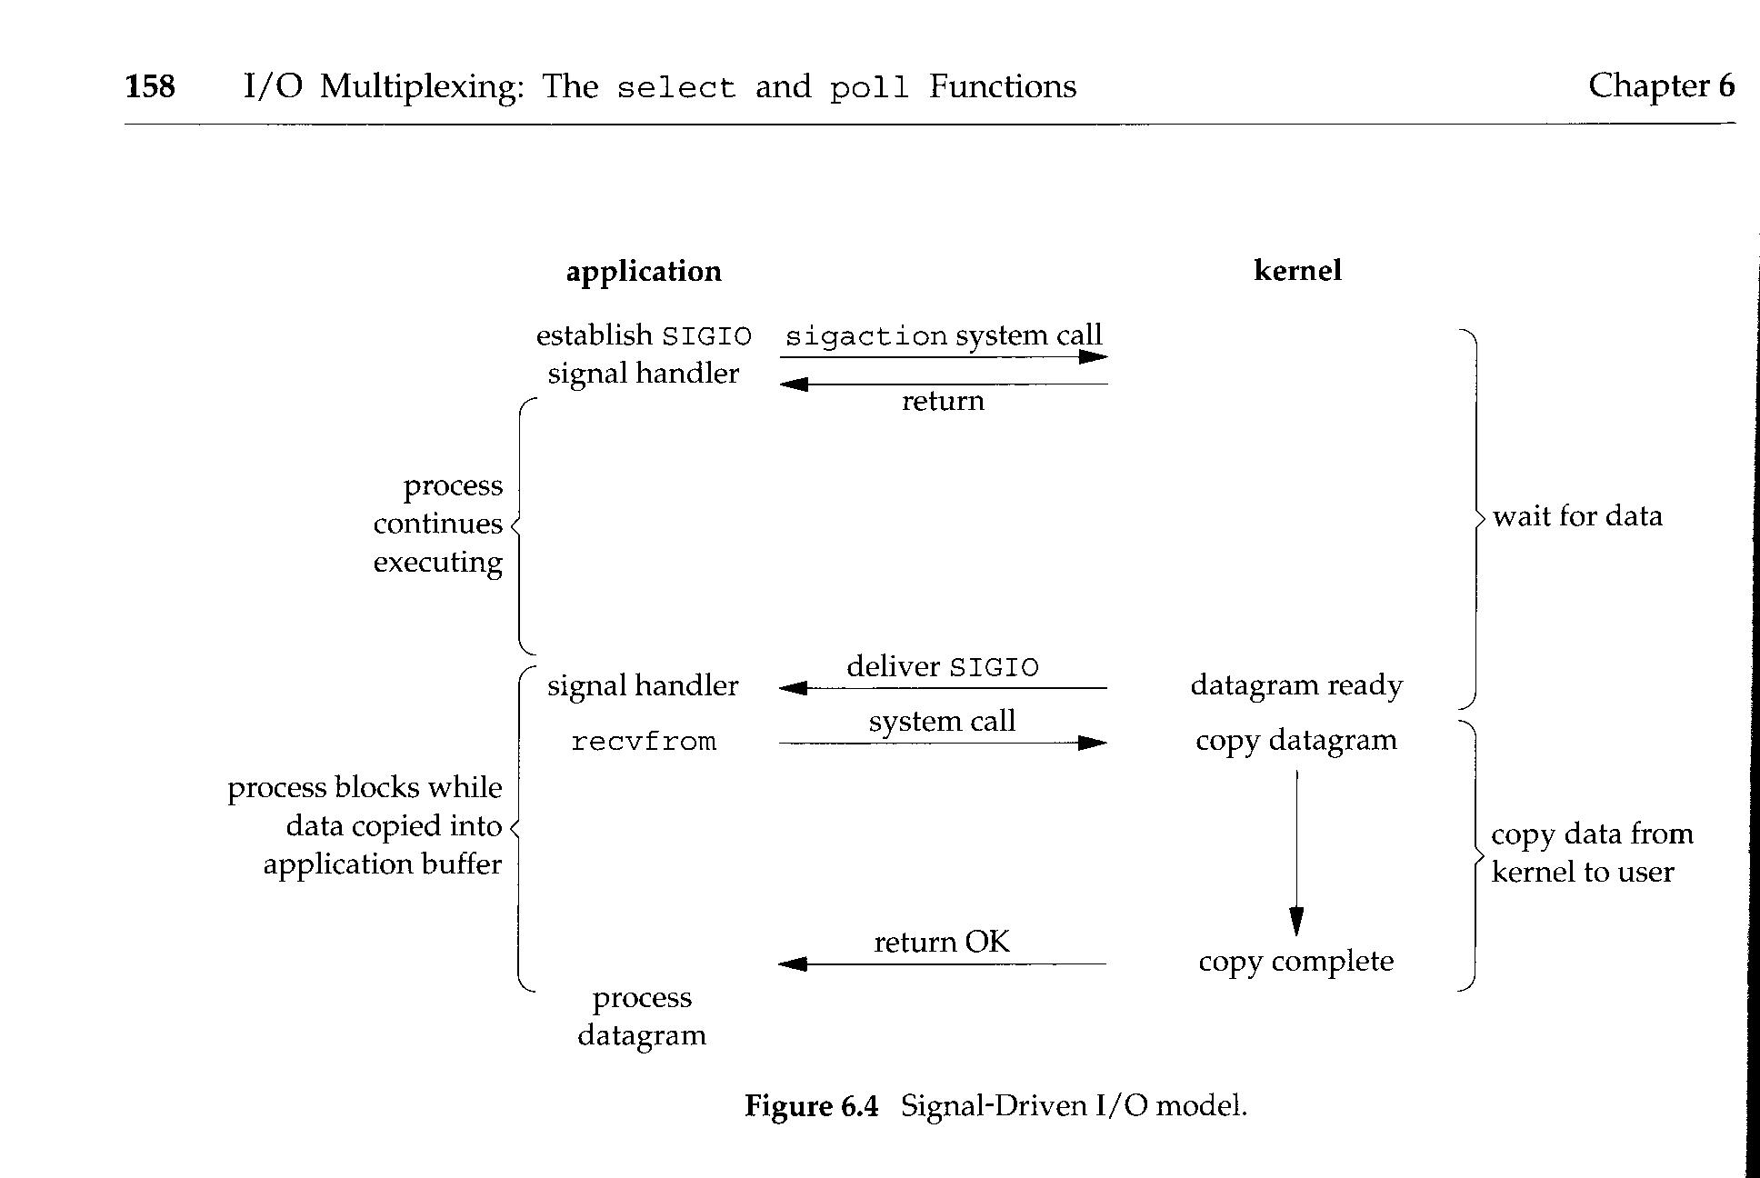
Signal driven

Slide 14
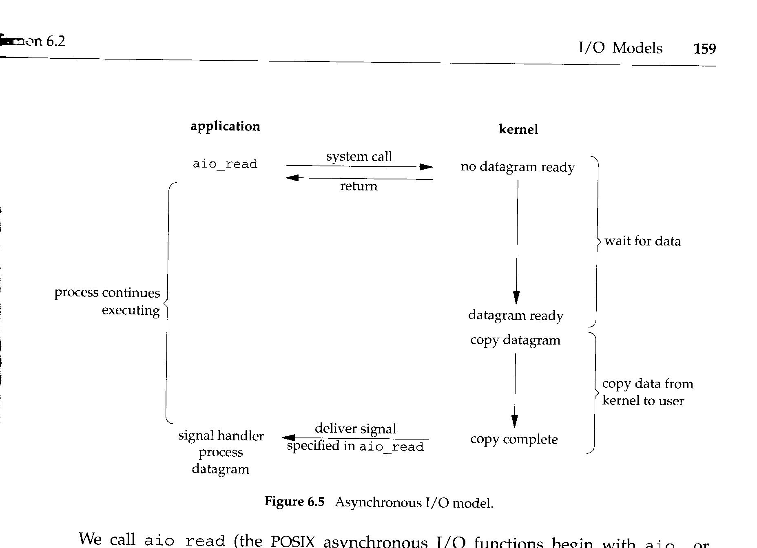
Asynchronous IO

