Slide 1
COP 5570 Concurrent, Parallel, and Distributed Programming
Welcome to
Zhenhai Duan

Slide 2
Instructor Information
Instructor
Zhenhai Duan (duan@cs.fsu.edu)
Office: Love 162
Office hours: 1:00PM to 2:00PM, TTh
Research area: computer networks and network security
TA (if any)
TBA on blackboard

Slide 3
What this Course is About
Hands-on introduction to advanced programming in Unix environment
File systems, advanced I/O
Concurrent programming with processes and threads
Signals
Inter-process communication and synchronization
Network programming
After taking this class, you should be able to
Use standard UNIX operating system APIs
Develop concurrent and distributed programs
Develop networking programs
Develop portable programs

Slide 4
Course Pre-requisites
Operating systems - COP 4610 or equivalent
Basic course on networks (highly desirable) – CNT 4504/5505 or equivalent.
Proficiency in C/C++ - absolute must!!
Working knowledge of Unix environment

Slide 5
Course Materials
Required textbook
“Unix Network Programming Volume 1: The Sockets Networking API,'‘ 3rd Edition, by W. Richard Stevens, Bill Fenner, and Andrew M. Rudoff. 2003
Recommended reference textbooks
“Advanced Programming in the Unix Environment,'' 2nd Edition, by W. Richard Stevens and Stephen A. Rago.
This is essentially the second required book
“The C Programming Language”, 2nd Edition, by B. Kernighan and D. Ritchie.
Lecture notes, other assigned readings
Materials on the Internet

Slide 6
Workload and Grading Policies (subject to change)
Two individual programming assignments: 35%
These are relatively large projects
1 group term project: 20%
Up to 3 students per group
1 midterm exam: 20%
1 final exam: 25%
Link to the final letter grade

Slide 7
Programming Assignments
The two individual projects
Fairly large, > 1000 lines
Must be written in C/C++
Late submission
10% penalty per day for up to two days.
Start early!
Don’t wait till the last minute; servers may go down and plan accordingly
Ask questions early!

Slide 8
Grading Programming Assignments
Grading is based not only on the software functionality/quality, but also on
Your understanding of your own code.
Your preparation to show the features of your program.
A program that is “kind of” working is not good enough.
Test your program thoroughly
Bugs identified by grader may severely affect your grade

Slide 9
Group Term Project
Up to 3 students / per group
Requirement: two types
Software development
Extending an existing project: software analysis + software development: analyze components and structure of an open-source software project, and then extend it by adding meaningful functionalities
Develop a new software application, re-develop or extend existing one, or performance analysis
Research project
Should also contain nontrivial software development components
Can be in C/C++, Java, Perl, or Python

Slide 10
Group Term Project
Graded based on
Project proposal and status report
Presentation (the last two weeks)
Demonstration (the last two weeks),
Final report (and software if applicable)

Slide 11
Programming Projects
Note
Develop all programming assignments/project on linprogs
In particular, do not use machine diablo.cs.fsu.edu

Slide 12
Important dates
Link to important dates
Subject to change
For homework assignments and group project
Submit through the online submission page
Midnight on the due dates

Slide 13
Accounts
Computer Science account (<yourid>@cs.fsu.edu)
For doing projects
http://www.cs.fsu.edu/sysinfo/newstudent.html
Use machines linprog.cs.fsu.edu to develop projects
FSU account (<yourid>@fsu.edu)
For receiving class announcements
For submitting assignments
For getting your grades
https://www.ucs.fsu.edu/getStarted.html
Access to blackboard
For class materials, discussion board, grades etc.
Through your FSU account
http://campus.fsu.edu

Slide 14
Policies and Guidelines
No late homework/projects
Please work on homework assignments/projects early and hand in on time
10% penalty per day for up to 2 days
No make-up exam, no Incomplete
unless proof of emergency
Scholastic behaviors
No copying from anywhere
Academic Honor Code enforced
Moss will be used to detect plagiarism
Dishonesty
Will be reported to the University
Please read detailed course policies on the course website.

Slide 15
Concerns and Questions?

Slide 16
VirtualBox and Ubuntu
If you have windows on your laptop or PC, you can install VirtualBox and Ubuntu to have a Unix environment
Check the hardware configuration requirement on VirtualBox website to see if your laptop is powerful enough.

Slide 17
VirtualBox and Ubuntu
From VirtualBox website (virtualbox.org)
VirtualBox is a general-purpose full virtualizer for x86 hardware, targeted at server, desktop and embedded use
Enables you to install many (different) OSes on a single physical machine (with a host OS)
Only discussed the basic steps to install and use VirtualBox, check website for details.
Ubuntu
A popular, user-friendly, Linux distribution
Support for many laptop hardwares

Slide 18
Installing VirtualBox and Ubuntu
Step 1
Download the VirtualBox package and the Ubuntu OS image
Step 2
Install VirtualBox
It is relatively simple, just execute it.
If you have difficulty, let us know.
Step 3
Install Ubuntu as a guest OS in a virtual machine on VirtualBox
See the next slide

Slide 19
Create Ubuntu Virtual Machine
From VirtualBox manager, click "New" to create a new virtual machine. Default memory and disk space will be fine.
After VM is created. Click "Settings", then "Storage", "CD" to mount the Ubuntu image.
Next, start the VM, the installation process of Ubuntu will start.
It will only ask very minimal information from you during this process
When the installation process finishes, it will ask you to reboot the machine, and remind you to remove the media (Ubuntu image) from CD.
Click "Machine"->Close->Power off the machine.
Click Settings again. Then Storage->CD->remove media from virtual drive.
Now, you can power on the VM again to log into Ubuntu with the account you have created when you install Ubuntu

Slide 20
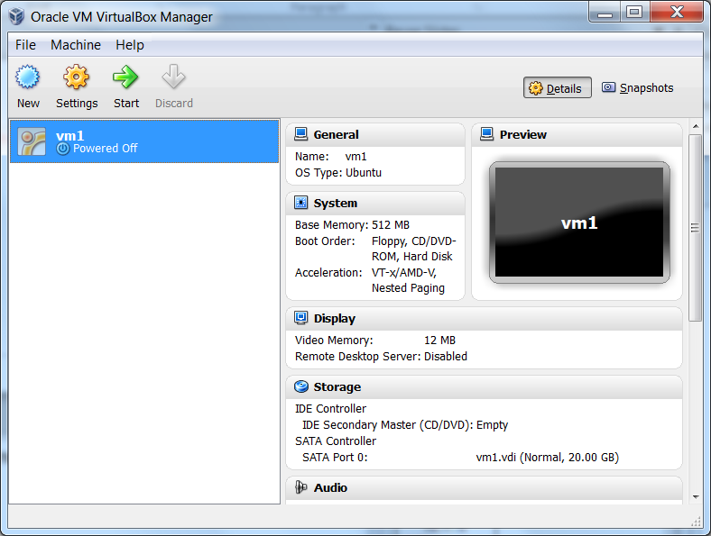
Creating Virtual Machines

Slide 21
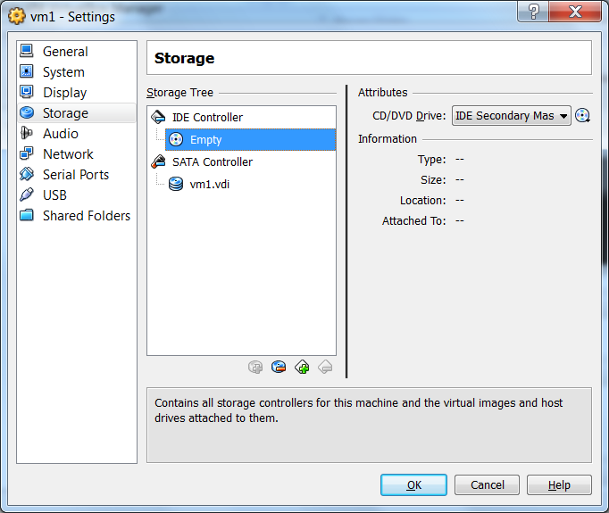
Creating Virtual Machines

