Slide 1
Miscellaneous UNIX/C Concepts
UNIX environment
Remote shell setup
C compilers
Debugger
Make
Some commonly used C/C++ programming tricks and conventions.
The system function
Readings
APUE 7.4, 7.5, 7.9, 8.13

Slide 2
Remote Shell using SSH
To run a command on a remote machine without typing in the password.
Remote ssh from machine A to machine B
Step 1: at machine A: ssh-keygen –t rsa
(do not enter any pass phrase, just keep typing “enter”)
Step 2: append A:.ssh/id_rsa.pub to B:.ssh/authorized_keys
After these steps, you should be able to run remote command.
On machine A: ssh user@B “command”
More info
SSH with Keys Howto

Slide 3
C Compilers
gcc, cc
Using ANSI C, the code must pass ‘–Wall –ansi –pedantic’ with no warning messages
‘-ansi’: ISO C90 programs.
‘-ansi’ + ‘-pedantic’: reject non-ISO programs
‘-std=c99’: ISO C99 programs
‘man gcc’ for more information.
Writing portable programs requires clear identification of the C dialect that is used.

Slide 4
C Compilers (Cont’d)
See the example code (example1.c), how to fix the errors/warnings?
Some examples:
gcc –g –c –Wall –ansi –pedentic example.c
gcc –Wall –ansi –pedantic example1.c example2.c
gcc –g example.o
gcc –g example.o -lm

Slide 5
Debugger
The code must be compiled with –g option.
ddd, xxgdb, gdb
The power of a debugger:
Finding the line that causes coredump.
See example:
Break point/show value/change value/step/next/continue/print
Very efficient in debugging sequential code
Not very effective in debugging concurrent code (multiple threads, multiple processes)

Slide 6
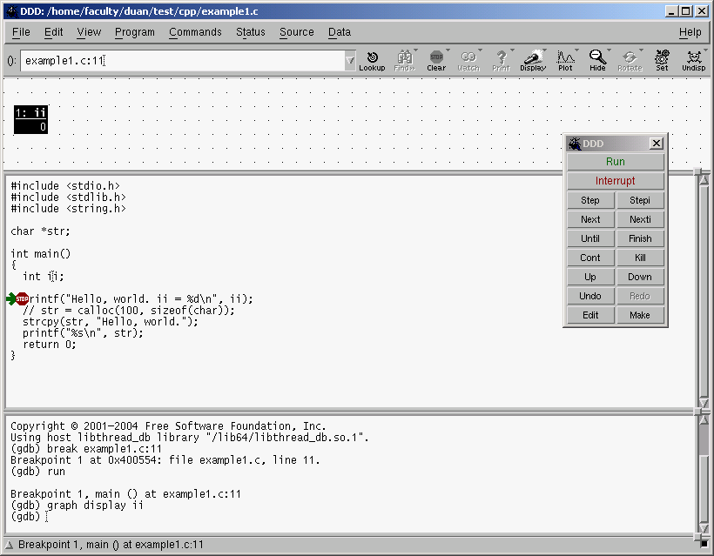
DDD Snapshot
Data window
Source window
Command tool
Debugger console

Slide 7
Core dump File
A file containing memory image of process when it terminates (crashes)
A common reason of core dump file not created is resource limit on core file
Controlling core file size is shell specific
csh:
limit [resource] [limit], or simply unlimit to remove all limits
Where resource should be coredumpsize
sh: ulimit -c [limit]
Load core dump file into debugger
gdb: gdb executable_file coredump_file
ddd: ddd executable_file coredump_file
To locate the line that causes core dump
backtrace (or bt)

Slide 8
Make
A tool to update files that are derived from other files. Great for software development.
Discussions based on GNU make utility
make command
make [-f makefile][option][target]
The default files for make are GNUmakefile, makefile, Makefile, in that order
GNUmakefile is not recommended
Makefile is recommended
The default files can be overwrite with the –f option
make –f myprog.mk

Slide 9
Make
A makefile has five kinds of components:
Explicit rules: tell when and how to remake one or more files (targets)
Implicit rules: tell when and how to remake a class of files
Variable definitions: define a text string for a variable
Directives: tell to do something special when reading a make file
Comments: anything after a # sign

Slide 10
Make
Variable definitions:
String1 = string2
E.g. CC=gcc
CFLAG=-Wall –ansi –pedantic
Default variables (default value)
CC: default C compiler (cc)
CXX: default C++ compiler (g++)
CFLAGS: extra flags to give to C compiler (empty)
CXXFLAGS: extra flags to give to C++ compiler (empty)
CPPFLAGS and LDFLAGS (empty)

Slide 11
Make
Explicit rules:
Target [target…] : [prerequisite…]
<tab> command
<tab> command
…
Example:
a.out : myprog1.c myprog2.c myprog3.c
$(CC) myprog1.c myprog2.c myprog3.c

Slide 12
Make
Implicit rules:
Tell make how to use certain customary techniques to remake a target so that you do not have to supply the rules
For example, look at the following makefile
make will search an implicit rule to make foo.o and bar.o since we did not specify how to make them
Define new implicit rules by writing pattern rules
Similar to explicit rule, except target contains “%”
Example
foo : foo.o bar.o
cc -o foo foo.o bar.o $(CFLAGS) $(LDFLAGS)
%.o : %.c
$(CC) -c $(CFLAGS) $(CPPFLAGS) $< -o $@
% : %.c
$(CC) $(CFLAGS) $(CPPFLAGS) $< -o $@

Slide 13
Make – Special Targets
.PHONY
.SUFFIXES
.PHONY : clean
clean :
rm *.o core.*
Add a new suffixes
.SUFFIXES : .x
If you want to delete existing ones first
.SUFFIXES:
.SUFFIXES: .x .o .c .h

Slide 14
Make
Old-fashioned suffix rules
Old way to define implicit rules. You should use pattern rules
Examples
Automatic variables
$@: target file
$<: name of first prerequisite
$?: name of all prerequisites newer than target
$^: name of all prerequisites
.c.o :
$(CC) -c $(CFLAGS) $(CPPFLAGS) $< -o $@
.c :
$(CC) $(CFLAGS) $(CPPFLAGS) $< -o $@

Slide 15
Make
See the example makefile2
How to modify the makefile if I want only recompile one file instead of the whole system?
A file (makefile5) with pattern rules, and file (makefile4) with suffix rules.
What happens when we do ‘make a.o’? What about ‘make b.o’?
What happens when myprog2.o also depends on myprog.h?
More info
GNU make

Slide 16
UNIX Convention
Normal execution: exit code 0
This is the default exit code.
Abnormal execution: exit with a non-zero code
Try to follow this convention in this course, or some utility may break.
See example x.mk
Make checks exist status of each command, and gives up when error occurs
You can use –i option to ignore errors
make –i –f x.mk

Slide 17
Some C Programming Tricks
Header files: contain common declarations.
Source files use the #include directive to include the header files.
Sometimes using header files can cause problems, see example2.c.
Including a header file multiple times may cause “duplicate declaration” errors.
Why including stdio.h two times does not have any problem?
Look at /usr/include/stdio.h, this file is protected.

Slide 18
Header Files
The following mechanism prevents the body of a header file from being included multiple times.
#ifndef MYHEADER
#define MYHEADER
….
/* the body of the header file */
#endif
Another way (not standard but widely supported)
#pragma once

Slide 19
Header Files
How/when is a macro processed?
Try ‘gcc –E example1a.c’ and ‘cpp example1a.c’
#define MAX_LENGTH 256
For (I=0; I<MAX_LENGTH; I++) ….

Slide 20
Header Files
Macros with parameters:
Macros with parameters look/work like functions:
#define max(a, b) (a>b)?a:b
Macros with parameters need to be defined and used carefully, otherwise weird things can happen.
What is wrong with the following macro?
#define sum(a, b) a +b
Checkout example3.c
How to fix the problem?

Slide 21
C Programs with command line arguments
int main(int argc, char* argv[]) {}
argc is the count of command line arguments. argc >=1. Command line arguments are separated by spaces.
argv is an array of pointers to character strings that contain the actual command-line arguments.
See example4.c (link) for the use of command line arguments.
You will need to use command line arguments in most of the programming assignments.

Slide 22
The Environment List
Try command env
Environment variables can be defined in shell
setenv DISPLAY L103:0.0
DISPLAY=L103:0.0
These variables can be accessed in the program
Historically,
int main(int argc, char *argv[], char *envp[]);
Not ANSI C.
New methods for accessing environmental variables:
extern char **environ;

Slide 23
Environment List
This figure shows an example how the environment list is organized.
See example6.c for how to use environ.

Slide 24
Environment List
ANSI C also specifies a routine for accessing environment variables:
char *getenv(char *name)
See example7.c.
Other routines (not in ANSI, now in some POSIX):
int putenv(const char *str);
int setenv (const char *name, const char *value, int rewrite);
void unsetenv (const char *name);
See example8.c

Slide 25
Some routines to parse/format strings in C
sprintf/sscanf
sprintf(str, format, arg1, arg2….)
Similar to printf except that the result is stored in str.
sscanf(str, format, arg1, arg2,…)
Similar to scanf except that the values are read from str.
Example: How to get all the fields from the output of ‘ps’ on diablo?
See example5.c for the use of sprintf/sscanf

Slide 26
The system Function
Allows commands to be executed in a program
int system(const char *string)
Works as if string is typed in a terminal.
Returns the exit status (format specified by waitpid()) if successful.
Returns –1 or 127 if error.
See example5a.c.

