Slide 1
File I/O and Pipes
File operations
I/O redirection
Inter-process communication through pipes
Readings
APUE: 3.2--3.8, 3.10, 3.12, 15.2

Slide 2
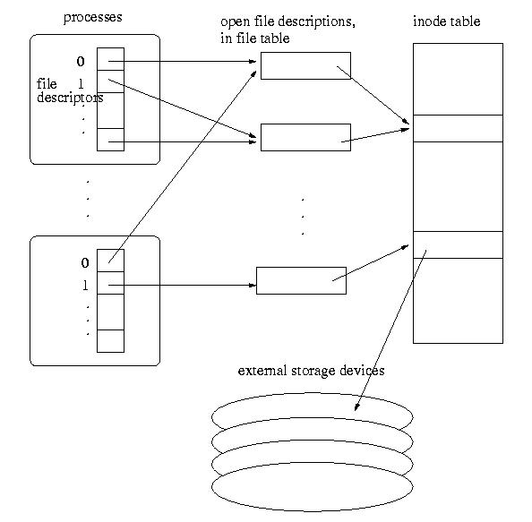
Data Structures for Open Files

Slide 3
Data Structures for Open Files
File descriptor table
Each process has a table.
nonnegative integer used to identify an entry in the file table
The table size is limited, which limits the number of files that can be opened in a process (see example0.c and example0a.c)
Open file table
The whole system shares the table
The entries are called open file descriptions, which are records of how files are currently accessed.
File offset: the byte position in the open file description that decides where to access the file through the open file description.

Slide 4
Implications of the Data Structures
open and create
Linear search for the first empty slot in the process file descriptor table.
allocate an open file description in the file table, which has a pointer to the inode table.
See example1.c
Flag: O_APPEND
Force offset in open file table to the end of file before each write
See example1a.c

Slide 5
The dup and dup2 System Calls
dup, dup2
Syntax
int dup(int oldfd)
int dup2(int oldfd, int newfd)
Duplicating the file descriptor in the process file descriptor table, sharing the same open file table
See example2.c
NOTE
Similarly, fork() will only duplicate file descriptor table, but not the system-wide open file table.

Slide 6
I/O Redirection
All UNIX processes have three predefined files open: stdin, stdout, stderr. STDIN_FILENO (0), STDOUT_FILENO (1) and STDERR_FILENO (2).
Defined in <unistd.h>
We can redirect the I/O by manipulating these file descriptors.
See example3.c, example3a.c, example4.c, example5.c, and example6.c
Where is the buffer for the standard output/error messages (example4a.c)?
Order enforcer: fflush();
Execise: mycat.c
When happens when the end of file is reached in read?

Slide 7
Pipes
two types of pipes, named pipes and unnamed pipes
Named pipes:
like a file (create a named pipe (mknod), open, read/write)
can be shared by any process
will not be discussed in detail.
Unnamed pipes:
An unnamed pipe does not associate with any physical file.
It can only be shared by related processes (descendants of a process that creates the unnamed pipe).
Created using system call pipe().

Slide 8
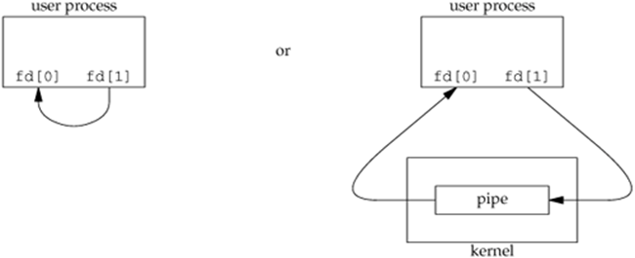
The pipe System Call
Syntax: int pipe(int fds[2])
Semantic
creates a pipe and returns two file descriptors fds[0] and fds[1]
a read from fds[0] accesses the data written to fds[1] (half-duplex, POSIX) and a read from fds[1] accesses the data written to fds[0] (full-duplex, non-standard, POSIX.1 allows).
pipe has limited size (64K in some systems) – write will block when pipe is full
Write to pipe with no reader (read end closed): broken pipe error (example7.c)
Read from a pipe with no writer (write end closed): end of file (example7a.c)
man –s 2 pipe and man –s 7 pipe for more information

Slide 9
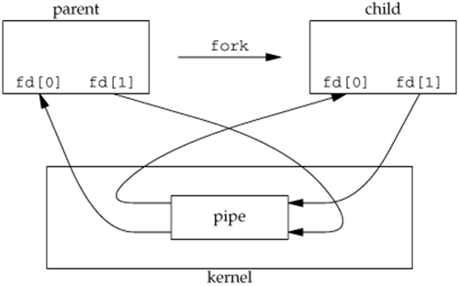
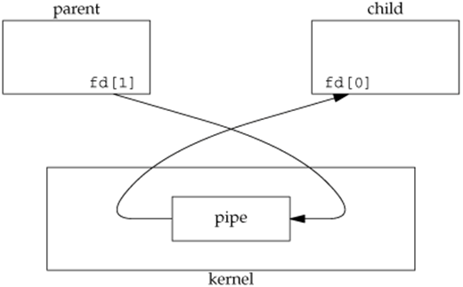
Pipe between Parent and Child Process
Half-duplex pipe after fork
Pipe from parent to child
See example8.c, example9.c, and example9a.c
For example9.c, which process will terminate first?
How abut example9a.c

Slide 10
Pipe and Inter-Process Communication
Once the processes can communicate with each other, the execution order of the processes can be controlled.
See example11.c
The execv system call revisit:
Format: int execv(const char * path, char * argv[])
Execute the path command and wipe out ALMOST everything in the original process.
ALMOST: the file descriptor table is kept.
We can manipulate the I/O for the execution of the path command by manipulating the file descriptor table.
See example14.c
How to implement I/O redirections in shell?

Slide 11
How to Implement pipe in Shell
Implementing pipe in shell.
E.g. /usr/bin/ps -ef | /usr/bin/more
How does the shell realize this command?
Create a process to run ps -ef
Create a process to run more
Create a pipe from ps -ef to more
the standard output of the process to run ps -ef is redirected to a pipe streaming to the process to run more
the standard input of the process to run more is redirected to be the pipe (from the process running ps –ef)
See example12.c and example13.c (need to be careful about the open files)

Slide 12
Execise: Implement one pipe
a.out cmd1 cmd2 ➔ cmd1 | cmd2
How about implementing multiple pipes?

