Slide 1


Multi-Task Learning Based Channel Estimation for Hybrid-Field STAR-RIS Systems
Jian Xiao*, Ji Wang*, Yuanwei Liu†, et.al.
*Department of Electronics and Information Engineering,
Central China Normal University,
†School of Electronic Engineering and Computer Science,
Queen Mary University of London.
Notes:
Hello everyone, in this talk,1 we will present a multi-task learning based channel estimation scheme for hybrid-field STAR-RIS systems.

Slide 2
Background
System Model
Proposed solution
Simulation results
Future Directions
Notes:
This presentation will be divided into five parts. Firstly, we will introduce the background of this work.

Slide 3
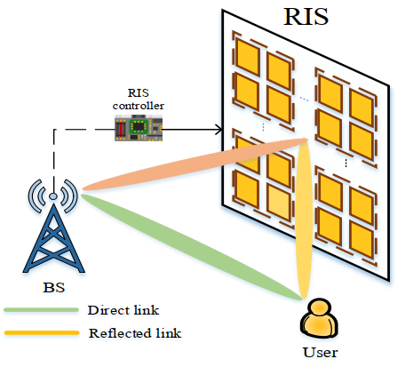
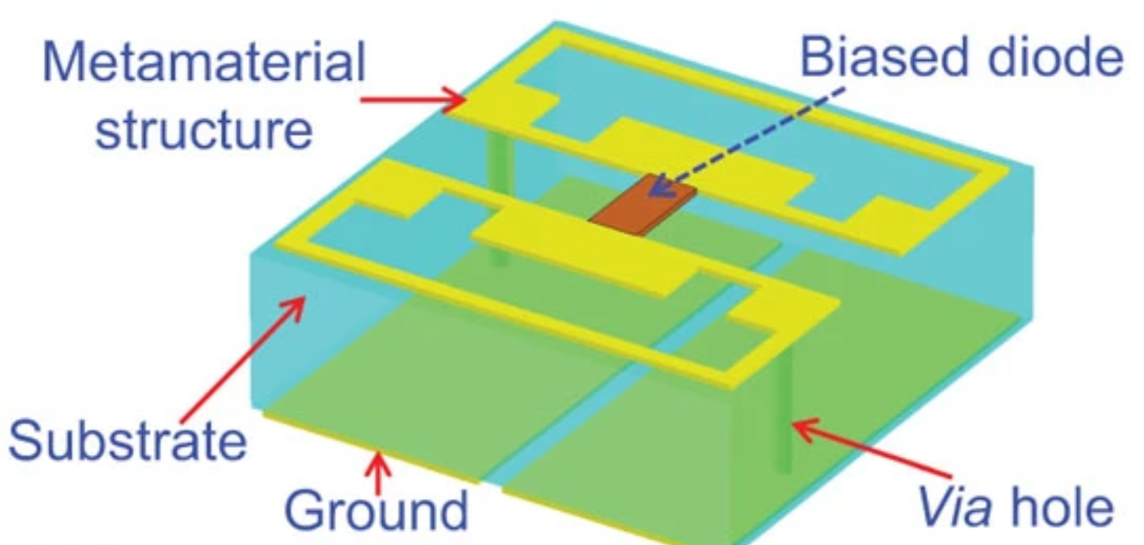
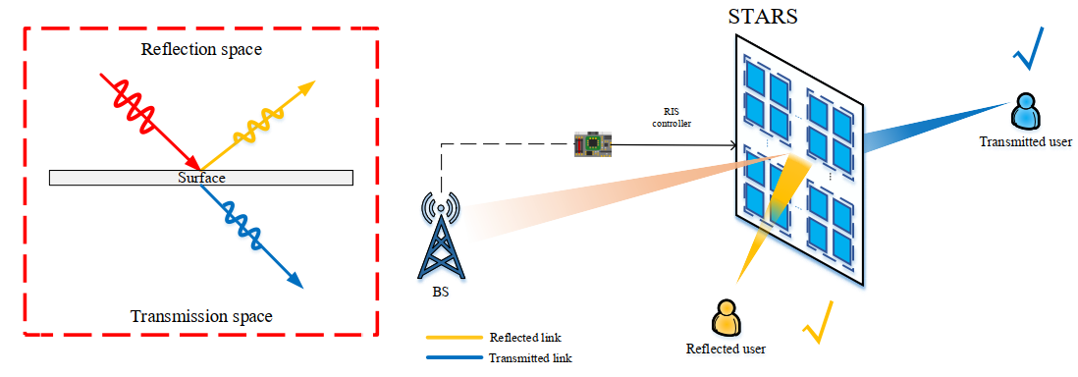
Background
Reconfigurable Intelligent Surface (RIS)
A meta-surface controlling the propagation of electromagnetic wave
Half-space coverage
Reflection-only RIS
Simultaneously transmitting and reflecting RIS (STAR-RIS)^{[1]}
Full-space coverage
Dual functionality
[1] Y. Liu, et al., “STAR: Simultaneous Transmission And Reflection for 360° Coverage by Intelligent Surfaces”, Dec. 2021
Notes:
Reconfigurable intelligent surface (RIS) has been regarded as a promising multiple input multiple output (MIMO) candidate to construct smart radio environments in the sixth-generation wireless networks. The typical reflection-only RISs only reflect the incident signal to desired user equipments at the same side, which only forms a half-space SRE. To break the limitation of reflection-only RISs and achieve the full-space SREs, the novel concept of simultaneously transmitting and reflecting RISs (STAR-RISs) has attracted increasing attention. The signal `imping on the STAR-RIS is divided into two parts. One part electromagnetic wave is reflected to the user at the same side as the incident wave, while the other part is transmitted to the users at the opposite side. The dual functionality of STAR-RISs provides greater potential to extend the wireless signal coverage.

Slide 4
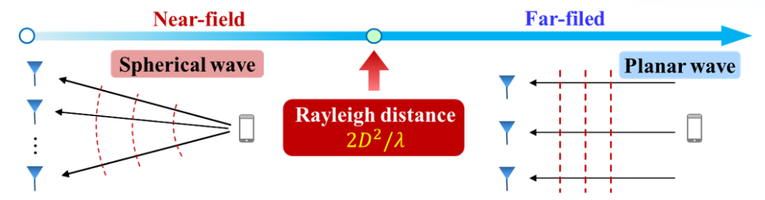
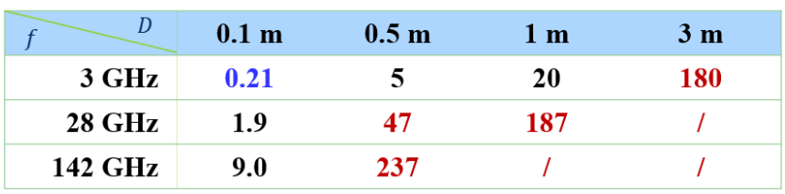
Background
Near-Field Communications
Near-field boundary: Rayleigh distance ^{[1]}
Extremely large-scale array
Tremendously high frequencies
Hybrid Near- and Far-Field Communications
A practical case of radiation field: far- and near-field signal coexist
[1] L.Dai, Near-Field Communications for Extremely Large Antenna Array, ICASSP (inviting talk), 2022
Notes:
As the number of STAR-RIS elements grows large in extremely large-scale antenna array systems, the far-field radiation assumptions are no longer valid, while the near-field propagation is likely to happen due to the increase of array aperture. As shown in this slide, the Rayleigh distance may reach hundreds of meters at the THz frequency and ultra-large `aperture array. Moreover, a practical case of radiation field, i.e., hybrid far- and near-field, is highly likely to happen in practical STAR-RIS systems.

Slide 5
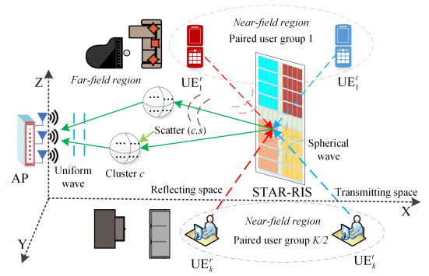

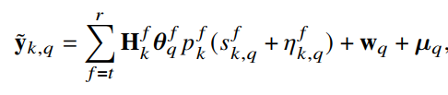

System Model
STAR-RIS assisted indoor mmWave communications
Signal model (focusing cascaded link)
Near-field boundary in RIS systems:
AP—RIS : Hybrid-field NLOS channel
RIS—UE: Near-Field LOS channel
hardware impairments at AP and users
Notes:
In this work, we study the uplink hybrid-field cascaded channel estimation for STAR-RIS aided multi-user millimeter-wave systems with hardware imperfections. It is worth noting that the near-field range in RIS systems is determined by the harmonic mean of the AP-RIS distance and the RIS-UE distance. It can be further implied that as long as any of these two distances is shorter than the Rayleigh distance, RIS-aided communication is operating in the near-field area. Therefore, near-field propagation is more likely to happen in RIS systems. In this work, we consider a practical communication environment between AP and STAR-RIS, where far-field and near-field signal components coexist, constituting a hybrid-field communication scenario.

Slide 6
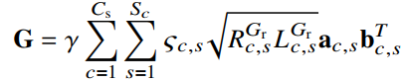
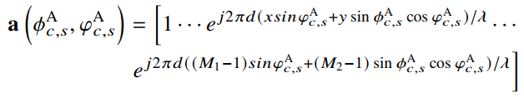
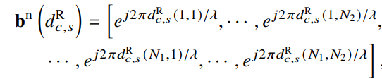


System Model
Hybrid-Field Channel Model
AP—RIS link
Far-field array response at the AP
Near-field array response at the RIS
Spatial non-stationarity caused by visibility regions (VRs)
Uniform Planar Wave
Only Related Angles
Spherical Wave
Related Distance and Angle
Notes:
In the hybrid-field channel modeling, we need to consider the far-field array response at the AP and near-field array response at the STAR-RIS. In the conventional far-field radiation, the signals is approximated as uniform planar wave, and hence the array response only depends on the identical angle.
For near-field communication with a spherical wavefront, the array response is related to not only the incident angle but also the distance between the STAR-RIS and scatter across different array antennas. Moreover, since the energy distribution across array elements is not constant in near-field propagation, the channel spatial non-stationarity caused by visibility regions is also considered in this work, which increases the channel estimation difficulty.

Slide 7
Prior Channel Estimation Schemes
Linear Estimator [1]
Expensive pilot overhead
Limited estimation accuracy due to energy leakage
Compressed Sensing Estimator [2]
Sparsity uncertainty and NP hard problem
Error propagation between near/far-field channel estimation
Deep Learning Estimator [3]
Orthogonal pilot design for multi-user systems
[1] C. Wu, et al., “Channel estimation for STAR-RIS-aided wireless communication,” IEEE Commun. Lett., 2022.
[2] X. Wei, et al., “Channel estimation for extremely large-scale massive MIMO: Far-field, near-field, or hybrid-field?,” 2022. [3] J. Xiao, et al, “U-MLP based hybridfield channel estimation for XL-RIS assisted millimeter-wave MIMO systems,” 2023.
Notes:
Firstly, we review existing channel estimation schemes in conventional RIS systems. A classic linear estimator is least square estimator. Due to the constraint of full-rank condition, the required minimum pilot overhead is the number of reflection elements N, which causes intractable training overhead. Another alternative is to take advantage of the sparsity of channel in a specific transform domain by utilizing the compressed sensing methods. (Sparsity uncertainty)However, the correlation of the actual channel may not be confined to a single exact domain that fully represent the internal sparse structure of cascaded channel. Deep learning-based channel estimation networks are widely used to achieve the mapping from pilot signal to channel matrix. However, in the existing deep learning estimators, the orthogonal pilot design for multi-user systems is utilized to construct the training data set, in which 𝐾 independent networks are required to estimate 𝐾 cascaded channels, and hence increases the training overhead for multi-user channel estimation. To address the limitation of the existing schemes, we exploit a multi-task learning framework for hybrid-field channel estimation in STAR-RIS systems.

Slide 8
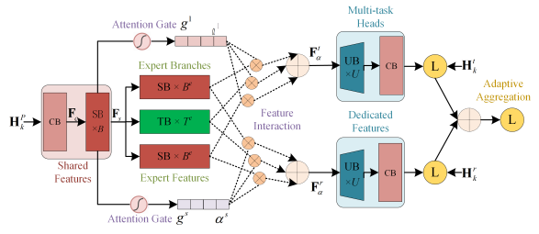

Proposed Solution
Multi-task Learning (MTL) for Joint Channel Estimation
Channel Correlations in STAR-RIS Systems
Transmitting users and reflecting users share STAR-RIS—AP channel
A MTL framework is proposed to implicitly exploit multi-user correlations
Multi-gate mixture-of-experts:
Joint learnable loss function:
Notes:
In this work, we propose a multi-task learning-based joint cascaded channel estimation framework, which leverages the hybrid-field cascaded channel correlations between different users and STAR-RIS elements. The proposed MTL framework can be divided into three parts, i.e., shared features extraction in the bottom of network, features interaction in different expert branches, and multi-task heads in the network output layers. To realize the loss balancing of multi-task optimization in the MTL framework, we design a multi-gate mixture-of-experts framework and an adaptive joint loss function to alleviate the multi-task competition between different subtasks, which not only utilizes the Energy Split prior information but also introduces an learnable scalar to allocate the adaptive weight for different subtasks.

Slide 9
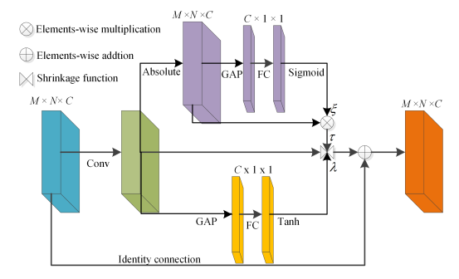


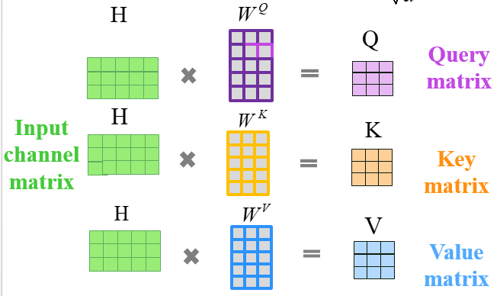
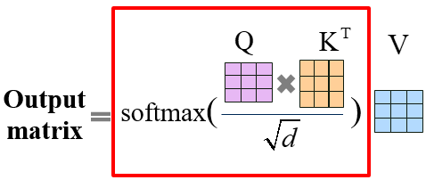
Proposed Solution
Attention-Guided Multi-task Network
Residual shrinkage module in low-level shared layers ()
Self-attention in feature interaction layers [1]
Soft thresholding denosing
Learnable threshold
Learnable slope
[1] H. Jiang, et al., “Attention-based hybrid precoding for mmWave MIMO systems,” IEEE ITW’21, 2021.
Notes:
Based on the design guideline of the proposed MTL framework, we exploit an efficient multi-task network to simultaneously reconstruct hybrid-field cascaded channels of transmitting and reflecting users. Considering the noise components of the input tensor introduced by the LS pre-estimation, we design a learnable denoising module by fusing the thresholding denoising and soft-attention mechanism. Specifically, in the low-level shared features extraction module of the multi-task network, a residual shrinkage network is developed to automatically learn the threshold τ with specialized network layers by imitating the operations of soft thresholding. In hybrid-field STAR-RIS systems, the local spatial correlations of non-stationary cascaded channel will be partly lost due to the presence of visibility regions, which restricts the effective feature learning ability for local convolutional operations-based CNN. Hence, in the feature interaction module of the multi-task network, we introduce the self-attention architecture to model the spatial non-stationarity characteristics of hybrid-field cascaded channel.

Slide 10
Simulation Setup
Simulation scenario
Parameter | Value
Number of RIS elements N | N = 8 × 64
Number of AP elements M | M = 4 × 8
The carrier frequency f | f = 73 GHz
Hardware impairments
Size of subarrary
Operating protocol | Time switching (TS) / Energy splitting (ES)
Benchmarks
Schemes | Basic Idea
TS/ES-LS estimator [1] | A DFT-based unbiased estimation
CS estimator [2] | A polar domain sparsity
EDSR-based DL estimator [3] | A super-resolution network
TS/ES-STN estimator | A single-task version of MTN
[1] C. Wu, et al., IEEE Commun. Lett., 2022.
[2] M. Cui, et al. IEEE Commun. Mag., 2023.
[3] Y. Jin, et al. IEEE Trans. Veh. Technol., 2021
The related code is available at:
https://github.com/WiCi-Lab/MTN
Notes:
Next, we will present the simulation results of this work. The main simulation parameters and benchmark scheme are summarized in this two tables. We compared the proposed multi-task network (MTN) and the existing LS estimator, the compressed sensing algorithm and the deep learning approach. The related code is available at our github homepage.

Slide 11
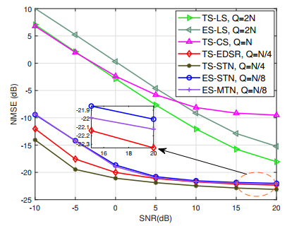
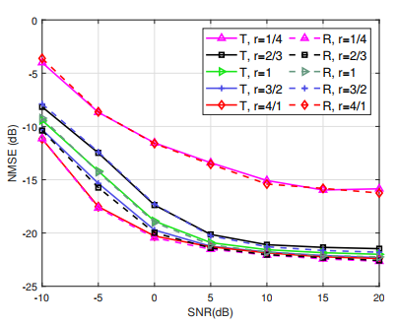

Simulation Results
NMSE for different algorithms
NMSE for different ES ratios 𝑟
·In TS protocol, superior channel estimation accuracy can be obtained compared to ES protocol.
·In ES protocol, less pilot overhead can be achieved compared to TS protocol.
·With the increase of ES ratios 𝑟 , the corresponding estimation accuracy is also improved
·The proposed MTN model has less pilot and training overhead compared to STN model
and can achieve the estimation accuracy similar to the STN model in ES protocol.
Notes:
In this slide, we present the channel estimation accuracy of different algorithms. As shown in the presented simulation results, we can obtain several key insights. Firstly, ·in TS protocol, superior channel estimation accuracy can be obtained for all channel estimation algorithms compared to ES protocol. Secondly,·in ES protocol, less pilot overhead can be achieved for deep learning approaches compared to TS protocol.·Thirdly, with the increase of ES ratios 𝑟 , the corresponding estimation accuracy is also improved.·Finally, the proposed MTN model has less pilot overhead and training overhead compared to STN model and can achieve the estimation accuracy similar to the single-task model in ES protocol.

Slide 12
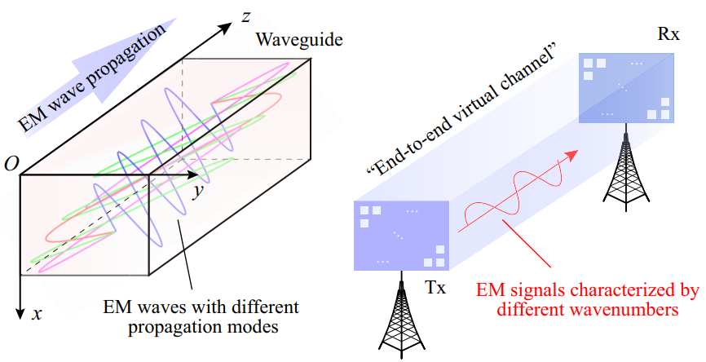
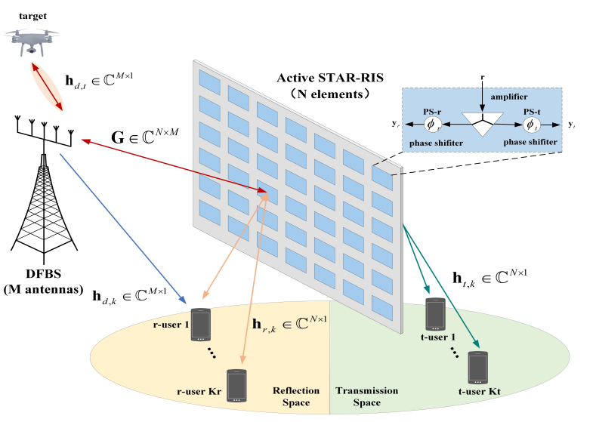
Future Directions
Wavenumber domain channel estimation for holographic STAR
ISAC channel estimation in active STAR-RIS networks
Notes:
In future works, we will extend the proposed model to higher-dimensional channel estimation scenarios, e.g., cooperative communication of multiple STAR-RISs. Moreover, the channel estimation schemes in STAR-RIS-aided high-dynamic communication scenarios need to be investigated, such as V2V communications, high-speed train communications and integrated space-air-ground networks.

Slide 13
Thank you ! Multi-Task Learning Based Channel Estimation for Hybrid-Field STAR-RIS Systems
Contact information
Ji Wang, Central China Normal University
Email: jiwang@ccnu.edu.cn
Reproducible projects : https://github.com/WiCi-Lab
Notes:
Thanks for your listening. If you have any queries, please don’t hesitate to contact us via the email of this slide.

