Slide 1
Computer Vision Project 1
[徐简]
[202220013]
[161200063@smail.nju.edu.cn]

Slide 2
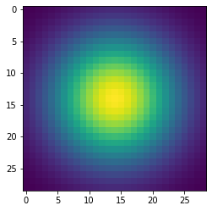
Part 1: Image filtering
visualization of Gaussian kernel
Add padding to the image and the size of padding should be enough for the first pixel to be in the center of the kernel. So, padding = floor(kernel.size/2)
Iterate through the image and apply filter to each pixel. pixel grid * filter and calculate the sum, which is the value of the new pixel.
The key of conv2d is to use the right range of pixel index.

Slide 3
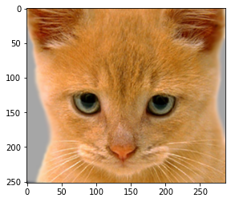
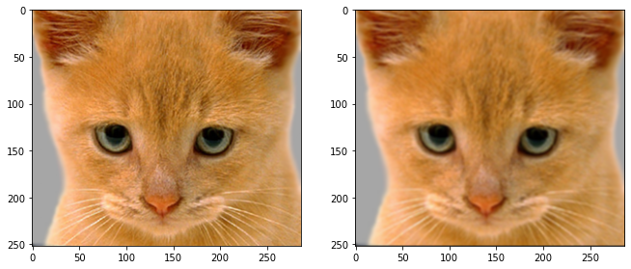
Part 1: Image filtering
Identity filter
Small blur with a box filter

Slide 4
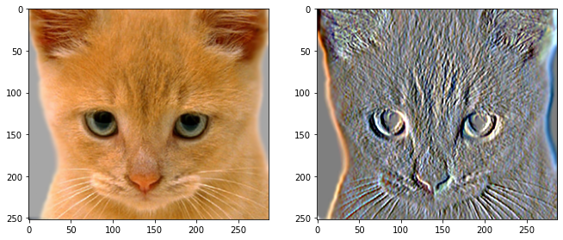
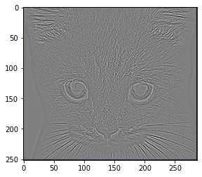
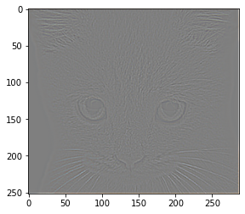
Part 1: Image filtering
Sobel filter
Discrete Laplacian filter

Slide 5
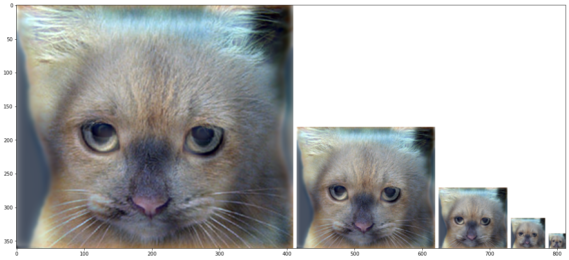
Part 1: Hybrid images
Apply the filter on both images to get the low frequency parts
The high frequency part of the image can be got by removing the low frequency part from the original one. High = Original – Low
Then, add the low part and the high part together.
Make sure to clip the hybrid image, so that the value of index is in range(0,1)
Cat + Dog
[insert your hybrid image here]
Cutoff frequency: 7

Slide 6
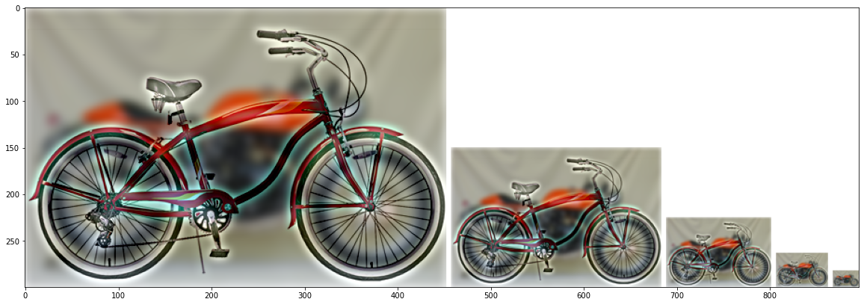
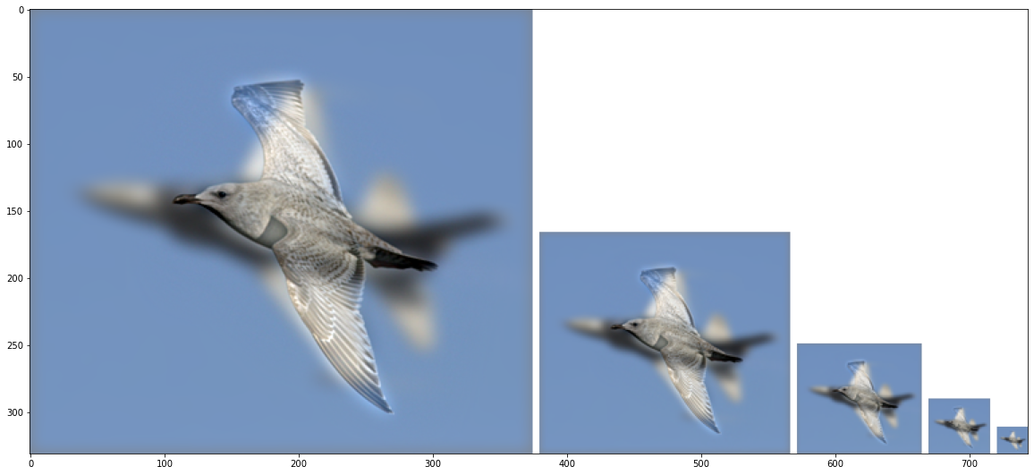
Part 1: Hybrid images
Motorcycle + Bicycle
[insert your hybrid image here]
Cutoff frequency: 5
Plane + Bird
[insert your hybrid image here]
Cutoff frequency:6

Slide 7
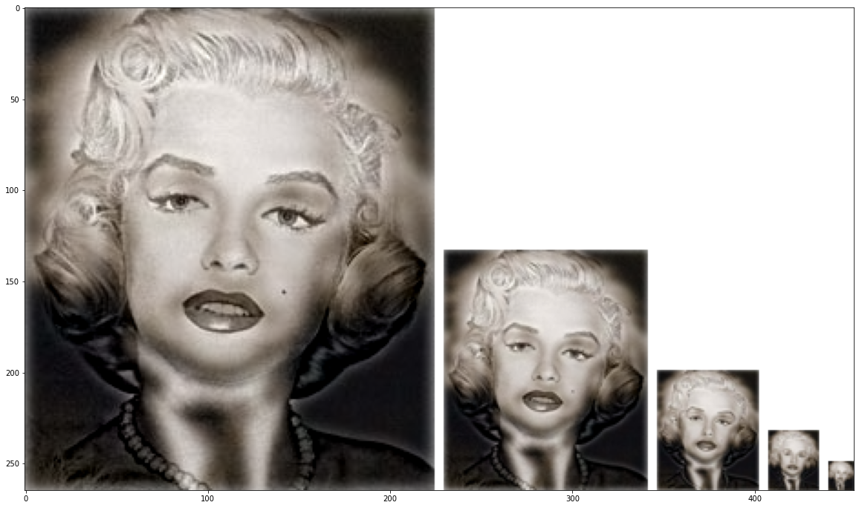
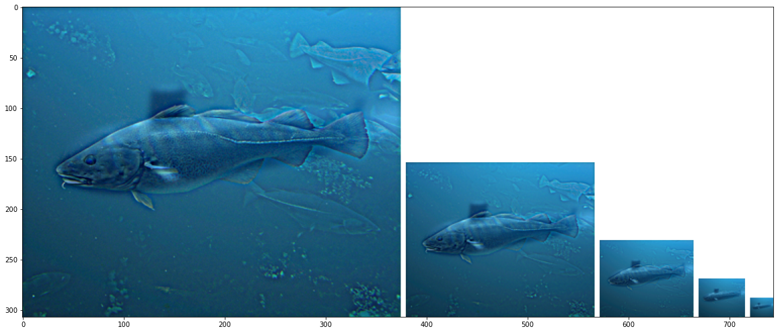
Part 1: Hybrid images
Einstein + Marilyn
[insert your hybrid image here]
Cutoff frequency: 4
Submarine + Fish
[insert your hybrid image here]
Cutoff frequency:3

Slide 8
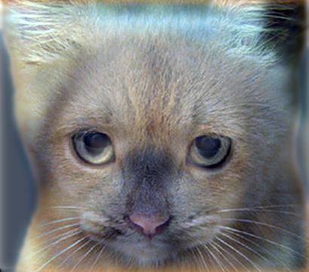
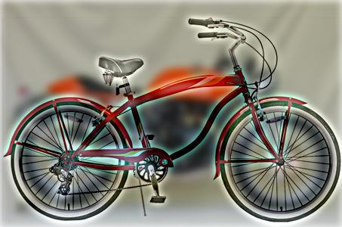
Part 2: Hybrid images with PyTorch
Cat + Dog
[insert your hybrid image here]
Motorcycle + Bicycle
[insert your hybrid image here]

Slide 9
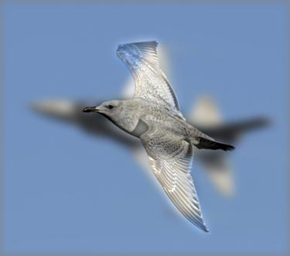
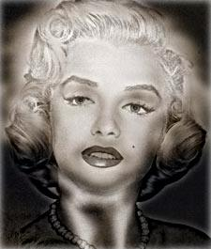
Part 2: Hybrid images with PyTorch
Plane + Bird
[insert your hybrid image here]
Einstein + Marilyn
[insert your hybrid image here]

Slide 10
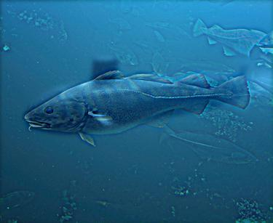
Part 2: Hybrid images with PyTorch
Submarine + Fish
[insert your hybrid image here]
Part 1 vs. Part 2
Part 1: 9.172 seconds
Part 2: 0.131 seconds
Part2 is much faster.

Slide 11
Part 3
[Consider a 1-channel 5x5 image and a 3x3 filter. What are the output dimensions of a convolution with the following parameters?
Stride = 1, padding = 0→(3,3,1)
Stride = 2, padding = 0→(2,2,1)
Stride = 1, padding = 1→(5,5,1)
Stride = 2, padding = 1→ (3,3,1)
[What are the input & output dimensions of the convolutions of the dog image and a 3x3 filter with the following parameters:
Stride = 1, padding = 0
Stride = 2, padding = 0
Stride = 1, padding = 1
Stride = 2, padding = 1
dog(1,3,361, 410)
(1)(359,408,3)
(2)(180,204,3)
(3)(361,410,3)
(4)(181,205,3)

Slide 12
Part 3
[How many filters did we apply to the dog image?]
12 filters in total
4*3
[Why do the output dimensions adhere to the equations given in the instructions handout?]
Kernel(N,d1/g,k,k)
So the output dimension equals to N.
In part 3, N is the number of filters stacked together.

Slide 13
Part 3
[What is the intuition behind this equation?]
The output size depends on the stride and padding. The larger the stride, the smaller the output. The larger the padding, the larger the output.
Besides, we can apply different filters on one image at the same time. We simply need to stack filters together and the channels of the output will change, which indicates the result of different filters.

Slide 14
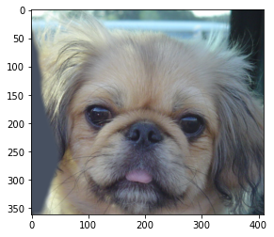

Part 3
[insert visualization 0 here]
[insert visualization 1 here]

Slide 15
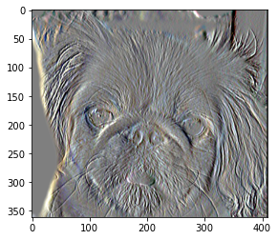
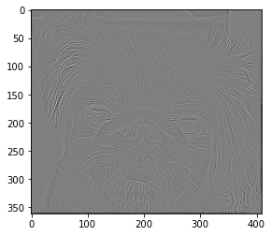
Part 3
[insert visualization 2 here]
[insert visualization 3 here]

Slide 16
Conclusion
[How does varying the cutoff frequency value or swapping images within a pair influences the resulting hybrid image?]
The cutoff frequency determines the ration of low frequency part and high frequency part. The larger the cutoff frequency, the more the hybrid image looks like the high frequency part. So, in order to have a nice hybrid image, you have to try different cutoff frequencies.
Besides, which image to reserve the low frequency part and which to reserve the high frequency part is also important. Images which can be classified by basic outline should contribute their low frequency parts. On the contrary, images can only be classified by details should keep their high frequency parts. Therefore, swapping images may also bring out a nicer hybrid image.

