Slide 1
mAZE SEARCH
--jianan wen

Slide 2
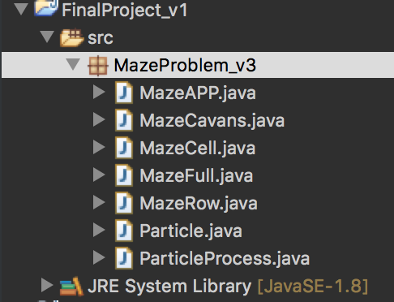
PROJECT STRUCTURE
Maze
Particle
UI

Slide 3
mAZE
Using maze cell to create each position of maze
Each position has two state: path or block

Slide 4

Particle process
Initiate 30 particles
Using TimerTask to run every particle
Using Manhattan algorithm to calculate the fitness score
$$fitnessScore= \frac{1}{Dis}$$
$$Dis=abs\left(DestinationX−CurrentX\right)+abs\left(DestinationY−CurrentY\right)+1$$
4. Calculate particle fitness score (pbest) and update global fitness score(gbest)

Slide 5




Particle process
$$V=w∗V+c1∗rand∗\left(pbest−x\right)+c2∗rand∗\left(gbest−x\right)+randomi$$
$$randomi=\{−1,0,1\}$$
Reason to add randomi:
let particle has other possible velocity when pbest part and gbest is 0
$$w=0.799$$
$$c1=1/MazeLength$$
$$c2=1/MazeWidth$$

Slide 6
UI
Using swing to create UI
Using Observable Pattern to transfer particles’ location to UI

